Slide 1
Edexcel IGCSE Physics
9 - Mains Electricity
Basic Principles and Safety, Electrical Resistance

Slide 2
Electrical Terms
Specification Points 2.1 and 2.14
Use the following units: ampere (A), coulomb (C), joule (J), ohm (Ω), second (s), volt (V) and watt (W).
Know that current is the rate of flow of charge.
Electricity can be defined as the flow of charged particles.
In electrical circuits, negatively charged electrons flow through a metal wire.
The rate of flow of electricity is called current.
Current is measured in amperes or amps (A).
Current is driven around a circuit by voltage.
Voltage, sometimes referred to as potential difference, is a type of electrical pressure.
Voltage is measured in volts (V).
The flow of electricity is opposed by resistance.
Resistance slows the flow of electricity around a circuit.
Resistance is measured in ohms (Ω).

Slide 3
Electricity is used to power an almost limitless selection of utilities and devices.

Slide 4
CURRENT
A simple electrical circuit.
Electric current, measured in amps (A), can be defined as the flow of electrons through a metal wire. The current is driven by a form of electrical pressure called voltage (V).

Slide 5
Electrical Safety
Specification Point 2.2
Understand how the use of insulation, double insulation, earthing, fuses and circuit breakers protects the device or user in a range of domestic appliances.
Electricity can be extremely dangerous.
50 volts is sufficient to drive a potentially lethal current through the body.
High currents also generate lots of heat, potentially leading to electrical fires.
There are a number of safety features that are routinely built into electrical appliances.
Most electrical appliances are insulated.
Electrical wires (usually made out of copper) are excellent conductors.
Touching a live electrical wire runs the risk of electrocution.
For this reason, wires are covered in an insulating material, such as plastic or rubber.
A hazard warning symbol for electric shock risk. Without proper safety features, electricity is potentially lethal.

Slide 6
CABLE JACKET
WIRE INSULATION
EXPOSED WIRE
Electrical wires are wrapped in insulating materials to help minimise the risk of electrocution.

Slide 7
Electrical Safety - The Earth Wire
All electrical appliances are earthed.
A standard UK plug has 3 wires - live, neutral and earth.
The live wire carries a voltage of about 230 V.
Electricity flows into the appliance through the live wire.
The neutral wire carries a voltage of 0 V.
Electricity flows out of the appliance through the neutral wire.
The earth wire does not usually carry a voltage and, together with a fuse, provides an additional layer of safety.
Earthing helps to prevent electric shocks and fires.
If a fault develops in an electrical appliance, the metal casing can become a live conductor.
If this happens, a large current (referred to as an electrical surge) will flow through the earth wire, melting the fuse and cutting off the supply of electricity.
ELECTRICAL FAULT
DEVELOPS
SURGE OF CURRENT THROUGH EARTH WIRE
FUSE MELTS, ISOLATING APPLIANCE FROM LIVE WIRE
APPLIANCE
SAFE

Slide 8
EARTH WIRE
FUSE
NEUTRAL WIRE
A standard UK 3 pin plug.
LIVE WIRE
INSULATION

Slide 9
Electrical Safety
Some appliances are double insulated.
If the appliance does not have a metal casing, it cannot become electrified.
These appliances are said to be double insulated:
The first layer of insulation is the plastic or rubber casing around the copper wiring.
The second layer of insulation is the casing of the appliance itself.
Fuses and circuit breakers are designed to cut off the flow of electricity to the appliance.
This will only occur if a surge of electricity flows through the appliance.
If a surge of current flows through a fuse, it will melt and the circuit will be broken.
This fuse is said to have ‘blown’.
The fuse then needs to be replaced.
Circuit breakers can switch off electricity to the whole house.
Circuit breakers also detect surges in current.
When a surge is detected, a switch is opened, immediately breaking the circuit.
Circuit breakers can be reset by flicking the switch back to its original position.
This makes them much more convenient than fuses.

Slide 10
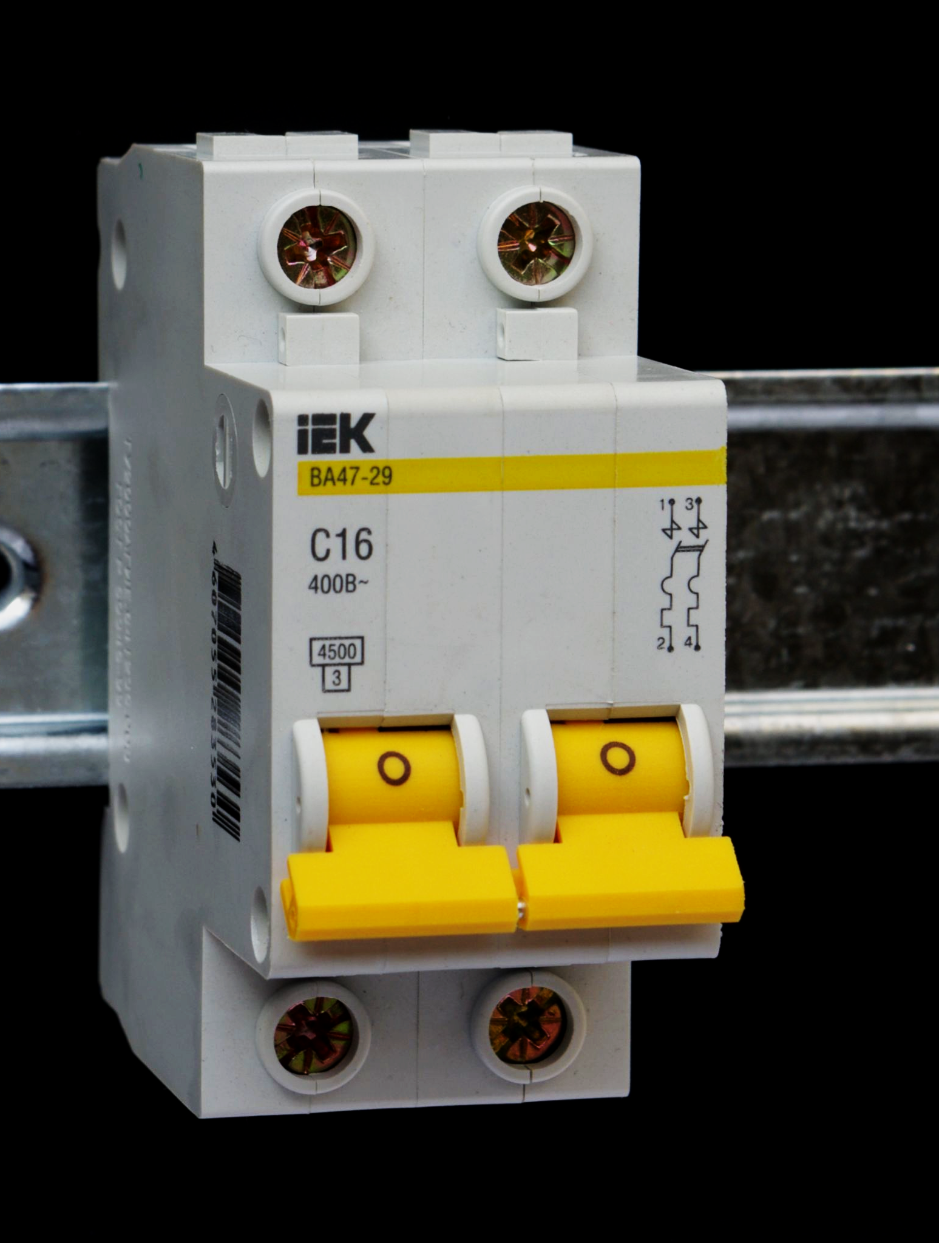
Switches on circuit breakers are driven by electromagnets.
When a surge in current is detected, the switch will immediately open, breaking the circuit and cutting off the power. Switches can be easily reset to their original position, giving them a major advantage over fuses.

Slide 11
Resistors
Specification Point 2.3
Understand why a current in a resistor results in the electrical transfer of energy and an increase in temperature, and how this can be used in a variety of domestic contexts.
A resistor is an electrical component that resists the flow of electric current.
Resistors are used to limit the amount of current that flows through a circuit.
As the resistance of circuit increases, the current will decrease.
This is sometimes referred to as Ohm’s law.
High currents produce lots of heat.
As temperature increases, resistance also increases.
ELECTRICAL RESISTANCE INCREASES WITH TEMPERATURE
Au
Cu
Ag
RESISTANCE (Ω) →
TEMPERATURE →

Slide 12
Thermistors
A thermistor is a type of resistor that is sensitive to changes in temperature.
The relationship between temperature and thermistors is the inverse of traditional resistors.
If the temperature is high, the resistance in the thermistor will decrease.
This will allow more current to flow through the circuit.
If the temperature is low, the resistance in the thermistor will increase,
This will reduce the flow of current through the circuit.
Thermistors have a number of practical applications:
As fire alarms.
As thermostats.
In car engines.
IN A THERMISTOR, RESISTANCE DECREASES WITH TEMPERATURE
RESISTANCE (Ω) →
TEMPERATURE →

Slide 13
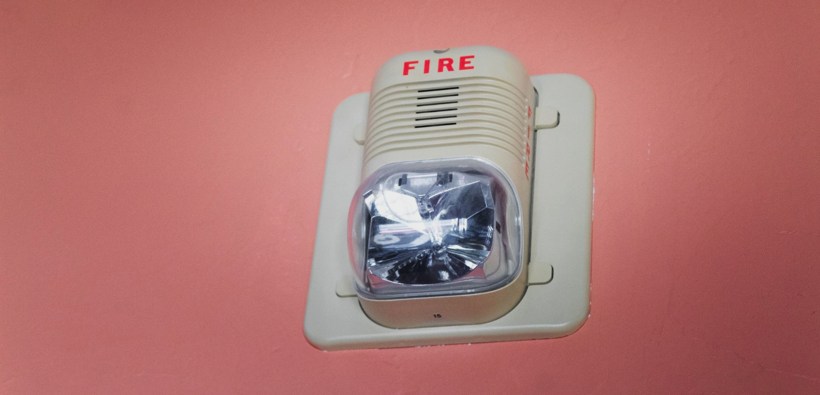
In a fire alarm, a thermistor detects changes in temperature. As it heats up in a fire, its resistance decreases. This triggers the alarm circuit to activate and sound the alarm.

