Slide 1
Edexcel IGCSE Physics
8 - Forces and Moments
Pivots and Planes
Paper 2

Slide 2
Moments
Specification Point 1.30P
Know and use the relationship between the moment of a force and its perpendicular distance from the pivot.
Forces have the ability to rotate objects around a particular point.
This rotation can be either clockwise or anticlockwise.
Rotation occurs around points called pivots.
A pivot is a fixed location on the object.
A moment can be defined as the turning effect of a force around a pivot.
The size of a moment (in newton metres) can be calculated using the following equation:
M = size of moment (Nm)
F = force (N)
d = distance from pivot (m)

Slide 3
This spanner is held 0.2 m from the hand. The force the mechanic exerts on the spanner is 20 N.
Calculate the moment.
0.2 × 20 = 4 Nm
A longer spanner would provide a greater moment or turning effect as the distance would be increased.
DISTANCE (d) - 0.2 m
FORCE (F) - 20 N

Slide 4
Centre of Gravity
Specification Point 1.31P
Know that the weight of a body acts through its centre of gravity.
An object’s centre of gravity can be defined as the point through which the weight of the object acts.
Symmetrical objects have a centre of gravity located at the point of symmetry.
Asymmetrical objects will have a centre of gravity at its centre of mass.
If an object is suspended, it will swing until the centre of gravity is directly below the point of suspension.
This square is a symmetrical object. The point of symmetry indicates its centre of gravity.

Slide 5
An object that is freely suspended is often described as a pendulum.
The object will swing until its centre of gravity is directly below the suspension point.
CENTRE OF GRAVITY

Slide 6
The Principle of Moments
Specification Point 1.32P
Use the principle of moments for a simple system of parallel forces acting in one plane.
The principle of moments states that, when an object is balanced, the total clockwise moment about a pivot equals the total anticlockwise moment about the same pivot.
The principle of moments is used to solve problems when two forces are acting on a balanced object, usually a seesaw.
If the moments are not balanced, the see-saw will topple over.
This seesaw is balanced. The clockwise and anticlockwise moments are equal. Given this, calculate the unknown distance.
Moment A = 250 × 2.4 = 600 Nm
Moment A = Moment B
Distance = moment ÷ force
600 ÷ 750 = 0.8 m
DISTANCE FROM PIVOT = 2.4 m
DISTANCE FROM PIVOT = UNKNOWN
250 N
750 N

Slide 7
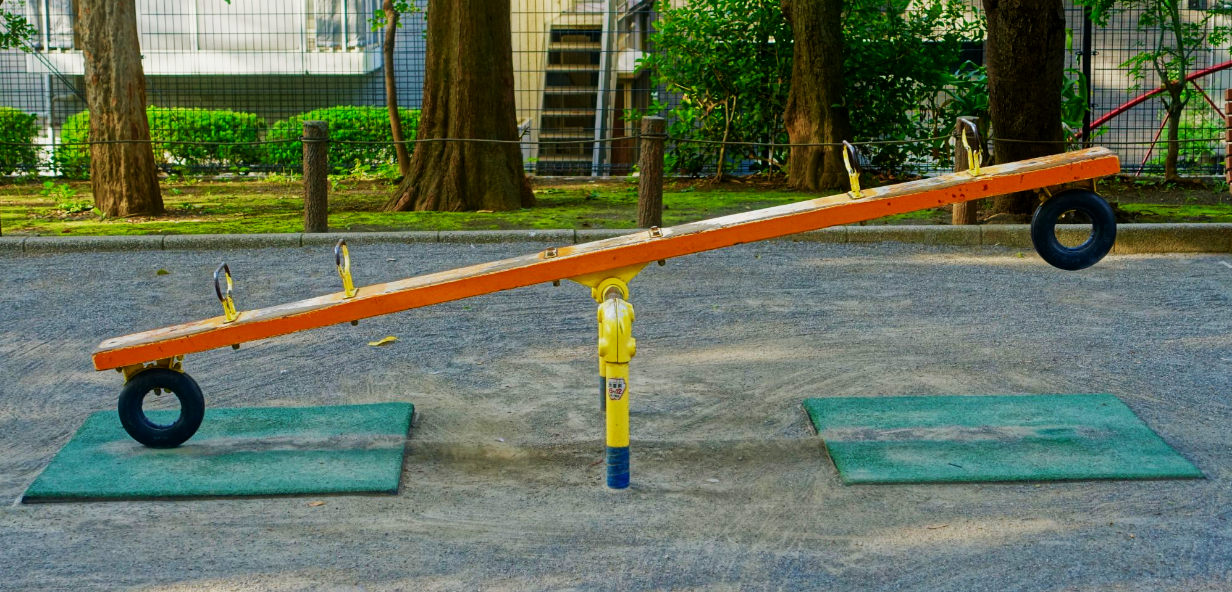
Seesaws are often used to illustrate the principle of moments. If the two moments are not balanced, the seesaw will topple.

Slide 8
Forces on a Light Beam
Specification Point 1.33P
Understand how the upward forces on a light beam, supported at its ends, vary with the position of a heavy object placed on the beam.
If a light beam is supported at both ends, it will supply an upward force to any weighted object that is placed on the beam.
A light beam can be treated as if it has no mass.
If a weighted object is placed on the beam, the support that is closer to the object will provide more upward force.
These forces are balanced. This means that the total upward force (Force_{A} + Force_{B}) must be the same as the downward force of 800 N.
To calculate Force_{A} and Force_{B}, begin by treating 1 side as a pivot. Here the clockwise and anticlockwise moments must balance.
Force_{A} × 8 = 800 × 6 = 4,800 N
4,800 ÷ 8 = 600 N = Force_{A}
800 - 600 = 200 N = Force_{B}
FORCE_{A}
FORCE_{B}
WEIGHTED OBJECT
2 m
6 m
800 N

Slide 9
The concept of upward force on a beam forms the basic physics for calculating tension. This is used by engineers that set safety standards for objects like bridges.

