Slide 1
Edexcel IGCSE Physics
7 - Momentum
Conservation and Newton’s Third Law
Paper 2

Slide 2
Momentum
Specification Point 1.25P
Know and use the relationship between momentum, mass and velocity.
All moving objects have a certain momentum.
Momentum is a vector quantity.
Momentum has both magnitude and direction.
Momentum can have a positive or negative value.
Momentum can be defined as the tendency of an object to continue moving in the same direction.
The greater the mass of an object, the larger its momentum.
The greater the velocity of an object, the larger its momentum.
Momentum can be calculated using the following equation:
p = momentum (kg m/s)
m = mass (kg)
v = velocity (m/s)

Slide 3
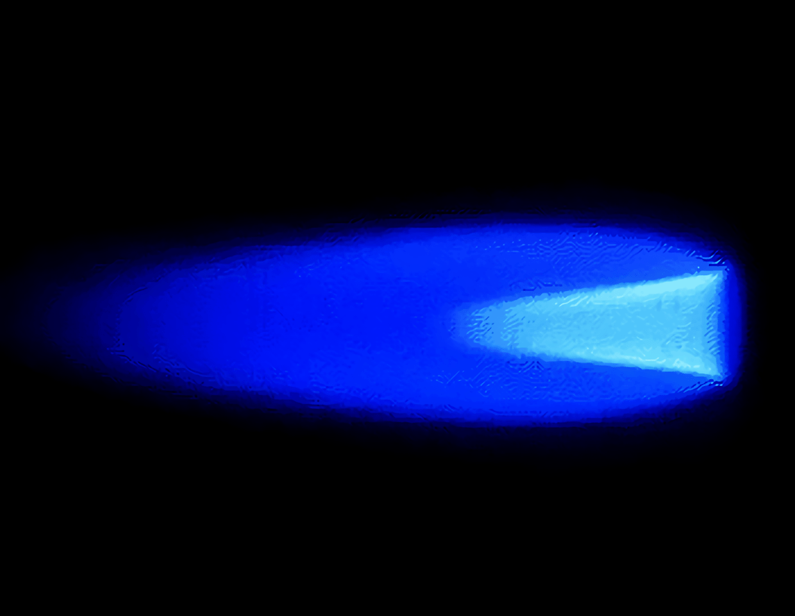
MASS = 20,000 kg
This jet fighter has a mass (m) of 20,000 kg and is travelling at a velocity (v) of 650 m/s.
20,000 × 650 = 13,000,000.
The jet fighter has a momentum (p) of 13,000,000 kg m/s to the right.
VELOCITY = 650 m/s

Slide 4
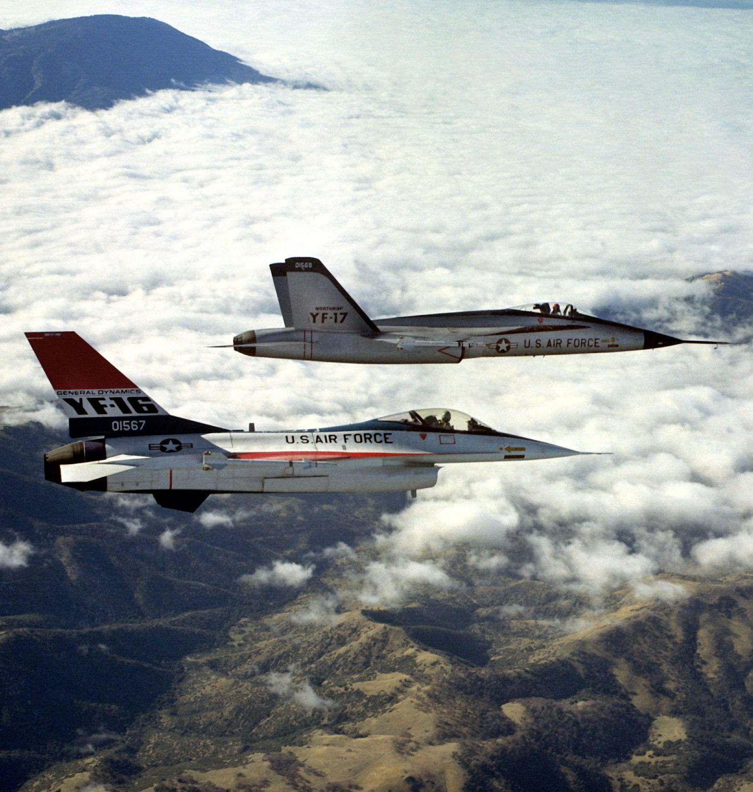
MOMENTUM
MASS
VELOCITY
The relationship between momentum, mass and velocity can also be summarised using a formula triangle.

Slide 5
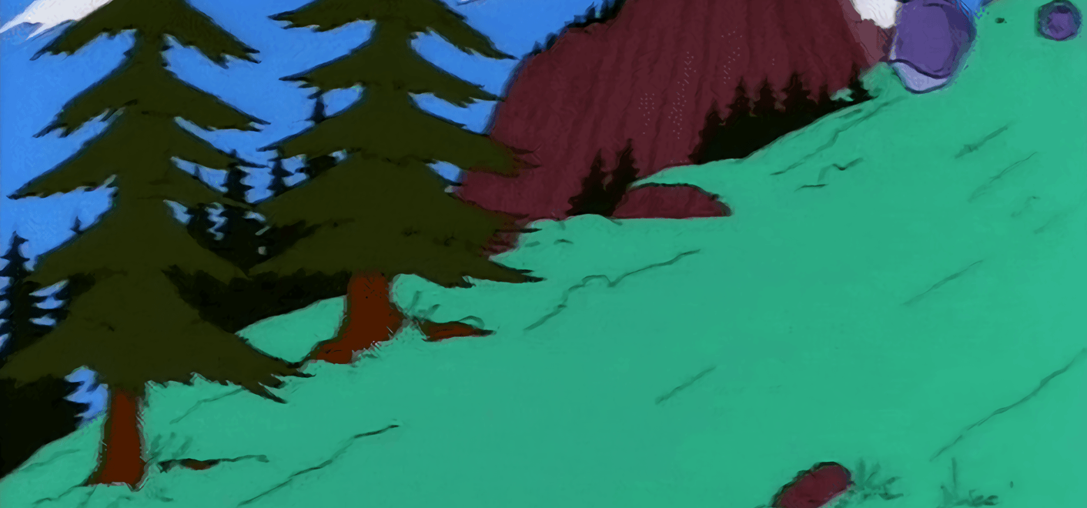
Objects that have both significant mass and velocity are very difficult to stop. They are said to have high momentum.

Slide 6
Conservation of Momentum
Specification Point 1.27P
Use the conservation of momentum to calculate the mass, velocity or momentum of objects.
When no external forces are acting on a system, momentum is conserved.
These systems are called closed systems.
Examples of closed systems include collisions.
When momentum is conserved, the total momentum after a collision is the same as the momentum before the collision.
Two railway carriages collide with each other. Carriage A has a mass of 10,000 kg and was travelling at 3 m/s before the collision. Carriage B has a mass of 5,000 kg and was stationary before the collision. What is the velocity of the two carriages after the collision?
3 m/s
MOMENTUM BEFORE = 10,000 × 3 = 30,000 kg m/s
MOMENTUM BEFORE = 5,000 × 0 = 0 kg m/s
Total momentum before = 30,000 + 0 = 30,000 kg m/s. As momentum is conserved, total momentum after = 30,000 kg m/s. The combined mass of carriage A and carriage B is now 15,000 kg.
The new velocity of the carriages (v = p ÷ m) is 30,000 ÷ 15,000 = 2 m/s to the right.

Slide 7
Changes in Momentum
Specification Point 1.28P
Use the relationship between force, change in momentum and time taken.
When a force acts on a moving object, there is a change in momentum.
A change in momentum can be defined as the difference between the final momentum (mv) and the initial momentum (mu).
The time taken to change the momentum (t) also has an effect on the force delivered.
F = force (N)
mv = final momentum (kg m/s)
mu = initial momentum (kg m/s)
t = time (s)

Slide 8
This Lamborghini (with a mass of 1,500 kg) accelerates from 25 m/s to 40 m/s in 2 seconds.
Calculate the force required.
Initial momentum (mu) = 25 × 1,500 = 37,500 kg m/s.
Final momentum (mv) = 40 × 1,500 = 60,000 kg m/s.
Change in momentum (mv - mu) = 60,000 - 37,500 = 22,500 kg m/s.
Force = 22,500 ÷ 2 = 11,250 N

Slide 9
Momentum and Safety Features
Specification Point 1.26P
Use the idea of momentum to explain safety features.
If an individual’s momentum changes quickly, they will experience significant force.
Large forces may cause damage a person’s body, resulting in injuries such as concussion and whiplash.
Most vehicles are equipped with safety features to help prevent injury.
These safety features are designed to slow the body over a longer period of time.
This will help to reduce the amount of force the body receives.
Seat belts are designed to stretch slightly.
During a crash, this increases the time it takes for the driver to stop, reducing force.
Airbags cushion the body from impact.
Airbags slow the deceleration of the body, reducing force.
Crumple zones crumple on impact.
Crumple zones increase the time it takes for the vehicle to stop, reducing force.

Slide 10
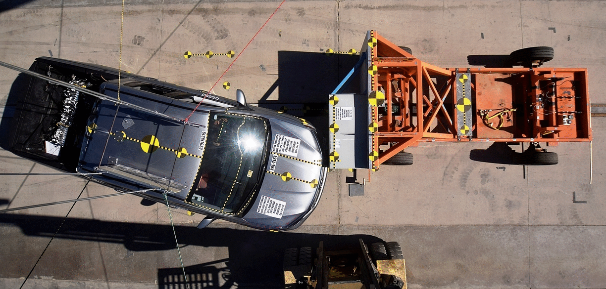
Crumple zones are designed to increase the time it takes for a vehicle to come to a complete halt, reducing the force experienced by the occupants.

Slide 11
Newton’s Third Law
Specification Point 1.29P
Demonstrate an understanding of Newton’s third law.
According to Newton’s third law of motion, when two objects interact, they will exert an equal and opposite force on each other.
This is most commonly worded as: ‘every action has an equal and opposite reaction’.
These objects are referred to as force pairs.
FORCE A - MOTHER PUSHING PRAM FORWARDS
FORCE B - PRAM PUSHING MOTHER BACKWARDS
Force A and force B are equal and opposing.
The pram moves forwards because of the lack of friction provided by the wheels.

