Slide 1


Edexcel IGCSE Physics
6 - Hooke’s Law
Springs, Extensions and Elasticity
For more help, please visit www.exampaperspractice.co.uk
© 2025 Exams Papers Practice. All Rights Reserved

Slide 2
Hooke’s Law
Specification Point 1.23
  Know that the initial linear region of a force-extension graph is associated with Hooke’s law.
The relationship between an elastic object and the force applied to it is summarised by Hooke’s law.
  Hooke’s Law was devised by physicist Robert Hooke in 1676.
Hooke’s law states that the extension of an elastic object is proportional to the force applied.
  Hooke’s law is most often applied to springs.
Hooke’s law only holds true whilst the object is elastic.
  After a certain point the object is likely to become deformed and will not return to its original length.
  This is called the limit of proportionality.
For more help, please visit www.exampaperspractice.co.uk
© 2025 Exams Papers Practice. All Rights Reserved

Slide 3
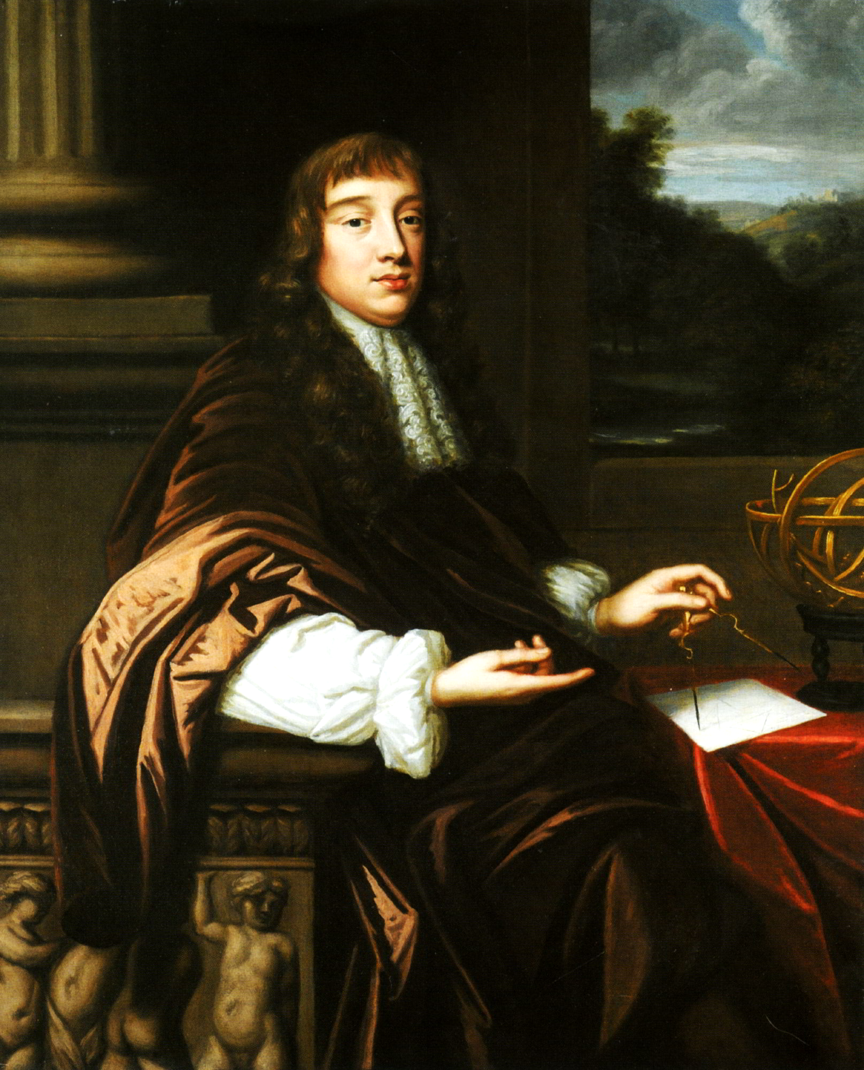
Robert Hooke was an English physicist and polymath who proposed Hooke’s law in 1676.
F = force (N)
k = constant of a spring (N/m)
e = extension of object (m)
For more help, please visit www.exampaperspractice.co.uk
© 2025 Exams Papers Practice. All Rights Reserved

Slide 4
Investigating Hooke’s Law
Specification Point 1.22
  Practical: investigate how extension varies with applied force for helical springs, metal wires and rubber bands.
Hooke’s law can be demonstrated using a spring and a set of weights.
Clamp a spring to a weighted stand.
Assemble a set of weights with known masses.
  A set of 10, each weighing 1 kg would be appropriate.
Measure the spring with no weights attached.
  This is the natural length of the spring.
Add a weight to the spring and measure the new length.
  This will cause the spring to stretch.
  This is the extension of the object (e).
Continue adding weights until the spring no longer recoils back to its original length.
  At this point the limit of proportionality has been reached.
  Hooke’s law video.
SPRING
RULER
1 kg WEIGHT
For more help, please visit www.exampaperspractice.co.uk
© 2025 Exams Papers Practice. All Rights Reserved

Slide 5
Force-Extension Graphs
When a force is applied to an elastic object, the object is stretched in a linear fashion.
  This means that there will be a straight-line relationship between force and extension.
After a certain point, the object will become permanently stretched.
  There will no longer be a straight-line relationship between force and extension.
The relationship between force and extension can be displayed using a graph.
  This is called a force-extension graph.
LIMIT OF PROPORTIONALITY
2. THE SECOND PART OF THE GRAPH DOES NOT OBEY HOOKE’S LAW - THE OBJECT HAS BECOME PERMANENTLY STRETCHED
FORCE
1. THE FIRST PART OF THE GRAPH OBEYS HOOKE’S LAW - A LINEAR RELATIONSHIP IS OBSERVED
EXTENSION
For more help, please visit www.exampaperspractice.co.uk
© 2025 Exams Papers Practice. All Rights Reserved

Slide 6
Elasticity
Specification Point 1.24
  Describe elastic behaviour as the ability of a material to recover its original shape after the forces causing deformation have been removed.
An elastic object is one that, when stretched, will return to its original length when the force applied to it is removed.
  Objects that exhibit elasticity include metal springs and rubber.
An inelastic object is one that, when stretched will not return to its original length.
  At this point the object is said to have been deformed.
  Objects that exhibit inelasticity include plastics and glass.
For more help, please visit www.exampaperspractice.co.uk
© 2025 Exams Papers Practice. All Rights Reserved

Slide 7

Steel springs exhibit elasticity and are often used in mechanisms where extension and compression are vital.
For more help, please visit www.exampaperspractice.co.uk
© 2025 Exams Papers Practice. All Rights Reserved

Slide 8
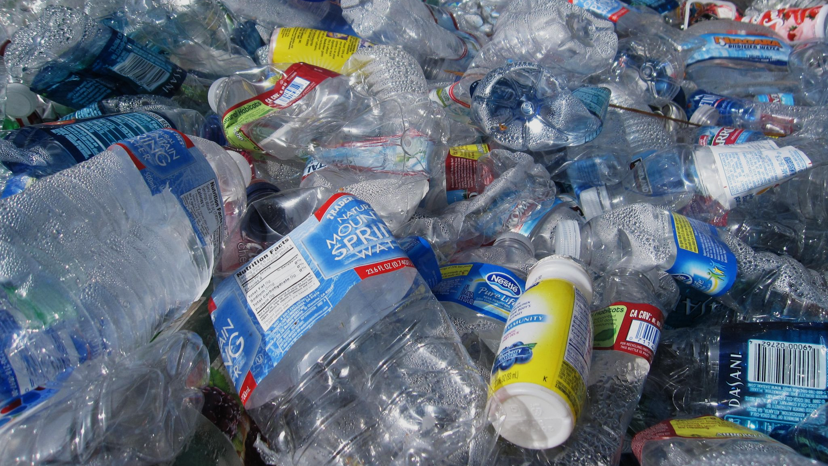
Once deformed, inelastic materials like plastics will not return to their original shape.
For more help, please visit www.exampaperspractice.co.uk
© 2025 Exams Papers Practice. All Rights Reserved

