Slide 1


Edexcel IGCSE Physics
5 - Gravity, Weight and Drag
Stopping Distances and Terminal Velocity
For more help, please visit www.exampaperspractice.co.uk
© 2025 Exams Papers Practice. All Rights Reserved

Slide 2
Gravity
Specification Point 1.18
  Know and use the relationship between weight, mass and gravitational field strength.
Gravity is a force that attracts any two or more objects to each other with a given mass.
  Objects that have a large mass (such as planets) exert a strong gravitational pull on other objects.
Gravity has a number of key effects:
  All objects fall towards the ground.
  All objects stay on the ground.
  Satellites that are spinning around a planet remain in orbit.
OBJECT WITH GIVEN MASS
Gravity ensures that all objects with a given mass fall towards the ground.
For more help, please visit www.exampaperspractice.co.uk
© 2025 Exams Papers Practice. All Rights Reserved

Slide 3
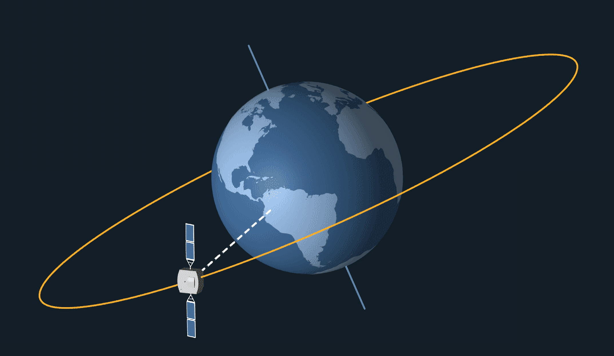
Gravity has the effect of keeping satellites in orbit around their planets.
For more help, please visit www.exampaperspractice.co.uk
© 2025 Exams Papers Practice. All Rights Reserved

Slide 4
Mass, Weight and Gravity
Mass is a measure of how much matter there is in an object.
  Mass is constant, regardless of the gravitational conditions.
  Mass is measured in kilograms (kg).
Weight is a measure of downward force on an object.
  Weight changes depending on the gravitational conditions.
  Weight is measured in newtons (N).
There is a relationship between mass, weight and gravity:
W = weight (N)
m = mass (kg)
g = gravitational field strength (N/kg)
For more help, please visit www.exampaperspractice.co.uk
© 2025 Exams Papers Practice. All Rights Reserved

Slide 5
Gravitational field strength (g), is dependent on the mass (m) of the object in question. The Earth has a much greater mass than the Moon, so gravity has more of an influence.
ON EARTH, g = 10 N/kg
ON THE MOON, g = 1.6 N/kg
An object that has a mass of 5 kg on both Earth and the Moon will weigh differently on each:
On Earth: 5 × 10 = 50 N
On the Moon: 5 × 1.6 = 8 N
For more help, please visit www.exampaperspractice.co.uk
© 2025 Exams Papers Practice. All Rights Reserved

Slide 6
Terminal Velocity
Specification Point 1.21
  Describe the forces acting on falling objects and explain why falling objects reach a terminal velocity.
Objects that fall through the air will initially increase in velocity.
  This is because the force causing the object to accelerate in much larger than any resistance that might slow it down.
Eventually the object will reach a terminal velocity.
  This is the maximum speed that the object will travel whilst falling.
  As the velocity of the object increases, air resistance also increases.
  Eventually the accelerating force and the resistance force will be equal to other.
A graph of velocity against time for a skydiver.
50
TERMINAL VELOCITY
40
30
VELOCITY (m/s)
20
10
0
10
20
30
40
50
TIME (s)
For more help, please visit www.exampaperspractice.co.uk
© 2025 Exams Papers Practice. All Rights Reserved

Slide 7
The concepts of air resistance and terminal velocity allow parachutists to land safely.
The large surface area of the parachute increases resistance and counteracts the effect of the parachutist’s weight.
The parachutist lands at a comfortable 0.25 m/s.
WEIGHT
RESISTANCE
For more help, please visit www.exampaperspractice.co.uk
© 2025 Exams Papers Practice. All Rights Reserved

Slide 8
Stopping Distances
Specification Points 1.19 and 1.20
  Know that the stopping distance of a vehicle is made up of the sum of the thinking distance and the braking distance.
  Describe the factors affecting vehicle stopping distance, including speed, mass, road condition and reaction time.
In an emergency, it is important that a driver brings their vehicle to a complete stop in the shortest possible distance.
  This is defined as the stopping distance of a car.
Stopping distance is a combination of thinking distance and braking distance.
  Thinking distance is defined as: the distance it takes for the driver to realise the hazard present and to apply the brakes.
  Braking distance is defined as: the distance the car travels whilst the brakes are being applied to the car.
For more help, please visit www.exampaperspractice.co.uk
© 2025 Exams Papers Practice. All Rights Reserved

Slide 9

Thinking Distance
Thinking distance can be affected by two main factors:
  The speed of the vehicle.
  The reaction time of the individual.
There are a number of things that may negatively affect the reaction time of an individual:
  Alcohol and drugs.
  Inexperience.
  Old age.
Many different types of drugs, whether medicinal or recreational, can negatively affect the reaction time of a driver.
For more help, please visit www.exampaperspractice.co.uk
© 2025 Exams Papers Practice. All Rights Reserved

Slide 10
Braking Distance
Braking distance can be affected by four main factors
The speed of the vehicle.
  The faster the vehicle is travelling the further it will travel before it stops.
The mass of the vehicle.
  Vehicles with more mass carry more momentum and thus travel further before they stop.
The condition of the road.
  Wet or icy roads provide much less grip than dry tarmac. Cars travelling on icy roads take up to ten times longer to stop.
The condition of the vehicle’s brakes.
  worn or faulty brakes will not provide as much braking force as systems in good condition.
BRAKING DISTANCES FROM CARS IN THE 1920s
BRAKING DISTANCE (m)
VELOCITY (m/s)
For more help, please visit www.exampaperspractice.co.uk
© 2025 Exams Papers Practice. All Rights Reserved

Slide 11
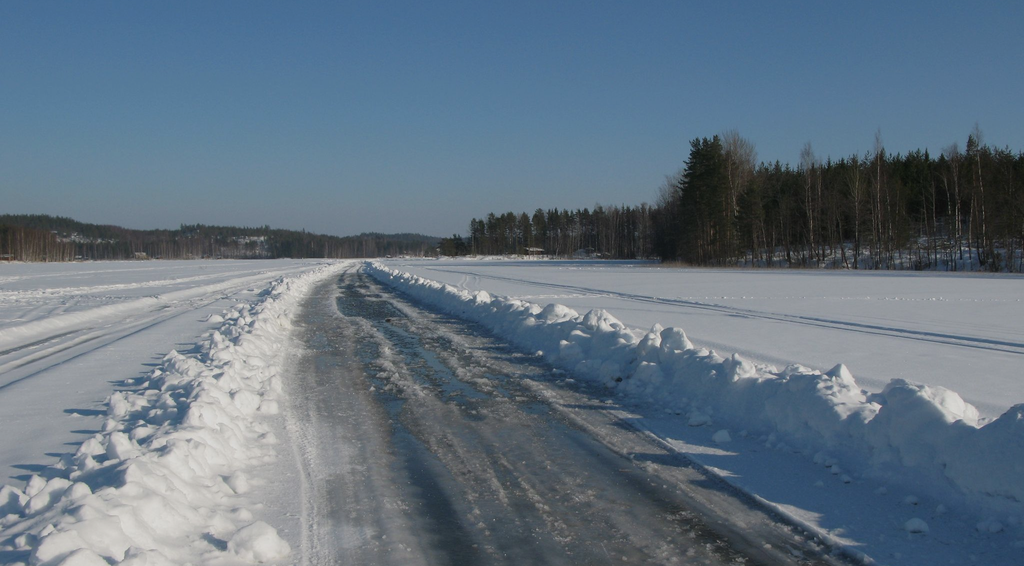
Icy roads offer very low levels of grip for a vehicle’s tyres. Braking distances are thus much further than when the road is in a good condition.
For more help, please visit www.exampaperspractice.co.uk
© 2025 Exams Papers Practice. All Rights Reserved

