Slide 1
Edexcel IGCSE Physics
4 - Balanced and Unbalanced Forces
Friction and Resultant Force

Slide 2
Balanced and Unbalanced Forces
Specification Point 1.15
Calculate the resultant force of forces that act along a line.
Forces may be either balanced or unbalanced.
Forces are balanced when the effect of one force is cancelled out by another force.
If an object is stationary, it will remain stationary.
If an object is moving, it will continue to move at the same velocity.
Forces are unbalanced when one force is stronger than the other.
If an object is stationary, it will begin to move.
If an object is moving, it will being to accelerate or decelerate.
The overall force acting on an unbalanced object is called the resultant force.

Slide 3
5 N
5 N
The two forces acting on object A are equal. The object is said to be balanced.
Object A has a resultant force of 0 N.
OBJECT A

Slide 4
The two forces acting on object B are not equal. The object is said to be unbalanced.
Object B has a resultant force of 5 N leftwards (10 - 5 = 5 N).
5 N
10 N
OBJECT B

Slide 5
Friction
Specification Point 1.16
Know that friction is a force that opposes motion.
Friction can be defined as the force that opposes the motion of an object.
Friction will act to slow a moving object.
Friction occurs when two or more objects are rubbing against each other:
Static friction occurs when two solid surfaces are gripping against each other.
Sliding friction occurs when two solid objects are sliding past each other.
Drag occurs when a solid object moves through a fluid (air or water).
FRICTION
FORCE

Slide 6
SURFACE A
SURFACE B
The source of dry friction is any imperfection on the surface of an object. This causes a force that opposes the motion of an object.
Surface D will create significantly more friction than surface A.
SURFACE C
SURFACE D

Slide 7
Resultant Force
Specification Point 1.17
Know and use the relationship between unbalanced force, mass and acceleration.
When a resultant force is present, the forces acting on an object are unbalanced.
This leads to acceleration or declaration of the object in question.
The resultant force can be calculated using the equation:
The relationship between force, mass and acceleration can be summarised using a formula triangle.
RESULTANT
FORCE
MASS
ACCELERATION
F = resultant force
m = mass of object
a = acceleration of object
Using a formula triangle, resultant force can be calculated as mass × acceleration.

Slide 8
0-60 ACCELERATION = 7 m/s²
This Porsche 911 has a mass of 1500 kg (m) and accelerates at 7 m/s² (a). Calculate the force generated.
1500 × 7 = 10,500
Force = 10,500 N
MASS = 1500 kg

Slide 9
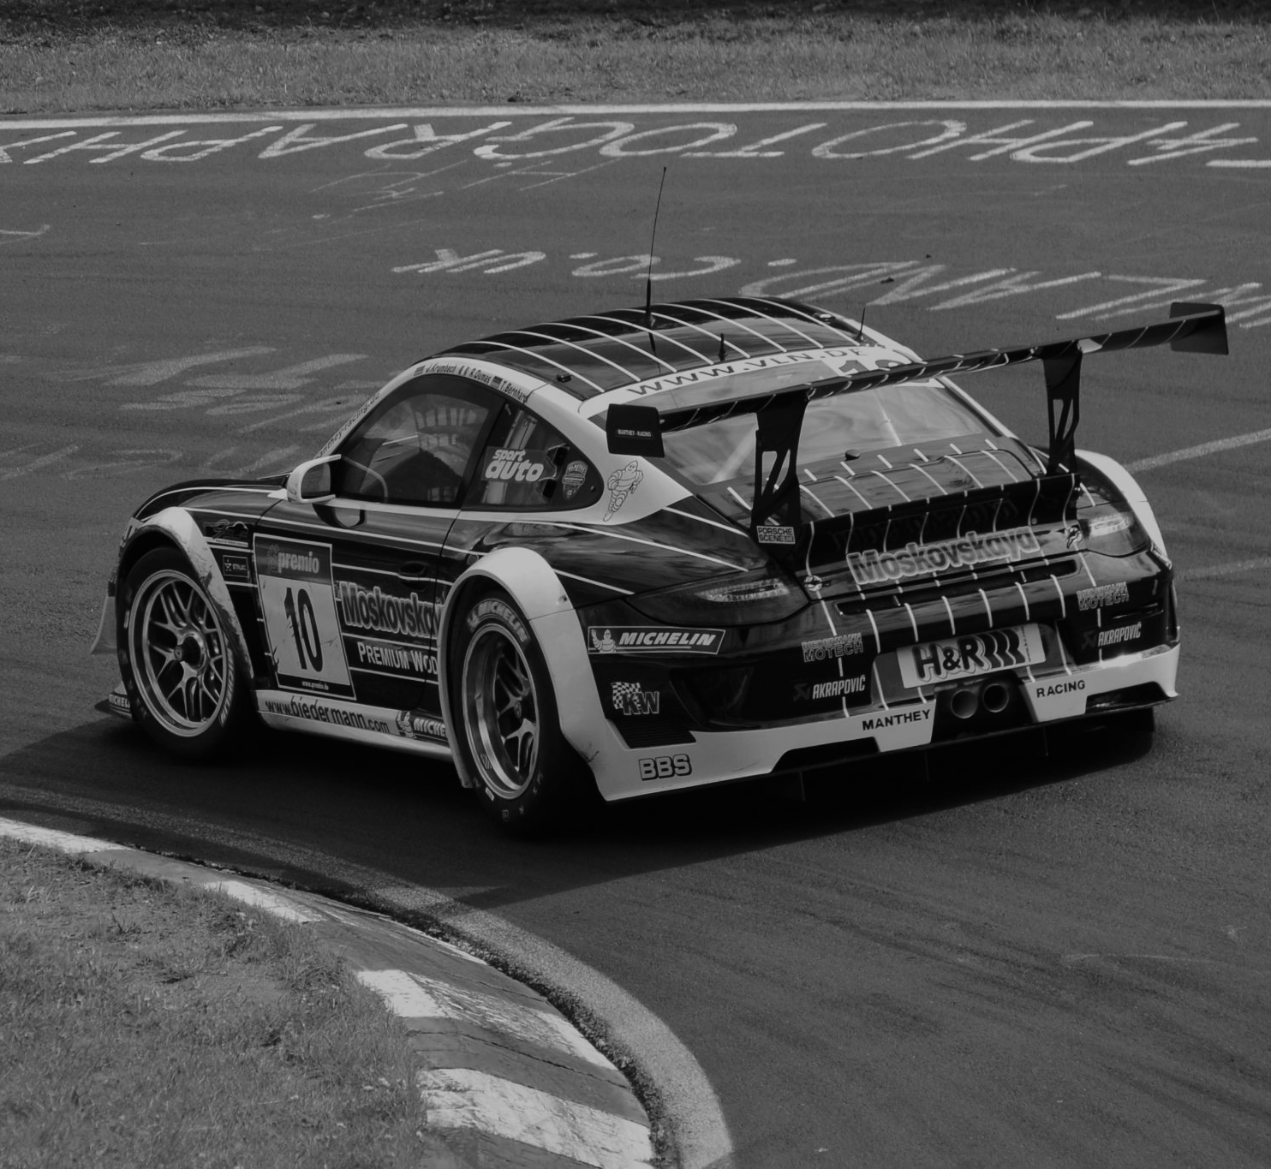
This Porsche 911 has a mass of 1500 kg (m) and accelerates at 7 m/s² (a). Calculate the force generated.
1500 × 7 = 10,500
Force = 10,500 N

