Slide 1
Edexcel IGCSE Physics
3 - Forces
Types of Forces, Scalars and Vectors

Slide 2
Forces
Specification Points 1.11 and 1.12
  Describe the effects of forces between bodies such as changes in speed, shape or direction.
  Identify different types of force such as gravitational or electrostatic.
A force can be defined as a push or a pull on any object.
Forces may cause an object to:
  Change their velocity.
  Change their direction.
  Change their shape.
Forces have both magnitude and direction.
  There are many examples of forces.
PULLING FORCE (DRAG)
PUSHING FORCE (THRUST)

Slide 3
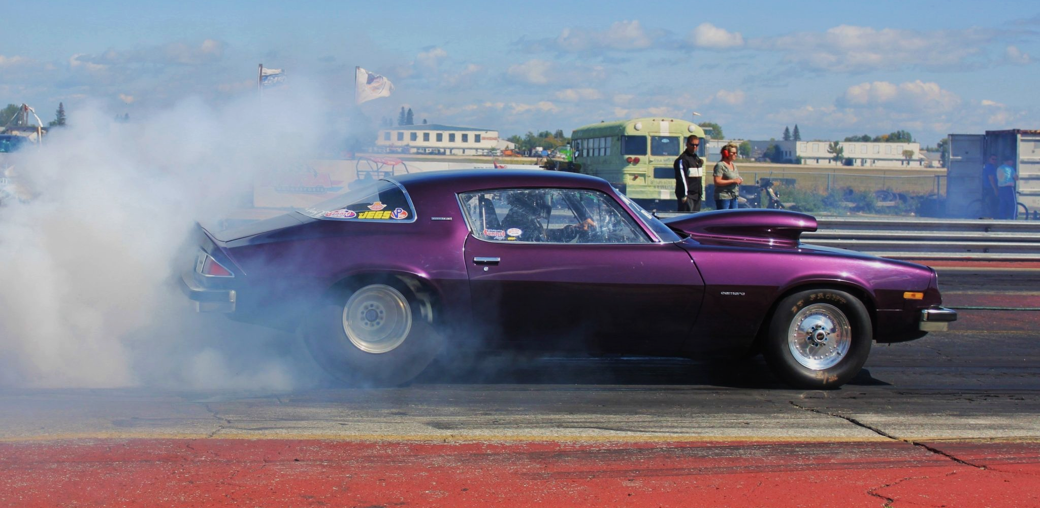
A moving car may experience two opposing forces. A pushing force (thrust) and a pulling force (drag).

Slide 4
There are many different kinds of forces.
Force | Description
Gravity | The force between any 2 objects with mass.
Thrust | The force that pushes or pulls a vehicle.
Drag | The force of friction on a moving object.
Lift | The upward force on an object.
Electrostatic Force | The force between any 2 objects with a charge.
Reaction Force | The force between 2 objects in constant contact.
Tension | The force that stretches an object.

Slide 5
Objects that have significant mass (such as moons and planets) can exert gravitational forces on each other. This keeps the Earth and the Moon in orbit.
GRAVITATIONAL
FORCE EXERTED
GRAVITATIONAL
FORCE EXERTED
BY EARTH
BY MOON

Slide 6
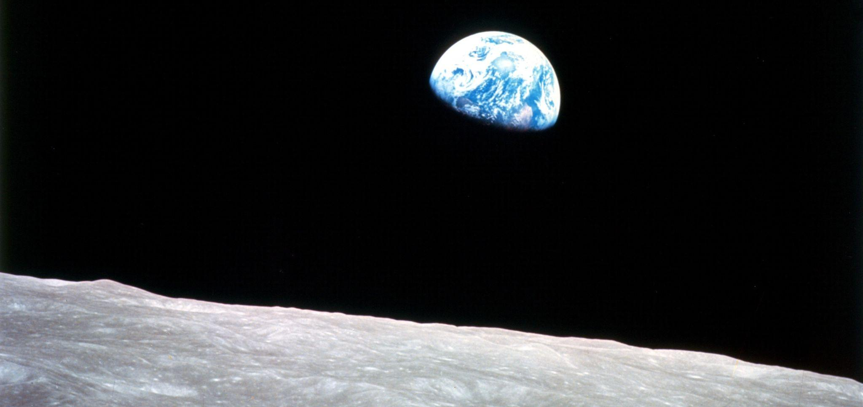
Objects that have significant mass (such as moons and planets) can exert gravitational forces on each other. This keeps the Earth and the Moon in orbit.

Slide 7
Electrostatic force (often referred to as static electricity) is generated when there is an imbalance of positive and negative charge in objects.
This can generate significant force.
+
-

Slide 8
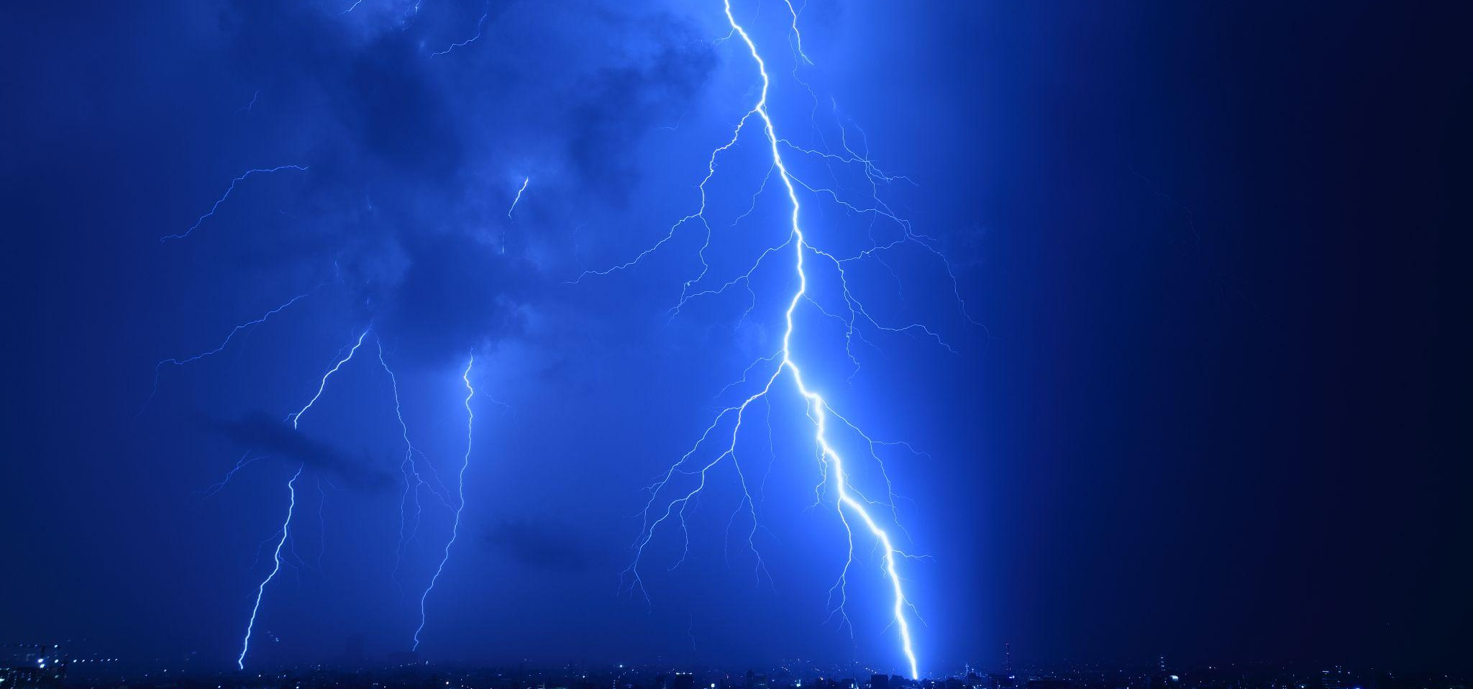
Electrostatic force (often referred to as static electricity) is generated when there is an imbalance of positive and negative charge in objects. This can generate significant force.

Slide 9
Vectors and Scalars
Specification Points 1.13 and 1.14
  Understand how vector quantities differ from scalar quantities.
  Understand that force is a vector quantity.
Quantities may be either vectors or scalars.
A vector quantity is a measure of both magnitude and direction.
  Velocity, acceleration and displacement are all examples of vector quantities.
A scalar quantity is a measure of magnitude only.
  Mass, distance and time are all examples of scalars.
All forces are vector quantities.
  Forces like gravity, thrust and drag describe both magnitude and direction.

Slide 10
GRAVITATIONAL FORCE
BLOCK WITH MASS OF 100 kg
FRICTION
RAMP
LIFT
There are several different forces being exerted on the block. All of these forces have both magnitude and direction and are thus examples of vector quantities.
The mass of the block is 100 kg. Mass is a scalar quantity as it is a measure of magnitude only.

