Slide 1
Edexcel IGCSE Physics
33 - Cosmology
The Brightness of Stars, Red Shift and the Big Bang
Paper 2

Slide 2
The Brightness of Stars
Specification Point 8.11P
Understand how the brightness of a star at a standard distance can be represented using absolute magnitude.
The brightness of a star depends on two factors:
The size of the star.
The temperature of the star.
The brightness of stars is measured using a value called absolute magnitude.
This is necessary because a bright star that is far away will look the same as a dim star that is much closer.
Absolute magnitude measures how bright stars would be if they were all the same distance (3.1 × 10¹⁷ m) from Earth.
Absolute magnitude decreases with increasing brightness.
The night sky is full of stars, some brighter than others. Absolute magnitude accounts for the variable distances between the star and Earth.

Slide 3
Hertzsprung-Russell Diagrams
Specification Point 8.12P
Draw the main components of the Hertzsprung–Russell diagram.
A Hertzsprung-Russell (HR) diagram is used to classify stars.
HR diagrams plot temperature (x-axis) against either absolute magnitude or luminosity (y-axis).
There are a number of clear groups in the HR diagram.
These correspond to stages in a star’s life cycle.
Red giants are found in the top right of the HR diagram.
Red giants are cool but very large so they are very bright.
White dwarfs are found in the bottom left of the HR diagram.
White dwarfs are hot but very small so they are dim.
Main sequence stars are found in the middle of the HR diagram.
Main sequence stars (like the Sun) are moderately hot and moderately sized.

Slide 4
RED GIANTS
INCREASING LUMINOSITY →
Hertzsprung-Russell diagrams are used to categorise stars.
Temperature is plotted against either luminosity or absolute magnitude.
MAIN SEQUENCE STARS
WHITE DWARFS
DECREASING TEMPERATURE →

Slide 5
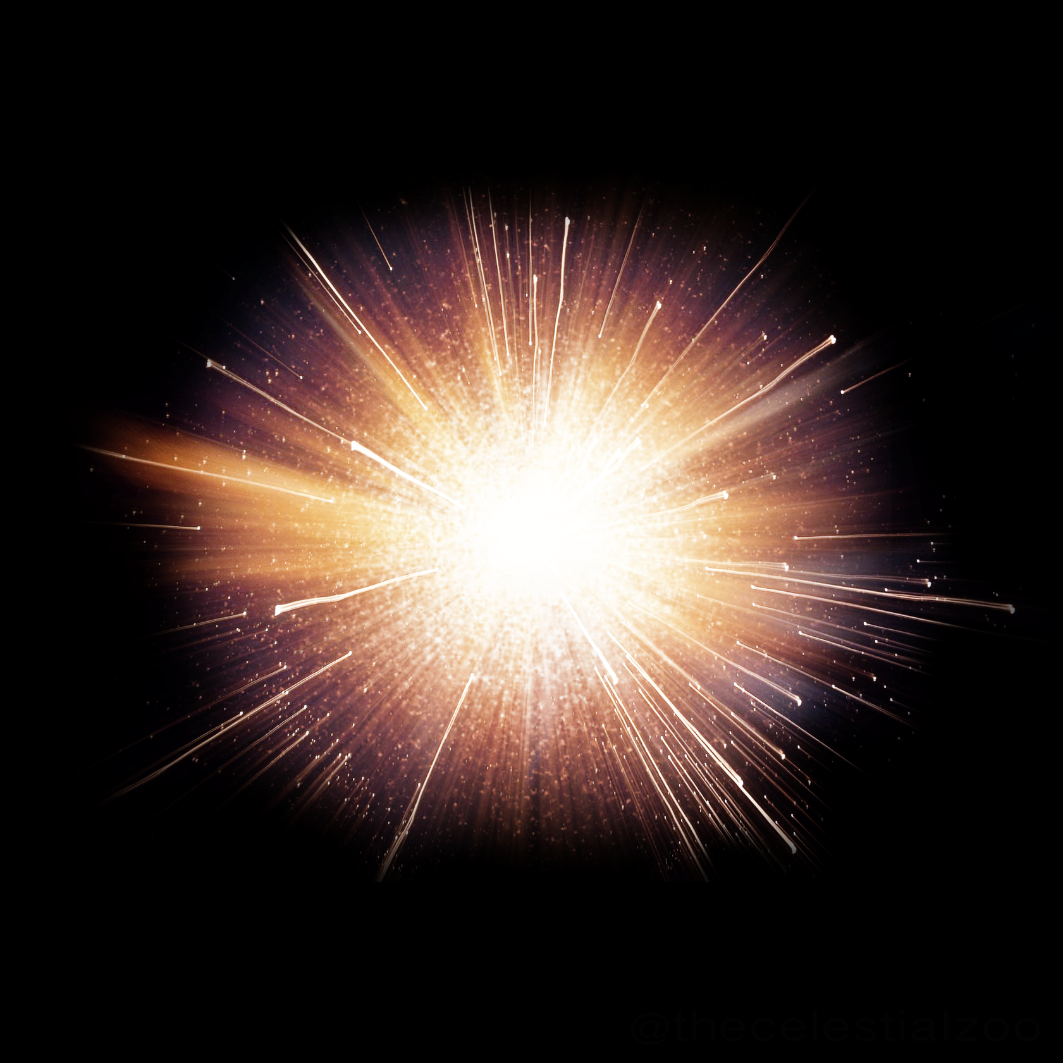
The Big Bang
Specification Point 8.13P
Describe the past evolution of the universe and the main arguments in favour of the Big Bang theory.
The origin of the universe is a topic of intense debate.
Most evidence points to a huge explosion around 14 billion years ago - the Big Bang.
The Big Bang theory suggests that the universe has expanded from a single point.
This single point was so dense and hot that it exploded, causing a gradual cooling and expansion which is still happening today.
The Big Bang theory is the dominant one used by physicists to explain the origin of the universe.

Slide 6
A working model for the history of the universe.

Slide 7
The Doppler Effect
Specification Point 8.15P
Describe that if a wave source is moving relative to an observer, there will be a change in the observed frequency and wavelength.
When an object emits a wave, the wavefronts will usually spread out symmetrically.
If the source of the waves is moving, the waves can compress or expand.
This will lead to a change in the frequency and wavelength of waves - the Doppler effect.
This occurs in all waves, including light.
The Doppler effect occurs in stars.
The light from distant stars is red-shifted.
This means that the light emitted from stars is of a longer wavelength than expected.
This suggests that the stars are moving away from Earth.

Slide 8
The phenomenon of the Doppler effect is shown below. It suggests that the universe is expanding.
STAR IS MOVING AWAY
OBSERVER ON EARTH SEES LIGHT AT A LONGER WAVELENGTH THAN IS EMITTED

Slide 9
Galactic Red-Shift
Specification Points 8.17P and 8.18P
Describe the red-shift in light received from galaxies at different distances away from the Earth.
Explain why the red-shift of galaxies provides evidence for the expansion of the universe.
Most galaxies appear to be moving away from each other.
When light is passed through certain elements, an EM emission spectrum can be created.
The light absorbed from distant galaxies create emission spectrums with lower frequencies and wavelengths.
These emission spectrums have been shifted to the red portion of the spectrum - referred to as galactic red-shift.
EMISSION SPECTRUM FROM A NEARBY GALAXY
EMISSION SPECTRUM FROM A DISTANT GALAXY
SPECTRUM IS SHIFTED LEFTWARDS TOWARDS THE RED PORTION OF THE EM SPECTRUM

Slide 10
Galactic Expansion
Red-shift suggest that the universe is expanding.
All galaxies are experiencing red-shift, suggesting they are moving away from Earth in all directions.
The further the galaxy is from Earth, the faster it is moving away.
Distant galaxies are experiencing greater red-shift than ones that are nearby.
This suggests that distant galaxies are expanding more quickly than nearby ones.
The Hubble Space Telescope calculates the velocities of many nearby and distant galaxies. Galaxies that are further from Earth are moving away at a greater velocity.
VELOCITY →
DISTANCE →

Slide 11
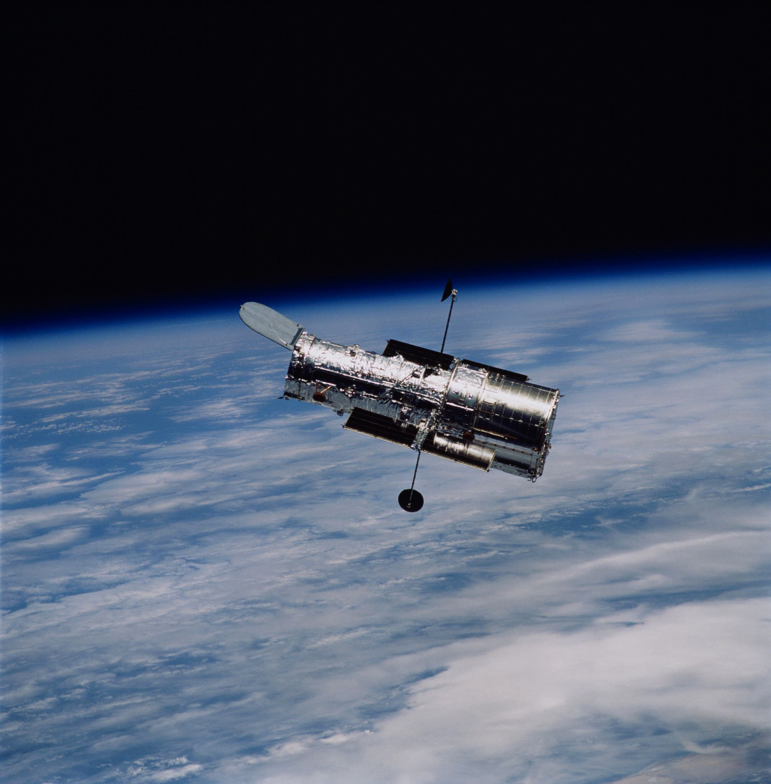
The Hubble Space Telescope calculates the velocities of many nearby and distant galaxies.
Galaxies that are further from Earth are moving away at a greater velocity.

Slide 12
Calculating Red-Shift
Specification Point 8.16P
Use the equation relating to change in wavelength, reference wavelength, velocity of a galaxy and the speed of light.
Red-shift can be calculated using the following equation:
= change in wavelength ÷ reference wavelength
= change in wavelength ÷ reference wavelength
= velocity of a galaxy ÷ speed of light

Slide 13
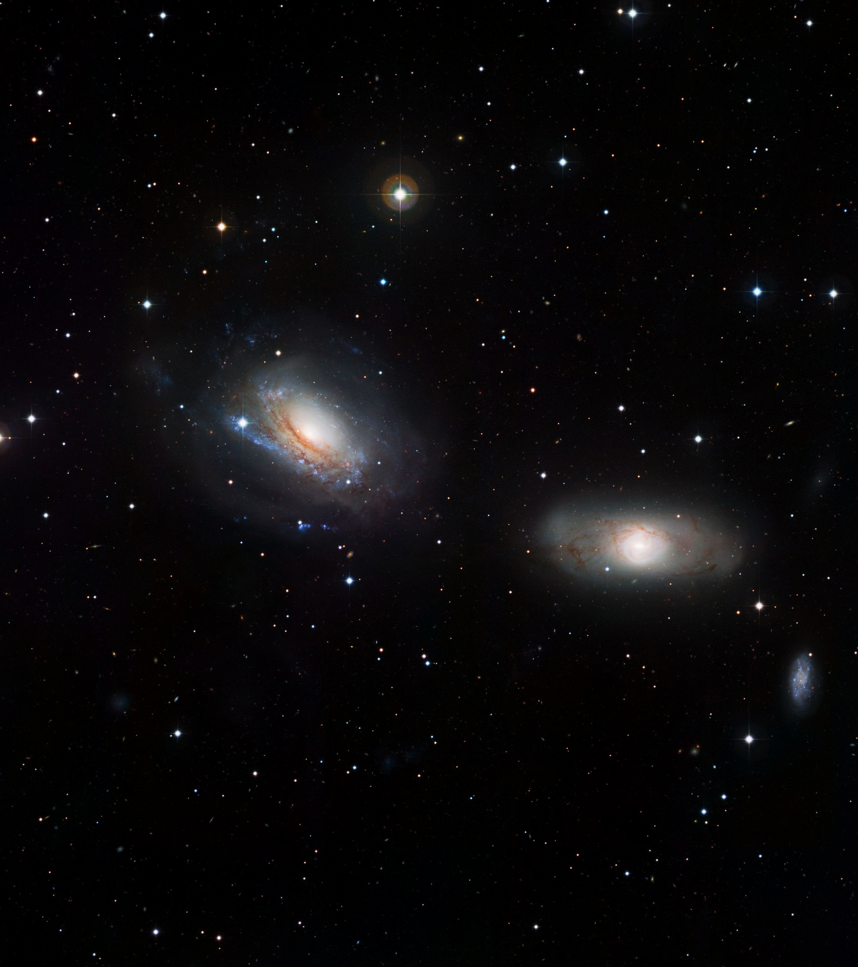
Light emitted from a nearby galaxy has a wavelength of 500 nm.
Light emitted from a distant galaxy has a wavelength of 400 nm.
Calculate the speed the galaxies are moving in relation to each other.
The speed of light (c) is 3 × 10⁸ m/s.
λ - λ₀ = 500 - 400 = 100 = Δλ
Δλ ÷ λ₀ = 100 ÷ 400 = ¼
v = ¼ × c = ¼ × 3 × 10⁸ = 7.5 × 10⁷ m/s

Slide 14
Evidence for the Big Bang
Specification Point 8.14P
Describe evidence that supports the Big Bang theory.
There are two major forms of evidence that support the Big Bang theory.
Evidence from galactic-red shift.
Evidence from galactic red shift suggests that all known galaxies are moving away from each other.
More distant galaxies are moving more quickly than nearby ones.
Evidence from microwave radiation.
Cosmic Microwave Background (CMB) radiation is a remnant of the early universe.
As the universe has expanded and cooled, CMB radiation has dropped in frequency.
This supports the theory that the universe was once very hot.
Evidence from galactic red-shift and CMB radiation both support the theory of the Big Bang.
TIME

Slide 15
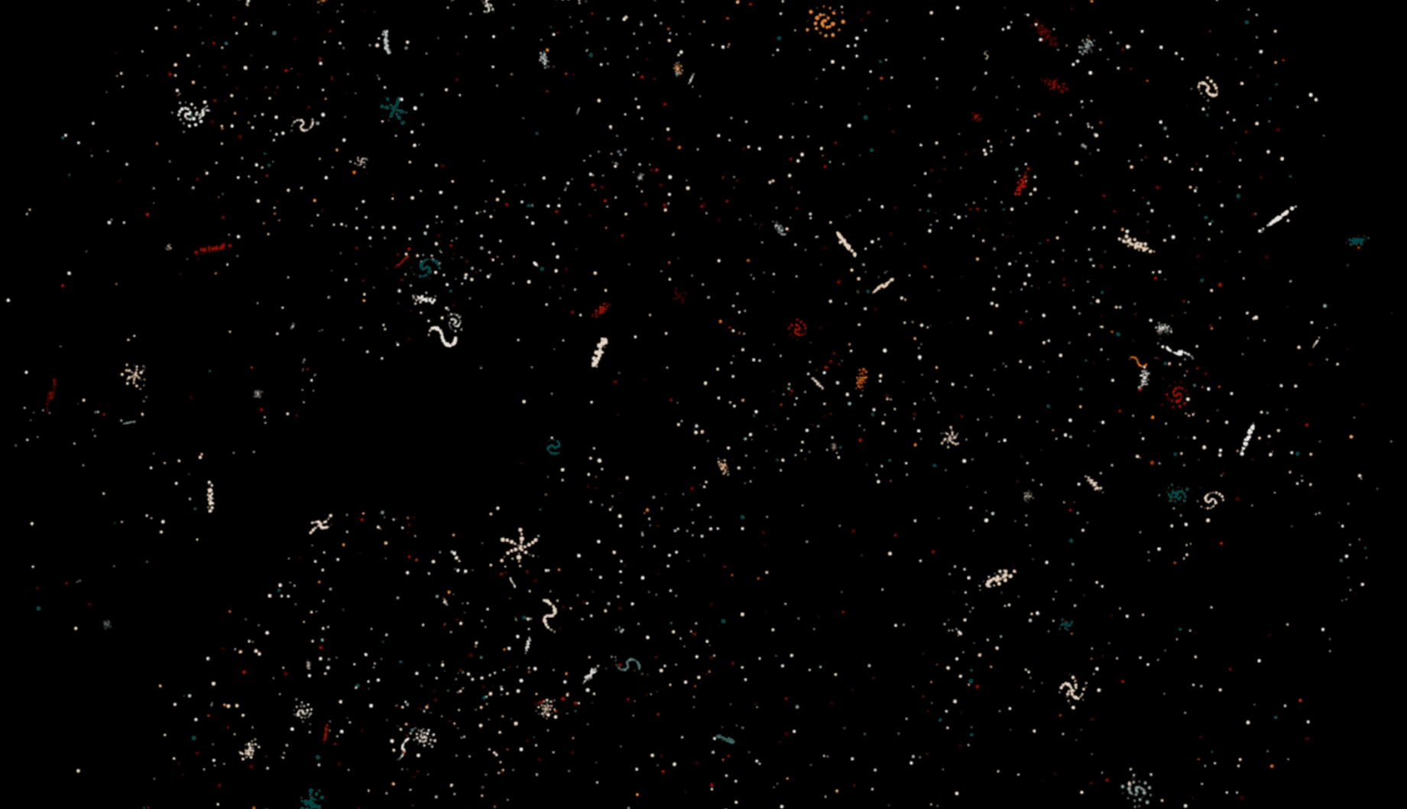
The majority of astrophysicists agree that the universe began around 14 billion years ago in a colossal explosion called the Big Bang.
Many believe it will continue to expand forever.

