Slide 1
Edexcel IGCSE Physics
32 - The Evolution of Stars
Colours and Classifications

Slide 2
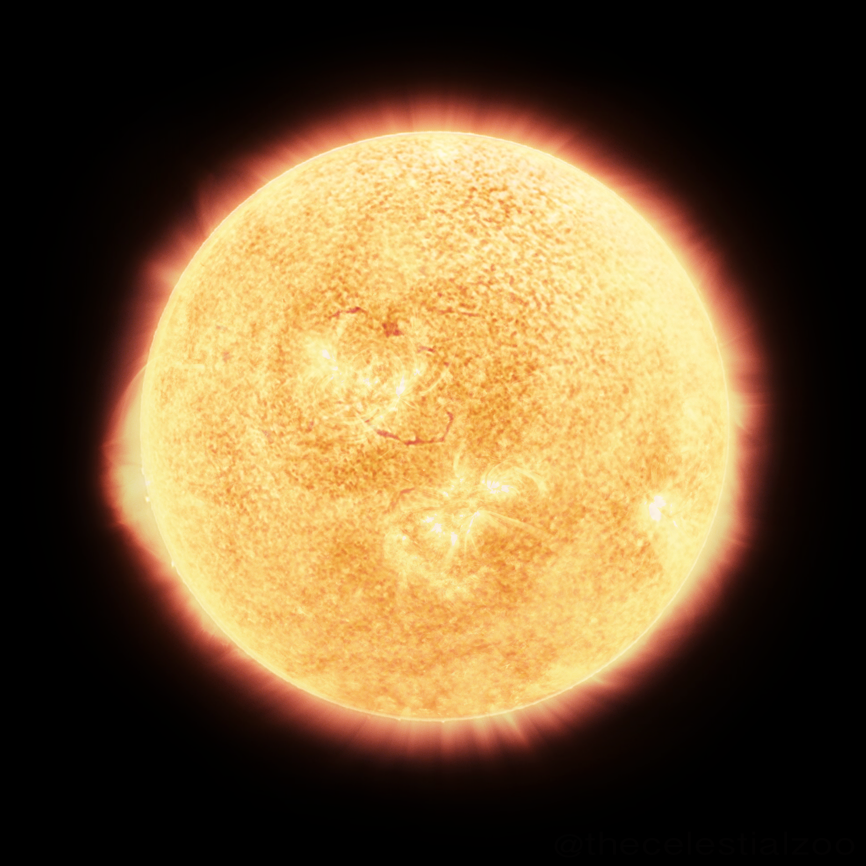
The Colour of Stars
Specification Points 8.7 and 8.8
Understand how stars can be classified according to their colour.
Know that a star’s colour is related to its surface temperature.
Stars come in a range of both sizes and colours.
Stars can be classified depending on their colour.
All stars emit visible light.
The frequency of light emitted by a star determines its colour.
The hotter the star, the higher the frequency of light emitted.
Blue stars are the hottest.
Blue light is of a high frequency.
The surface of blue stars is about about 30,000°C.
Red stars are the coolest.
Red light is of a low frequency.
The surface of red stars is about about 3,000°C.
The surface of the Sun is about 5,500 °C. This is quite cool compared to other stars.

Slide 3
Higher temperatures emit higher frequencies of visible light. This means that blue stars will burn the hottest and red stars will burn the coolest.
30,000°C
10,000°C
7,000°C
4,000°C
3,000°C

Slide 4
Stellar Evolution
Specification Point 8.9
Describe the evolution of stars of similar mass to the Sun through the following stages: nebula, star, red giant and white dwarf.
Stars go through a number of stages during their lifetime:
All stars form from a cloud of hydrogen gas and dust called a nebula.
Gravity pulls the particles in the nebula closer together to form a protostar.
Gravity causes more frequent collisions between particles.
These collisions lead to an increase in temperature.
The star enters a long period of stability - a main sequence star.
Once the protostar reaches sufficient temperature, nuclear fusion begins to take place.
Hydrogen nuclei fuse to create helium nuclei.
The heat from nuclear fusion leads to thermal expansion.
The outward force from thermal expansion and the force of gravity pulling inwards are balanced - the star is in a state of equilibrium.

Slide 5
Stellar Evolution
The star turns into a red giant as the hydrogen in the core begins to run out.
Fusion reactions in the core will begin to slow.
The inward force from gravity now becomes greater than the outward force of thermal expansion.
The core of the star will begin to shrink.
Energy in the outer layers of the star lead to expansion.
The star will collapse to form a white dwarf.
The star will become unstable and will eject its outer layer of dust and gas.
The core will collapse due to the forces of gravity.
Life cycle of stars video.

Slide 6
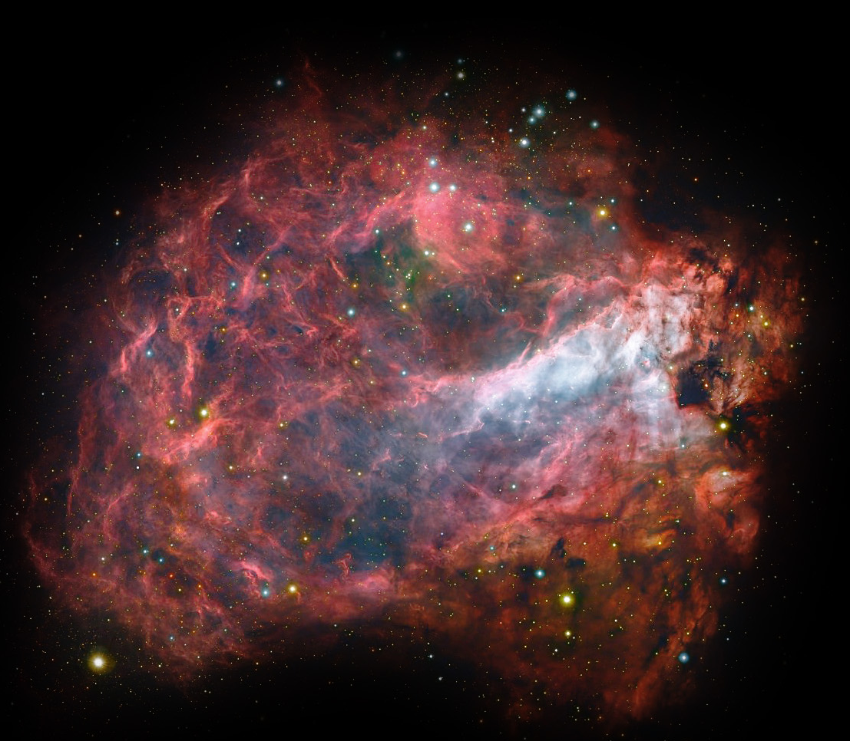
All stars form from a cloud of hydrogen gas and dust called a nebula.

Slide 7
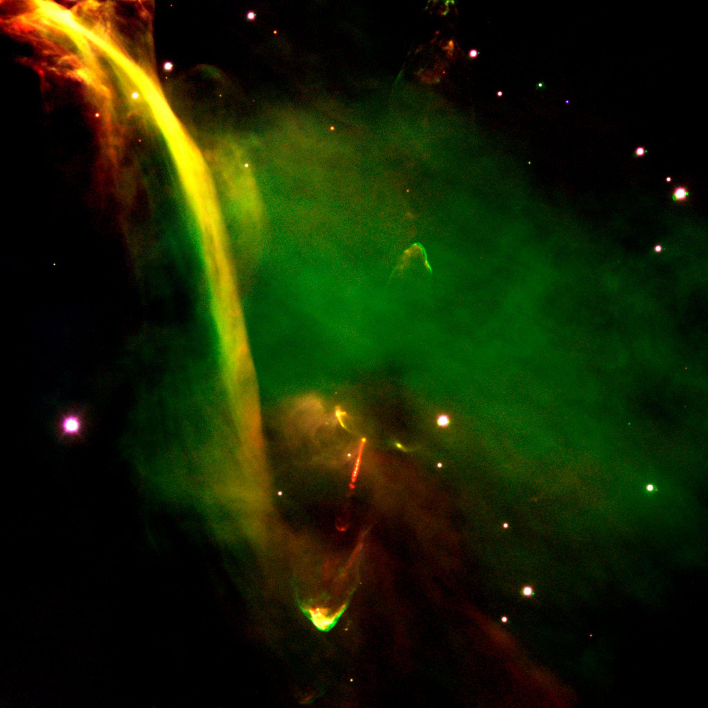
Gravity pulls the particles in the nebula closer together to form a protostar.

Slide 8
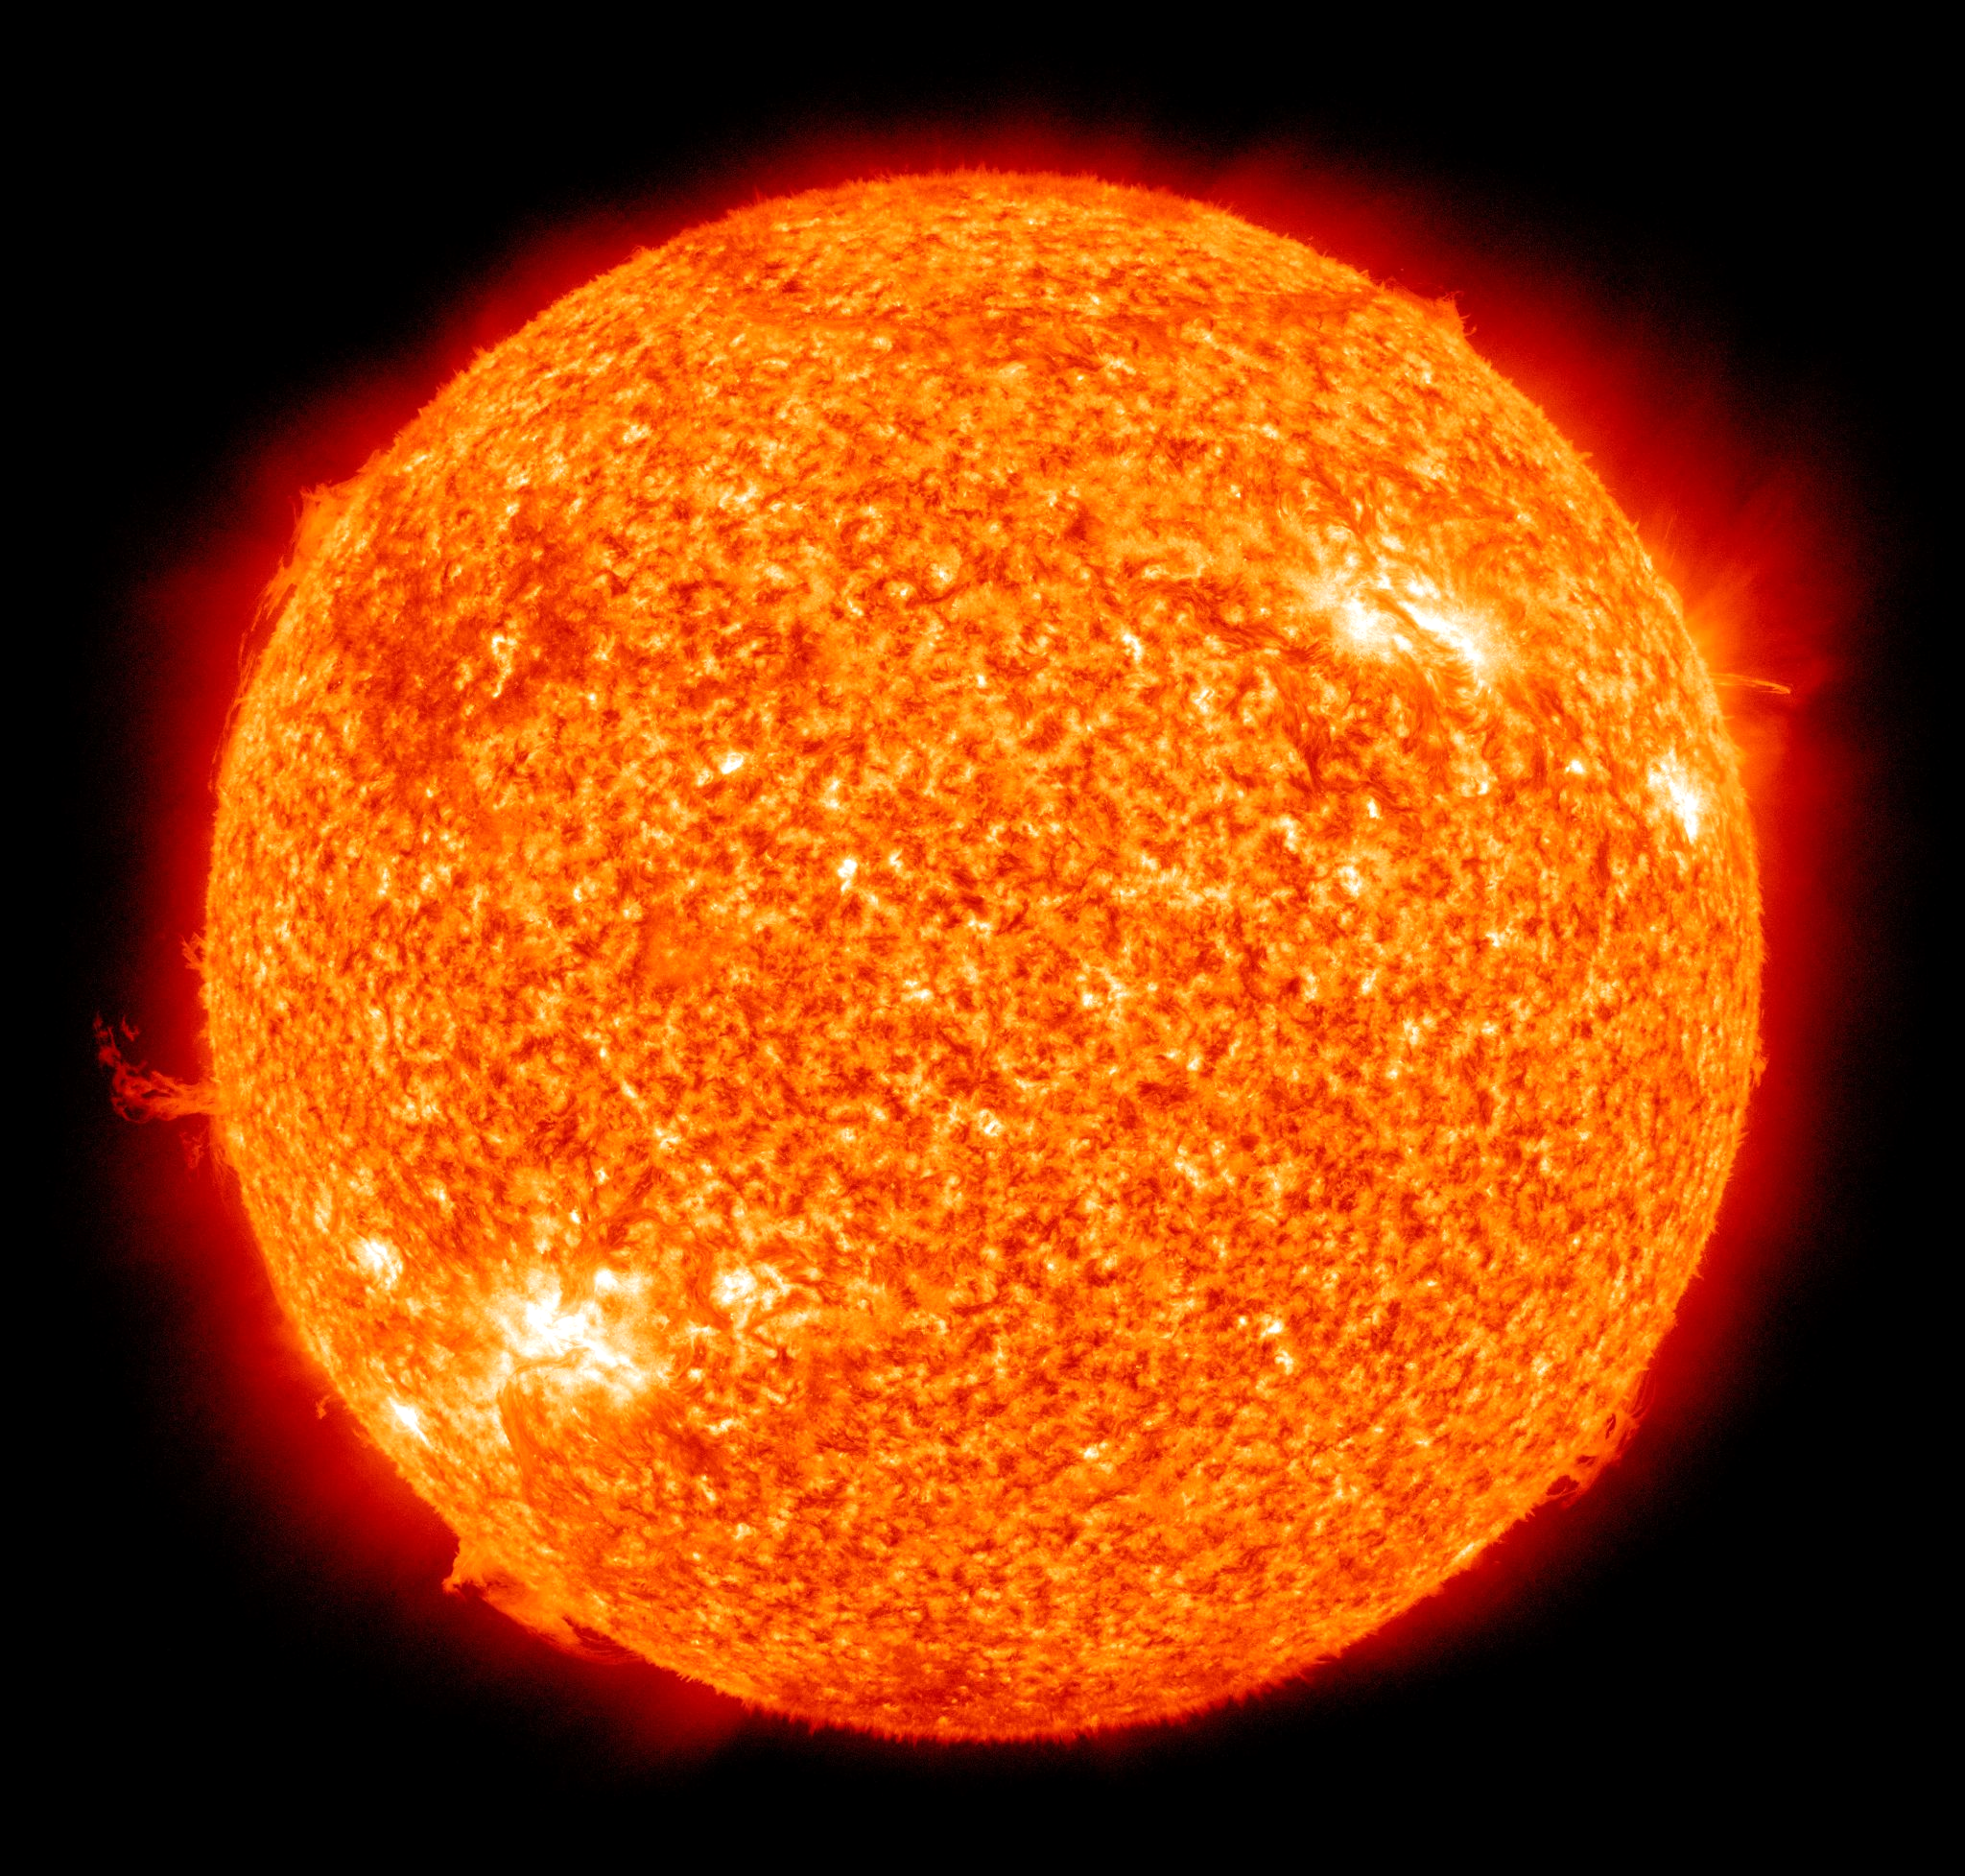
The star enters a long period of stability - a main sequence star.

Slide 9
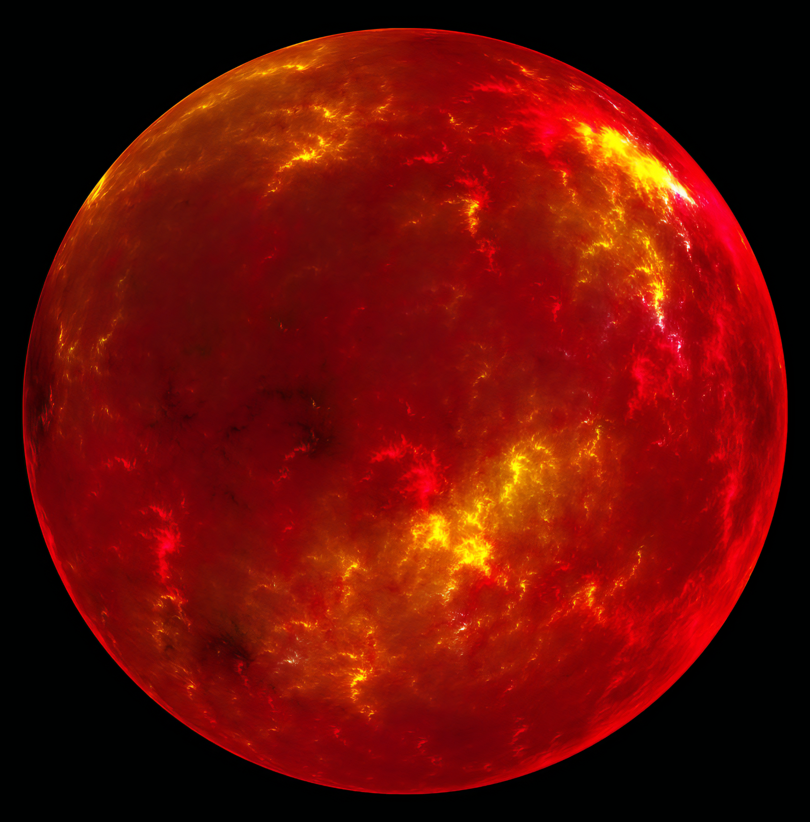
The star turns into a red giant as the hydrogen in the core begins to run out.

Slide 10
Finally, the star will collapse to form a white dwarf.

Slide 11
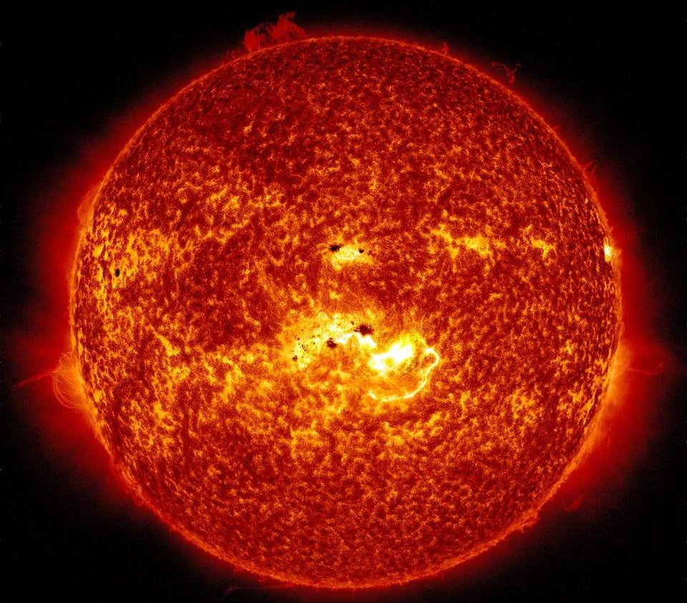
1. NEBULA
2. PROTOSTAR
3. MAIN SEQUENCE STAR
4. RED GIANT
5. WHITE DWARF

Slide 12
Stellar Evolution of Larger Stars
Specification Point 8.10
Describe the evolution of stars with a mass larger than the Sun.
There are stars that are much larger than the Sun.
The star Betelgeuse is about 950 times larger than the Sun.
Larger stars have a shorter lifespan.
The lifespan of large stars is measured in hundreds of millions of years.
The lifespan of stars the size of the Sun is measured in billions of years.
Larger stars undergo different stages during their stellar evolution.
Larger stars go through the same first stages as a smaller star.
The nebula, protostar and main sequence star phases are identical to a smaller star.
A larger star will then turn into a red supergiant.
A red supergiant is much larger than a red giant.

Slide 13
Stellar Evolution of Larger Stars
Red supergiants will go supernova.
Nuclear fusion in red supergiants will lead to heavier elements such as beryllium being formed.
Once fusion reactions end, the core of the star will collapse leading to a huge explosion called a supernova.
Following the supernova a neutron star will form.
The supernova will shoot the outer layers of dust and gas into space.
A very dense core will remain - this is called a neutron star.
In the case of the very largest stars, the neutron star will collapse to form a black hole.
The gravity of the neutron star will be so massive it will collapse inwards.
This leads to an extremely dense point in space that not even light can escape from.

Slide 14
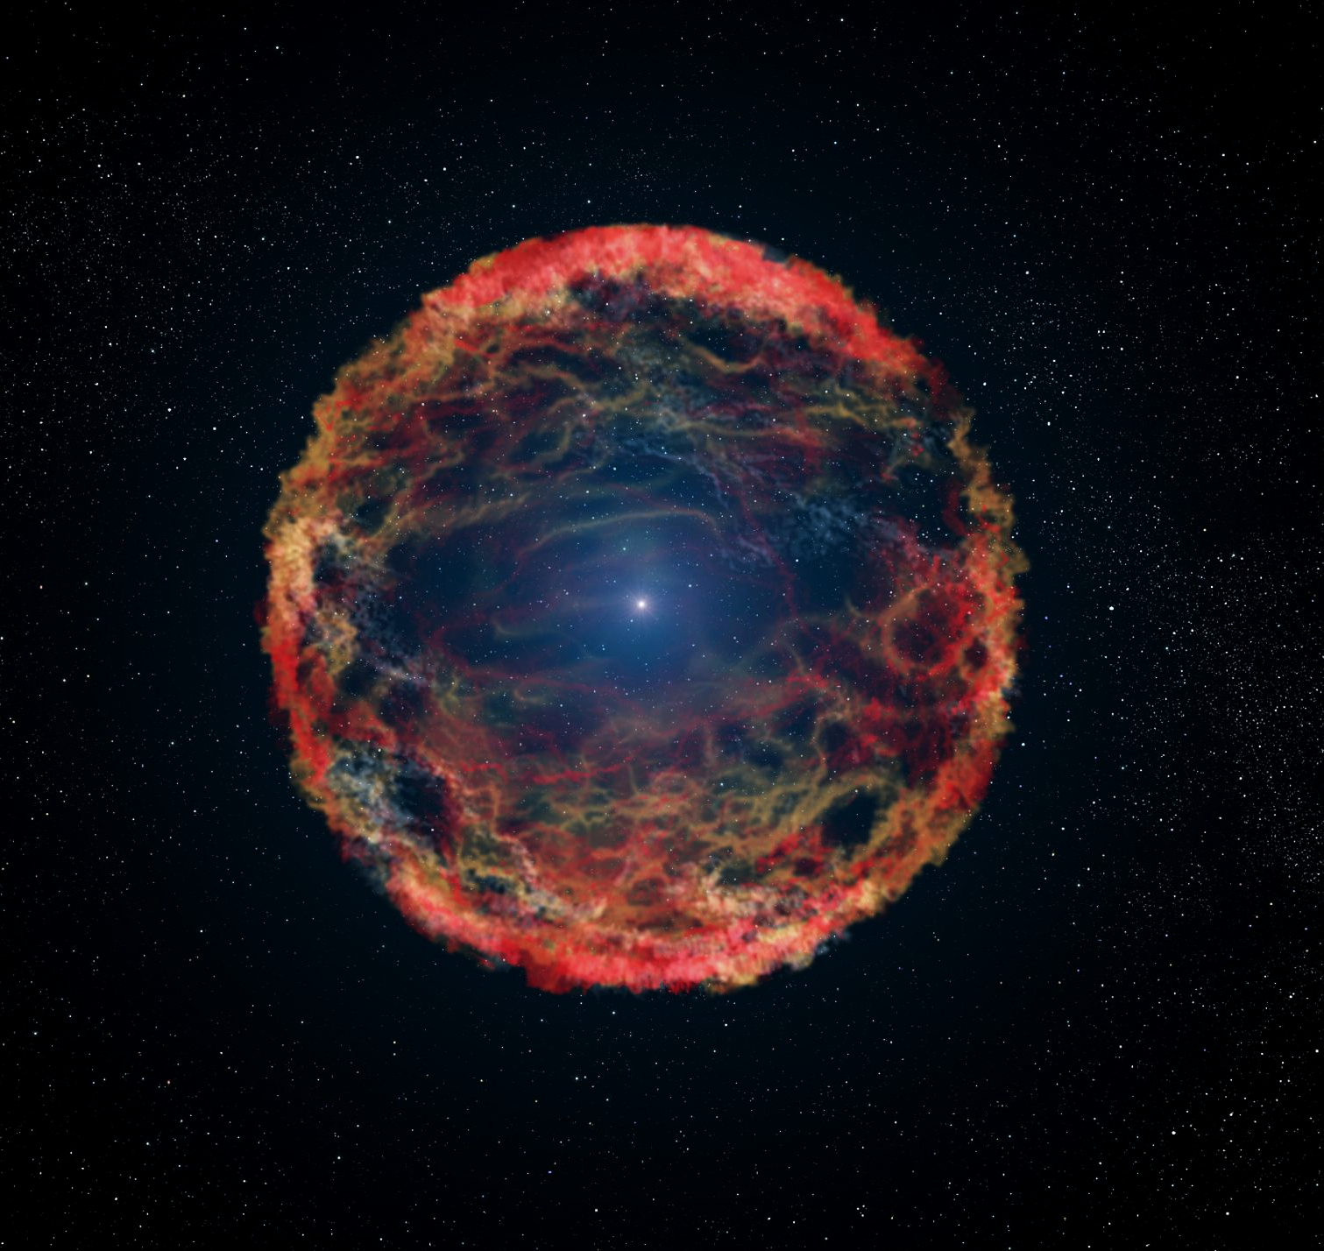
Red supergiants will explode and go supernova. A neutron star will remain in the centre.

Slide 15
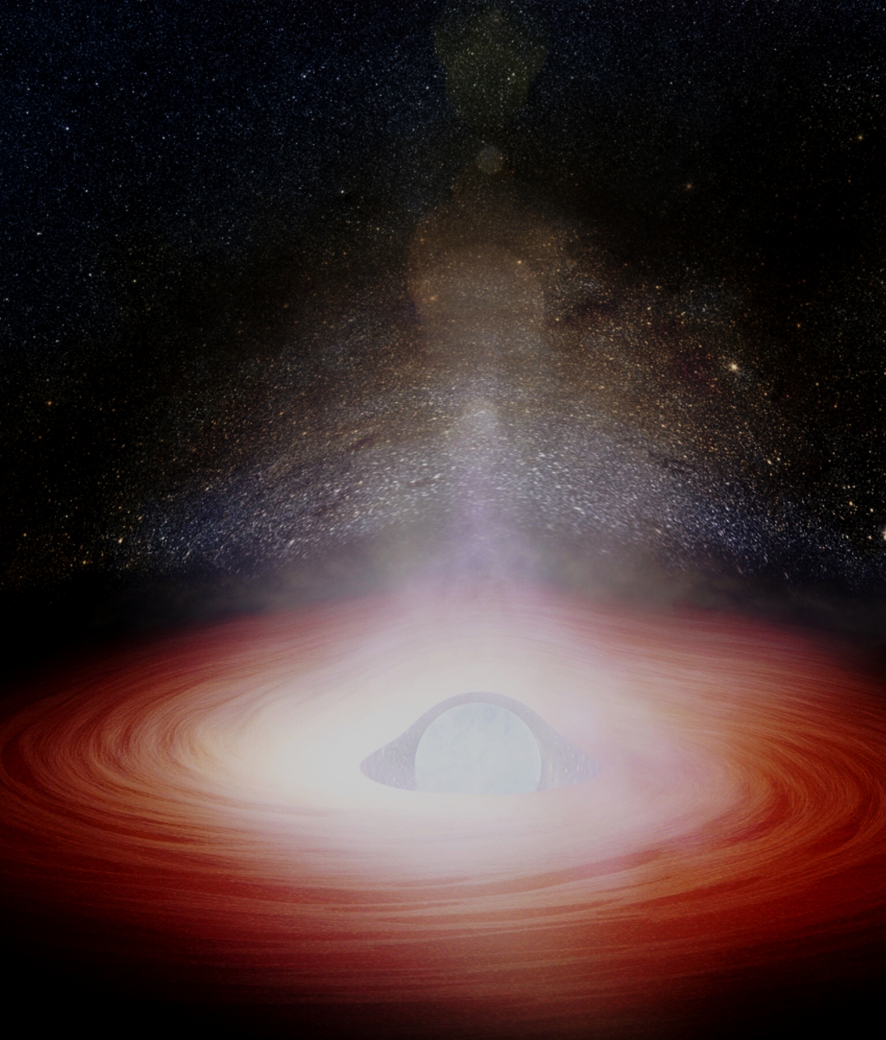
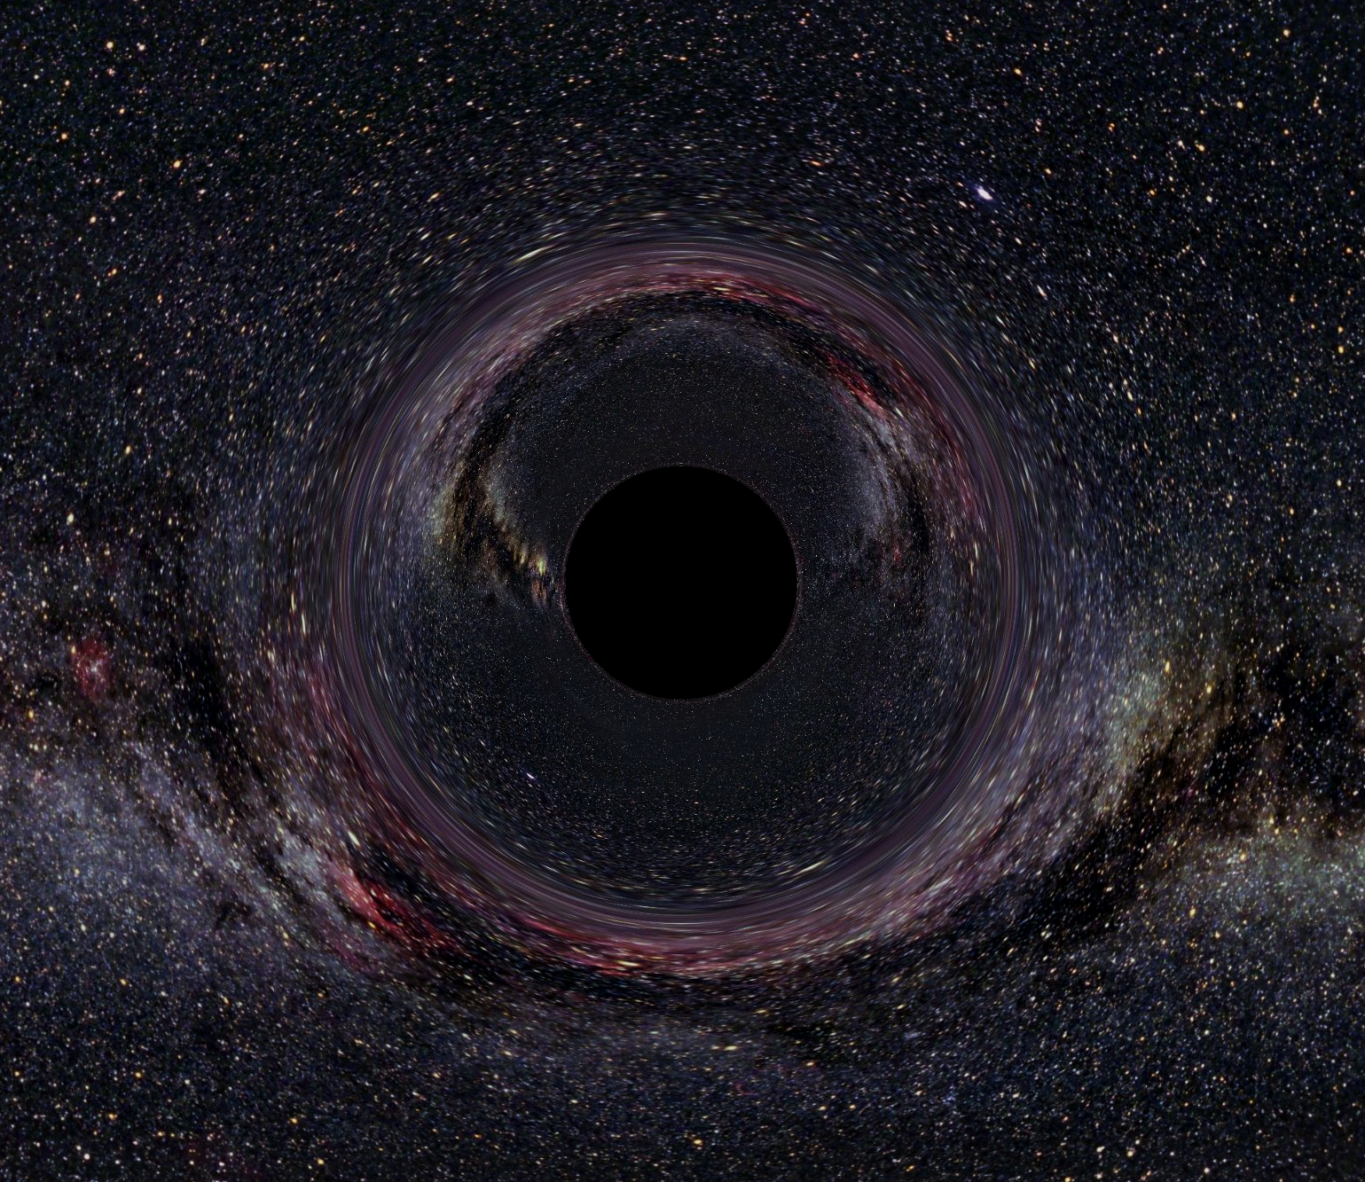
1. NEBULA
2. PROTOSTAR
3. MAIN SEQUENCE STAR
4. RED SUPERGIANT
5. NEUTRON STAR
6. BLACK HOLE

Slide 16
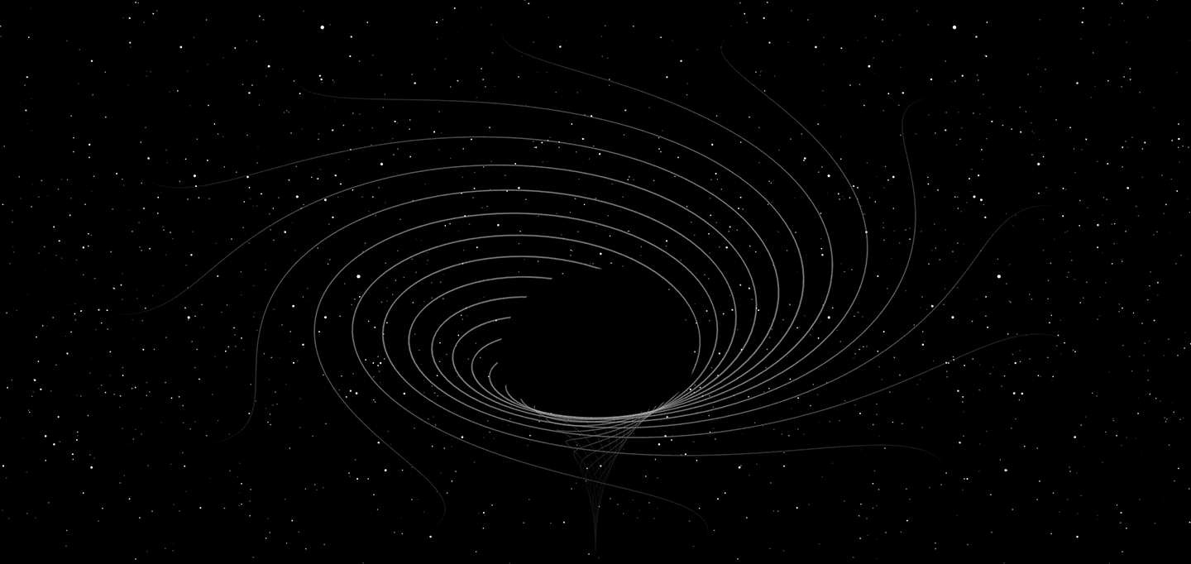
The massive gravity-well created by black holes can rip stars apart as they approach.

