Slide 1
Edexcel IGCSE Physics
31 - The Universe
Planets, Galaxies and Orbits

Slide 2
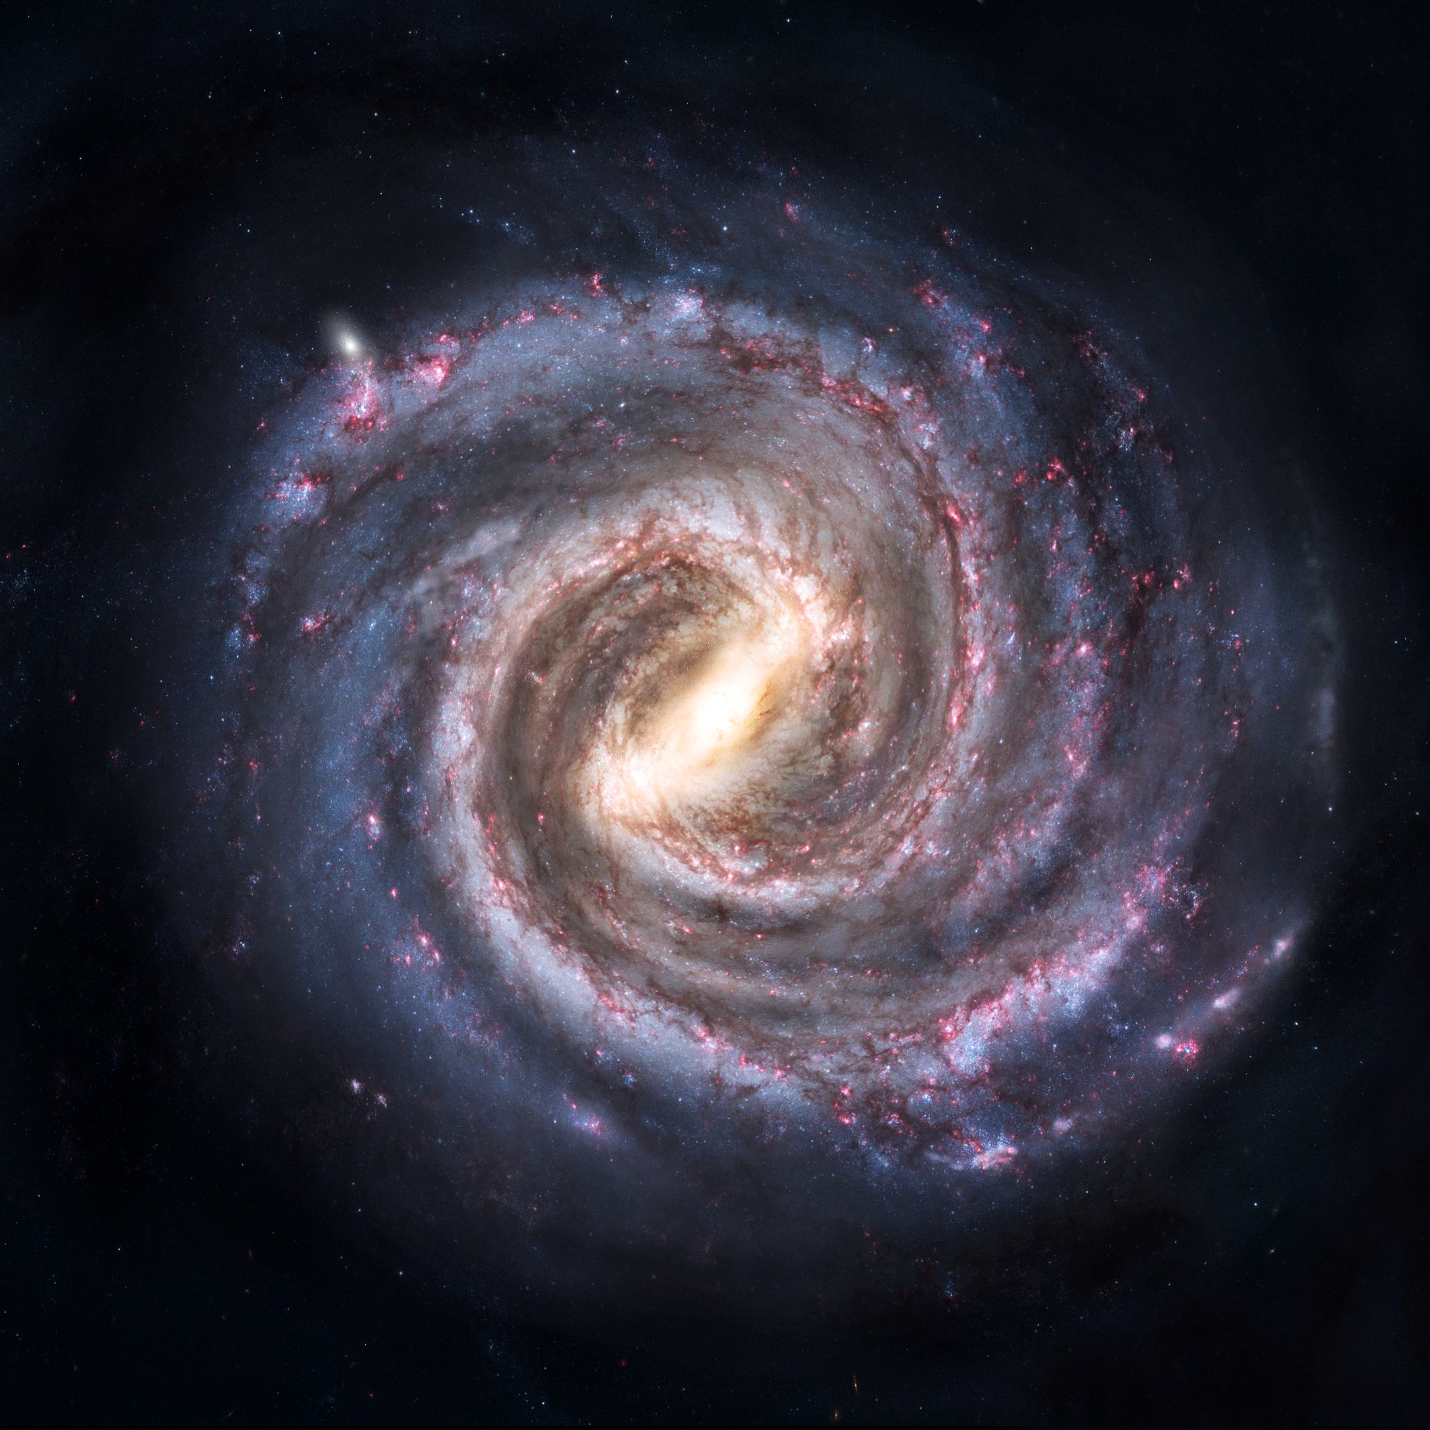
The Milky Way Galaxy
Specification Points 8.1 and 8.2
  Use the following units: kilogram (kg), metre (m), metre/second (m/s), metre/second² (m/s²), newton (N), second (s), newton/kilogram (N/kg).
  Know that the universe is a large collection of billions of galaxies, that a galaxy is a large collection of billions of stars and that our solar system is in the Milky Way galaxy.
The universe is a collection of billions of galaxies.
  A galaxy is a collection of billions of stars.
Stars are parts of solar systems.
  Our solar system is part of the Milky Way galaxy.
Solar systems also contain planets.
  There are eight planets in the Milky Way.
The Milky Way galaxy is home to our solar system, containing Earth and seven other planets.

Slide 3
The major components of our solar system. There are eight planets, as well as numerous moons, asteroids and other celestial bodies.

Slide 4
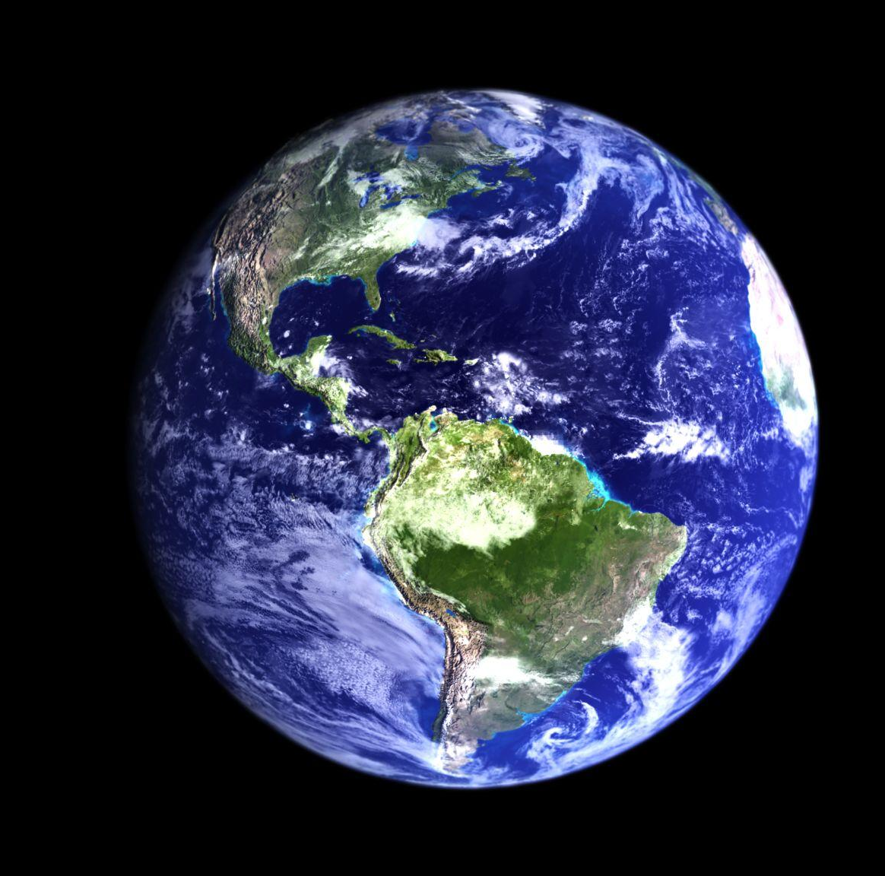
The planet Earth is home to millions of different species of flora and fauna, including humans.

Slide 5
Gravitational Field Strength
Specification Point 8.3
  Understand why gravitational field strength, g, varies and know that it is different on other planets and the Moon from that on the Earth.
The weight of an object can be defined as the force acting on it due to gravitational attraction.
  Planets have strong gravitational field strength (g).
The more massive a planet is, the greater the gravitational field strength.
  Planets with more mass create stronger gravitational fields.
  The weight of an object and the g of a planet are directly proportional to each other.
The gravitational field strength on Earth is much stronger than on the Moon.
  The g on Earth is 10 N/kg.
  The g on the Moon is 1.6 N/kg or approximately one sixth of the gravity.

Slide 6
Gravitational field strength (g), is dependent on the mass (m) of the object in question. The Earth has a much greater mass than the Moon, so gravity has more of an influence.
ON EARTH, g = 10 N/kg
ON THE MOON, g = 1.6 N/kg
An object that has a mass of 5 kg on both Earth and the Moon will weigh differently on each:
On Earth: 5 × 10 = 50 N
On the Moon: 5 × 1.6 = 8 N

Slide 7
Gravity and Orbits
Specification Points 8.4 and 8.5
  Explain that gravitational force causes moons to orbit planets, causes the planets to orbit the Sun, causes artificial satellites to orbit the Earth and causes comets to orbit the Sun.
  Describe the differences in the orbits of comets, moons and planets.
Gravity provides the force that creates orbits.
  Planets orbit the Sun in almost circular trajectories.
  Moons orbit planets in same fashion.
  Comets have a much more elliptical orbit.
As an object travels in a circle, it is constantly changing direction.
  It is said that the object is constantly accelerating.
  The force causing this acceleration is called centripetal force.
The closer a body is to a larger body, the faster the orbit.
  Planets that are closer to the Sun will have a faster orbit.
  Moons that are closer to planets will have a faster orbit.
The orbits of various planets (Mercury, Venus, Earth and Mars) around the Sun. The gravitational attraction of the Sun causes these planets to remain in a perpetual near-circular motion.

Slide 8
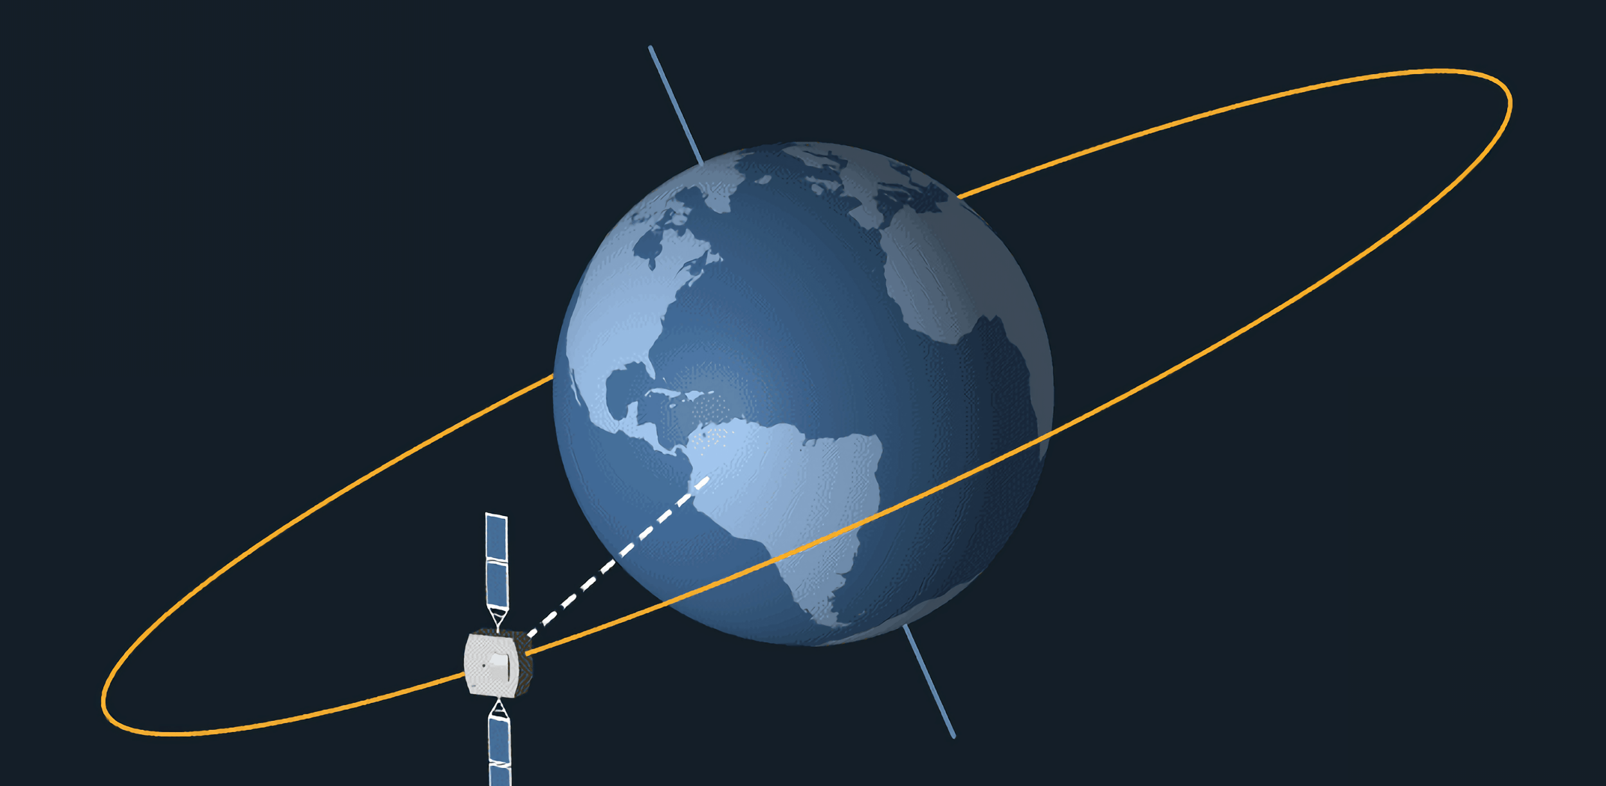
Gravity also has the effect of keeping satellites in orbit around their planets.

Slide 9
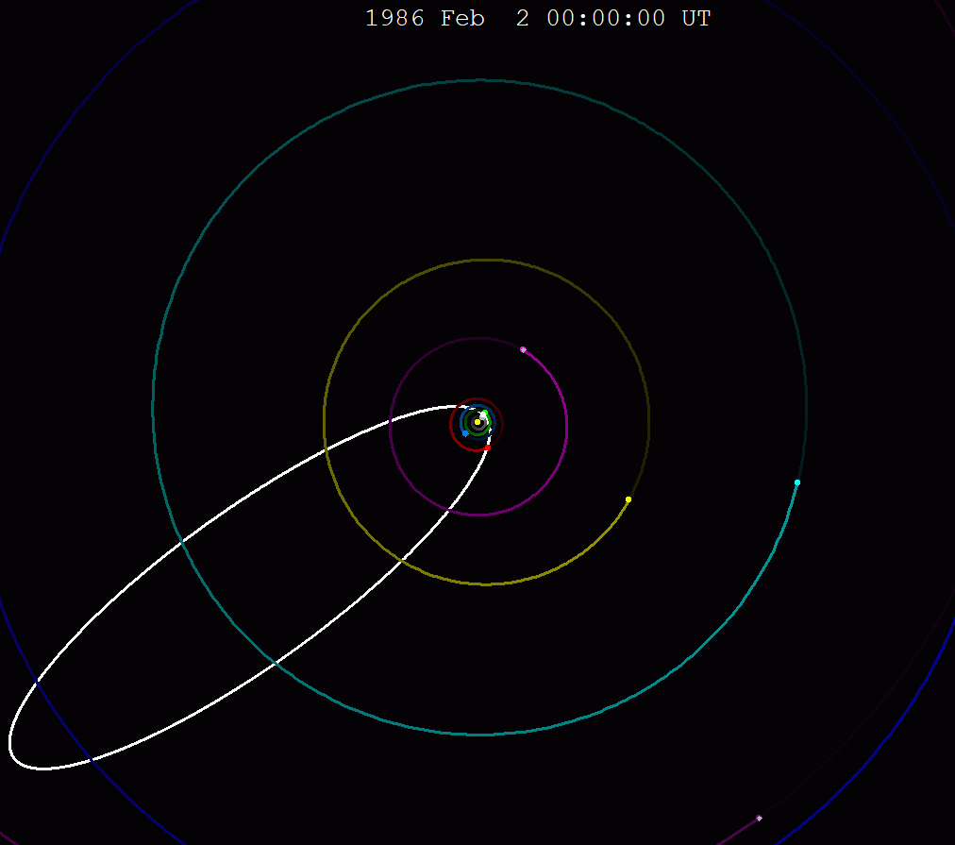
The orbit of Halley's comet.
Whilst the orbits of moons and planets are near-circular, the orbits of comets are very elliptical.
As they travel to the edges of the galaxy, the speed of comets decrease. When they get closer to the Sun, the increase in gravity causes their speed to increase.

Slide 10
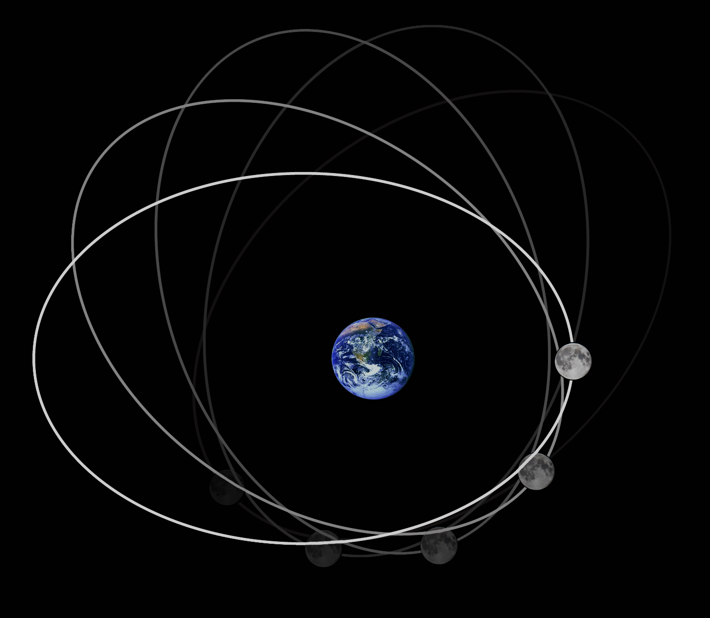
Orbital Periods and Speed
Specification Point 8.6
  Use the relationship between orbital speed, orbital radius and time period.
The time it takes for an object to complete a single orbit is called the orbital period.
  The orbital period of Earth around the Sun is 365 days.
  The orbital period of the Moon around Earth is 27 days.
Assuming the orbit is circular, it is possible to calculate the speed of an orbit:
v = speed (m/s)
r = orbital radius (m)
T = time taken (s)
The Moon orbits the Earth once every 27 days. This is referred to as the lunar orbital period.
Notes:
a = acceleration (m/s²)
Δv = change in velocity (m/s)
t = time taken (s)

Slide 11
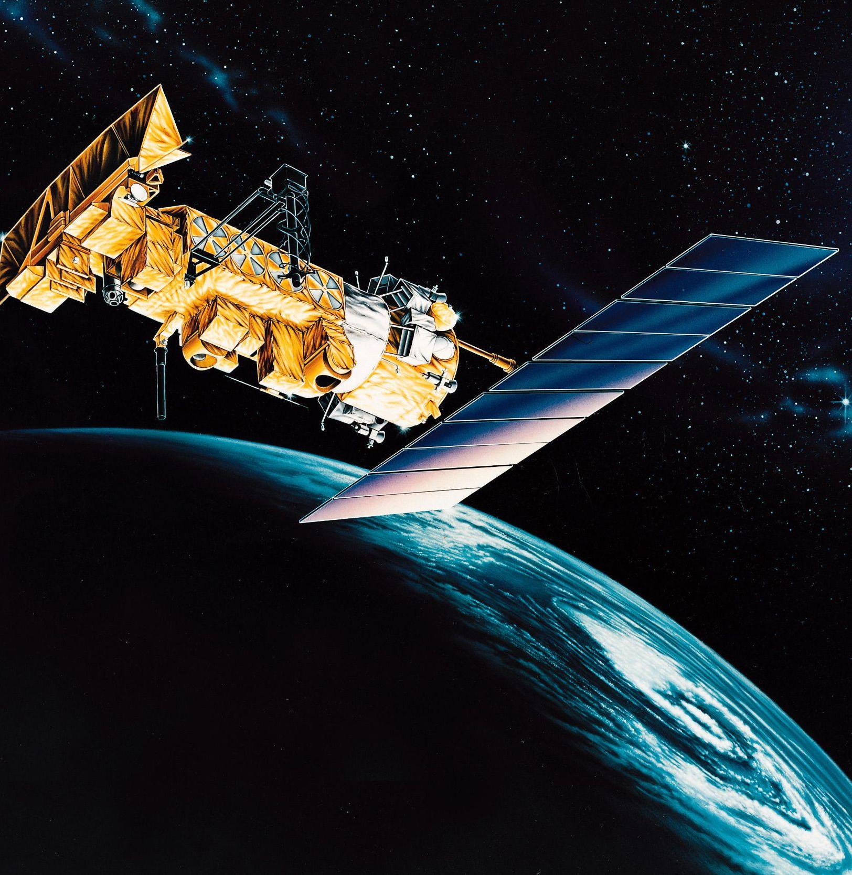
This satellite is orbiting the Earth at an altitude of 35,000 km. It takes 1 day for the satellite to complete an orbit.
Calculate the speed of the satellite.
35,000 km = 35,000,000 m = r
1 day = 86,400 s = T
2 × Π × 35,000,000 = 219,911,486
219,911,486 ÷ 86,400 = 2545 m/s
Notes:
a = acceleration (m/s²)
Δv = change in velocity (m/s)
t = time taken (s)

