Slide 1
Edexcel IGCSE Physics
30 - Fission and Fusion
Chain Reactions and Nuclear Reactors

Slide 2
Nuclear Reactions
Specification Points 7.17 and 7.23
Know that nuclear reactions, including fission, fusion and radioactive decay, can be a source of energy.
Explain the difference between nuclear fusion and nuclear fission.
Nuclear reactions can generate huge amounts of energy.
When completely reacted, 1 kilogram of ²³⁵U releases the equivalent of 17,000 kilograms of TNT.
There are three main forms of nuclear reactions:
Nuclear fission.
Nuclear fusion.
Radioactive decay.
Nuclear fission involves the splitting of atoms.
When atoms are split, lots of energy is released.
Nuclear fusion involves the joining of atoms.
When the nuclei of atoms fuse, lots of energy is released.

Slide 3
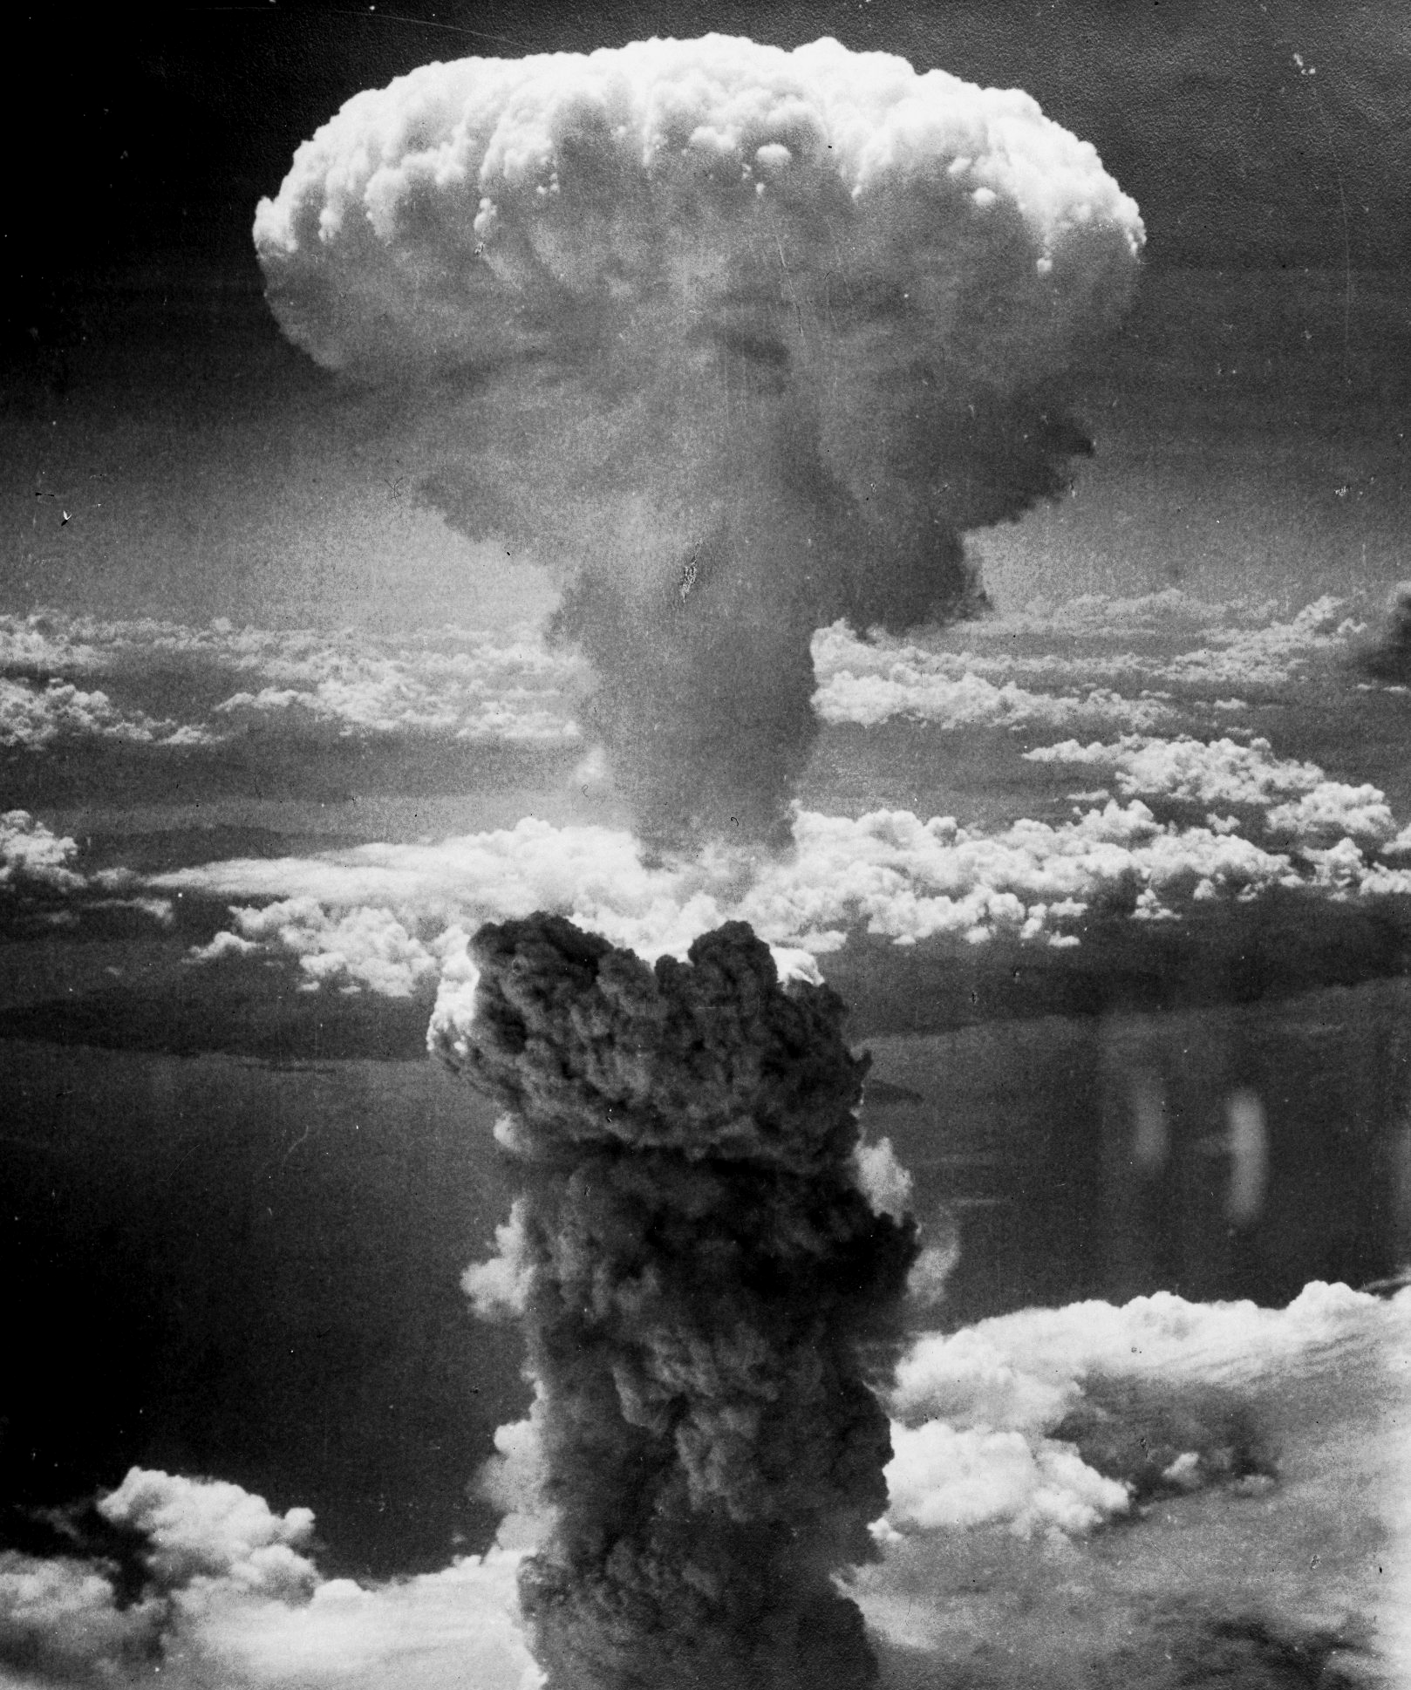
In August 1945, the Japanese city of Nagasaki was targeted with a nuclear bomb.
The amount of energy generated was equivalent to 25,000 tons of conventional explosives.

Slide 4
Nuclear Fission
Specification Point 7.18
Understand how a nucleus of U-235 can be split by collision with a neutron, and that this process releases energy as kinetic energy of the fission products.
Nuclear fission involves the splitting of an unstable nuclei into two smaller nuclei.
Uranium-235 (U-225) is an example of an element that undergoes nuclear fission.
Some fission reactions are spontaneous.
This means that they happen without an external cause.
Most fission reactions require additional energy to occur.
When a neutron collides with a U-235 nucleus, the nucleus can split.
When this happens, two daughter nuclei are formed.
These nuclei belong to lighter elements than uranium.
Nuclear fission also releases more neutrons.
These neutrons, as well as the lighter nuclei, are called fission products.

Slide 5
The process of nuclear fission.
BARIUM-141
URANIUM-235
URANIUM-236
NEUTRON
NEUTRON
NEUTRON
NEUTRON
1. A U-235 nucleus is bombarded by a neutron.
2. The nucleus absorbs the neutron, forming an unstable U-236 nucleus, which immediately splits apart into smaller fission products.
KRYPTON-92

Slide 6
Chain Reactions
Specification Points 7.19 and 7.20
Know that the fission of U-235 produces two radioactive daughter nuclei and a small number of neutrons.
Describe how a chain reaction can be set up if the neutrons produced by one fission strike other U-235 nuclei.
During U-235 fission reactions, two or three neutrons are released.
These neutrons may then collide with other U-235 nuclei.
The collisions may cause these other U-235 nuclei to also split.
This is referred to as a chain reaction.
Chain reactions may continue for thousands or millions of years.

Slide 7
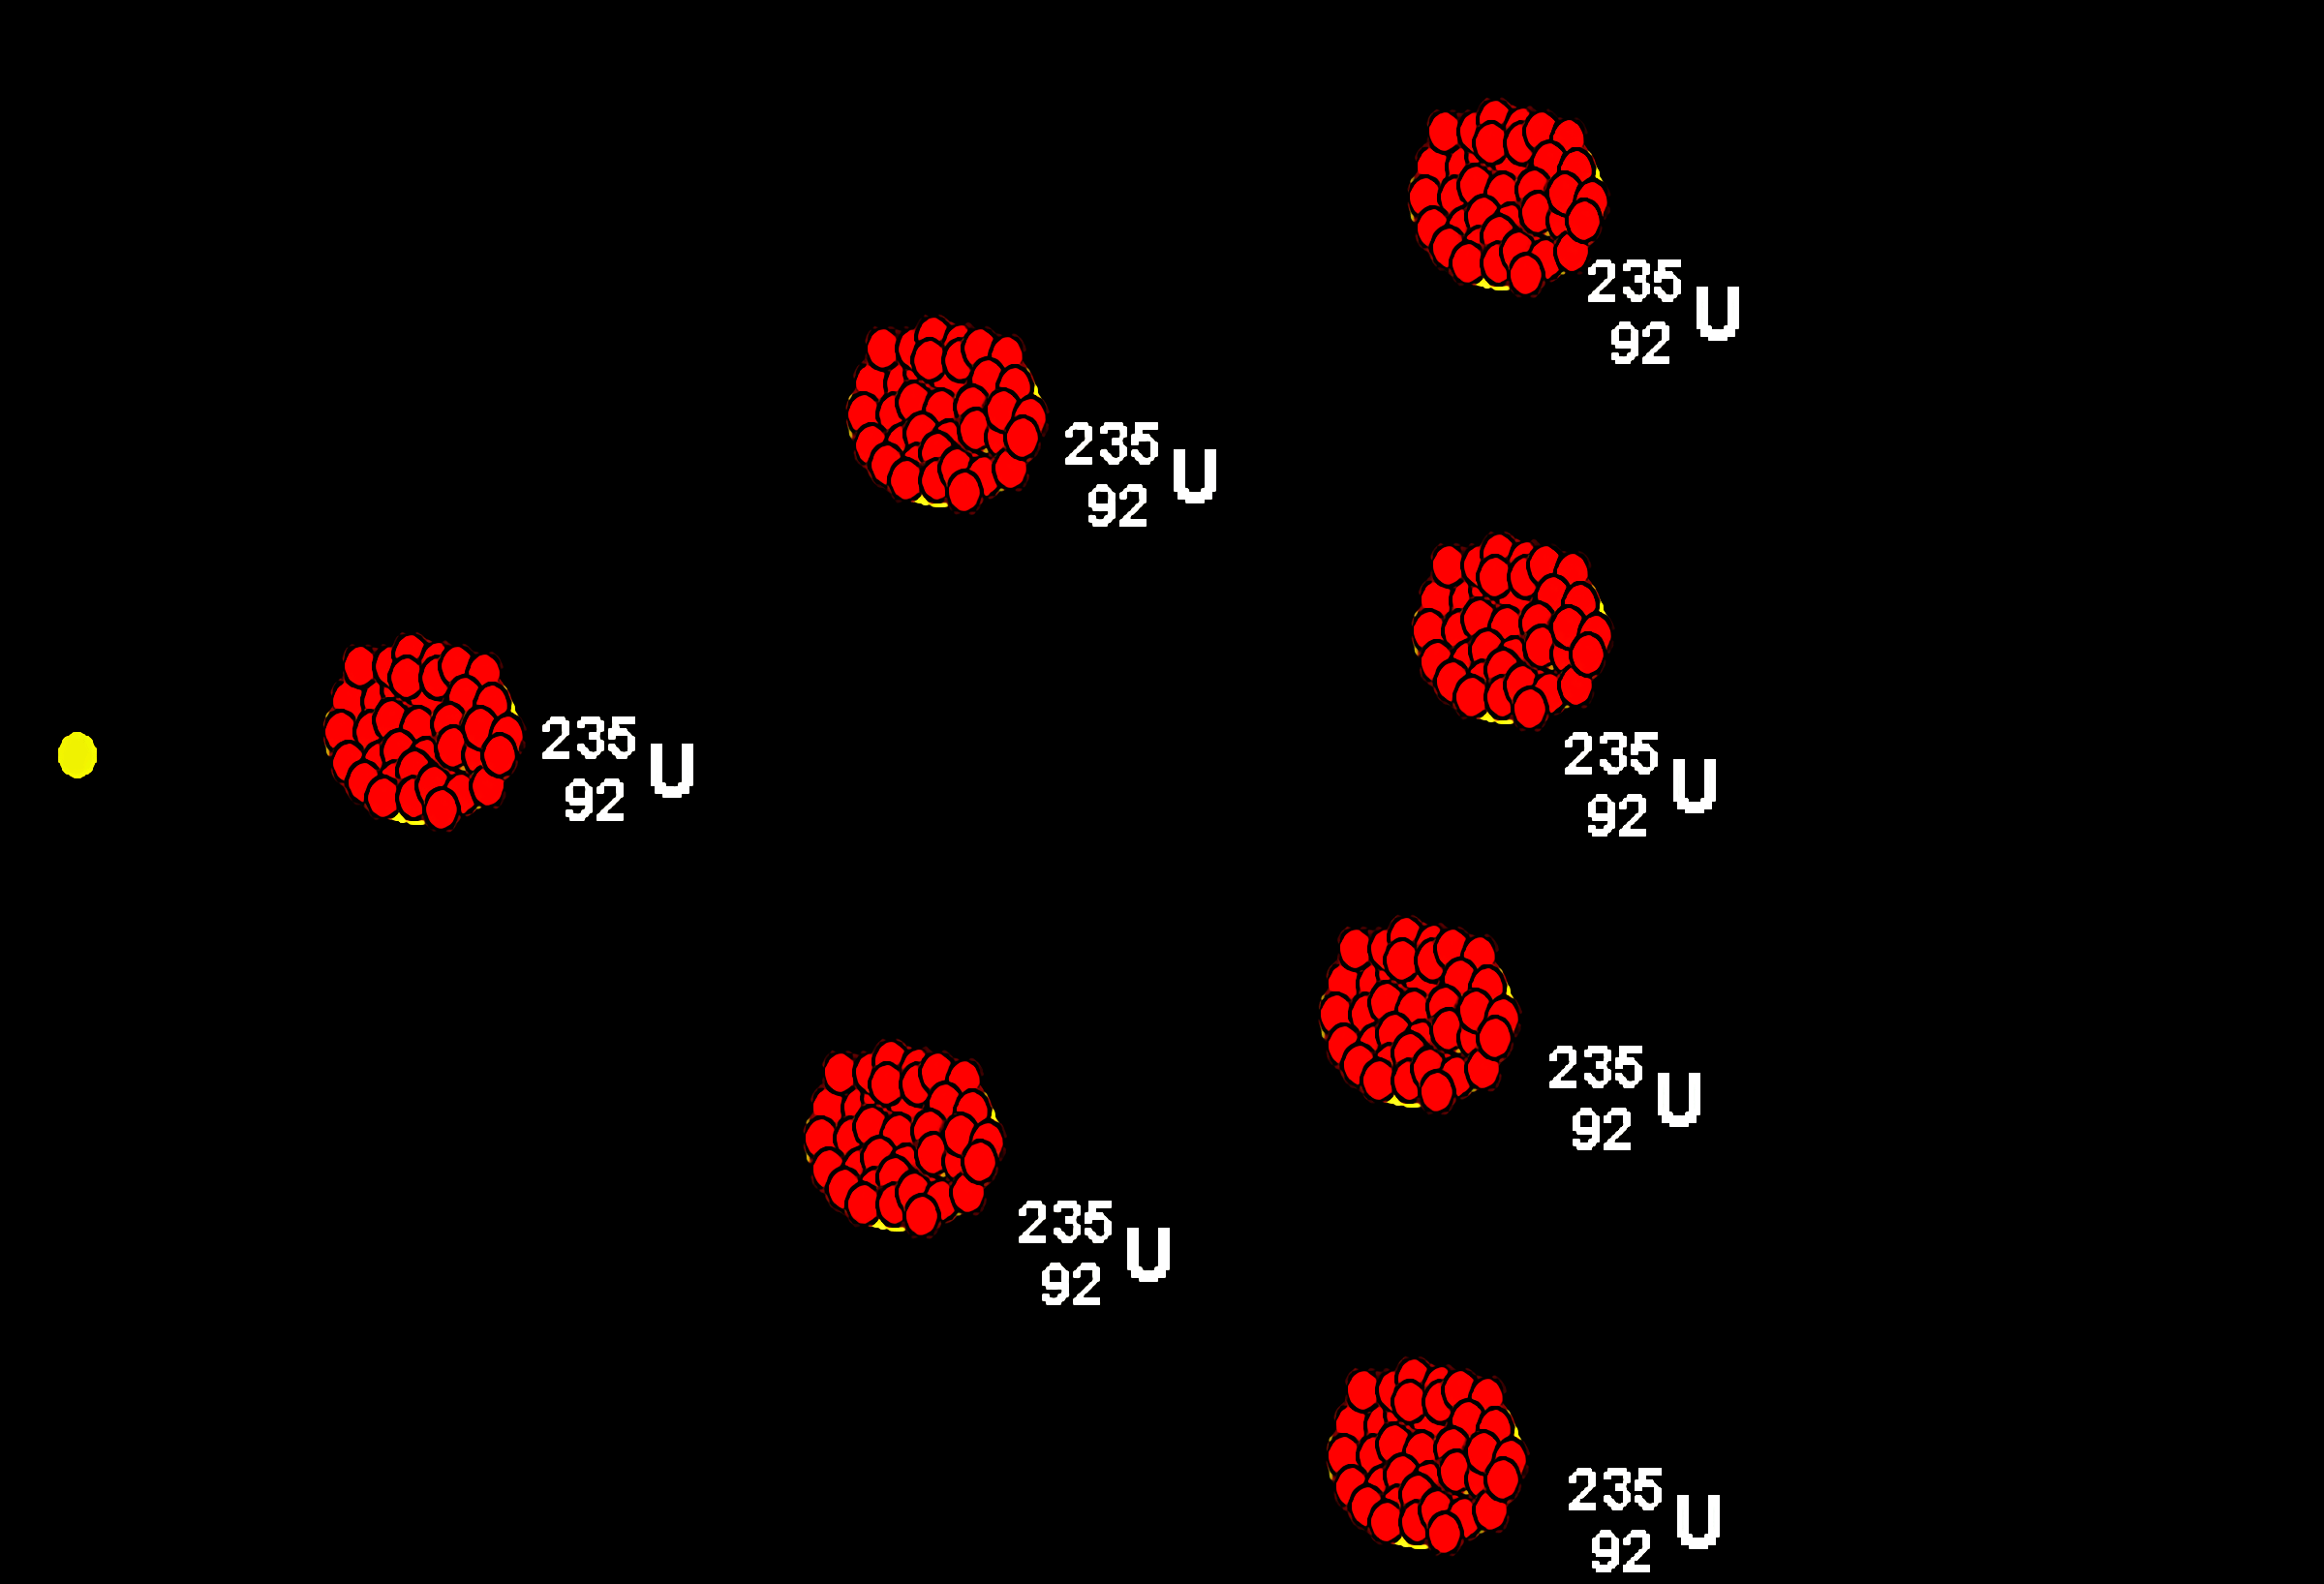
A single neutron can lead to a chain reaction involving thousands or millions of U-235 nuclei.

Slide 8
Nuclear Reactors
Specification Point 7.21
Describe the role played by the control rods and moderator in the fission process.
The energy released from fission is harnessed using nuclear reactors.
Nuclear reactors are linked to steam turbines which then generate electricity.
Nuclear reactors need to operate safely.
If the chain reaction gets out of control, a nuclear meltdown may occur.
There have been a number of well-publicised nuclear disasters, including Chernobyl in 1986 and Fukushima in 2011.
Nuclear reactors use control rods to absorb neutrons.
Control rods absorb excess neutrons to slow the rate of reaction.
Control rods are usually made of boron.
Nuclear reactors also use a moderator to slow down neutrons.
The moderator surrounds the rods made of U-235, as well as the control rods.
The moderator is also in place to slow the rate of reaction.
Moderators can be made from graphite or water.

Slide 9
CONTROL RODS
STEAM OUT
RADIATION SHIELDING
A diagram of a nuclear reactor. Fission releases heat energy, which is used to convert water into steam. This then drives a turbine and generates electricity.
GRAPHITE MODERATOR
U-235 FUEL RODS
WATER IN
COOLANT PUMP

Slide 10
Nuclear Shielding
Specification Point 7.22
Understand the role of shielding around a nuclear reactor.
Nuclear fission releases lots of ionising radiation.
Ionising radiation can be very harmful.
Nuclear reactors are highly shielded.
Shielding is designed to absorb ionising radiation.
Nuclear reactors are shielded by up to 2 metres of steel and concrete.
Shielding protects workers at the reactor, as well as the general public.
Nuclear reactors are shielded by a combination of steel and concrete.

Slide 11
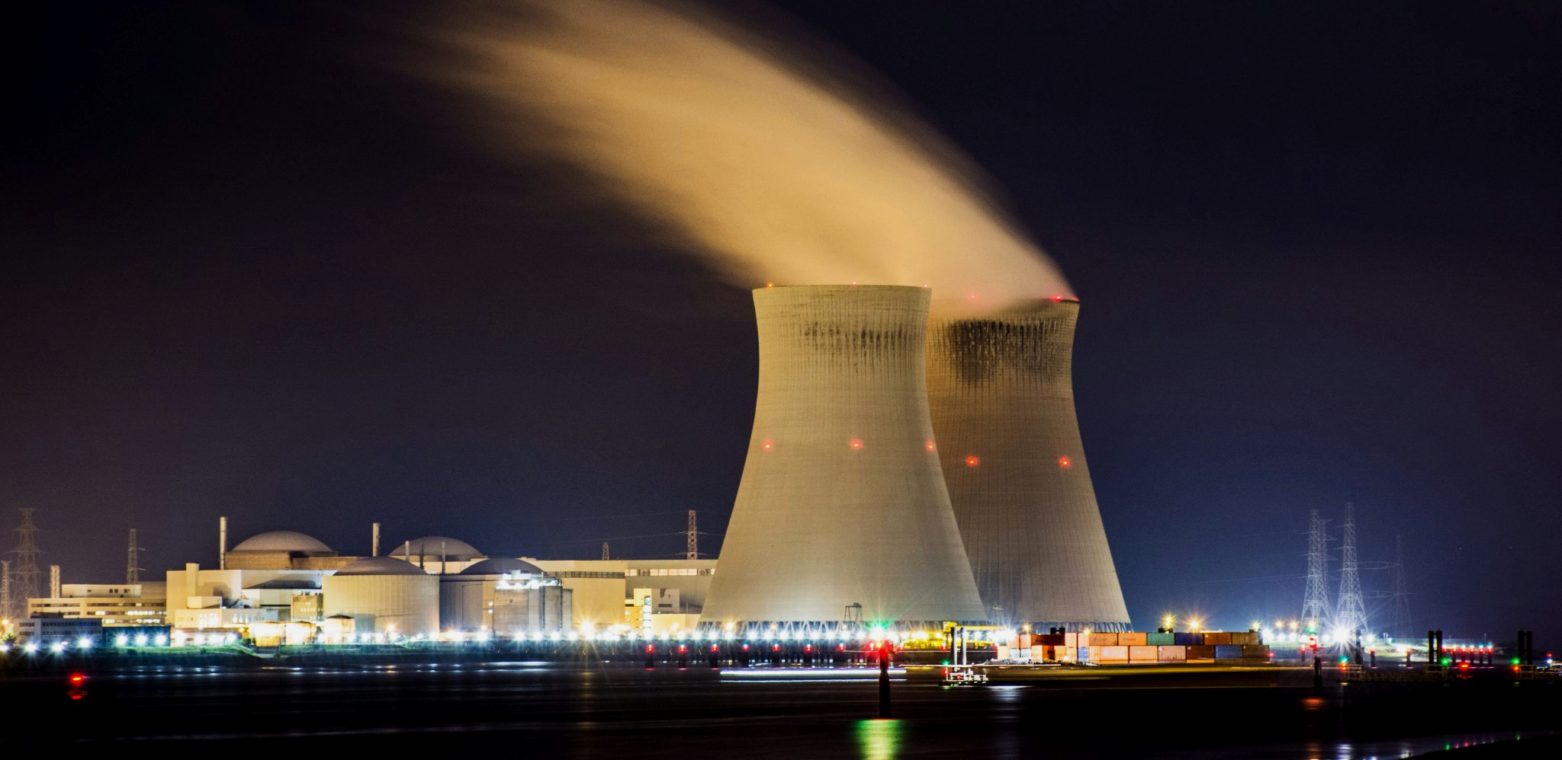
When run properly, nuclear power plants offer a steady and clean energy supply.

Slide 12
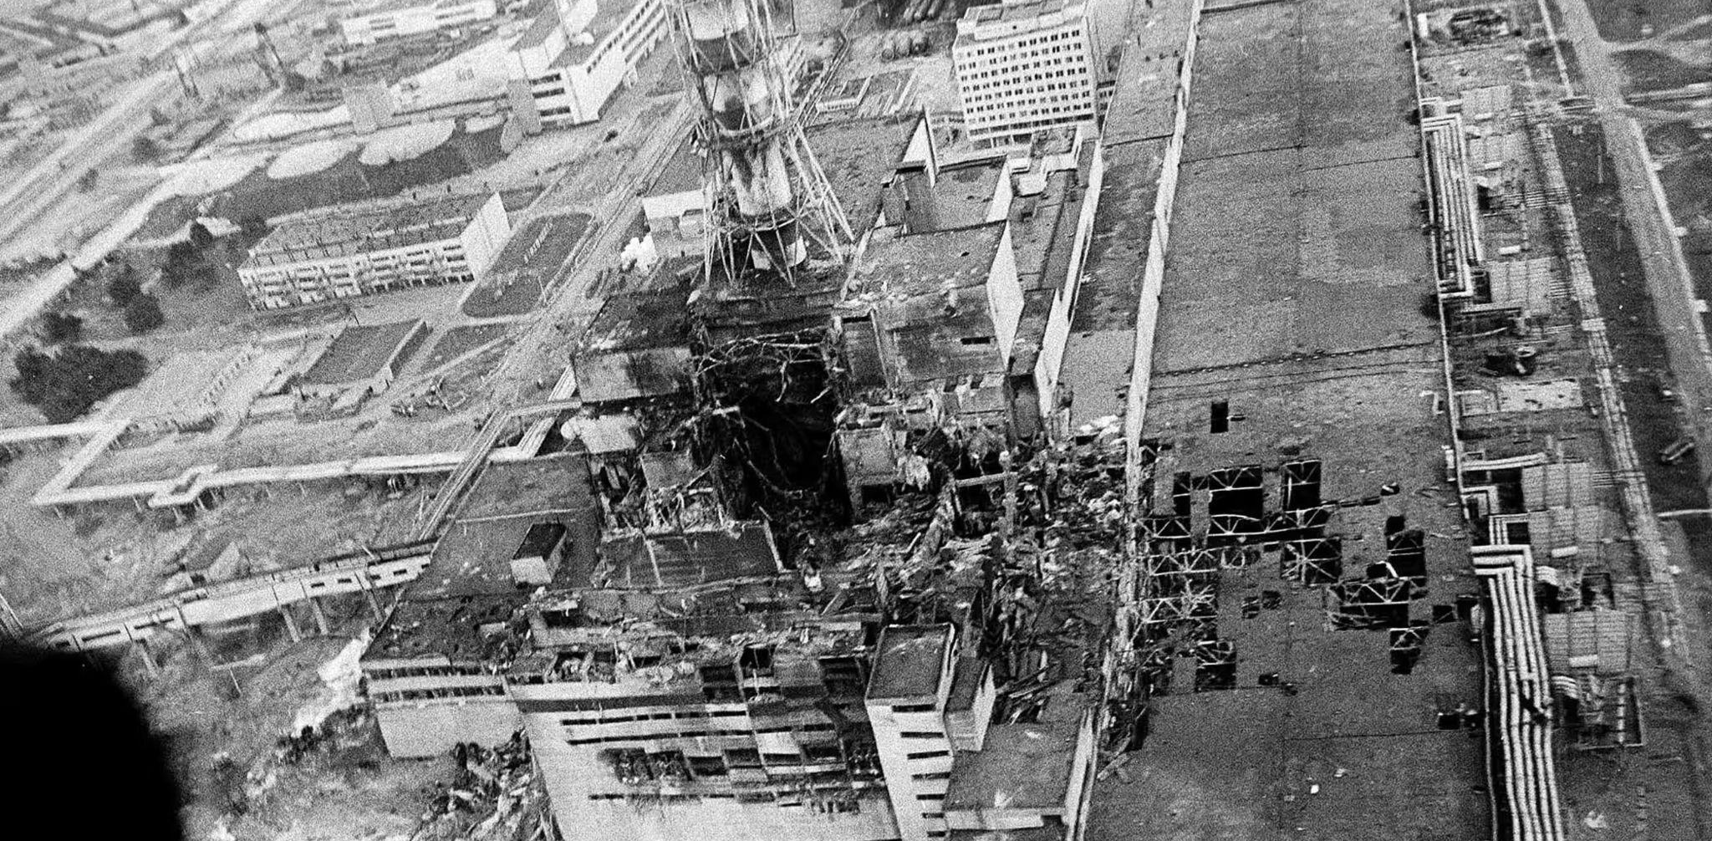
But poor management can lead to serious incidents, like the Chernobyl disaster in 1986.

Slide 13
Nuclear Fusion
Specification Point 7.24
Describe nuclear fusion as the creation of larger nuclei resulting in a loss of mass from smaller nuclei, accompanied by a release of energy.
Nuclear fusion is the opposite of nuclear fission.
Nuclear fusion occurs when two light nuclei join together to form a heavier nucleus.
In order to fuse, nuclei have to collide at high speed.
When nuclei fuse, lots of energy is released.
²H
³He
+ ENERGY
In this example, two isotopes of hydrogen nuclei fuse together to produce a helium nuclei.
¹H

Slide 14
Fusion in Stars
Specification Points 7.25 and 7.26
Know that fusion is the energy source for stars.
Explain why nuclear fusion does not happen at low temperatures and pressures, due to electrostatic repulsion of protons.
The energy from stars is due to fusion.
Most stars are made from hydrogen (H₂) gas.
Isotopes of hydrogen can fuse to create helium (He) nuclei.
Huge amounts of energy is released during this reaction.
Fusion only occurs at very high temperatures and pressures.
Fusion only occurs in excess of 10,000,000 °C.
This is because fusion has to overcome electrostatic repulsion.
All nuclei are positively charged so will naturally repel each other.
Nuclei have to be moving very quickly and be close to each other to fuse.
Fusion occurs at extreme temperatures and pressures. These conditions are found in stars.

Slide 15
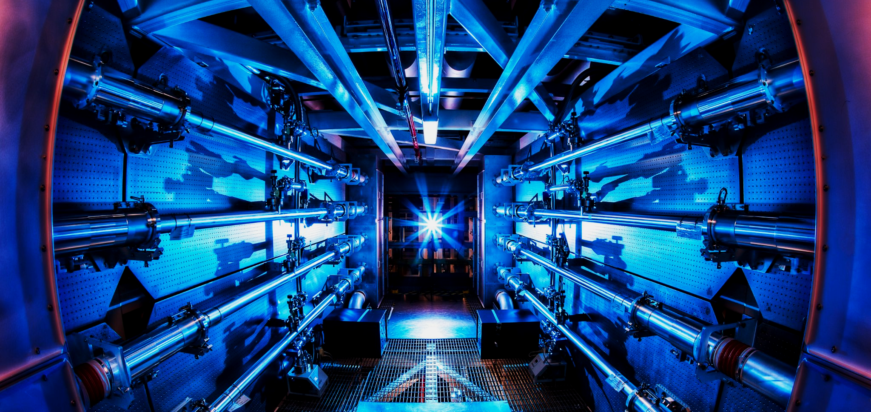
Much research has been conducted into creating fusion reactors that operate at lower temperatures - dubbed cold fusion. A breakthrough in cold fusion could lead to a new cheap and reliable source of energy.

