Slide 1
Edexcel IGCSE Physics
2 - Acceleration
Changes in Velocity

Slide 2
Acceleration
Specification Point 1.6
  Know and use the relationship between acceleration, change in velocity and time taken.
Acceleration measures how quickly velocity changes.
  Acceleration measures the rate of change of velocity per second.
  Velocity can be measured as a change in speed or a change in direction.
Acceleration is measured in m/s².
The following equation can be used to calculate the average acceleration of an object:
a = acceleration (m/s²)
Δv = change in velocity (m/s)
t = time taken (s)

Slide 3

As a ball is dropped, its velocity changes.
The change in velocity (Δv) was 2 m/s.
The time it took for the ball to fall to the ground (t) was 4 seconds.
2 ÷ 4 = 0.5 m/s²

Slide 4
Initial and Final Velocity
The change in velocity of an object can be defined as the difference between the initial velocity and the final velocity.
  Initial velocity is usually represented by the letter u.
  Final velocity is usually represented by the letter v.
The relationship between acceleration, change in velocity and time can be summarised using a formula triangle.
CHANGE IN VELOCITY
Δv = change in velocity
v = final velocity
u = initial velocity
ACCELERATION
TIME
Using a formula triangle, acceleration can be calculated as change in velocity ÷ time.

Slide 5

Acceleration and Deceleration
An object that is speeding up is said to be accelerating.
  It is sometimes said that the object has positive acceleration.
An object that is slowing down is said to be decelerating.
  It is sometimes said that the object has negative acceleration.
From launch, this rocket reaches a top speed of 8000 m/s in 2000 seconds. Calculate the acceleration.
1. As the rocket is stationary on the launchpad, its initial velocity (u) is 0 m/s.
2. The rocket’s final velocity (v) is 8000 m/s.
3. The change in velocity (Δv) is also 8000 m/s.
4. 8000 ÷ 2000 = +4 m/s²

Slide 6

The motorcycle rider is riding at a constant speed of 20 m/s.
It then takes her 2 seconds to accelerate to 25 m/s.
Δv = 5 m/s.
5 ÷ 2 = +2.5 m/s²
Wary of her speed, she then decelerates back to 20 m/s.
It takes her 1 second to do this.
Δv = -5 m/s.
-5 ÷ 1 = -5 m/s²

Slide 7
Velocity-Time Graphs
Specification Points 1.7, 1.8 and 1.9
  Plot and explain velocity-time graphs.
  Determine acceleration from the gradient of a velocity−time graph.
  Determine the distance travelled from the area between a velocity-time graph and the time axis.
Velocity-time graphs show how an object’s velocity changes over time.
Any line with a positive gradient indicates acceleration.
Any line with a negative gradient indicates deceleration.
Flat sections of the the graph represent objects with a constant speed.
The area under the graph is equal to the distance travelled.
OBJECT C IS AT A STEADY SPEED
VELOCITY
OBJECT A IS ACCELERATING
OBJECT B IS DECELERATING
TIME

Slide 8
300
Acceleration can be calculated using the gradient of the line.
Gradient can be calculated as Δy ÷ Δx.
For the period of acceleration:
250 ÷ 30 = 8.33 m/s²
For the period of deceleration:
-250 ÷ 60 = -4.17 m/s²
250
CONSTANT SPEED
200
VELOCITY (m/s)
ACCELERATION
DISTANCE TRAVELLED BETWEEN 80-120 SECONDS = 40 × 250 = 10,000 m
DECELERATION
150
100
50
STATIONARY
0
20
40
60
80
100
120
140
160
180
TIME (s)

Slide 9
Uniform Acceleration
Specification Point 1.10
  Use the relationship between final speed, initial speed, acceleration and distance moved.
When an object is accelerating or decelerating steadily, it is an example of uniform acceleration.
  The following equation can be used to calculate the uniform acceleration of an object:
v = final speed (m/s²)
u = initial speed (m/s)
a = acceleration (m/s²)
s = distance moved (m)

Slide 10
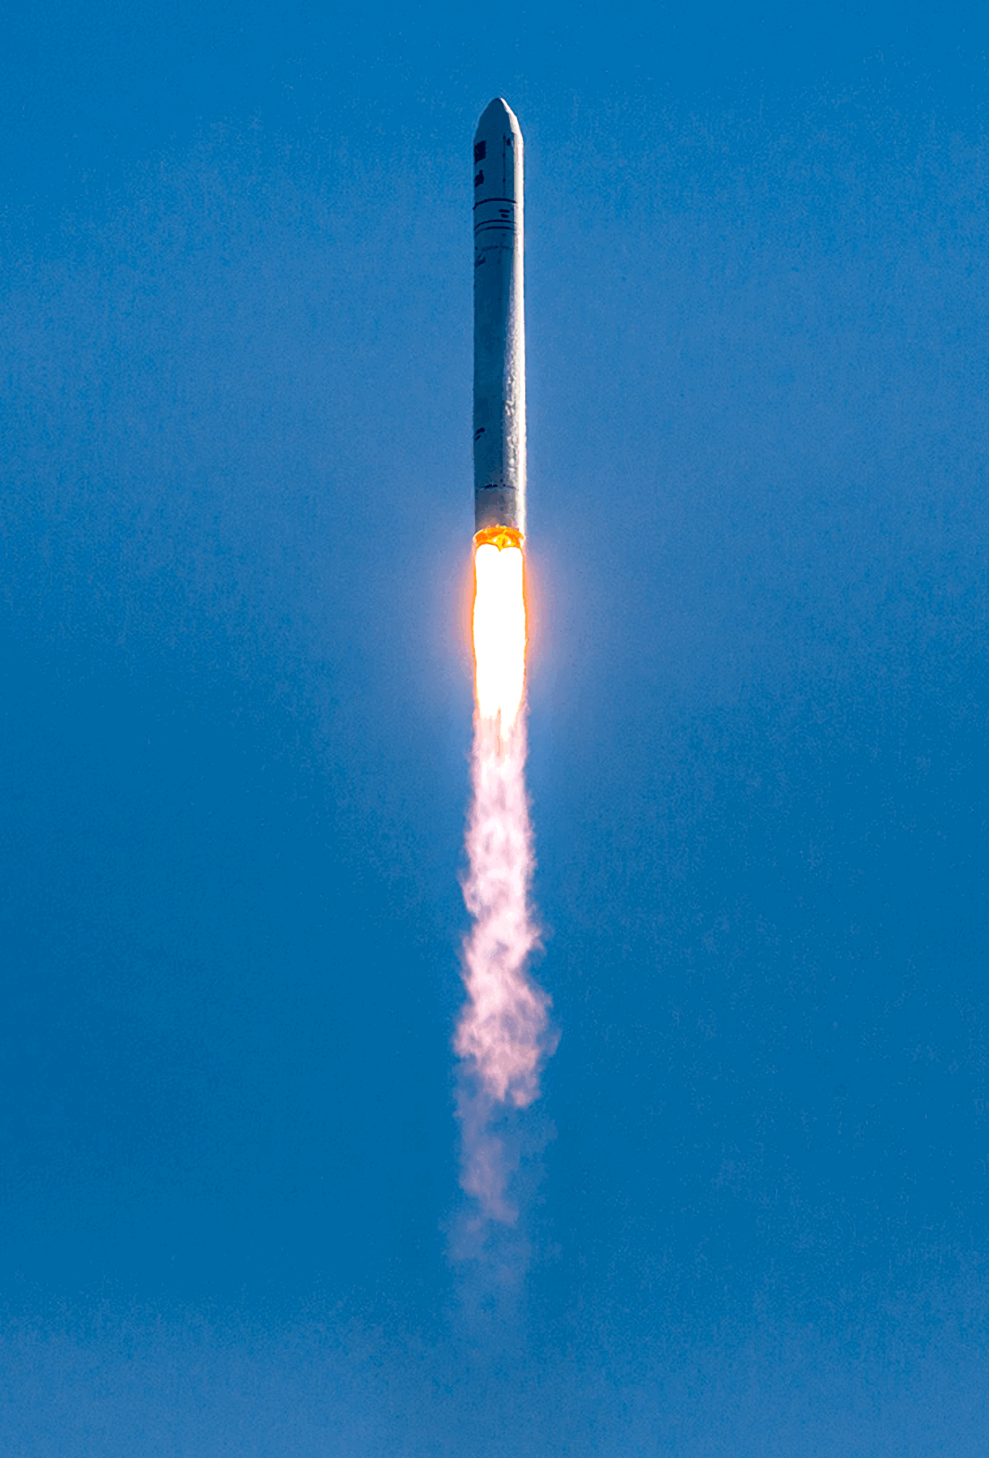
v = final speed (m/s²)
u = initial speed (m/s)
a = acceleration (m/s²)
s = distance moved (m)
This rocket begins to accelerate steadily at 5 m/s².
Assuming the rocket is travelling at 1000 m/s, what speed will it be travelling at when it leaves the Earth in 15,000 metres time?
v² = (1000)² + (2 × 5 × 15,000) = 1,150,000
√1,150,000 = 1072 m/s

