Slide 1
Edexcel IGCSE Physics
29 - Radioactivity Part 2
Half-Lives, Uses and Dangers
For more help, please visit www.exampaperspractice.co.uk
© 2025 Exams Papers Practice. All Rights Reserved

Slide 2
Background Radiation
Specification Point 7.10
Explain the sources of background radiation from Earth and space.
All individuals are exposed to a low-level of daily radiation.
This exposure comes from a combination of natural and artificial sources.
This form of radiation is referred to as background radiation.
Background radiation comes from a variety of sources:
Radiation from materials on Earth - mostly radon gas.
Cosmic rays from space.
Living organisms.
Radiation due to human activity - such as the construction and use of nuclear power stations.
OTHER SOURCES
MEDICAL SOURCES
RADON GAS
COSMIC RAYS
GROUND AND BUILDINGS
FOOD, WATER
There are many different sources of background radiation.
For more help, please visit www.exampaperspractice.co.uk
© 2025 Exams Papers Practice. All Rights Reserved

Slide 3
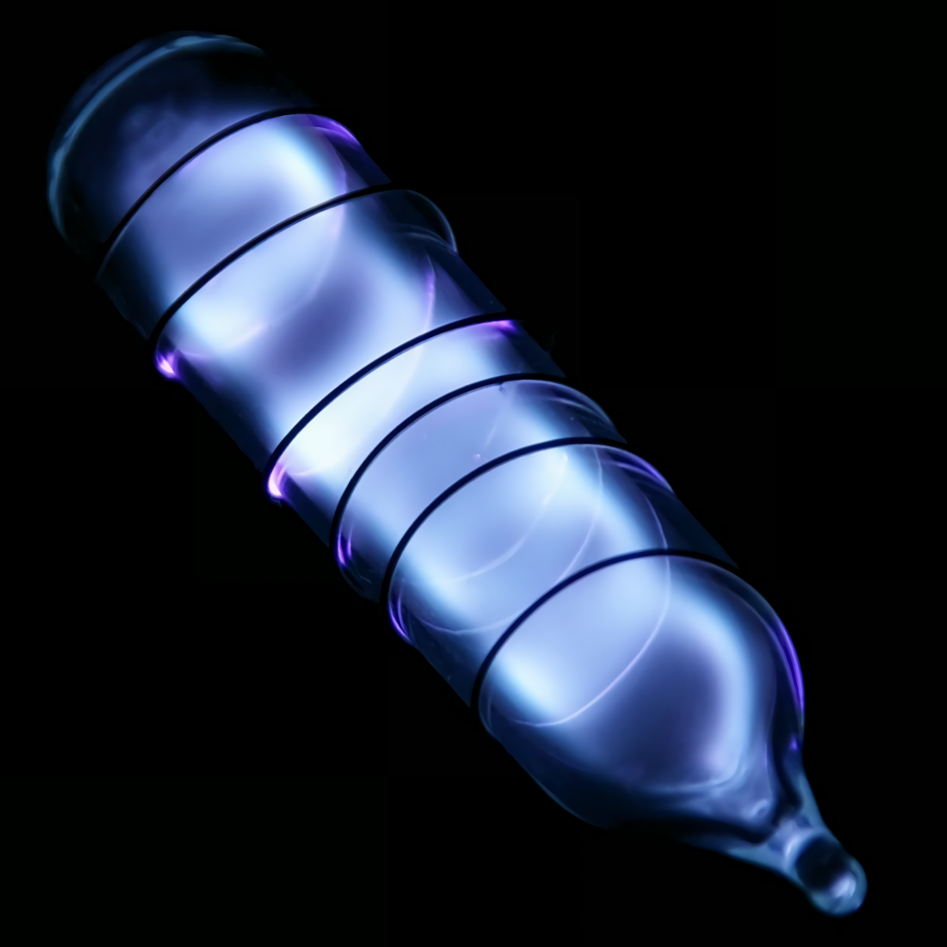
Radon (Rn) gas is the largest worldwide producer of background radiation. Radon is formed from the radioactive decay of uranium (U) in rocks.
For more help, please visit www.exampaperspractice.co.uk
© 2025 Exams Papers Practice. All Rights Reserved

Slide 4
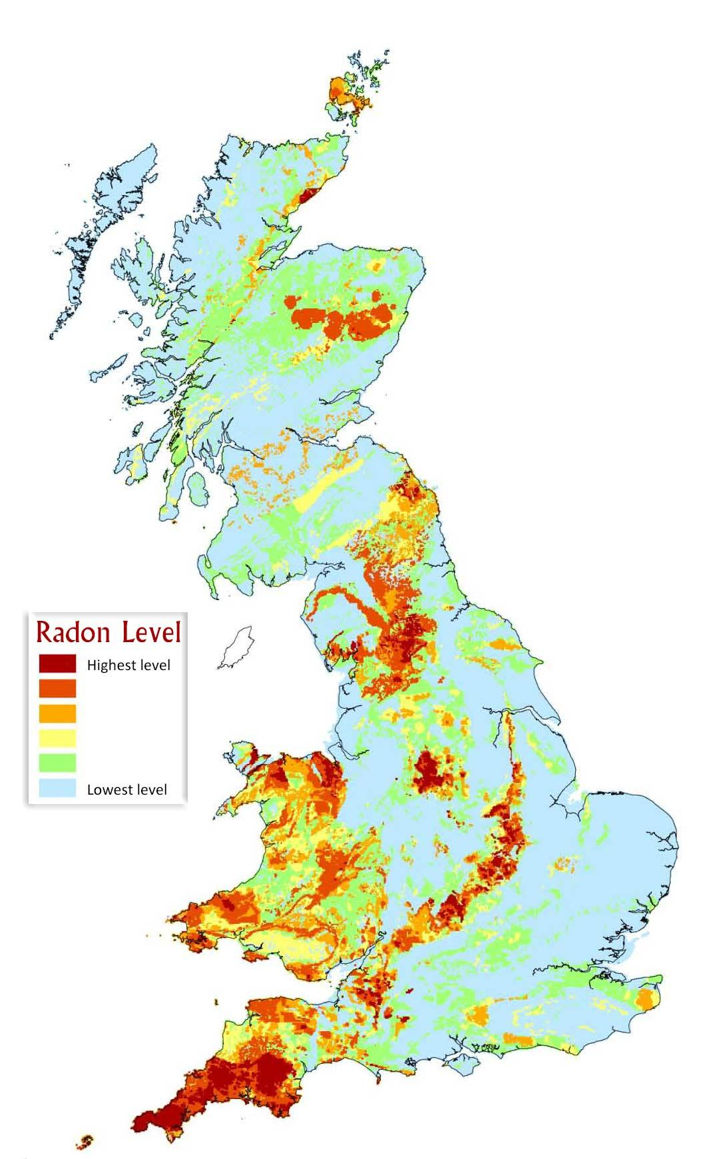
Depending on the location, there can be large variation in the amount of background radon radiation.
For more help, please visit www.exampaperspractice.co.uk
© 2025 Exams Papers Practice. All Rights Reserved

Slide 5
Activity of a Radioactive Source
Specification Point 7.11
Know that the activity of a radioactive source decreases over a period of time and is measured in becquerels.
The rate at which radioactive nuclei decay is referred to as their activity.
Activity is measured in becquerels (Bq).
A single becquerel is equivalent to a single nucleus decaying per second.
Over time the activity of a radioactive source will decrease.
This is because the unstable nuclei disappear as they are emitted.
Activity is measured using a Geiger-Muller counter.
As time increases, the activity of a radioactive source decreases. This is because the unstable nuclei disappear as they are emitted.
ACTIVITY →
TIME →
For more help, please visit www.exampaperspractice.co.uk
© 2025 Exams Papers Practice. All Rights Reserved

Slide 6
Half-Lives
Specification Points 7.12 and 7.13
Know the definition of the term half-life and understand that it is different for different radioactive isotopes.
Use the concept of the half-life to carry out simple calculations on activity, including graphical methods.
Some radioactive nuclei decay very quickly.
Copernicium-285 has a half life of 28 seconds.
Other radioactive nuclei decay much more slowly.
Uranium-235 has a half life of 700 million years.
The activity of a radioactive isotope will never reach zero.
The rate at which the activity of a sample decreases is referred as its half-life.
Half-life can be defined as the time it takes for half of the radioactive atoms present in a sample to decay.
The half-life of a sample will remain constant.
For more help, please visit www.exampaperspractice.co.uk
© 2025 Exams Papers Practice. All Rights Reserved

Slide 7
1
The half-life of americium-245 is around 2 hours. The half-life of a radioactive compound can be determined using a graph by finding the time it takes for the radioactivity to halve. The half-life will remain constant.
RADIOACTIVITY (Bq)
½
¼
2
4
6
8
10
12
14
16
18
20
TIME (HOURS)
For more help, please visit www.exampaperspractice.co.uk
© 2025 Exams Papers Practice. All Rights Reserved

Slide 8
Uses of Radiation - Medicine
Specification Point 7.14
Describe uses of radioactivity in industry and medicine.
Radiation has a number of useful applications.
Radioactivity is used in a number of medical procedures:
Application | Explanation
Medical tracers. | Radioactive isotopes are injected into or swallowed by patients. As the tracer moves through the body, it is detected by an external device. Doctors can use these to detect cancers.
Treating cancers. | Radiation can target and destroy cancerous cells. A beam of gamma rays are directed at tumours.
Sterilizing food and equipment. | Food can be irradiated using gamma radiation. This will kill any potentially harmful microorganisms.
For more help, please visit www.exampaperspractice.co.uk
© 2025 Exams Papers Practice. All Rights Reserved

Slide 9
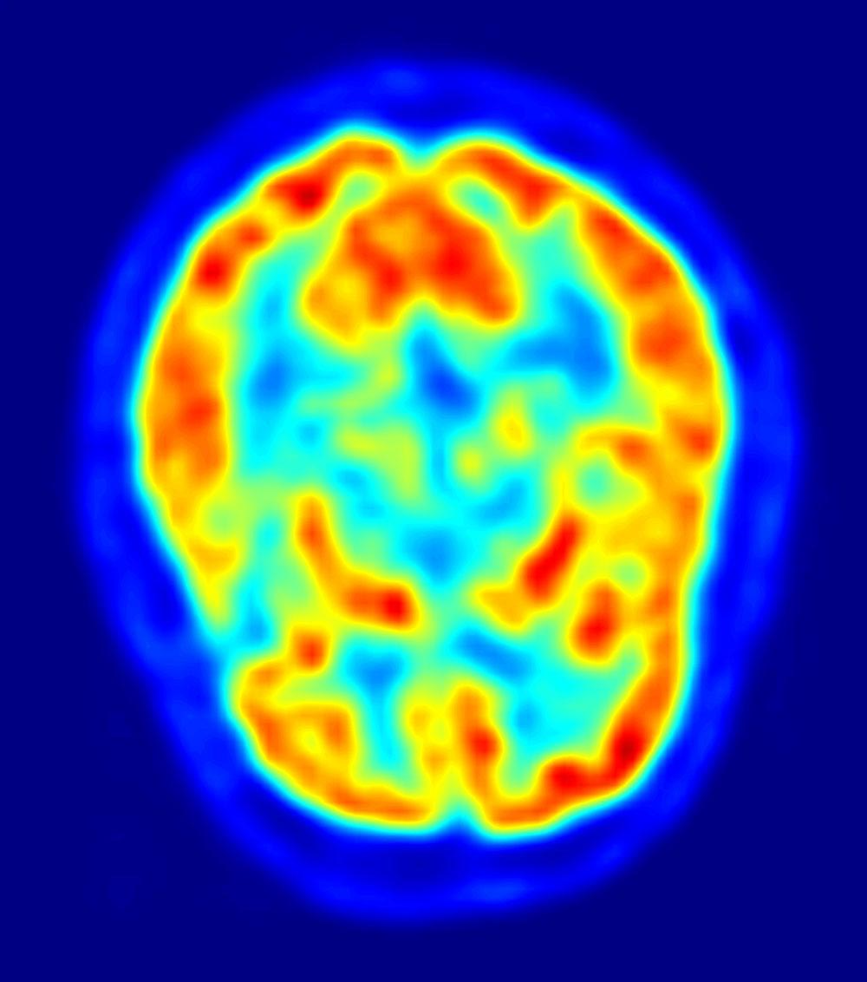
Radioactive tracers are often injected into patients to reveal medical conditions, such as cancers. These tracers have a short half-life, so the radiation in the patient will disappear quickly. This example uses radioactive isotopes to map the brain.
For more help, please visit www.exampaperspractice.co.uk
© 2025 Exams Papers Practice. All Rights Reserved

Slide 10
The Radura is the international symbol to indicate that food has been irradiated with ionizing radiation and is thus safe to eat.
For more help, please visit www.exampaperspractice.co.uk
© 2025 Exams Papers Practice. All Rights Reserved

Slide 11
Uses of Radiation - Industry
Radiation is also used in industry.
Radiation is used to determine the thickness of materials.
Beta radiation can penetrate thin materials, such as aluminium.
The amount of radiation that penetrates the material can be recorded using a detector.
If the material gets thinner, more particles will penetrate the material and be detected.
If the material gets thicker, fewer particles will penetrate the material and be detected.
This allows a machine to regulate the thickness of a material.
Radiation is also used in smoke detectors.
Alpha radiation will ionise air within a smoke detector.
This creates an electrical current.
When smoke enters the detector, the current is blocked.
This triggers an alarm.
Radioactive isotopes are used in smoke detectors. When smoke enters the detector, current is inhibited, triggering an alarm.
For more help, please visit www.exampaperspractice.co.uk
© 2025 Exams Papers Practice. All Rights Reserved

Slide 12
SOURCE OF RADIATION
ROLLER
Industrial rollers use beta radiation to determine the thickness of materials, such as aluminium.
SHEET OF ALUMINIUM
DETECTOR
CONTROL UNIT
For more help, please visit www.exampaperspractice.co.uk
© 2025 Exams Papers Practice. All Rights Reserved

Slide 13
Contamination and Irradiation
Specification Point 7.15
Describe the difference between contamination and irradiation.
Sometimes, a radioactive particle can settle on other objects or materials.
This is called contamination.
Contaminating particles may then radioactively decay, causing harm.
Contamination is usually accidental.
When an object or person is exposed to radiation, they are said to have been irradiated.
Irradiation does not make that object or individual radioactive.
It can cause damage to cells and tissues.
RADIOACTIVE CLOUD
NORMAL CLOUD
It is possible for radioactive particles to contaminate other objects when they come into contact with each other.
For more help, please visit www.exampaperspractice.co.uk
© 2025 Exams Papers Practice. All Rights Reserved

Slide 14
Protecting Against Contamination and Irradiation
Contamination and irradiation can be extremely hazardous.
To protect against contamination:
When handling sources of radioactivity, use gloves and tongs.
If near industrial sources of radiation, many workers will wear protective suits and masks.
To protect against irradiation:
When not using sources of radiation, keep in lead-lined boxes.
Exposure can also be minimised by using physical barriers or operating sources remotely.
Workers who are regularly exposed to radiation are likely to wear protective hazmat suits and respirators.
For more help, please visit www.exampaperspractice.co.uk
© 2025 Exams Papers Practice. All Rights Reserved

Slide 15
Dangers of Radiation
Specification Point 7.16
Describe the dangers of ionising radiations and how to dispose of radioactive waste.
Ionising radiation can directly damage cells and tissues.
If a radioactive particle or wave infiltrates the body, it will collide with molecules inside cells.
Collisions result in ionisation, damaging or destroying these molecules.
Lower doses of radiation may lead to cancers.
Lower doses of ionising radiation causes DNA to mutate.
When cells replicate, cancerous tumours may form.
Higher doses of radiation may be lethal.
High doses of ionising radiation kill cells.
This may lead to widespread radiation sickness and death.
Ionising radiation can cause DNA to break. Errors in its reformation can lead to mutations.
For more help, please visit www.exampaperspractice.co.uk
© 2025 Exams Papers Practice. All Rights Reserved

Slide 17
Radioactive Waste
Some medical fields and industries lead to the production of radioactive waste.
Most radioactive waste comes from nuclear power stations.
Some radioactive waste comes from discarded medical materials.
Radioactive waste can remain hazardous for thousands of years.
Many of the radioactive isotopes used have long half-lives.
These isotopes will continue to be radioactive for a long period of time.
Radioactive waste is usually buried in landfill.
High-level waste is often sealed in glass blocks or lead-lined canisters first.
The waste is then buried deep underground.
There are challenges when burying radioactive waste.
It is often difficult to find suitable locations to bury the waste.
If the container holding the waste were to be compromised, the waste may contaminate surrounding land and groundwater.
For more help, please visit www.exampaperspractice.co.uk
© 2025 Exams Papers Practice. All Rights Reserved

Slide 18
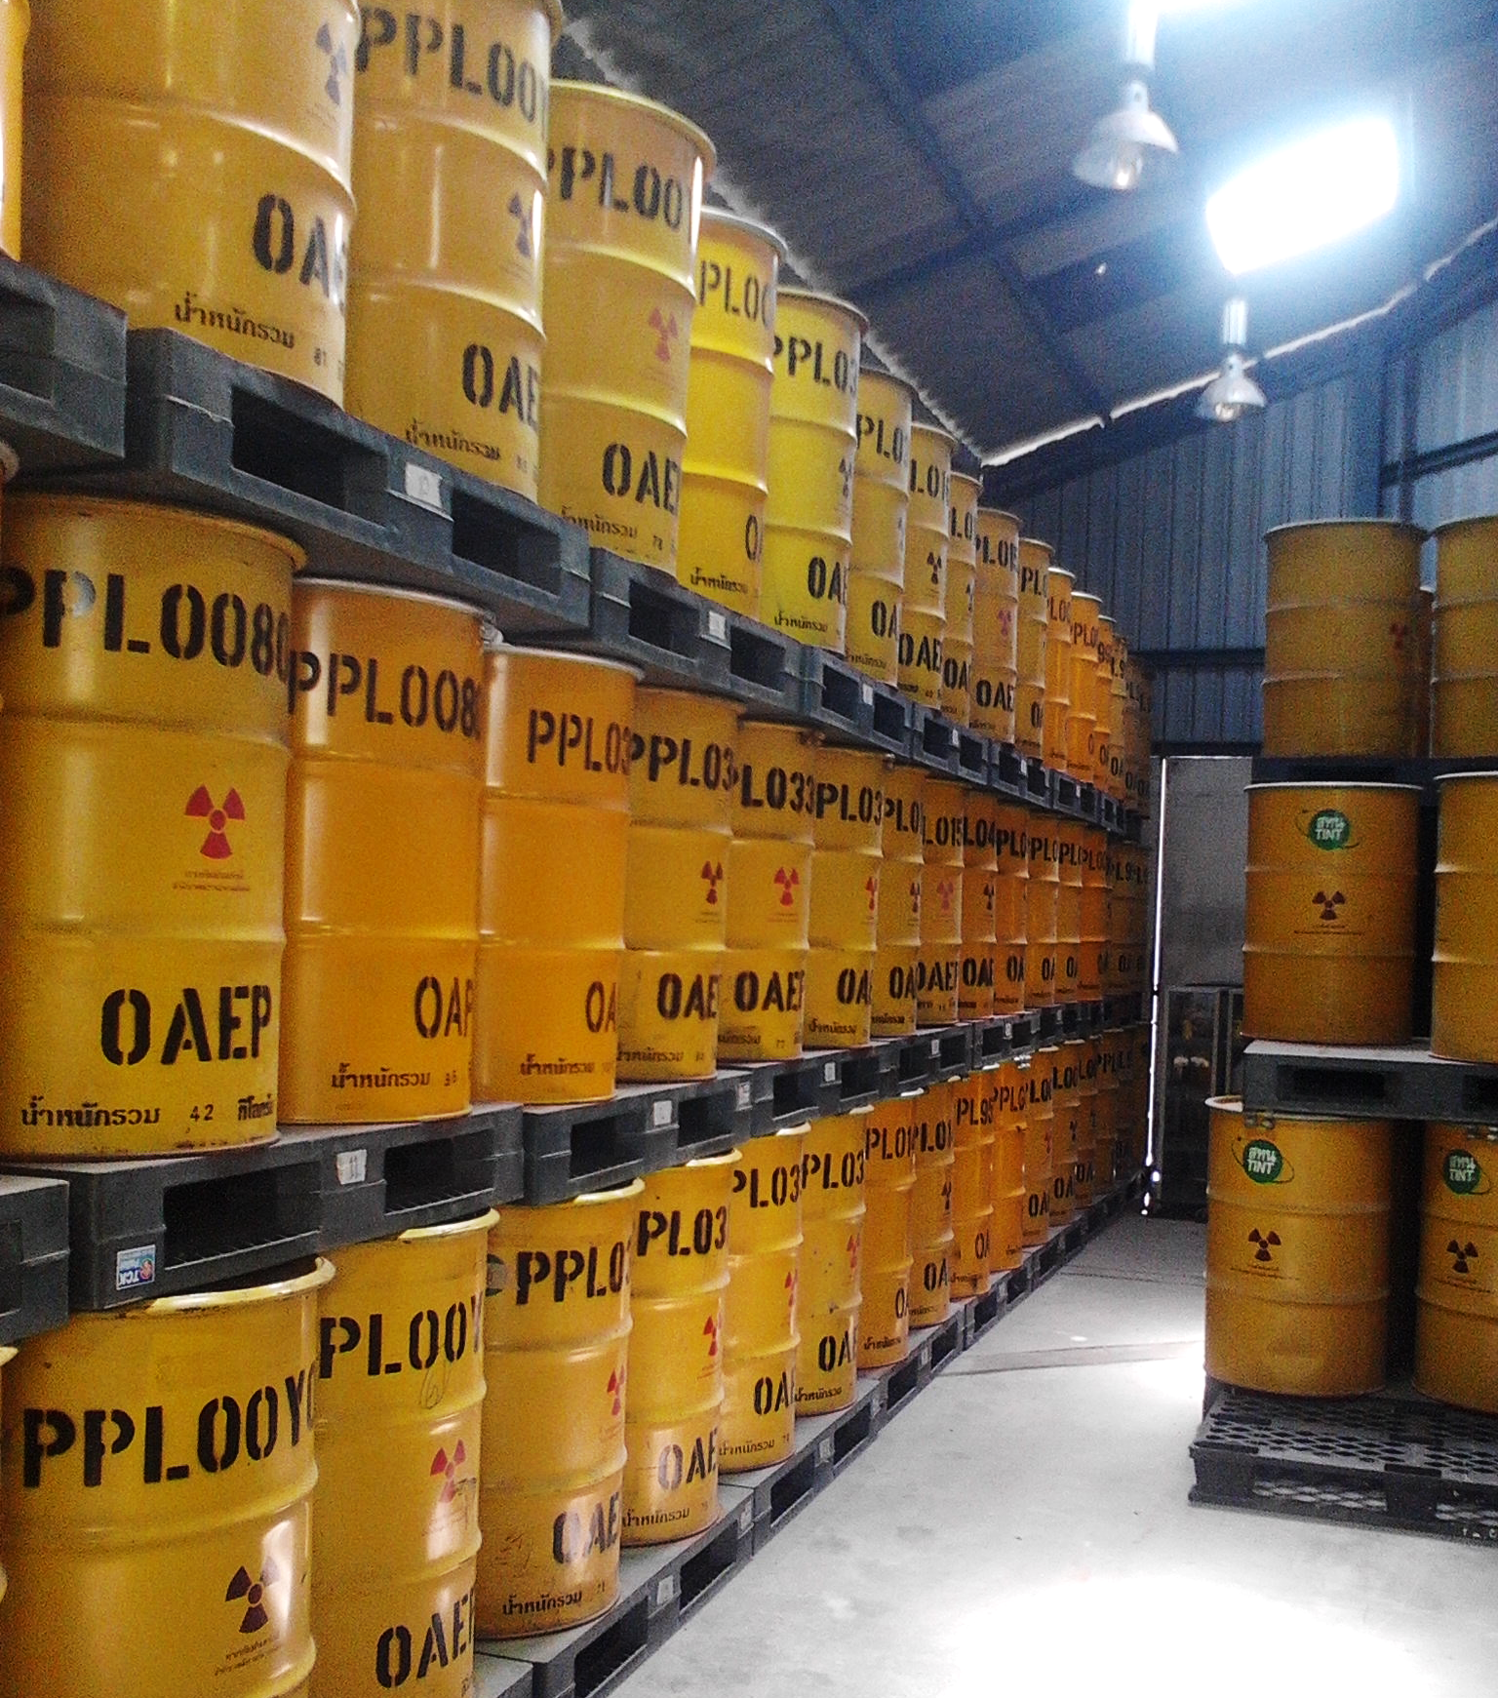
There are significant challenges surrounding the long-term storage of radioactive waste. Radioactive material often has to be stored in dense metal canisters to minimise the hazard. These canisters are then buried deep underground in specially designated landfill sites.
For more help, please visit www.exampaperspractice.co.uk
© 2025 Exams Papers Practice. All Rights Reserved

