Slide 1
Edexcel IGCSE Physics
27 - Electromagnets Part 2
Field Patterns and Transformers
Paper 2

Slide 2
Electromagnets
Specification Point 6.9P
Describe the construction of electromagnets.
When an electric current is passed through a wire, a magnetic field is created.
The strength of the magnetic field can be increased by winding the wire into a coil.
If the wire is wrapped around a soft magnetic material, an electromagnet is produced.
Using a soft magnetic material ensures that a magnetic field is only present when a current is flowing through the wire.
A core made from iron is often used as the soft magnetic material.
Electromagnets can be created by wrapping a current-carrying wire around a soft magnetic material, such as iron.

Slide 3
Magnetic Field Patterns
Specification Point 6.10P
Draw magnetic field patterns for a straight wire, a flat circular coil and a solenoid when each is carrying a current.
A magnetic field is generated when a current is passed through a straight wire.
The magnetic field is made up of concentric circles.
These circles get further apart as the distance from the magnet increases - indicating the field is becoming weaker.
A magnetic field is generated through a flat circular coil.
In the centre of the coil, the magnetic field mimics that of a bar magnet.
Around the coil, concentric ellipses are formed.
A magnetic field is generated through a solenoid.
A solenoid is a coil of wire.
Inside the solenoid, the magnetic field is strong and uniform.
Outside of the solenoid, the magnetic field mimics that of a bar magnet.

Slide 4
DIRECTION OF CURRENT
Around a straight wire the magnetic field lines consist of concentric circles with the wire in the centre.
As the distance from the wire increases, the field lines become more widely spaced.
MAGNETIC FIELD

Slide 5
Around a flat circular coil the magnetic mimic a bar magnet in the centre, becoming more elliptical around the extremities of the coil.

Slide 6
The magnetic field lines inside a solenoid are strong and uniform.
Outside of the coil the magnetic field is identical to that of a bar magnet. This means that there is a north and south pole to the solenoid.

Slide 7
Force on Charged Particles
Specification Point 6.11P
Know that there is a force on a charged particle when it moves in a magnetic field as long as its motion is not parallel to the field.
When a current-carrying wire is put between two magnetic fields, the wire will experience a force.
This is referred to as the motor effect.
This is because the magnetic field exerts a force on electrons that are travelling through the wire.
The electrons will experience maximum force if they are perpendicular to the magnetic field.
If the wire is running parallel to the magnetic field, the electrons will experience no force.
RESULTING FORCE
S
N
WIRE
An electron will experience a force when passing between two magnets.

Slide 8
Transformers
Specification Point 6.17P
Describe the structure of a transformer, and understand that a transformer changes the size of an alternating voltage by having different numbers of turns on the input and output sides.
A transformer is a device that changes the voltage of an alternating current.
All transformers have the same basic design:
A primary coil.
A secondary coil.
A core made from iron.
An alternating current is supplied to the primary coil.
Because the current is constantly changing direction, a changing magnetic field is produced.
The iron core is magnetised and demagnetised quickly.
Iron is a soft magnetic material, allowing for this capability.
This induces a voltage in the secondary coil.

Slide 9
MAGNETIC FIELD
Transformers are used to change the size of the voltage in an alternating current. When an alternating current is supplied to the primary coil, a changing magnetic field is produced. This induces a voltage in the secondary coil.
1. ALTERNATING CURRENT IS SUPPLIED TO PRIMARY COIL
2. THE CHANGING MAGNETIC FIELD IN THE IRON CORE INDUCES A VOLTAGE IN THE SECONDARY COIL

Slide 10
Step-Up and Step-Down Transformers
Specification Point 6.18P
Explain the use of step-up and step-down transformers in the large-scale generation and transmission of electrical energy.
Transformers can increase or decrease the voltage in a circuit.
The ratio between the number of turns in the primary and secondary coils is the same as the ratio between primary and secondary voltages.
Step-up transformers increase the voltage in a circuit.
Step-up transformers have more turns on the secondary coil than on the primary coil.
Step-down transformers decrease the voltage in a circuit.
Step-down transformers have more turns on the primary coil than on the secondary coil.

Slide 11
A step-up transformer. There are 9 turns on the primary coil and 18 turns on the secondary coil.
The secondary coil will therefore double the voltage as it has twice as many turns.

Slide 12
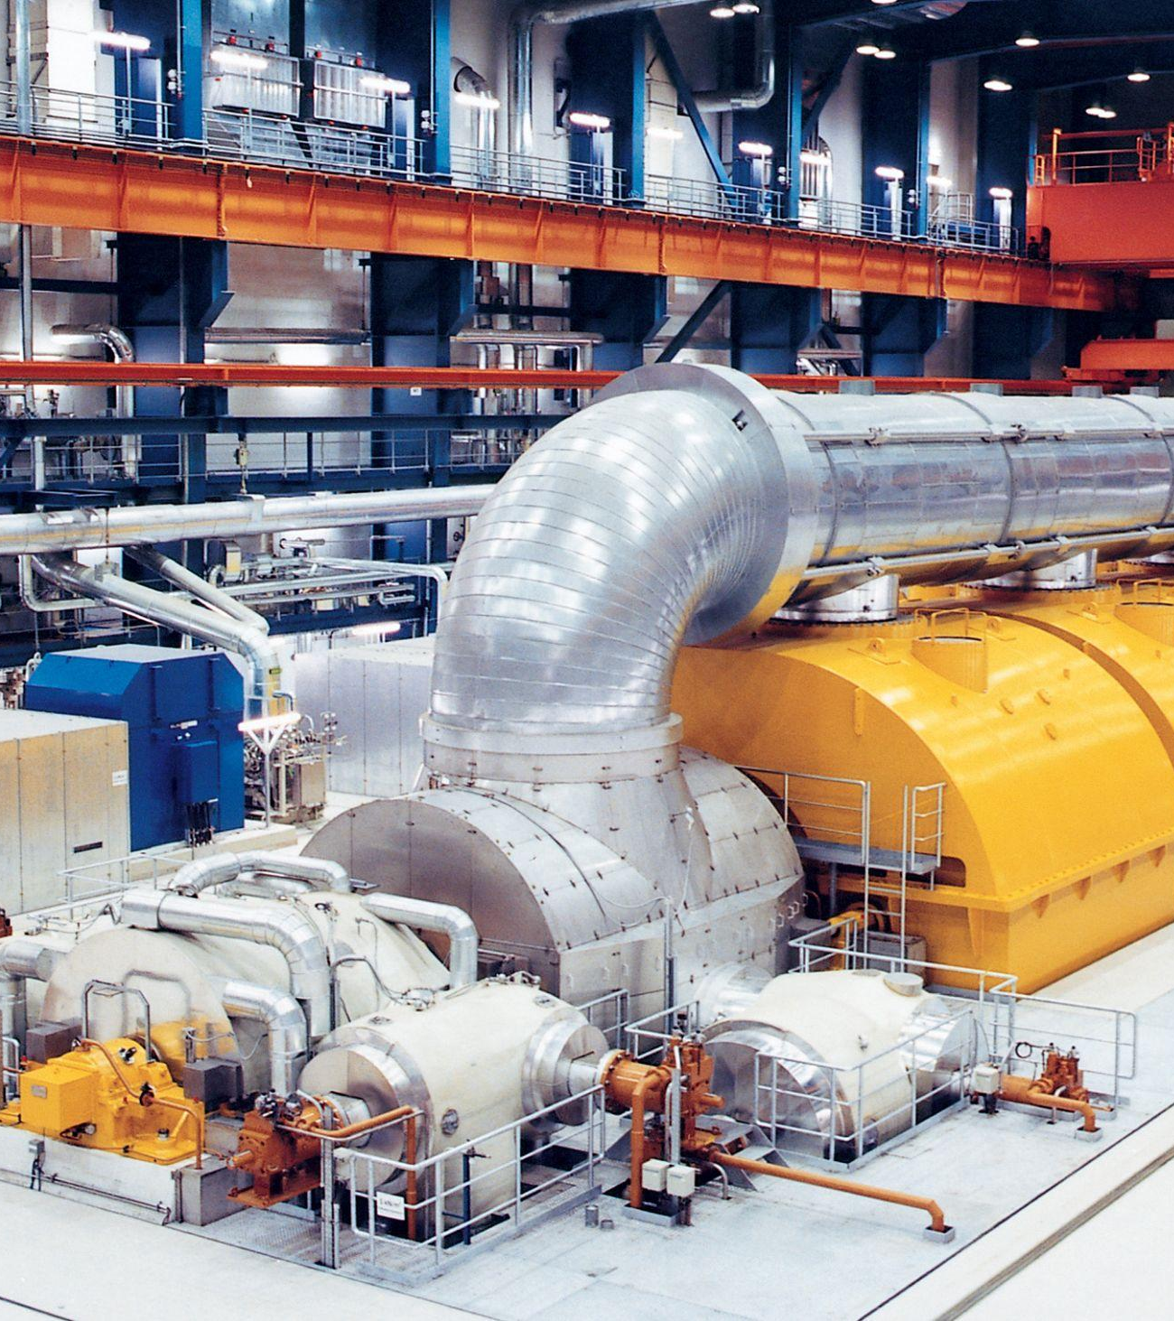
Power stations generate electricity at around 25,000 volts.This is too low for an efficient transfer of power.
Low voltages lead to high currents, which waste lots of energy as heat.
A series of step-up and step-down transformers are used to maximise the efficiency of energy transfer through a an electrical grid.

Slide 13
Step-up and step-down transformers are used in electrical grids to maximise the efficiency of energy transfer. Step-up transformers reduce the current to ensure minimal energy is wasted as heat whilst step-down transformers increase safety in domestic settings.
1. POWER STATION GENERATES ELECTRICITY AT 25,000 VOLTS
2. STEP-UP TRANSFORMER INCREASES VOLTAGE TO 400,000 VOLTS
3. FIRST STEP-DOWN TRANSFORMER REDUCES VOLTAGE TO 33,000 VOLTS
4. SECOND STEP-DOWN TRANSFORMER REDUCES VOLTAGE TO 230 VOLTS
5. ENERGY FED TO HOMES

Slide 14
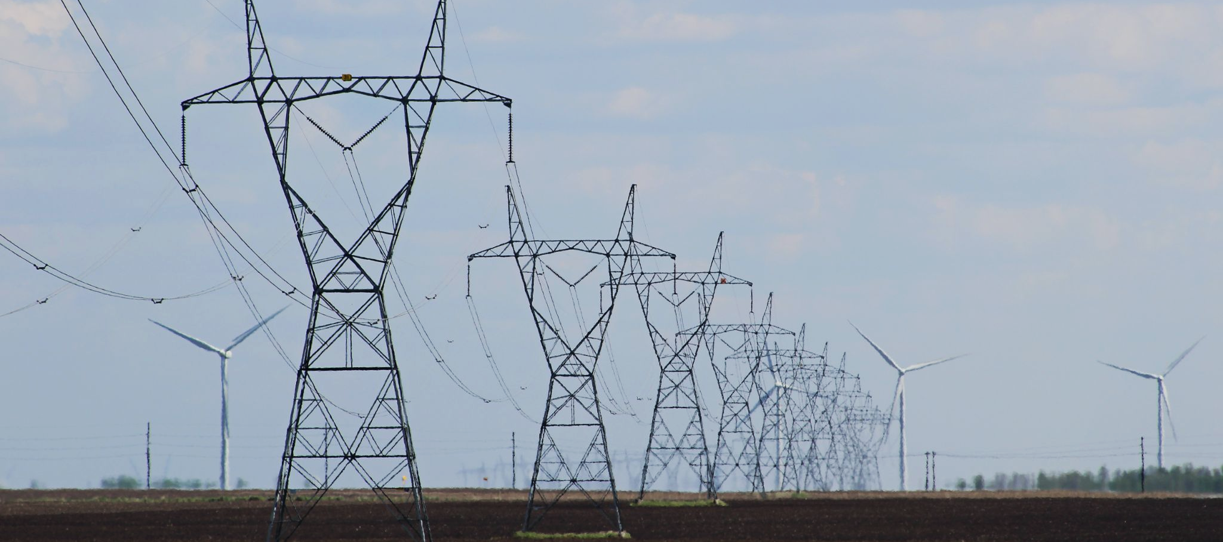
Step-up and step-down transformers are used in electrical grids to maximise the efficiency of energy transfer. Step-up transformers reduce the current to ensure minimal energy is wasted as heat whilst step-down transformers increase safety in domestic settings.

Slide 15
Input and Output Voltages
Specification Point 6.19P
Know and use the relationship between input and output voltages and the turns ratio for a transformer.
It is possible to calculate the output voltage of a transformer knowing the following:
The input voltage.
The number of turns on each coil.
V_{p} = input (primary) voltage
V_{s} = output (secondary) voltage
N_{p} = number of turns on primary coil
N_{s} = number of turns on secondary coil

Slide 16
In this step-down transformer there are 18 turns on the primary coil (N_{p}). There are 6 turns on the secondary coil (N_{s}). The voltage in the primary coil is 400 V.
Calculate the voltage in the secondary coil.
The equation can be used either way up.
V_{s} ÷ V_{p} = N_{p} ÷ N_{s}
V_{s} = (N_{s} × V_{p}) ÷ N_{p}
(6 × 400) ÷ 18 = 133 V

Slide 17
Transformer Efficiency
Specification Point 6.20P
Know and use the relationship between input power and output power.
Transformers are very efficient at transferring electrical power.
An ‘ideal transformer’ is considered to be 100% efficient.
The formula for power supplied is P = VI.
P = power, V = voltage and I = current.
As energy cannot be created nor destroyed, the power output cannot be greater than the power input.
Using this equation, the relationship between input power and output power can be determined:
V_{p} = input voltage
I_{p} = input current
V_{s} = output voltage
I_{s} = output current

Slide 18
A transformer inside the plug of a pair of hair straighteners steps down the mains voltage of 230 V to 80 V. A current of 10 A runs through the mains supply.
Calculate the current flowing through the straighteners.
230 × 10 = 2,300
2,300 ÷ 80 = 28.75 A

