Slide 1
Edexcel IGCSE Physics
26 - Electromagnets Part 1
Current, Motors and Fleming’s Left-Hand Rule

Slide 2
Current and Magnetic Fields
Specification Point 6.8
Know that an electric current in a conductor produces a magnetic field around it.
When an electric current flows through a wire, a magnetic field is produced.
There is a positive relationship between the size of the current and the strength of the magnetic field.
The larger the current, the stronger the field.
The direction of the current determines the direction of the magnetic field.
DIRECTION OF CURRENT
MAGNETIC FIELD

Slide 3
The Motor Effect
Specification Point 6.12
Understand why a force is exerted on a current-carrying wire in a magnetic field, and how this effect is applied in simple D.C. electric motors and loudspeakers.
When a wire with a current flowing through it is put between two magnetic poles, a force is exerted on the wire.
This is called the motor effect.
The force will cause the wire to move.
The motor effect is due to two magnetic fields that are interacting with each other.
The first is the magnetic field produced by the current-carrying wire itself.
The second is the magnetic field created by the two bar magnets.
To experience the full force of the motor effect, the wire should be perpendicular to the magnetic field.
The wire will experience maximum force at 90° to the magnetic field.
If the wire is parallel to the magnetic field, it will experience no force at all.

Slide 4
A simple D.C electric motor. A current-carrying wire is passed between two magnets with opposing poles. As the wire moves between the magnets it experiences a force.
The positively charged section of the wire experiences a downward force whilst the negatively charged section of the wire experiences an upward force. This creates a rotational effect and drives the motor.
The polarity of the wire is reversed using a device called a split-ring commutator.
DOWNWARD FORCE
UPWARD FORCE
NORTH
SOUTH
+ CURRENT
- CURRENT

Slide 5
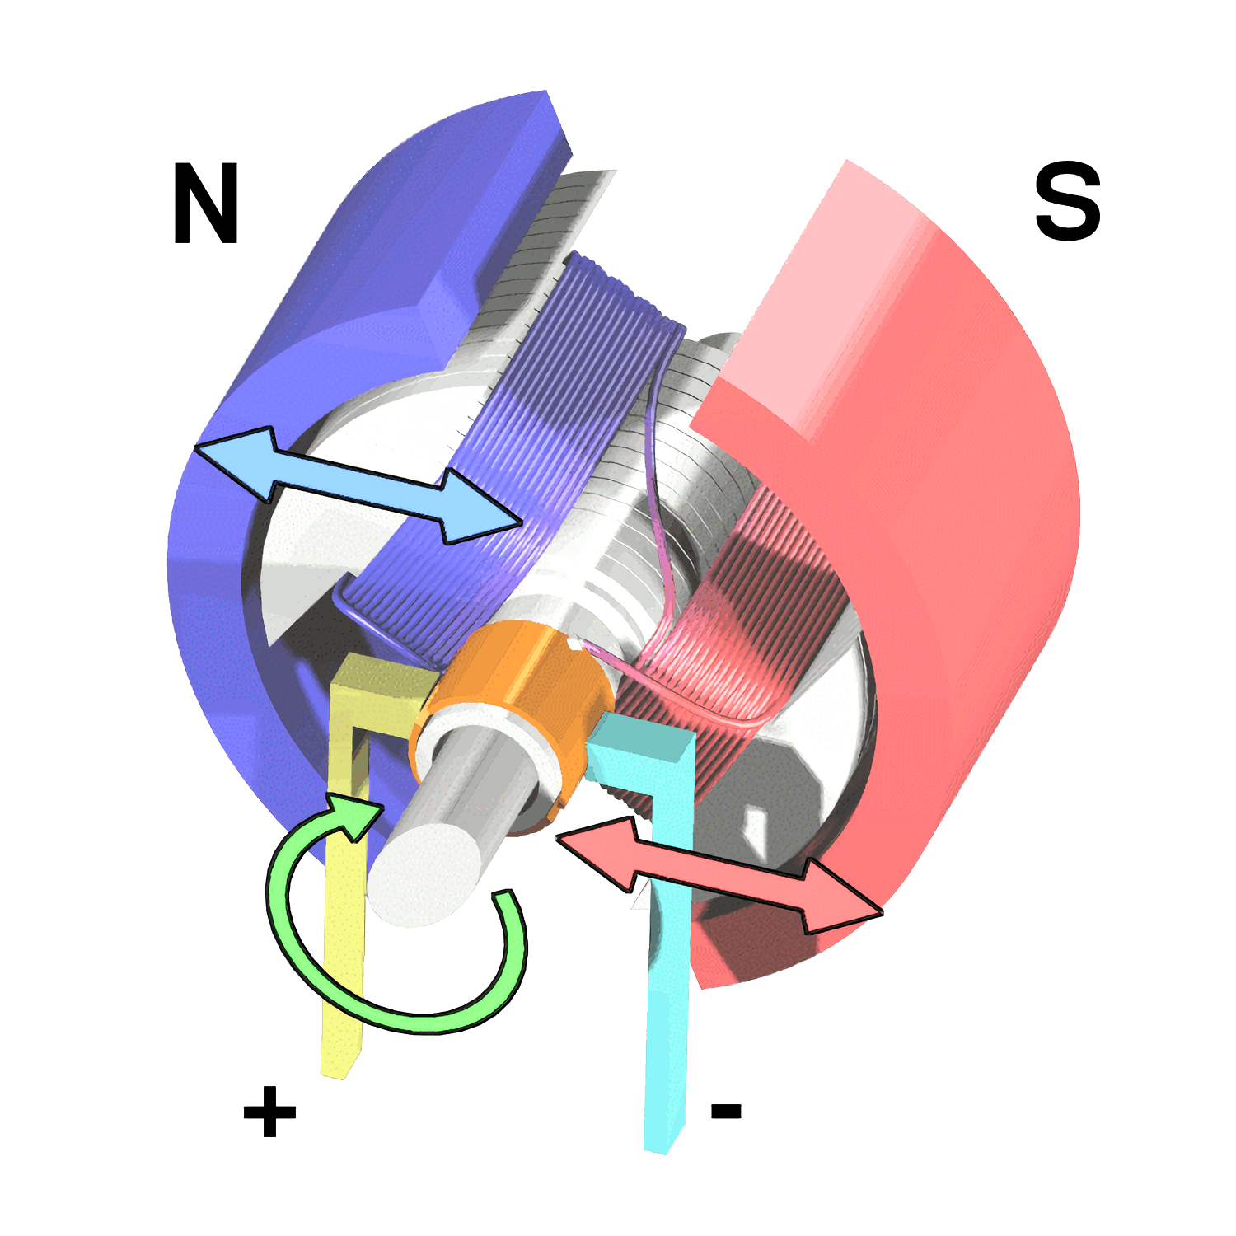
A simple D.C electric motor. A current-carrying wire is passed between two magnets with opposing poles. As the wire moves between the magnets it experiences a force.
The speed at which the wire rotates can be increased using:
1. A larger current.
2. Stronger magnets.
3. More turns on the wire coil.
4. A soft iron core in the middle of the coil.

Slide 6
WIRE
Loudspeakers and headphones also work due to the motor effect.
A loudspeaker consists of a coil of wire wrapped around a magnet. As an alternating current (one that constantly changes direction) is passed through the wire, a force is induced.
This force causes the speaker cone of the loudspeaker to vibrate, creating sound.
SPEAKER CONE
MAGNET

Slide 7
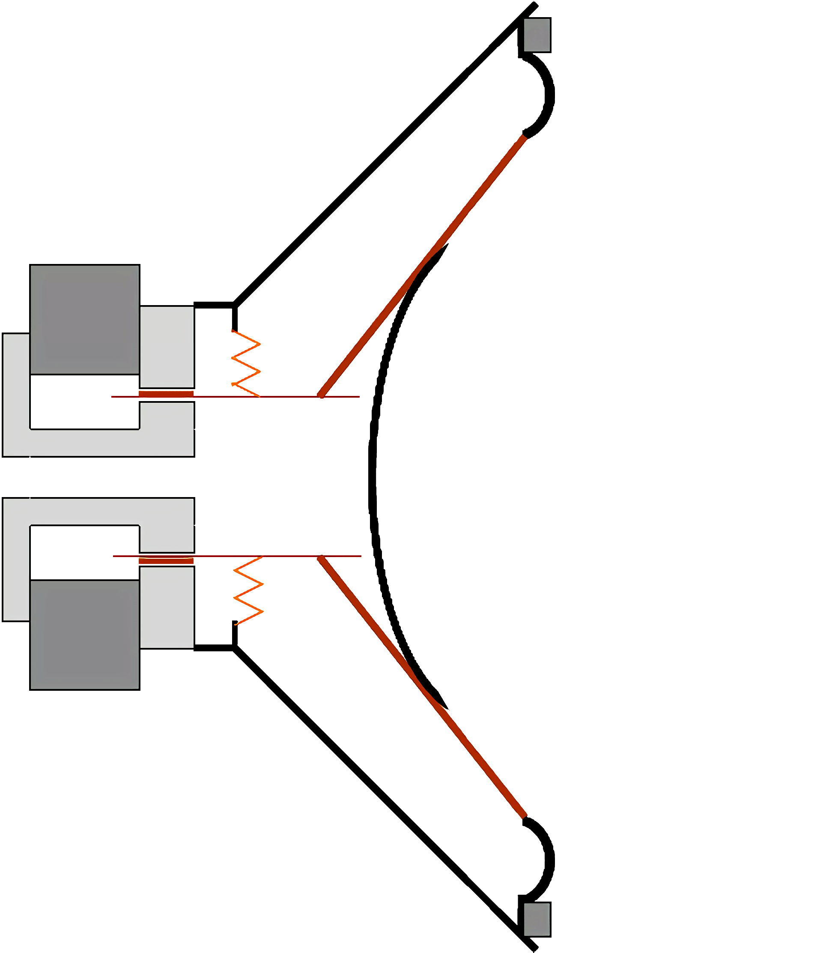
Loudspeakers and headphones also work due to the motor effect.
A loudspeaker consists of a coil of wire wrapped around a magnet. As an alternating current (one that constantly changes direction) is passed through the wire, a force is induced.
This force causes the speaker cone of the loudspeaker to vibrate, creating sound.

Slide 8
Fleming’s Left-Hand Rule
Specification Point 6.13
Use the left-hand rule to predict the direction of the resulting force when a wire carries a current perpendicular to a magnetic field.
The direction of the force (motion) exerted on a current-carrying wire depends on:
The direction of the current.
The direction of the magnetic field.
Motion, current and magnetic field are all perpendicular to each other.
The relationship between motion, current and magnetic field can be demonstrated using Fleming’s left-hand rule.
THUMB - MOTION
FIRST FINGER - FIELD
SECOND FINGER - CURRENT
Fleming’s left-hand rule illustrates the 3D relationship between motion, magnetic field and current.

Slide 9
Factors Affecting Force
Specification Point 6.14
Describe how the force on a current-carrying conductor in a magnetic field changes with the magnitude and direction of the field and current.
As the strength of the magnetic field increases, the size of the force increases.
This is referred to as an increase in magnitude.
More powerful magnets will increase the strength of the force.
As the strength of the electric current increases, the size of the force increases.
Larger currents (measured in amps) will increase the strength of the force.
Reversing the magnetic field or the current also reverses the direction of the force.
This is referred to as a change in polarity.

Slide 10
Electromagnetic Induction
Specification Point 6.15
Know that a voltage is induced in a conductor or a coil when it moves through a magnetic field or when a magnetic field changes through it and describe the factors that affect the size of the induced voltage.
Electricity can be created using magnets.
This is referred to as electromagnetic (EM) induction.
EM induction involves the generation of a voltage through a wire.
Voltage can be generated when a wire is experiencing a change in magnetic field.
EM induction is used to generate electricity through the dynamo effect.
The dynamo effect occurs when a wire moves through a magnetic field.
It can also occurs when the magnetic field is moves through an electrical conductor.
The dynamo effect is utilised in a simple A.C generator.

Slide 11
A simple A.C. generator. As a wire is rotated in a magnetic field a voltage is induced. This is referred to as EM induction.
This is because as the wire is rotated, is is moving through a magnetic field.
The presence of a voltage (and a current) can be confirmed by connecting the wire to an LED light bulb.

Slide 12
Factors Affecting EM Induction
Specification Point 6.16
Describe the generation of electricity by the rotation of a magnet within a coil of wire and of a coil of wire within a magnetic field, and describe the factors that affect the size of the induced voltage.
Several factors can affect the magnitude and direction of the induced voltage:
Factor | Reasoning
Speed at which wire or magnet is moved. | Increasing the rate of movement increases the rate at which the magnetic field lines are disrupted.
Number of turns on wire or size of wire coils. | More magnetic field lines will be disrupted if the wire has greater surface area.
Strength of magnet. | Increasing the strength of the magnetic increases the induced voltage, due to their proportional relationship.
Orientation of magnet. | Reversing the direction of the magnet reverses the polarity of the induced voltage.

