Slide 1
Edexcel IGCSE Physics
25 - Magnetism
Attraction, Repulsion and Magnetic Fields
For more help, please visit www.exampaperspractice.co.uk
© 2025 Exams Papers Practice. All Rights Reserved

Slide 2
Magnets
Specification Points 6.1 and 6.2
Use the following units: ampere (A), volt (V) and watt (W).
Know that magnets repel and attract other magnets and attract magnetic substances.
A magnet is an object which produces a magnetic field.
Magnetic fields exert forces on other objects.
All magnets have two poles.
Magnets have a north pole and a south pole.
Like poles will repel each other.
Two magnets with their north poles facing each other will experience a repulsive effect.
Opposite poles will attract each other.
If the north pole of one magnet is brought to the south pole of another magnet, they will experience an attractive effect.
NORTH
All magnets have two poles, north and south. Magnets are usually metals and exert a non-contact force on other objects.
SOUTH
For more help, please visit www.exampaperspractice.co.uk
© 2025 Exams Papers Practice. All Rights Reserved

Slide 3
Soft and Hard Magnetic Materials
Specification Point 6.3
Describe the properties of magnetically hard and soft materials.
Some magnetic materials are described as ‘soft’.
Soft magnetic materials will lose their magnetism quickly.
Soft magnetic materials are only magnetised temporarily.
Iron is an example of soft magnetic material.
Iron is used in transformers because it can be quickly magnetised and demagnetised.
Other magnetic materials are described as ‘hard’.
Hard magnetic materials will not lose their magnetism.
Hard magnetic materials are magnetised permanently.
Steel is an example of a hard magnetic material.
Items made out of steel will be attracted to a magnet regardless of the conditions.
For more help, please visit www.exampaperspractice.co.uk
© 2025 Exams Papers Practice. All Rights Reserved

Slide 4
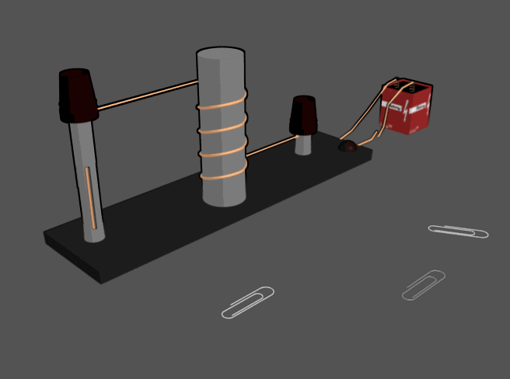
Iron is a soft magnetic material. This means it will can gain and lose its magnetism easily. This makes iron particularly useful as the core of a solenoid - a piece of wire functioning as an electromagnet.
For more help, please visit www.exampaperspractice.co.uk
© 2025 Exams Papers Practice. All Rights Reserved

Slide 5
Magnetic Field Lines
Specification Points 6.4 and 6.6
Understand the term magnetic field line.
Practical: investigate the magnetic field pattern for a permanent bar magnet and between two bar magnets.
Magnets are surrounded by magnetic field lines.
Magnetic field lines display the strength and direction of a magnetic field.
Magnetic field lines can be defined as regions where magnetic materials experience a force.
Magnetic field lines will always point from the north pole to the south pole.
Magnetic field lines can be investigated using iron filings.
Place a bar magnet under a piece of paper.
Scatter iron filings on top of the paper and tap the paper until a clear pattern is formed.
For more help, please visit www.exampaperspractice.co.uk
© 2025 Exams Papers Practice. All Rights Reserved

Slide 6
Magnetic field lines as seen in a bar magnet.
The magnetic field is strongest at the poles - this is represented by field lines that are close together.
As the distance from the magnet increases, the field lines get further apart, indicating that the magnetic field is getting weaker.
S
N
For more help, please visit www.exampaperspractice.co.uk
© 2025 Exams Papers Practice. All Rights Reserved

Slide 7
Inducing Magnetism
Specification Point 6.5
Know that magnetism is induced in some materials when they are placed in a magnetic field.
Magnets are surrounded by magnetic field lines.
Magnetic field lines display the strength and direction of a magnetic field.
Magnetic field lines can be defined as regions where magnetic materials experience a force.
Magnetic field lines will always point from the north pole to the south pole.
Magnetic field lines can be investigated using iron filings.
Place a bar magnet under a piece of paper.
Scatter iron filings on top of the paper and tap the paper until a clear pattern is formed.
Iron filings video.
For more help, please visit www.exampaperspractice.co.uk
© 2025 Exams Papers Practice. All Rights Reserved

Slide 8
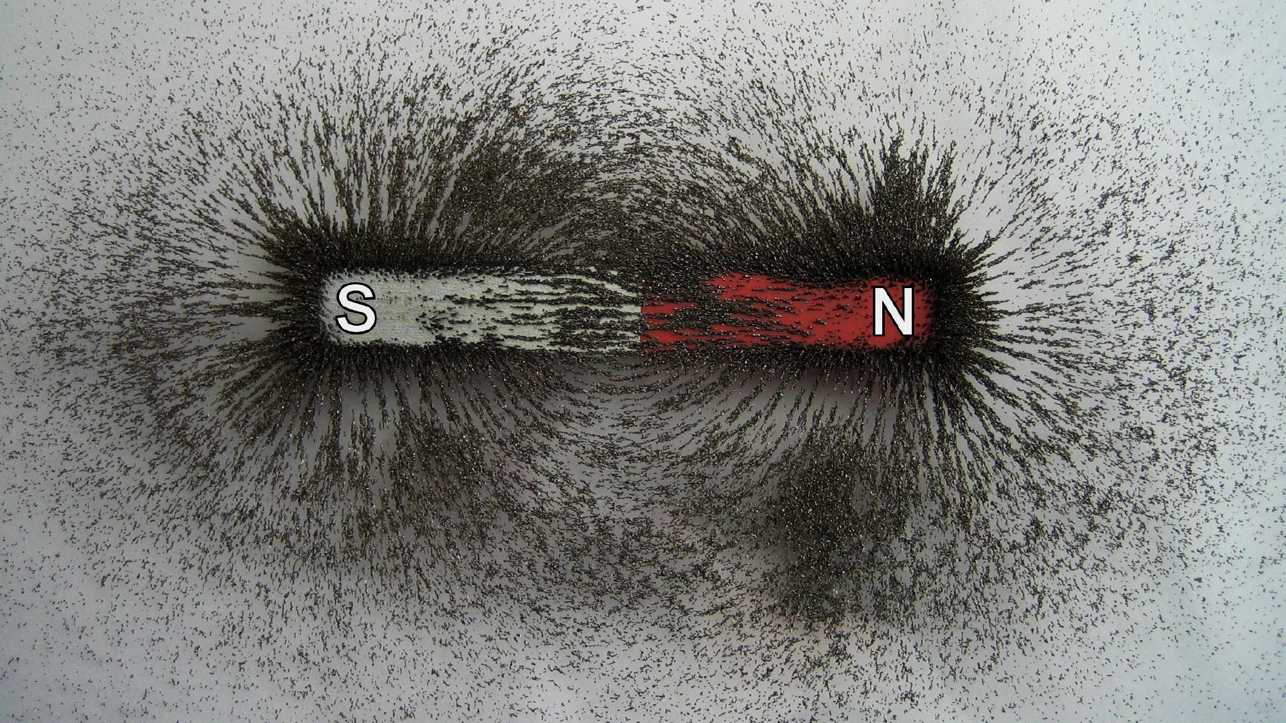
Magnetic field lines can be visualised using iron filings.
For more help, please visit www.exampaperspractice.co.uk
© 2025 Exams Papers Practice. All Rights Reserved

Slide 9
Uniform Fields
Specification Point 6.7
Describe how to use two permanent magnets to produce a uniform magnetic field pattern.
When two bar magnets are placed next to each other, they produce a uniform magnetic field.
These magnets need to be placed near each other to create a uniform field.
Uniform fields have the same strength and direction.
The magnetic field will move from the north to the south pole.
NORTH
SOUTH
When two bar magnets with opposing poles are placed next to each other, a uniform field is created.
For more help, please visit www.exampaperspractice.co.uk
© 2025 Exams Papers Practice. All Rights Reserved

