Slide 1
Edexcel IGCSE Physics
24 - Ideal Gases
Absolute Zero, Pressure and Volume
For more help, please visit www.exampaperspractice.co.uk
© 2025 Exams Papers Practice. All Rights Reserved

Slide 2
Particle Theory
Specification Point 5.15
Explain how molecules in a gas have random motion and that they exert a force and hence a pressure on the walls of a container.
Particles in a gas are constantly moving at high speed.
This is sometimes referred to as Brownian motion.
The movement of gas particles is random.
Gas particles will constantly collide with each other.
If in a container, particles will also collide with the walls of the container.
Ideal gases are assumed to behave in predictable ways.
Ideal gases are used in mathematical models, but are not representative of real gases.
Gas particles move randomly and at high speeds, often colliding with the walls of a container.
For more help, please visit www.exampaperspractice.co.uk
© 2025 Exams Papers Practice. All Rights Reserved

Slide 3
Absolute Zero
Specification Points 5.16 and 5.17
Understand why there is an absolute zero of temperature which is –273 °C.
Describe the Kelvin scale of temperature and be able to convert between the Kelvin and Celsius scales.
When temperature increases, particles gain kinetic energy.
When particles gain kinetic energy, they begin to vibrate more frequently.
When temperature decreases, particles lose kinetic energy.
At absolute zero, particles have no kinetic energy.
Absolute zero is the coldest temperature it is possible to reach.
At absolute zero, particles will stop vibrating.
Absolute zero is equivalent to -273 °C or 0 kelvin (K).
The Kelvin scale begins at -273 °C.
A temperature change of 1 °C is equivalent to 1 K.
When converting from celsius to kelvin, add 273.
When converting from kelvin to celsius, subtract 273.
For more help, please visit www.exampaperspractice.co.uk
© 2025 Exams Papers Practice. All Rights Reserved

Slide 4
Gas particles at absolute zero will not vibrate. This is because they have no kinetic energy. As a result they do not exert any pressure on their container. Absolute zero is the theoretical minimum possible temperature.
PRESSURE (kPa)
-273 °C
TEMPERATURE (°C)
For more help, please visit www.exampaperspractice.co.uk
© 2025 Exams Papers Practice. All Rights Reserved

Slide 5
Gas Molecules and Kinetic Energy
Specification Points 5.18 and 5.19
Understand why an increase in temperature results in an increase in the average speed of gas molecules.
Know that the Kelvin temperature of a gas is proportional to the average kinetic energy of its molecules.
When a gas is heated, it gains kinetic energy.
The more the gas is heated, the faster it will move.
When a gas is heated, particles hit the walls of the container more frequently.
This causes an increase in pressure.
As the temperature of the gas increases, so does the pressure.
There is said to be a proportional relationship between temperature and pressure.
For more help, please visit www.exampaperspractice.co.uk
© 2025 Exams Papers Practice. All Rights Reserved

Slide 6
Gas Molecules and Volume
Specification Point 5.20
Explain, for a fixed amount of gas, the qualitative relationship between:
Pressure and volume at constant temperature.
Pressure and Kelvin temperature at constant volume.
Decreasing the volume of a container leads to an increase in pressure.
This is because there will be more frequent collisions between gas particles and the walls of the container.
When the volume of the container is reduced, the gas is said to have been compressed.
Increasing the volume of a container leads to a decrease in pressure.
This is because there will be less frequent collisions between gas particles and the walls of the container.
When the volume of the container is increased, the gas is said to have expanded.
LOWER PRESSURE
HIGHER PRESSURE
When the volume of a container is increased, gas particles expand to fill the new space. This leads to fewer collisions with the walls of the container and a reduction in pressure.
For more help, please visit www.exampaperspractice.co.uk
© 2025 Exams Papers Practice. All Rights Reserved

Slide 7
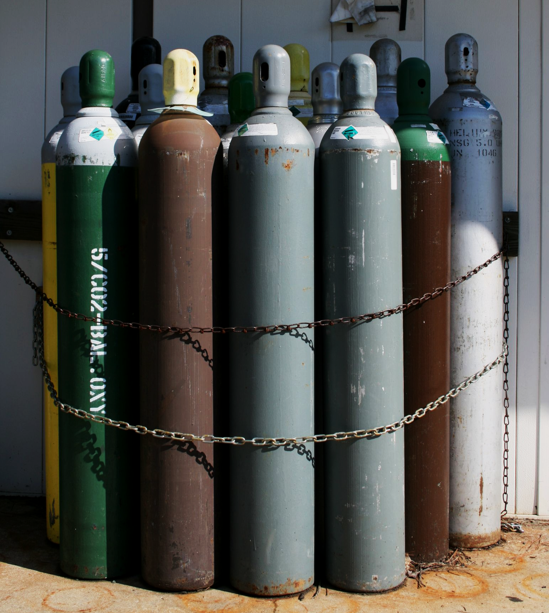
Gases are often stored in pressurised containers, such as canisters. The compression of gas particles allows for easier storage, transport and consumption of gases.
For more help, please visit www.exampaperspractice.co.uk
© 2025 Exams Papers Practice. All Rights Reserved

Slide 8
The Pressure Law
Specification Point 5.21
Use the relationship between the pressure and Kelvin temperature of a fixed mass of gas at constant volume.
When the volume (V) of a gas is constant, it will adhere to the pressure law.
The pressure law states that pressure (p) is proportional to temperature (T).
This means that as the pressure increases, so does the temperature (and vice versa).
The pressure law can be abbreviated to p ∝ T.
If the pressure of a sealed container changes, the temperature will change accordingly.
The pressure law can be rewritten to summarise this phenomenon:
p₁ = initial pressure (kPa)
T₁ = initial temperature (K)
p₂ = final pressure (kPa)
T₂ = final temperature (K)
For more help, please visit www.exampaperspractice.co.uk
© 2025 Exams Papers Practice. All Rights Reserved

Slide 9
A container has a fixed volume of 50 litres. It is filled with gas until a pressure of 1,000 kPa is achieved. This occurs at a temperature of 298 K.
The canister is then heated to 353K.
Find the new pressure of the gas.
p₁ ÷ T₁ = 1000 ÷ 298 = 3.36
p₂ ÷ T₂ = 3.36
p₂ ÷ 353 = 3.36
3.36 × 353 = 1,186 kPa.
COMPRESSED GAS (50 l)
For more help, please visit www.exampaperspractice.co.uk
© 2025 Exams Papers Practice. All Rights Reserved

Slide 10
Boyle’s Law
Specification Point 5.22
Use the relationship between the pressure and volume of a fixed mass of gas at constant temperature.
When the temperature of a gas is constant, it will adhere to Boyle’s law.
Boyle’s law states that pressure is inversely proportional to volume of gas.
This means that as the pressure increases, the volume of the gas decreases.
The pressure law can be abbreviated to p ∝ 1 ÷ V.
If the volume of a sealed container changes, the pressure will change accordingly.
Boyle’s law can be rewritten to summarise this phenomenon:
p₁ = initial pressure (kPa)
V₁ = initial volume (cm³)
p₂ = final pressure (kPa)
V₂ = final volume (cm³)
For more help, please visit www.exampaperspractice.co.uk
© 2025 Exams Papers Practice. All Rights Reserved

Slide 11
A container with a volume of 200 cm³ at a pressure of 150 kPa is compressed to 100 cm³. The temperature of the gas remains constant.
Find out the new pressure of the gas.
p₁V₁ = 150 × 200 = 30,000
p₂ × 100 = 30,000
p₂ = 30,000 ÷ 100 = 300 kPa.
EXPANDED (200 cm³)
COMPRESSED (100 cm³)
For more help, please visit www.exampaperspractice.co.uk
© 2025 Exams Papers Practice. All Rights Reserved

Slide 12
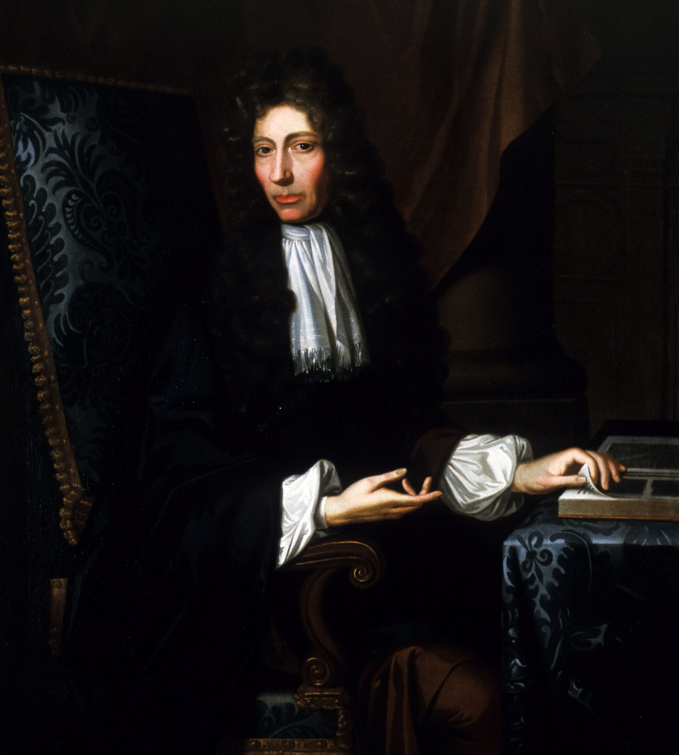
Robert Boyle was an Irish polymath who proved the relationship between pressure and volume in 1662. It is now referred to as Boyle’s law.
PRESSURE AND VOLUME ARE INVERSELY PROPORTIONAL TO EACH OTHER
PRESSURE →
VOLUME →
For more help, please visit www.exampaperspractice.co.uk
© 2025 Exams Papers Practice. All Rights Reserved

