Slide 1
Edexcel IGCSE Physics
23 - Changes of State
Kinetic Theory, Particle Arrangement, Specific Heat Capacity
Paper 2

Slide 2
Solids, Liquids and Gases
Specification Point 5.10P
Describe the arrangement and motion of particles in solids, liquids and gases.
There are three states of matter:
These are solids, liquids and gases.
The particles in solids are close together in a regular arrangement.
There are strong forces of attraction between particles.
Particles cannot move and can only vibrate around fixed positions.
The particles in liquids are close together but are no longer regularly arranged.
There are weaker forces of attraction between particles.
Particles can move past each other but do so at low speeds.
The particles in gases are widely separated.
There are almost no forces of attraction between particles.
Particles are free to move and do so at high speeds.

Slide 3
In solids, particles are regularly arranged with strong forces of attraction between particles.
In liquids, particles are irregularly arranged with weaker forces of attraction between particles.
In gases, particles are randomly arranged with almost no forces of attraction between particles.
SOLID
LIQUID
GAS

Slide 4
Kinetic Theory
Specification Point 5.8P
Explain why heating a system will change the energy stored within the system and raise its temperature or produce changes of state.
All objects contain thermal energy.
This is held in the particles of the object as kinetic energy.
The temperature of the object is directly related to the kinetic energy of its particles.
When heat is supplied to an object, the kinetic energy of its particles increases.
This makes the particles move more quickly.
When enough heat is supplied, a change in state can occur.
A solid will melt to form a liquid.
A liquid will boil to form a gas.

Slide 5
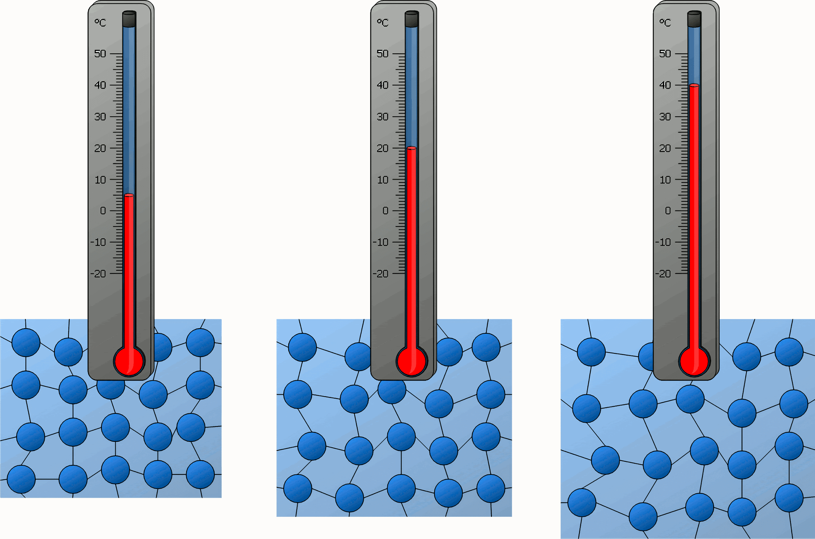
When heat is applied to an object, particles gain kinetic energy. This makes the particles in the object vibrate more quickly.
If enough energy is supplied, the object can experience a change in state.

Slide 6
Melting, Boiling and Evaporation
Specification Point 5.9P
Describe the changes that occur when a solid melts to form a liquid, and when a liquid evaporates or boils to form a gas.
Solids contain intermolecular bonds.
These are forces that attract the particles in the solid to each other.
If a solid is melted, some of the intermolecular bonds are broken.
This causes the change in state from solid to liquid.
The temperature this occurs at is called the melting point of the solid.
In a liquid is boiled, the remaining intermolecular bonds are broken.
This causes the change in state from liquid to gas.
The temperature this occurs at is called the boiling point of the liquid.
Evaporation can occur at temperatures lower than the boiling point.
Evaporation occurs when gas particles escape from a liquid.
This only occurs in particles that are near the surface of the liquid.
Particles near the surface of the liquid carry the most kinetic energy.
When particles evaporate from the liquid, a cooling effect occurs.

Slide 7
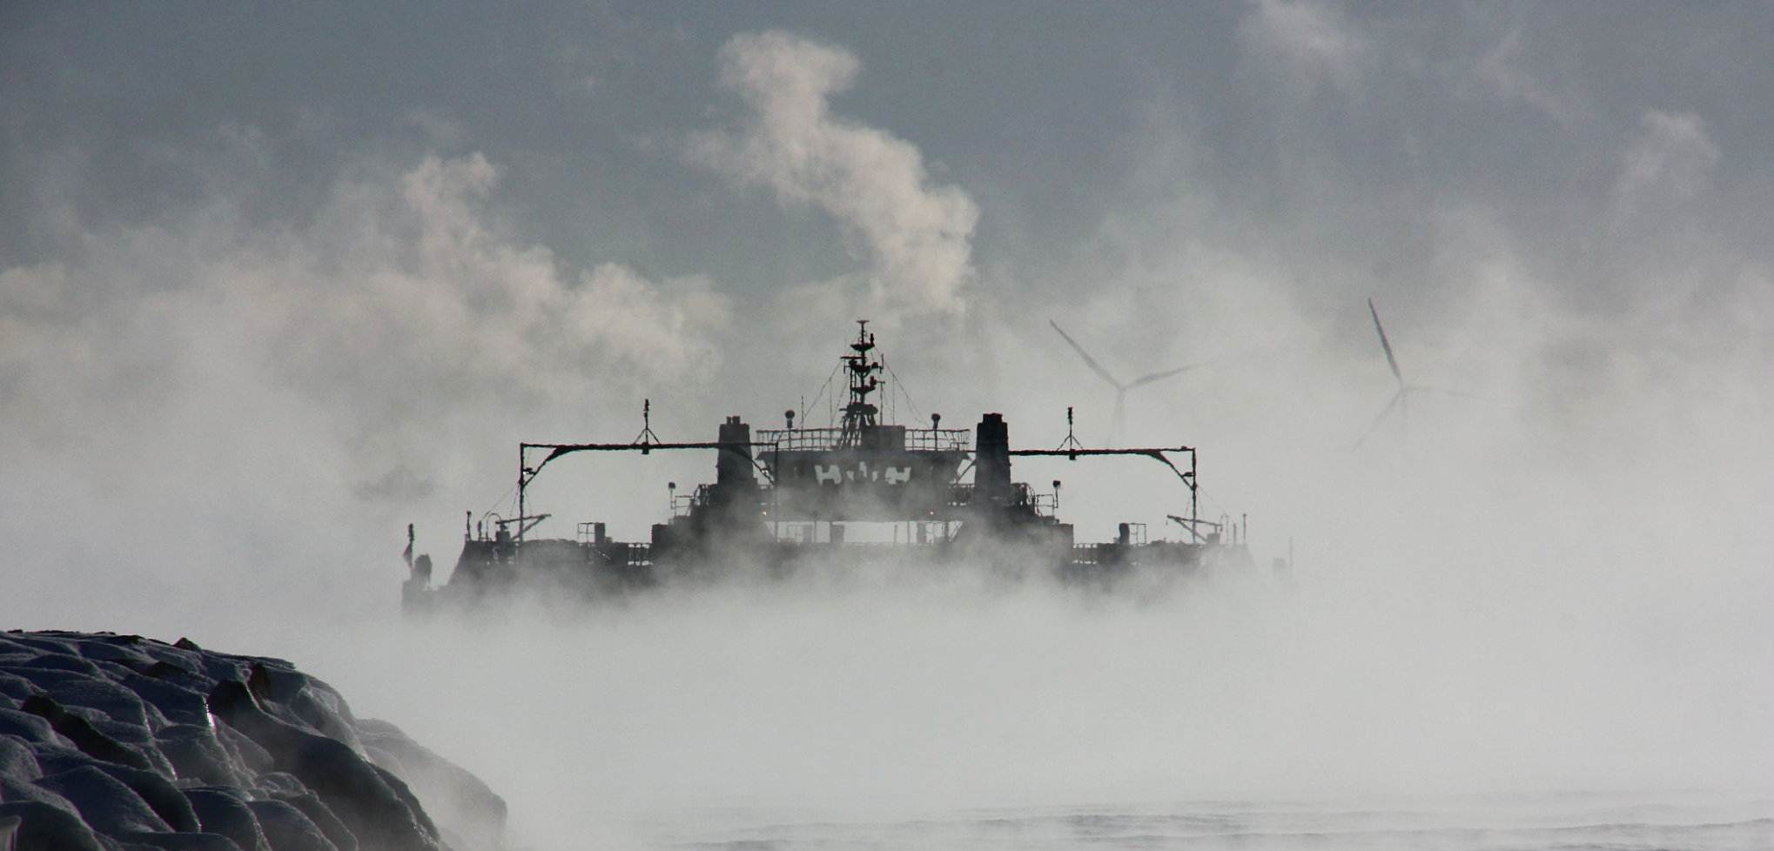
Evaporation usually occurs on the surface of bodies of water. Only particles travelling in the right direction, with sufficient kinetic energy can escape the liquid and form a gas.

Slide 8
Temperature-Time Graphs
Specification Point 5.11P
Practical: obtain a temperature–time graph to show the constant temperature during a change of state.
An experiment can be devised to show how the temperature of an object changes when heated.
This is most commonly done using ice cubes.
Fill a beaker with cubes of ice.
Add a thermometer to the beaker and measure the temperature of the ice.
Using a bunsen burner, gently heat the ice cubes.
Record the temperature at regular intervals.
Record the temperature at which the ice begins to melt.
Eventually all the ice will melt to form water.
Continue heating until the water begins to boil.
Record this temperature.
The results can be plotted on a temperature-time graph.
MEASURE TEMPERATURE USING THERMOMETER
GENTLY HEAT ICE CUBES USING BUNSEN BURNER

Slide 9
STEAM (GAS)
BOILING POINT - 10O°C
A temperature-time graph for water.
When a change of state occurs, kinetic energy is used to break the intermolecular bonds between particles, rather than to raise the temperature of the substance. This explains why the substance stays at the same temperature during changes of state.
TEMPERATURE
MELTING POINT - O°C
ICE (SOLID)
TIME

Slide 10
Specific Heat Capacity
Specification Points 5.12P and 5.13P
Know that specific heat capacity is the energy required to change the temperature of an object by one degree celsius per kg of mass.
Use an equation to derive the change in thermal energy in a system.
When a substance is heated, the amount of thermal energy it contains increases.
This is because energy is transferred to its thermal energy store.
This is measured as a change in temperature.
The temperature change observed in an object depends on:
The mass of the substance heated.
The type of substance heated.
The amount of thermal energy added to the system.
The specific heat capacity (c) of an object can be defined as the energy required to change the temperature of an object by 1°C per kg of mass.
Different substances will have different specific heat capacities.
The specific heat capacity of a substance is measured in J/kg/°C.
There is a relationship between the change in thermal energy, mass, specific heat capacity and the change in temperature:
ΔQ = change in thermal energy (J)
m = mass of substance (kg)
c = specific heat capacity (J/kg/°C)
ΔT = change in temperature (°C)

Slide 11
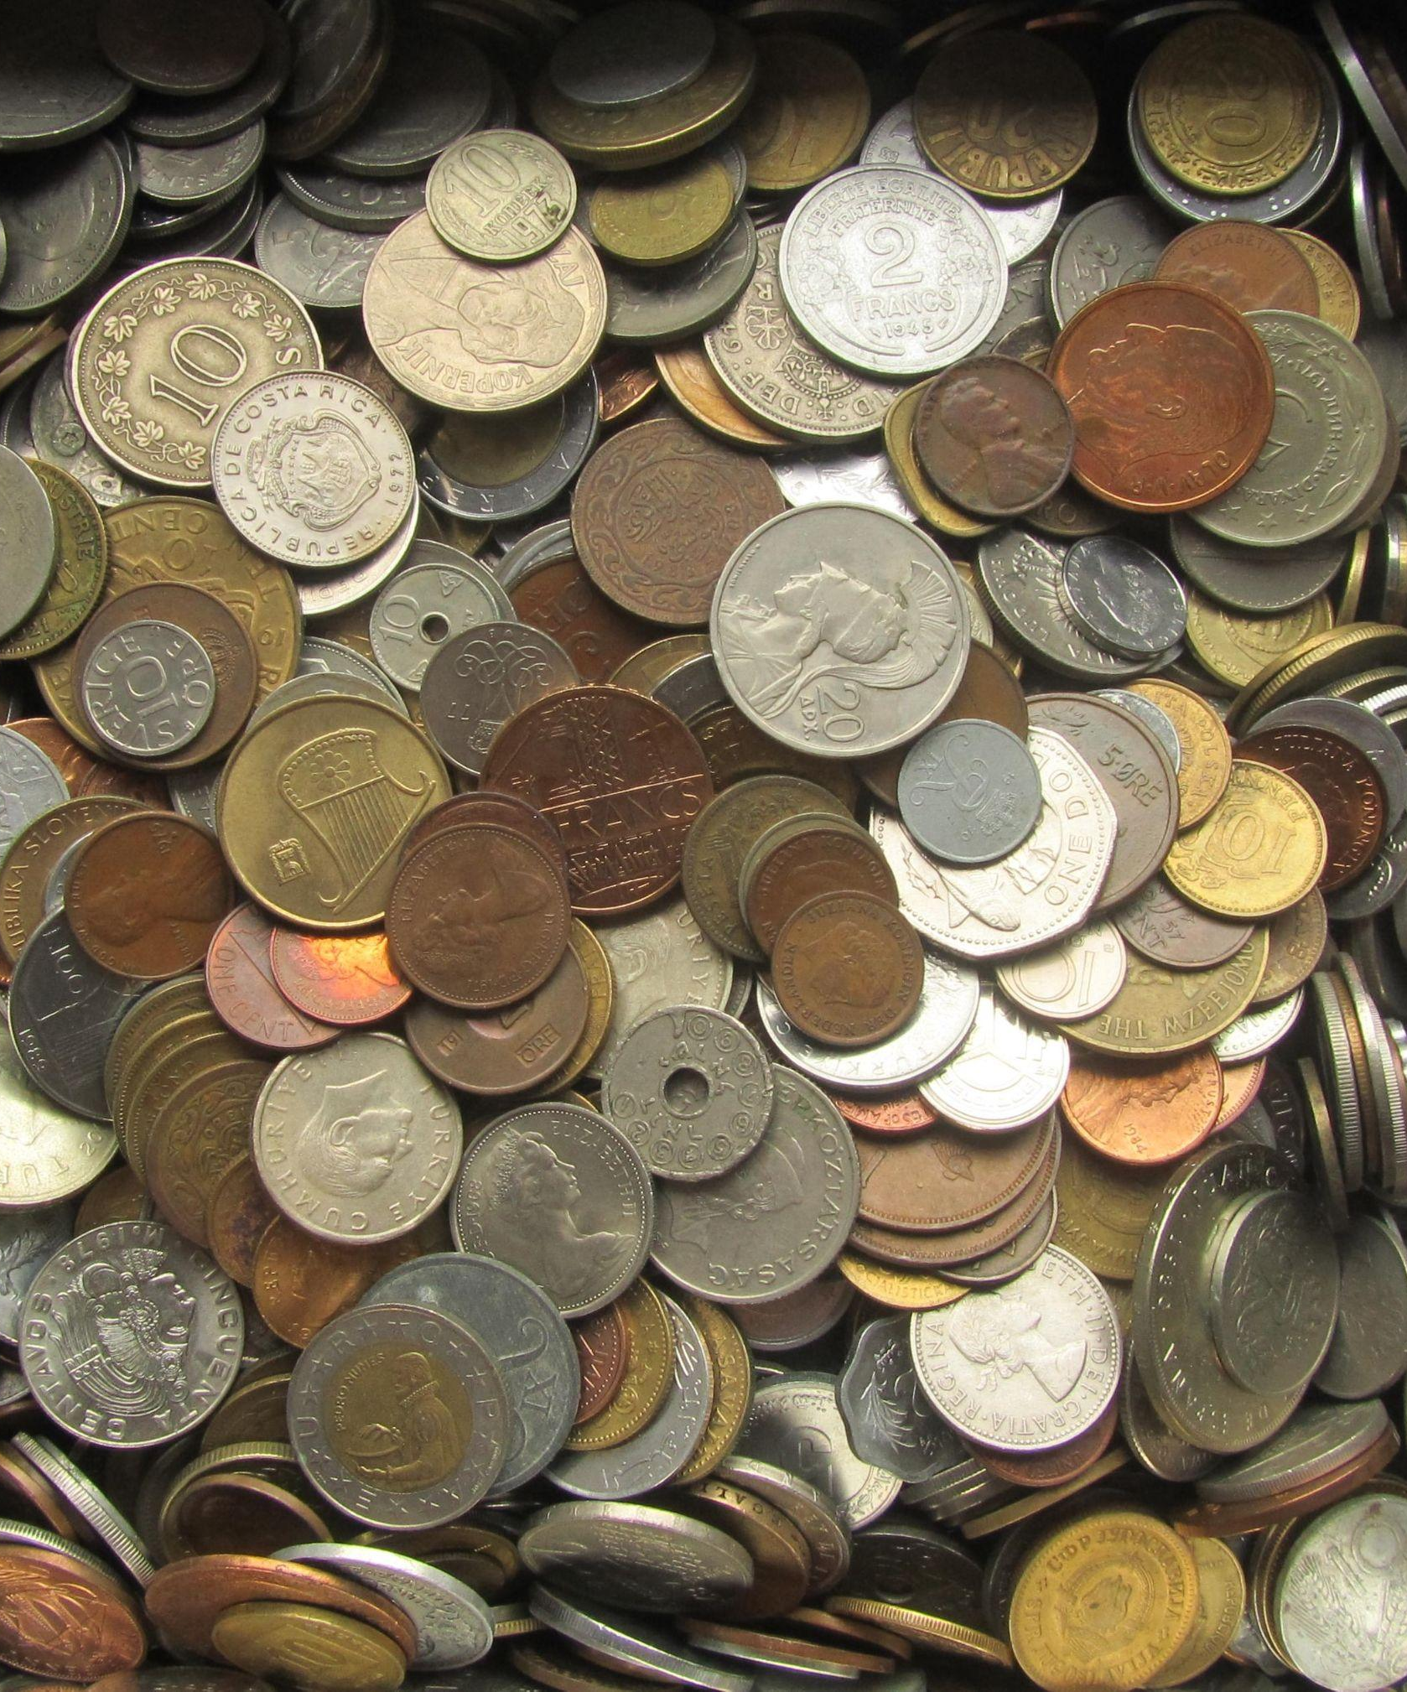
Different substances have different specific heat capacities. This is often due to differences in thermal conductivity.
Copper has a specific heat capacity of 385 J/kg/°C.
Nickel has a specific heat capacity of 444 J/kg/°C.

Slide 12
Specific Heat Capacity of Water
Specification Point 5.14P
Practical: investigate the specific heat capacity of materials including water and some solids.
The specific heat capacity of water can be determined using the following:
Insulated beaker containing a known mass of water.
Thermometer.
Immersion heater.
Measure a known volume of water.
1 ml of water is equivalent to 1 gram.
Transfer the water to an insulated beaker and measure the initial temperature.
The beaker can be insulated using cotton wool.
Gently heat the water using an immersion heater until the temperature has increased by 10°C.
Record the amount of energy (in joules) supplied to the water.
This can be used to calculate the specific heat capacity of the water.
This experiment can be modified to investigate the specific heat capacity of solids.
Insert two holes in a solid block of material.
Insert the leads of the immersion heater in these holes and insulate the solid.
Measure the temperature change.
Specific heat capacity video.
THERMOMETER
IMMERSION HEATER
COTTON WOOL INSULATION
POLYSTYRENE CUP CONTAINING 250 g OF WATER
The specific heat capacity of water can be determined using an insulated beaker, a thermometer and an electric immersion heater.

Slide 13
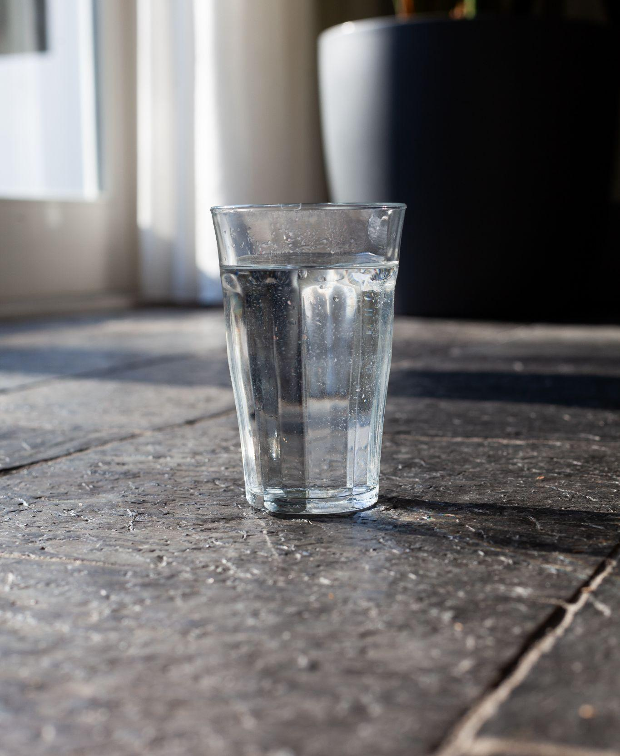
A beaker containing 0.4 kg of water is heated by 10°C. This requires 16,800 J of energy.
Use this to calculate the specific heat capacity of water:
16,800 ÷ (0.4 × 10) = 4,200 J/kg/°C

