Slide 1
Edexcel IGCSE Physics
22 - Density and Pressure
Pressure, Force and Area

Slide 2
Density, Mass and Volume
Specification Points 5.1 and 5.3
  Use the following units: degree celsius (°C), kelvin (K), joule (J), kilogram (kg), kilogram/metre³ (kg/m³), metre (m), metre² (m²), metre³ (m³), metre/second (m/s), metre/second² (m/s²), newton (N) and pascal (Pa).
  Know and use the relationship between density, mass and volume.
Density (ρ) can be defined as the mass per unit volume of a material.
  Density is a measure of how compact a substance is.
  Density considers the mass of an object compared to the amount of space it takes up.
There is a relationship between density, mass and volume:
MASS
DENSITY
VOLUME
Using a formula triangle, density can be calculated as mass ÷ volume.
ρ = density (kg/m³)
m = mass (kg)
V = volume (m³)

Slide 3
A plastic ball and a metal ball are placed into water. The plastic ball has a mass of 0.15 kg. The metal ball has a mass of 1.5 kg. Both balls have a volume of 0.0002 m³.
The density of the plastic ball is: 0.15 ÷ 0.0002 = 750 kg/m³
The density of the metal ball is 1.5 ÷ 0.0002 = 7,500 kg/m³
The density of water is 1,000 kg/m³. Objects that are less dense than water (the plastic ball) will float. Objects that are more dense than water (the metal ball) will sink.
750
kg/m³
PLASTIC BALL
METAL
BALL
7,500
kg/m³

Slide 4
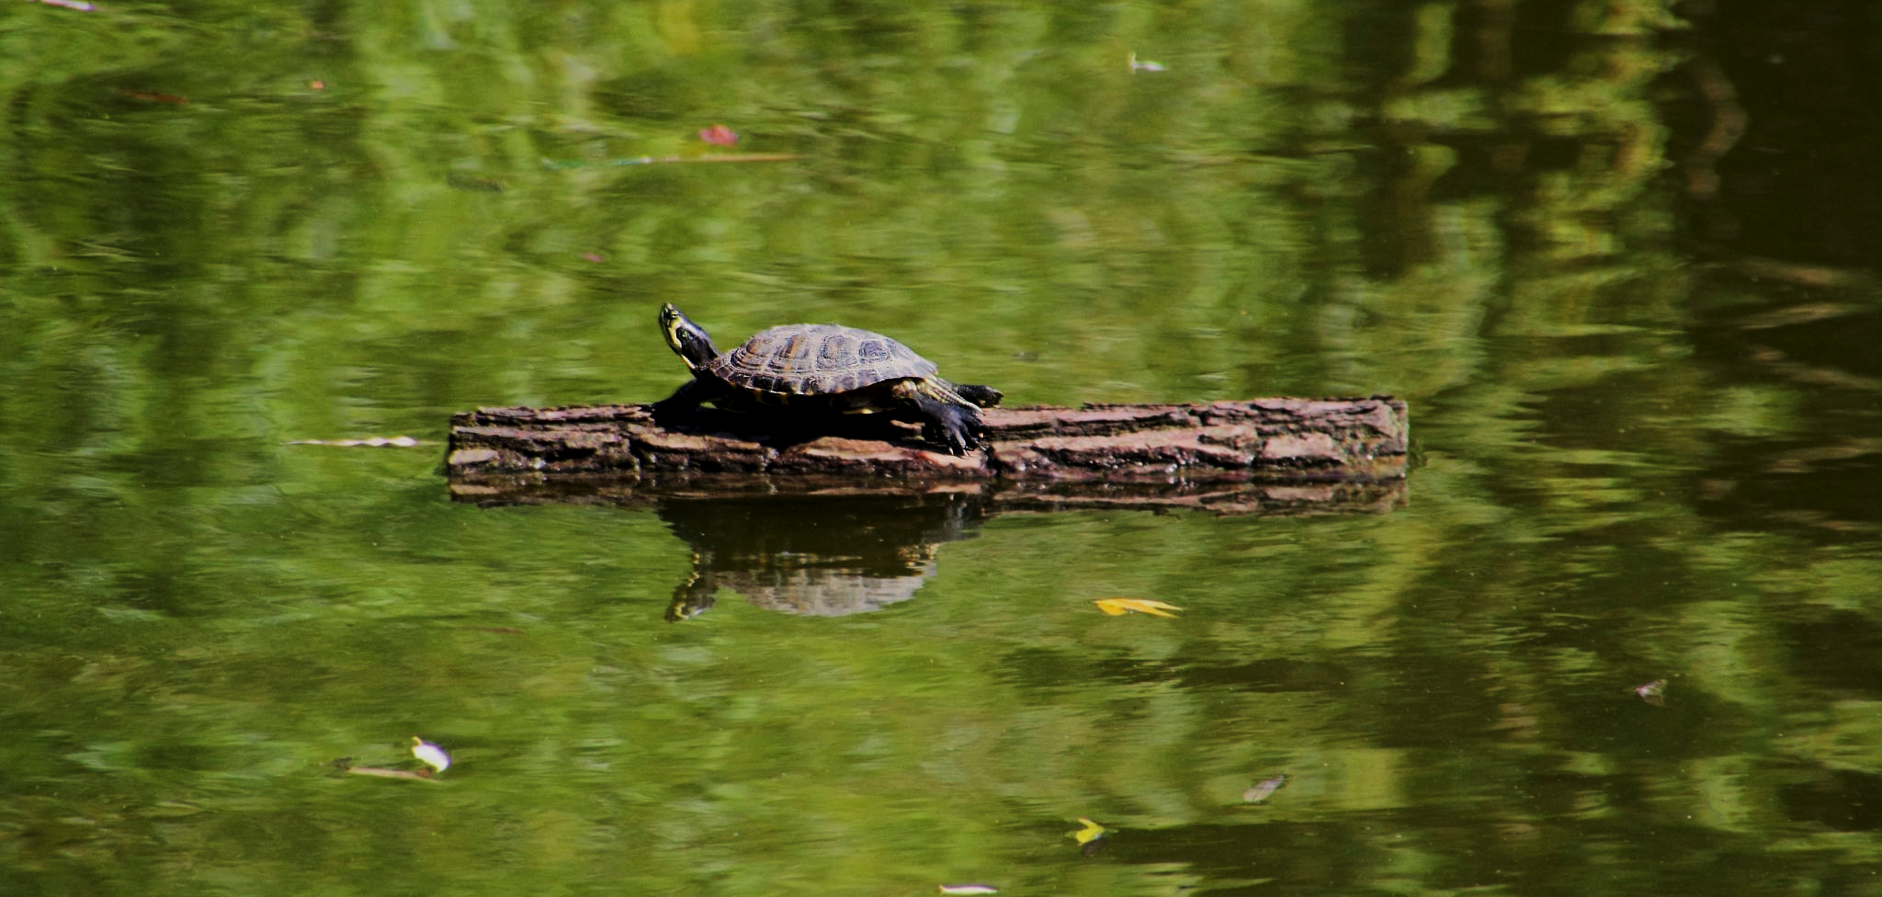
Water has a density of around 1000 kg/m³. Any object with a lower density will float. This wooden log has a density of around 500 kg/m³.

Slide 5
Calculating the Density of Regularly Shaped Objects
Specification Point 5.4
  Practical: investigate density using direct measurements of mass and volume.
The density of an object can be calculated from its mass and volume.
  Density practical video.
Use a digital balance to measure the mass of the object.
Use callipers to measure the dimensions of the object.
  Measure the height, length and depth of the object.
Use the dimensions of the object to find out its volume.
  There are a number of equations that can be used to calculate the volume of regularly shaped objects:
VOLUME OF CUBE = HEIGHT × LENGTH × DEPTH
VOLUME OF SPHERE = 4/3 × π × RADIUS³
VOLUME OF CYLINDER = π × RADIUS² × LENGTH

Slide 6
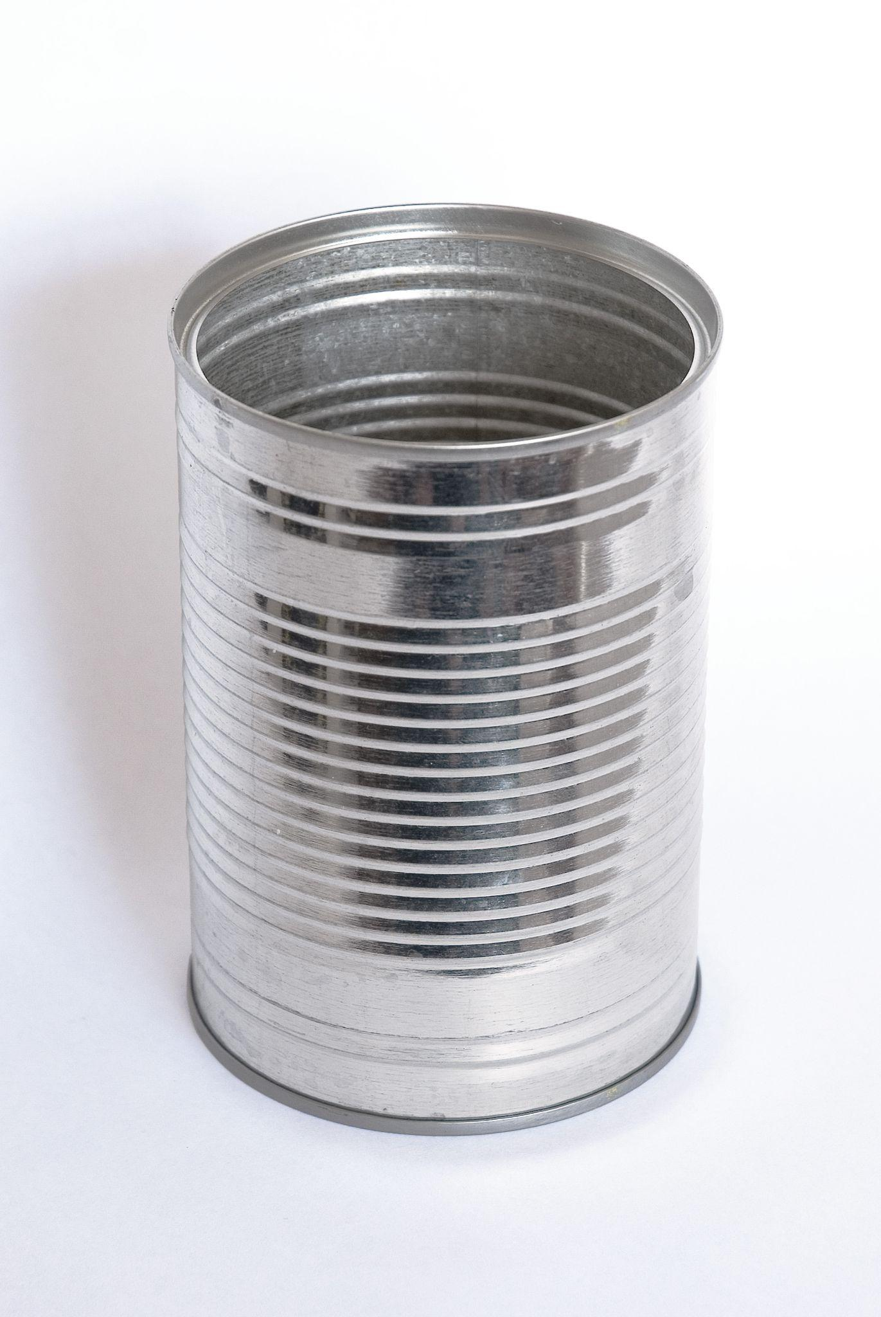
This tin can has a cylindrical shape.
When full, it has a mass of 0.4 kg.
It has a radius of 5 cm or 0.05 m.
It has a length of 10 cm of 0.1 m.
π × 0.05² × 0.1 = 0.00079 m³.
0.4 ÷ 0.00079 = 506 kg/m³

Slide 7
Calculating the Density of Irregularly Shaped Objects
The volume of irregularly shaped objects is difficult to measure directly.
The volume of irregularly shaped objects can be measured using the idea of displacement.
  When the object is submerged in a measuring cylinder, it will displace a certain volume of water.
  The volume of water displaced is equal to the volume of the object.
Measure the mass of the object.
Record the initial volume of water in the cylinder
Submerge the object in the cylinder.
Measure the volume of water with the object added.
  The difference in volume is equal to the volume of the object.
A measuring cylinder is filled with a known volume of water. The displaced water is equal to the volume of the submerged object.
SUBMERGED
OBJECT

Slide 8
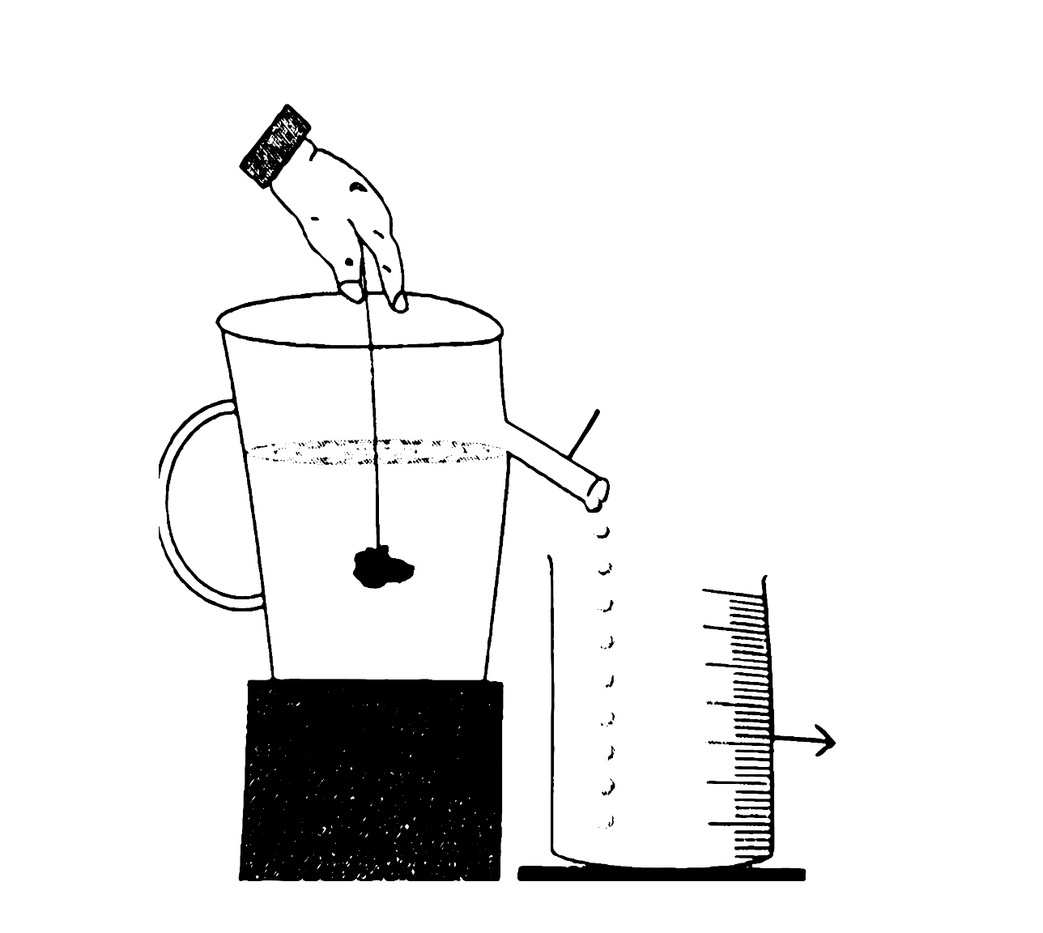
A Eureka can measures an irregular object's volume.
It's filled with water to a spout's level. when an object is submerged, water overflows. The volume of the overflowed water should equal the object's volume.
EUREKA CAN
MEASURING CYLINDER

Slide 9
Pressure
Specification Point 5.5
  Know and use the relationship between pressure, force and area.
Pressure can be defined as the concentration of a force per unit area.
  Pressure (p) uses a similar symbol to density (ρ).
  Objects that are exerting high pressure are supplying significant force over a small area.
There is a relationship between pressure, force and area:
FORCE
PRESSURE
AREA
Using a formula triangle, pressure can be calculated as force ÷ area.
p = pressure (Pa or kPa)
F = force (N)
A = area (m²)

Slide 10
AREA = 3 × 10⁻³ m
FORCE = 700 N
PRESSURE = FORCE ÷ AREA
In a flat shoe, weight is distributed over a large area. The pressure exerted on the ground is low.
LOW PRESSURE (233 kPa)

Slide 11
AREA = 4 × 10⁻⁴ m
FORCE = 700 N
PRESSURE = FORCE ÷ AREA
In a heeled shoe, weight is distributed over a small area. The pressure exerted on the ground is high.
HIGH PRESSURE (1,750 kPa)

Slide 12
Pressure in Fluids
Specification Points 5.6 and 5.7
  Understand how the pressure at a point in a gas or liquid at rest acts equally in all directions.
  Know and use the relationship for pressure difference.
A fluid is either a liquid or a gas.
In fluids, the pressure at is exerted equally in all directions.
  Pressure in fluids exerts a force against surfaces.
Pressure increases with depth.
  The pressure at the bottom of the ocean is significantly higher than the pressure at sea level.
  This is referred to as the pressure difference.
In fluids, there is a relationship between pressure difference, height, density and gravitational field strength (GFS):
PRESSURE DIFFERENCE
HEIGHT
DENSITY
GFS
p = pressure difference (Pa or kPA)
h = height (m)
ρ = density (kg/m³)
g = gravitational field strength (N/kg)
Using a formula triangle, pressure difference can be calculated as height × density × gravitational field strength.

Slide 13
Consider a submarine that is stationed 250 m below sea level. Calculate the pressure difference exerted on the submarine between this depth and sea level.
250 × 1,000 × 10 = 2,500,000 Pa.
2,500,000 Pa = 2,500 kPa.
DENSITY OF WATER = 1,000 kg/m³
GFS = 10 N/kg
DEPTH = 250 m
PRESSURE DIFFERENCE = 2,500 kPa

