Slide 1
Edexcel IGCSE Physics
21 - Sources of Energy
Energy Production and Resources, Pros and Cons
Paper 2

Slide 2
Generating Electricity
Specification Points 4.18P and 4.19P
Describe the energy transfers involved in generating electricity.
Describe the advantages and disadvantages of methods of large-scale electricity production from various renewable and non-renewable resources.
Electricity is generated from stores of energy.
Most energy is currently generated from non-renewable fossil fuels.
Coal.
Oil.
Natural gases.
Fossil fuels are burned to release thermal energy.
This energy is used to boil water and convert it to steam.
The steam is used to drive a turbine.
The turbine will begin to spin.
The spinning turbine is used to power a generator, which will in turn create an electric current.
This current is distributed through the national grid as electricity.
Electricity is often distributed through electrical pylons.

Slide 4
Fossil Fuels
The use of fossil fuels has advantages and disadvantages.
Burning fossil fuels releases lots of energy very easily.
It is also quite cost-efficient to burn fossil fuels, although it is likely to become less so in the future.
Fossil fuels can be burned all year round.
The use of fossil fuels is not dependent on weather conditions.
It is said that fossil fuels are a reliable source of energy.
The infrastructure for fossil fuels is well-established.
There are lots of fossil fuel power stations that have already been built.
There is no need to spend time and money building new fossil fuel power stations.
Burning fossil fuels releases lots of carbon dioxide (CO₂) into the atmosphere.
CO₂ is a greenhouse gas and a major contributor to global warming.
Burning certain fossil fuels also releases other pollutants.
The burning of coal releases sulphur dioxide (SO₂) into the atmosphere, which can lead to acid rain.
Fossil fuels are a non-renewable resource.
This means that our stores of fossil fuels will eventually be depleted.

Slide 5
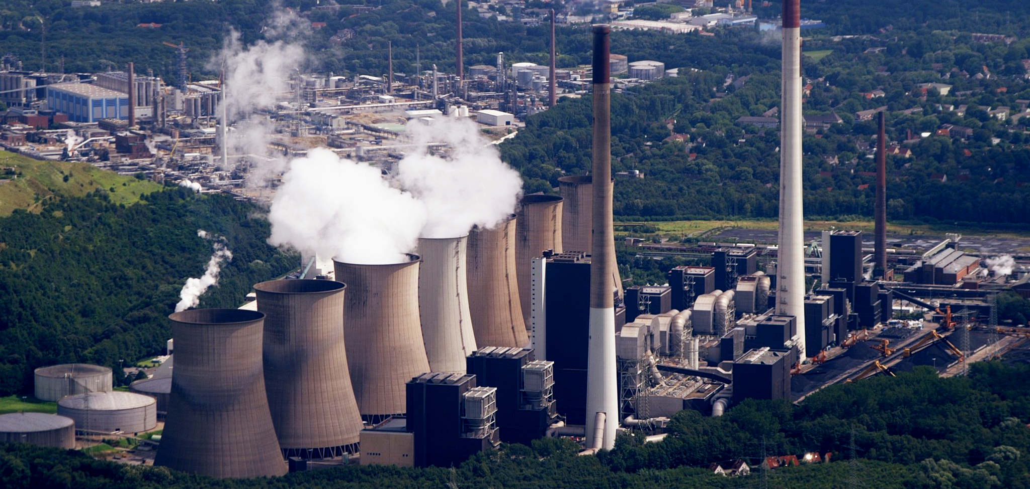
A coal-fired power plant in Germany. Fossil fuels are non-renewable resources and major sources of pollution. This must be balanced with their ability to quickly and reliably generate large amounts of electricity.

Slide 6
Nuclear Power
Nuclear power is a non-renewable resource.
Nuclear power uses the heat from nuclear fission to create electricity.
Radioactive elements such as uranium constantly release energy as heat.
This heat can be used to drive turbines in much the same way as fossil fuel burning.
Nuclear power does not produce greenhouse gases.
Unlike traditional fossil fuels, nuclear energy is also non-polluting.
There are significant stores of nuclear material.
The stores of radioactive material (such as uranium) are expected to last much longer than fossil fuels.
Nuclear power plants are expensive to build and maintain.
They are also expensive to decommission.
Nuclear material must be processed and handled correctly.
There are risks associated with radiation leaks.
This has led to nuclear disasters in the past.

Slide 7
STEAM OUT
A typical nuclear fission reactor.
Uranium rods are inserted into the reactor. The radiation from the rods is used to heat water to form steam. As with fossil fuel power plants, steam is used to drive a turbine. This turbine is linked to a generator which creates electricity.
WATER IN

Slide 8
The 1986 Chernobyl nuclear disaster resulted in radiation fallout spanning hundreds of miles. These areas are highlighted in red.
Radiation leaks and reactor meltdowns are ongoing concerns with nuclear power.

Slide 9
Renewable Energy
Renewable sources of energy are infinite.
This means that they will never be depleted.
There are many sources of renewable energy:
Wind power.
Solar power.
Geothermal power.
Tidal power.
Hydroelectric power.
Renewable energies tend to be less damaging than fossil fuels.
This is because they tend not to release CO₂ into the atmosphere.
They also do not release polluting gases (such as SO₂).

Slide 10
Wind Power
Wind power involves the use of wind turbines.
Wind turbines are either placed inland, or offshore.
Wind turbines use the kinetic energy generated by wind to generate electricity.
Wind will turn the blades of the turbine.
This will turn a generator inside the turbine’s housing.
Wind power is cheap to run and non-polluting.
Wind turbines are unsightly.
Many people believe that wind turbines spoil the natural beauty of the environment.
Lots of turbines are needed to generate significant amounts of electricity.
Around 1500 turbines are needed to replace a single coal power station.
Wind turbines are used to convert the kinetic energy of wind into electricity.

Slide 11
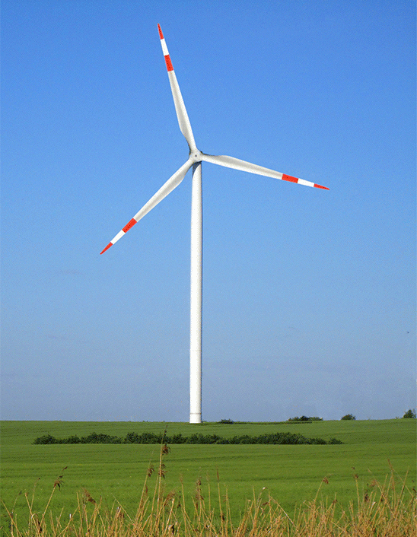
Wind turbines, although cheap to run, are expensive to build.
Many people also consider them to be unsightly, spoiling the view of the natural environment.

Slide 12
Solar Power
Solar power involves the use of solar cells.
Solar cells are sometimes called photovoltaic cells.
Solar cells use the energy from sunlight to create an electric current.
This current is then used to charge components such as batteries.
Solar power is free to run and non-polluting.
Solar cells can be used off-grid.
This makes them an excellent way to generate electricity in remote locations.
Solar cells are dependent on weather conditions.
Solar cells generate a very small amount of electricity if it is not sunny.
Solar cells are expensive to build.
It may also be impractical to connect solar cells to the national grid.
Solar cells are arranged into panels which are then connected to electrical components.

Slide 13
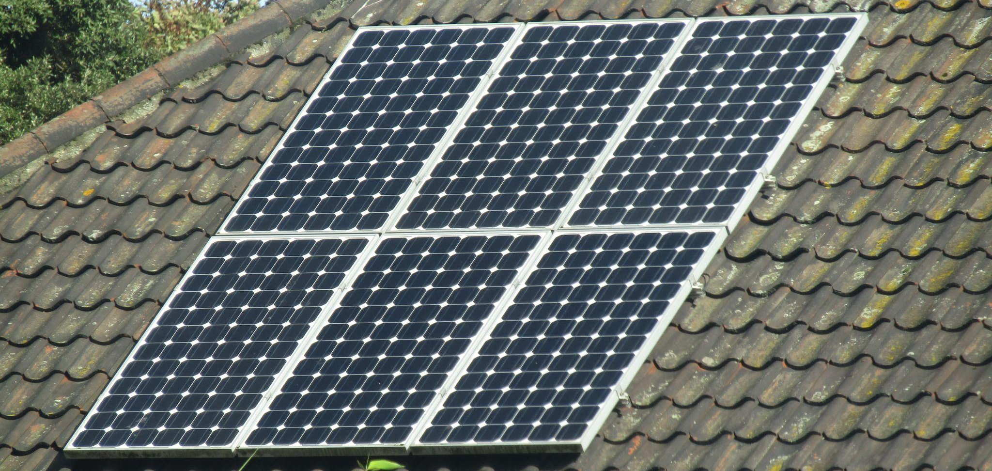
Solar panels are often attached to the roofs of houses. This can help individuals reduce their energy bills by generating some free electricity.

Slide 14
Solar Heating Panels and Solar Ovens
Solar heating panels can be used to heat water.
Solar heating panels use energy from the sun to heat pipes containing water.
This hot water can then be used for baths and showers.
Solar ovens use a mirror to focus sunlight.
This can be used for outdoor cooking.
These mechanisms are free to use and renewable.
In the long term, they can be used to reduce bills.
They are inefficient and have high setup costs.
Solar mechanisms are highly dependent on weather.

Slide 15
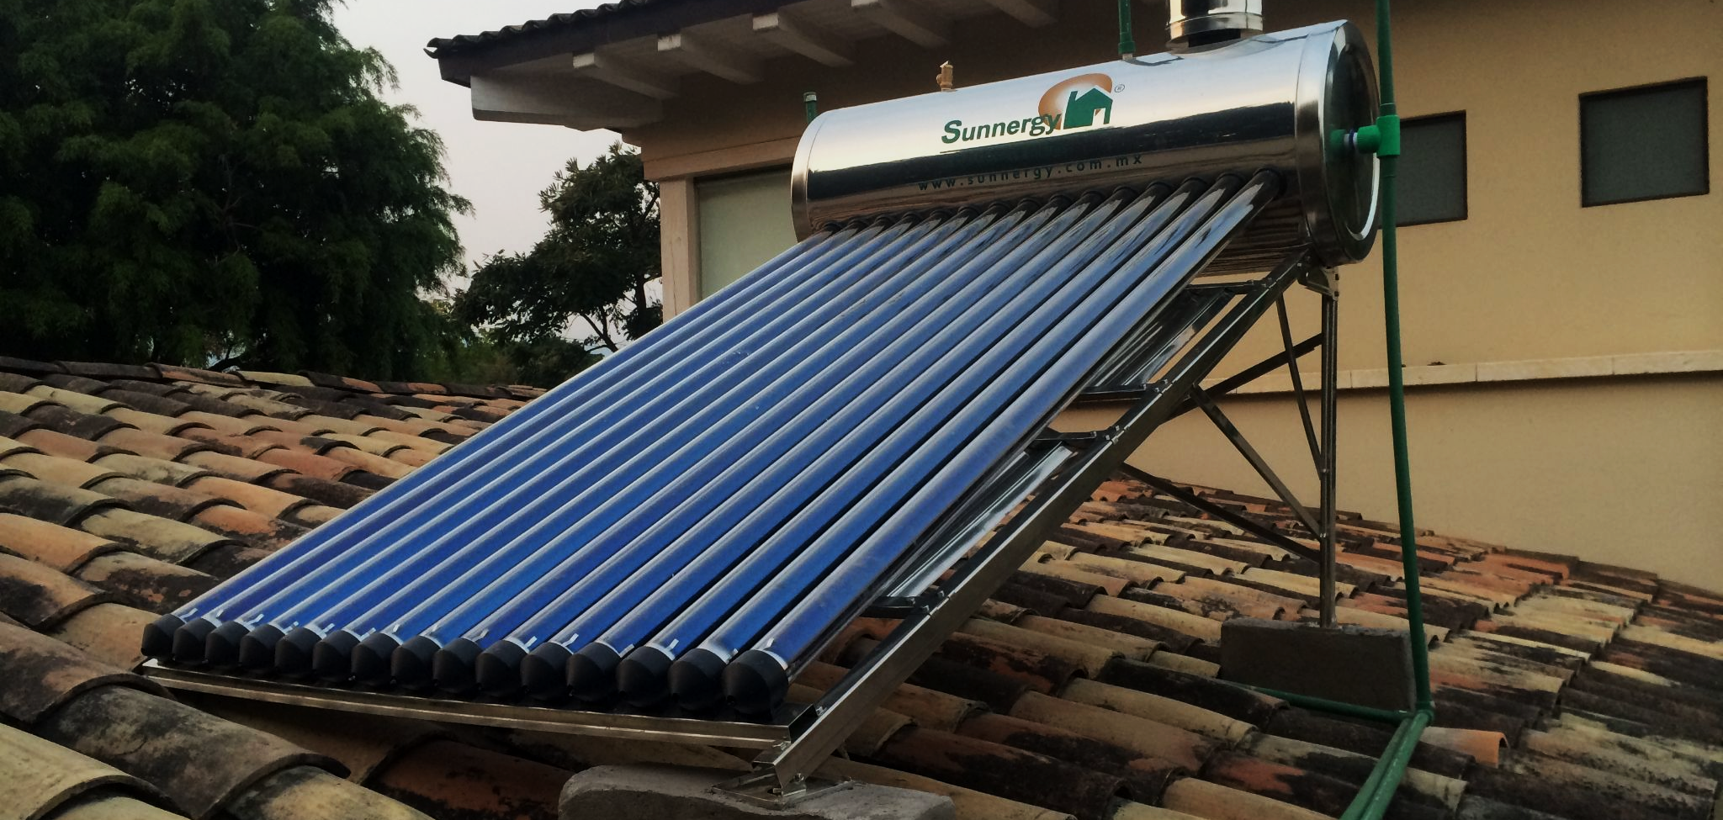
Solar heating panels use black pipes to absorb as much solar energy as possible. This energy is then used to heat domestic water.

Slide 16
Geothermal Power
Geothermal power involves the use of underground sources of heat.
Much of this heat is generated from the radioactive decay of rocks underneath the Earth’s surface.
Cold water is pumped down to the hot rocks.
The rocks heat the water which is then pumped to a turbine.
This turbine drives a generator, creating electricity.
Geothermal power is free to run and non-polluting.
In suitable areas, large amounts of energy can be generated.
It is expensive to drill down to the rocks.
In order to generate enough heat, several kilometres of drilling is required.
There are very few areas where geothermal plants are suitable.
Geothermal is only economically viable when the heated rocks are near the surface.
GENERATOR
HOT
WATER
COLD
WATER
Geothermal power harnesses the thermal energy from hot rocks to heat water. This can then be used to generate electricity.

Slide 17
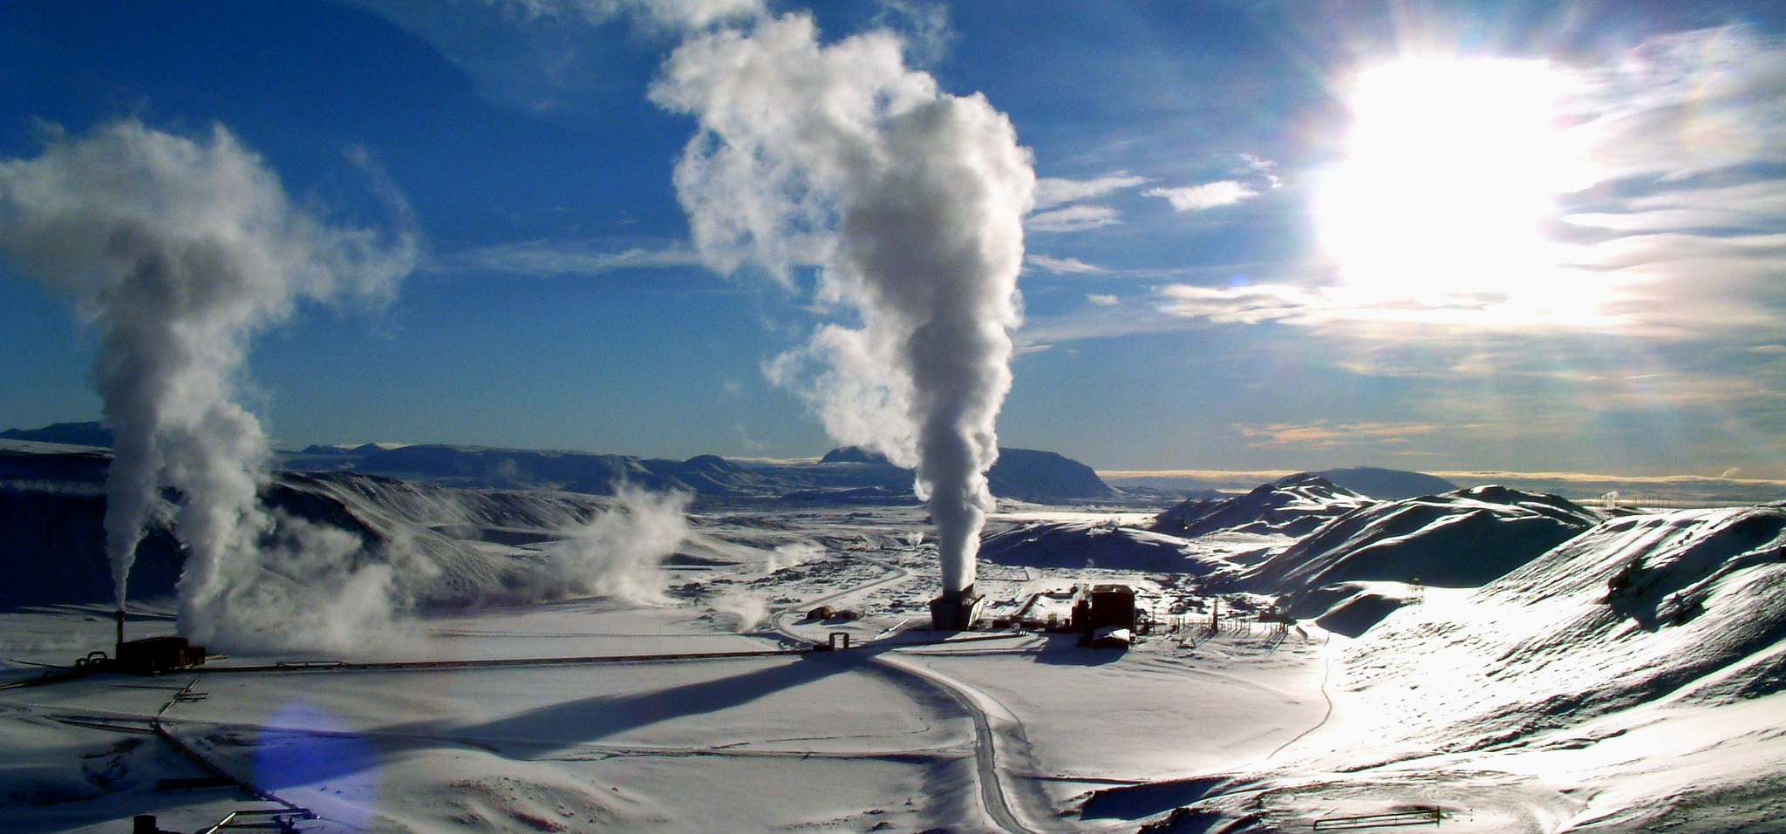
Whilst a clean and renewable form of energy, geothermal power has high setup costs. Geothermal power is also only viable in a limited number of locations.

Slide 18
Tidal Power
Tidal power involves the use of waves or tidal barrages.
Wave convertors are placed near the coast.
Tidal barrages are dams built across the estuaries of rivers.
Tidal power uses the energy from waves to drive a turbine.
This turbine is linked to a generator.
The generator converts the kinetic energy of the wave into electricity.
Tidal power is free to run and non-polluting.
When utilised properly, tidal power can generate lots of electricity.
Tidal power is dependent on the wind.
The energy generated by waves is highly dependent on wind speed.
The infrastructure required for tidal power is unsightly and can be hazardous to boats and wildlife.
Tidal power uses the kinetic energy created by waves to drive turbines. This in turn drives a generator, creating electricity.

Slide 19
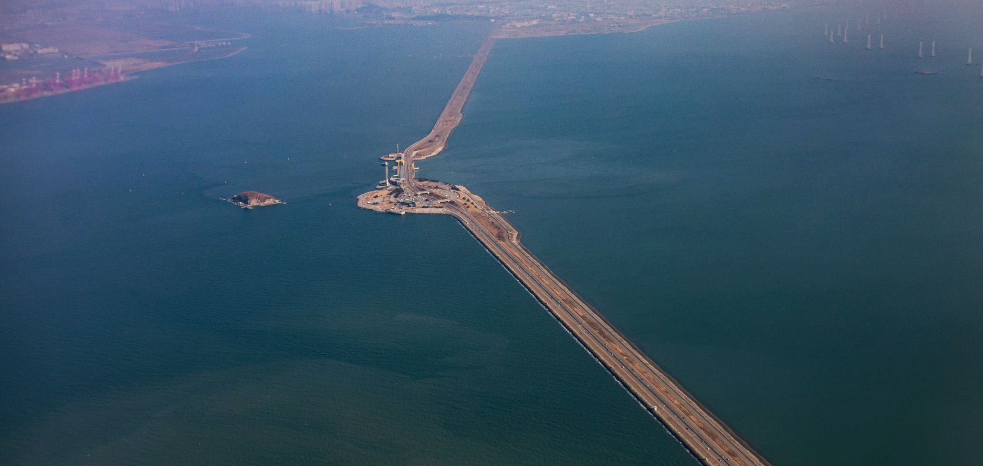
Tidal barrages are often placed at the mouth of estuaries. Many argue that these are extremely unsightly, as well as hazardous to boats and wildlife.

Slide 20
Hydroelectric Power
Hydroelectric power involves the construction of a dam.
This dam is then used to collect rainwater.
Water is gradually released from the dam to drive a turbine.
This turbine is linked to a generator.
The generator converts the kinetic energy of the water into electricity.
Hydroelectric power has low running costs and generates lots of electricity.
Hydroelectric dams can release more water when energy demand is high.
Creating dams causes environmental damage.
Dams are often created by flooding valleys.
This can lead to habitat destruction.
Hydroelectric dams are very expensive to build.
Many complain that the dams are also unsightly.

Slide 21
Hydroelectric power uses dams to store water. Water is released gradually, generating a reliable source of electricity.
1. WATER IS STORED IN A DAM UPSTREAM
4 THE GENERATOR CONVERTS KINETIC ENERGY INTO ELECTRICITY
2. WATER IS GRADUALLY RELEASED THROUGH A NETWORK OF PIPES TO A TURBINE
3. THE WATER DRIVES A TURBINE WHICH IS LINKED TO A GENERATOR

Slide 22
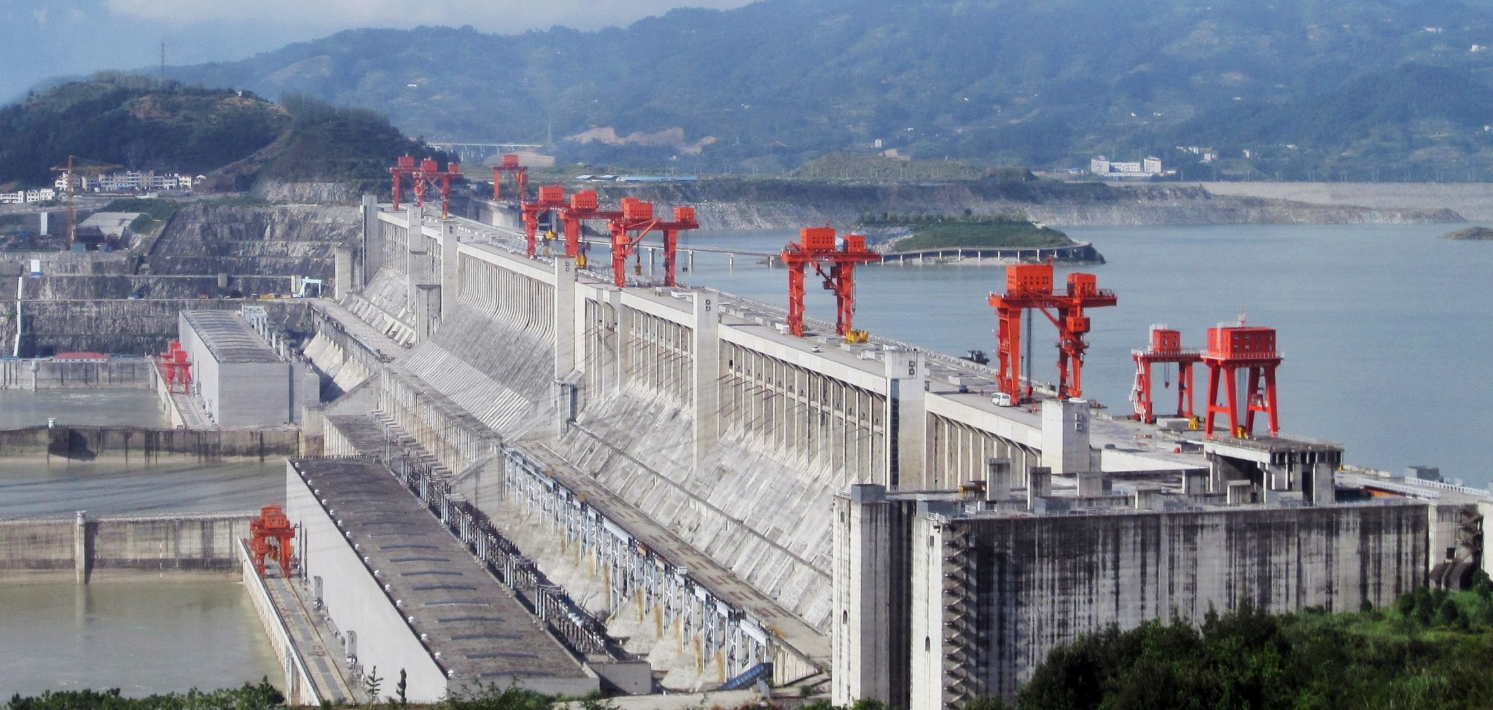
The construction of dams can be hugely destructive to the environment. In the case of the Three Gorges Dam in China, it has also increased the incidence of landslides.

