Slide 1
Edexcel IGCSE Physics
20 - Work and Power
Work Done, Gravitational Potential Energy
For more help, please visit www.exampaperspractice.co.uk
© 2025 Exams Papers Practice. All Rights Reserved

Slide 2
Work Done
Specification Points 4.11 and 4.12
Know and use the relationship between work done, force and distance moved in the direction of the force.
Know that work done is equal to energy transferred.
When energy is transferred from one object to another, work is done on the object.
To make an object move, a force needs to act on that object.
The thing applying the force requires a source of energy.
The energy transferred to an object and the work done on that object are equal to each other.
Energy transferred and work done are both measured in joules (J).
In this example, work is done on the pram to make it move. The pram is moved over a distance by kinetic energy.
For more help, please visit www.exampaperspractice.co.uk
© 2025 Exams Papers Practice. All Rights Reserved

Slide 3
Work Done
The amount of work done (W) on an object is dependent on the size of force (f) applied to it.
It is also dependent on the distance moved (d) by the object.
There is a relationship between work done, force and distance moved:
WORK
DONE
FORCE
DISTANCE
W = work done (J)
f = force (N)
d = distance (m)
Using a formula triangle, work done can be calculated as force × distance.
For more help, please visit www.exampaperspractice.co.uk
© 2025 Exams Papers Practice. All Rights Reserved

Slide 4
A cyclist moving at speed begins to apply the brakes.
The brakes apply 150 N of force to the bicycle. It stops in 20 metres.
Calculate the work done by the brakes.
150 × 20 = 3,000 J
150 N
20 m
For more help, please visit www.exampaperspractice.co.uk
© 2025 Exams Papers Practice. All Rights Reserved

Slide 5
Gravitational Potential Energy
Specification Point 4.13
Know and use the relationship between gravitational potential energy, mass, gravitational field strength and height.
The gravitational potential energy (GPE) of an object can be defined as the energy an object has due to its height in a gravitational field.
All objects that are lifted off the floor have GPE.
If an object is lifted, it will gain GPE.
If an object falls, it will lose GPE.
There is a relationship between GPE, mass, gravitational field strength and height:
GPE
MASS
g
HEIGHT
Using a formula triangle, GPE can be calculated as mass × gravitational field strength × height.
GPE = gravitational potential energy (J)
m = mass (kg)
g = gravitational field strength (N/kg)
h = height (m)
For more help, please visit www.exampaperspractice.co.uk
© 2025 Exams Papers Practice. All Rights Reserved

Slide 6
A paper airplane with a mass of 0.005 kg is dropped from a skyscraper 200 m above the ground.
Calculate the gravitational potential energy of the airplane.
On Earth, the gravitational field strength is 10 N/kg.
0.005 × 10 × 200 = 10 J
200 m
For more help, please visit www.exampaperspractice.co.uk
© 2025 Exams Papers Practice. All Rights Reserved

Slide 7
Kinetic Energy
Specification Point 4.14
Know and use the relationship between kinetic energy, mass and speed.
All moving objects have kinetic energy (KE).
KE can be defined as the energy an object has as a result of its mass and speed.
Objects that have a large mass and that are moving quickly carry lots of KE.
There is a relationship between KE, mass and speed:
KE
0.5
MASS
SPEED²
KE = kinetic energy (J)
m = mass (kg)
v = speed (m/s)
Using a formula triangle, KE can be calculated as 0.5 × mass × speed².
For more help, please visit www.exampaperspractice.co.uk
© 2025 Exams Papers Practice. All Rights Reserved

Slide 8
A frigate with a mass of 5,000,000 kg is travelling at a speed of 15 m/s.
Calculate the kinetic energy of the frigate.
0.5 × 5,000,000 × 15² = 562,500,000 J
DIRECTION OF TRAVEL
For more help, please visit www.exampaperspractice.co.uk
© 2025 Exams Papers Practice. All Rights Reserved

Slide 9
Linking Work, GPE and KE
Specification Point 4.15
Understand how conservation of energy produces a link between gravitational potential energy, kinetic energy and work.
When work is done, energy is transferred from one store to another.
This is due to the law of the conservation of energy.
A falling object will transfer energy from its gravitational potential energy store to its kinetic energy store.
This is only true in theoretical circumstances where there is no air resistance.
GPE → KE
A falling object will convert GPE to KE.
For more help, please visit www.exampaperspractice.co.uk
© 2025 Exams Papers Practice. All Rights Reserved

Slide 10
Power
Specification Points 4.16 and 4.17
Describe power as the rate of transfer of energy or the rate of doing work.
Use the relationship between power, work done and time taken.
Power can be defined as the rate of work done.
The power of a machine is the rate at which it transfers energy.
Power is measured in watts (W).
Machines that transfer energy more quickly have more power.
There is a relationship between power, work done and time:
WORK
DONE
POWER
TIME
Using a formula triangle, power can be calculated as work done ÷ time.
P = power (W)
W = work done (J)
t = time (s)
For more help, please visit www.exampaperspractice.co.uk
© 2025 Exams Papers Practice. All Rights Reserved

Slide 11
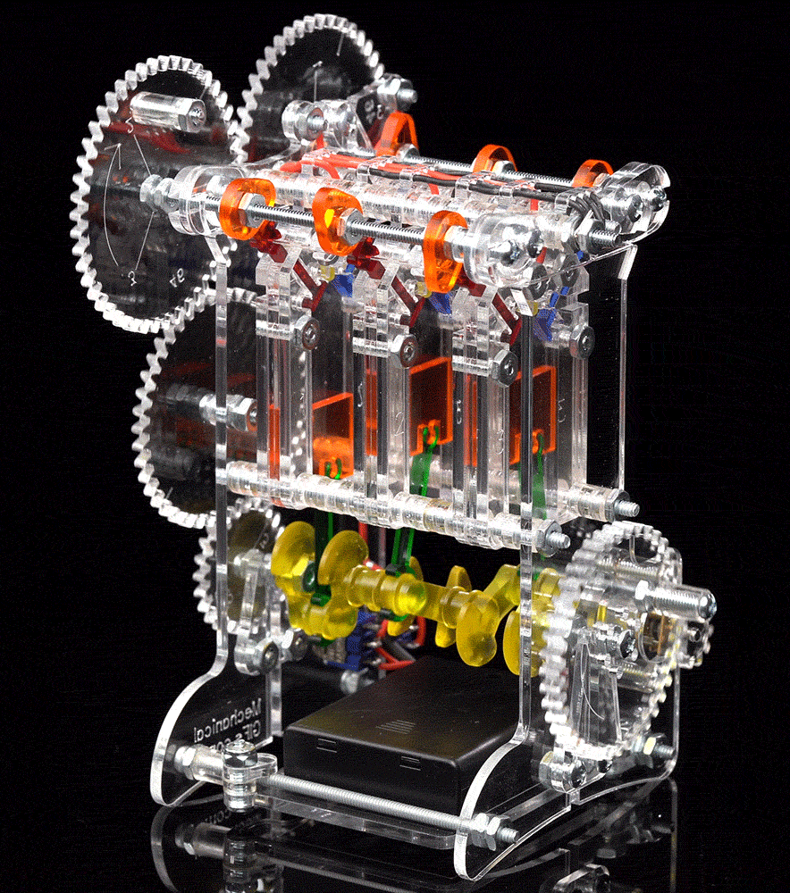
This engine transfers 12 kJ of energy every minute.
Calculate the power generated by the engine.
12 kJ = 12,000 J
1 minute = 60 seconds
12,000 ÷ 60 = 200 W
For more help, please visit www.exampaperspractice.co.uk
© 2025 Exams Papers Practice. All Rights Reserved

