Slide 1
Edexcel IGCSE Physics
1 - Distance and Speed
Relationships and Graphs

Slide 2
Speed and Velocity
Specification Points 1.3 and 1.4
Plot and explain distance−time graphs.
Know and use the relationship between average speed, distance moved and time taken.
Speed and velocity are both measures of how quickly and object is moving.
Speed is a scalar quantity - it does not have a direction associated with it.
Velocity is a vector quantity - it does have a direction associated with it.
Speed is measured in metres per second (m/s).
There is a relationship between average speed, the distance moved, and the time taken to do so.
DISTANCE MOVED
AVERAGE
SPEED
TIME
TAKEN
Using a formula triangle, speed can be calculated as distance moved ÷ time taken.

Slide 3
Distance-Time Graphs
Distance-time graphs record how far an object has moved from a starting position in a given time.
Distance is traditionally measured in metres (m).
Straight lines on a distance-time graph represents constant speed.
If the line is very steep, the object is moving quickly.
If the line is quite shallow, the object is moving slowly.
If the line is horizontal, the object is stationary.
OBJECT A IS MOVING QUICKLY
DISTANCE
OBJECT B IS MOVING SLOWLY
TIME

Slide 4
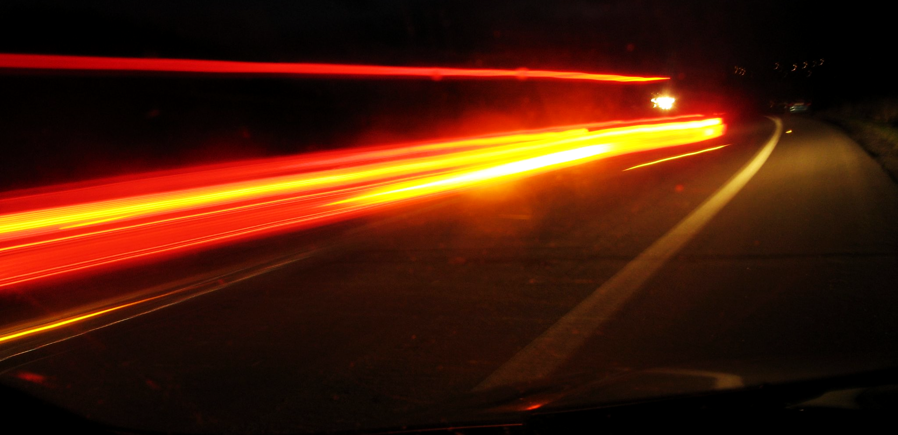
Objects that cover a great deal of distance in a short period of time are said to be traveling at high speed.

Slide 5
300
3. OBJECT MOVING QUICKLY
250
In this example, an object covers 320 metres in 160 seconds.
The average speed of the object is thus 320 ÷ 160 = 2 m/s.
Throughout the object’s journey, it is travelling at different speeds. This is represented by the gradient of the line.
3.9 m/s
200
DISTANCE (m)
150
2. OBJECT STATIONARY
100
0 m/s
50
2.1 m/s
1. OBJECT MOVING SLOWLY
0
20
40
60
80
100
120
140
160
200
TIME (s)

Slide 6
Investigating Speed
Specification Point 1.5
Practical: investigate the motion of everyday objects such as toy cars or tennis balls.
The speed that an everyday object travels when dropped can be investigated using experiments.
Objects such as a paper cone or a tennis ball are commonly used.
Measure a height on a ruler.
This marks the start point of the experiment.
A height of around 1 metre would be appropriate.
Drop a tennis ball from this height.
This will act as the distance travelled by the object.
Use a stopwatch to measure the time it takes for the tennis ball to hit the ground.
Repeat the experiment at different heights.
Repeat at 1.2, 1.4 and 1.6 metres.
The experiment can be modified by using different objects.

Slide 7
TENNIS BALL
The results of this experiment can be analysed to calculate the average speed of the tennis ball as it travels through the air.
Distance the Ball Falls (m) | Time Taken to Fall to Ground (s) | Speed (m/s)
1.0 | 1.52 | 0.66
1.2 | 1.60 | 0.75
1.4 | 1.65 | 0.85
1.6 | 1.67 | 0.96
DISTANCE TRAVELLED BY OBJECT
The average speed of the tennis ball across all distances was:
(0.66 + 0.75 + 0.85 + 0.96) = 3.22
3.22 ÷ 4 = 0.81 m/s
STOP CLOCK

