Slide 1


Edexcel IGCSE Physics
19 - Thermal Energy
Conduction, Convection, Radiation and Insulation
For more help, please visit www.exampaperspractice.co.uk
© 2025 Exams Papers Practice. All Rights Reserved

Slide 2
Conduction, Convection and Radiation
Specification Point 4.6
  Describe how thermal energy transfer may take place by conduction, convection and radiation.
Thermal energy is transferred from a hotter area to a colder one.
There are three ways that thermal energy transfer can happen:
  Conduction.
  Convection.
  Radiation.
An object will continue to lose heat until it is in equilibrium with the surrounding environment.
  At this point the object will be at the same temperature as its environment.
For more help, please visit www.exampaperspractice.co.uk
© 2025 Exams Papers Practice. All Rights Reserved

Slide 3
Conduction
Conduction occurs mainly in solids.
  In solids, particles are held tightly together.
When an object is heated, atoms begin to vibrate.
  The more thermal energy an object has, the greater the level of vibration.
When atoms vibrate, they collide into other atoms.
  This transfers kinetic energy from one atom to the next atom.
  This is the process of thermal conduction.
Metals are very good conductors.
  This is because they contain delocalised electrons which can collide with other atoms easily.
COLD
HOT
CONDUCTION
When a solid is heated, its atoms begin to vibrate. The hotter atoms collide with the cooler atoms, transferring heat energy through the process of conduction.
For more help, please visit www.exampaperspractice.co.uk
© 2025 Exams Papers Practice. All Rights Reserved

Slide 4
Convection
Specification Point 4.7
  Explain the role of convection in everyday phenomena.
Convection occurs in liquids and gases.
  Liquids and gases are sometimes referred to as fluids.
When a fluid is heated, molecules are pushed apart.
  This is referred to as thermal expansion.
The hot fluid is now less dense than the surroundings.
  The hot fluid rises and the cooled fluid moves to replace it.
As the hot fluid cools, it sinks and contracts.
  This phenomenon is called a convection current.
HOT FLUID EXPANDS AND RISES. COLD FLUID CONTRACTS AND SINKS
Convection is used by immersion heaters. Heater coils are used to heat water. As the hot water rises it displaces the cooler water which sinks. This cooler water is then heated by the coils, creating a continuous convection current.
For more help, please visit www.exampaperspractice.co.uk
© 2025 Exams Papers Practice. All Rights Reserved

Slide 5
Convection currents are used in immersion heaters to heat water in apartments and houses.
For more help, please visit www.exampaperspractice.co.uk
© 2025 Exams Papers Practice. All Rights Reserved

Slide 6
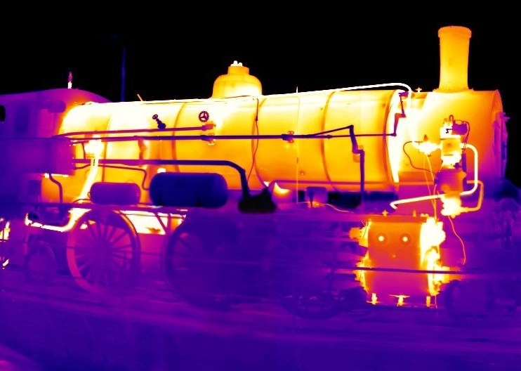
Thermal Radiation
Specification Point 4.8
  Explain how emission and absorption of radiation are related to surface and temperature.
Thermal radiation is sometimes referred to as infrared (IR) radiation.
  All objects emit a certain amount of IR radiation.
A hot object will release more IR radiation than a cool object.
  An object that is hotter than its surroundings will emit more radiation than it absorbs.
  An object that is cooler than its surroundings will absorb more radiation than it emits.
IR radiation can be observed using a thermal imaging camera.
  Hotter areas of the image will appear brighter on the image.
A thermal image of a steam train. Hotter regions of the image are emitting more IR radiation than cooler regions. These appear as brighter hotspots on the image.
For more help, please visit www.exampaperspractice.co.uk
© 2025 Exams Papers Practice. All Rights Reserved

Slide 7

Burning objects such as fires release a lot of infrared or thermal radiation.
For more help, please visit www.exampaperspractice.co.uk
© 2025 Exams Papers Practice. All Rights Reserved

Slide 8
Investigating Thermal Energy Transfer
Specification Point 4.9
  Practical: investigate thermal energy transfer by conduction, convection and radiation.
Conduction can be investigated using wax, glass beads, a bunsen burner and a stand.
Attach a metal bar to a clamp stand.
  Clamp the bar in the middle.
Attach glass beads using wax at regular intervals to one side of the bar.
  Add beads every 5 cm.
Heat the other side of the bar using a bunsen burner.
  As the thermal energy is conducted through the bar, the wax will begin to melt and the beads will fall off of the bar.
For more help, please visit www.exampaperspractice.co.uk
© 2025 Exams Papers Practice. All Rights Reserved

Slide 9
Conduction can be demonstrated using a bunsen burner and a metal bar. As the bar is heated, the wax that attached the beads to the bar will melt and the beads will fall.
METAL BAR
GLASS BEADS ATTACHED WITH WAX
For more help, please visit www.exampaperspractice.co.uk
© 2025 Exams Papers Practice. All Rights Reserved

Slide 10
Investigating Thermal Energy Transfer
Convection can be investigated using potassium permanganate in a beaker of cold water.
Add some potassium permanganate crystals to the beaker.
  Try to ensure the crystals land on one side of the beaker.
Using a bunsen burner, gently heat the crystals.
As the temperature of the beaker increases, the crystals will begin to dissolve.
  This will form a bright purple solution.
The solution will be carried through the beaker by convection currents.
For more help, please visit www.exampaperspractice.co.uk
© 2025 Exams Papers Practice. All Rights Reserved

Slide 11
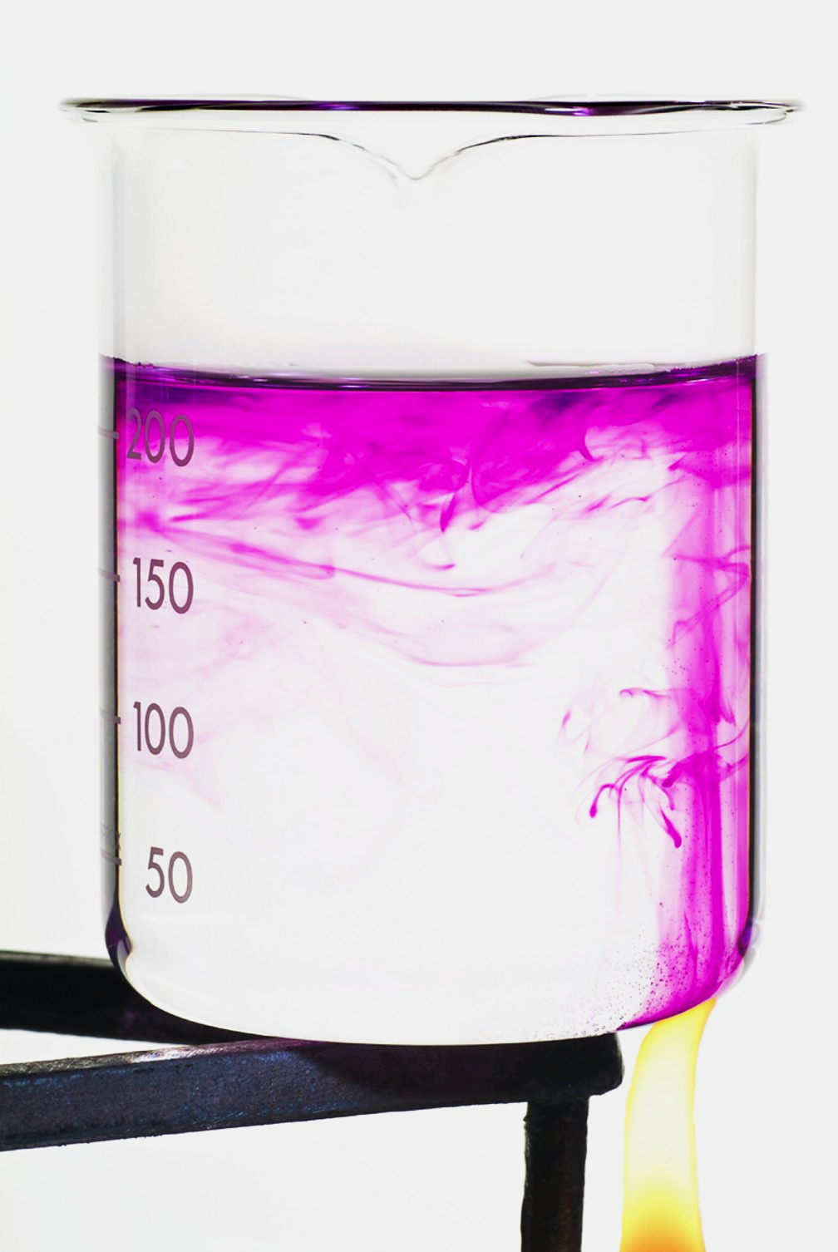
Potassium permanganate crystals will dissolve when heated, creating a visible trace of convection currents.
For more help, please visit www.exampaperspractice.co.uk
© 2025 Exams Papers Practice. All Rights Reserved

Slide 12
Investigating Thermal Energy Transfer
Radiation can be investigated using a Leslie cube.
  A Leslie cube is a hollow metal cube with four different faces.
Fill the Leslie cube with boiling water.
Test the faces of the cube using a thermometer.
  Each face should register at the same temperature.
Using an infrared detector, record how the faces of the cube cool.
  A graph called a cooling curve can be created.
The black face of the cube should cool fastest.
  This is because black is a good radiator of heat.
The white face of the cube should cool slowest.
  This is because white is a poor radiator of heat.
A Leslie cube. The cube has four faces with different colours: matt black, matt white, shiny metal and dull metal.
For more help, please visit www.exampaperspractice.co.uk
© 2025 Exams Papers Practice. All Rights Reserved

Slide 13
A cooling curve showing the four colours of the Leslie cube. Matt black cools fastest, followed by matt white, dull metal and shiny metal.
TEMPERATURE (°C)
TIME (MINS)
For more help, please visit www.exampaperspractice.co.uk
© 2025 Exams Papers Practice. All Rights Reserved

Slide 14
Insulation
Specification Point 4.10
  Explain ways of reducing unwanted energy transfer, such as insulation.
All objects have a certain thermal conductivity.
  Good conductors of heat have a high thermal conductivity.
  Poor conductors of heat have a low thermal conductivity.
Good insulators have low thermal conductivity.
  This helps to reduce heat that might be lost by conduction.
Good insulators also reduce heat loss by convection.
  Insulators trap pockets of air, reducing the movement of fluid.
  This prevents the formation of convection currents.
Insulation is used in the construction of roofs to minimise heat loss by conduction and convection.
For more help, please visit www.exampaperspractice.co.uk
© 2025 Exams Papers Practice. All Rights Reserved

Slide 15
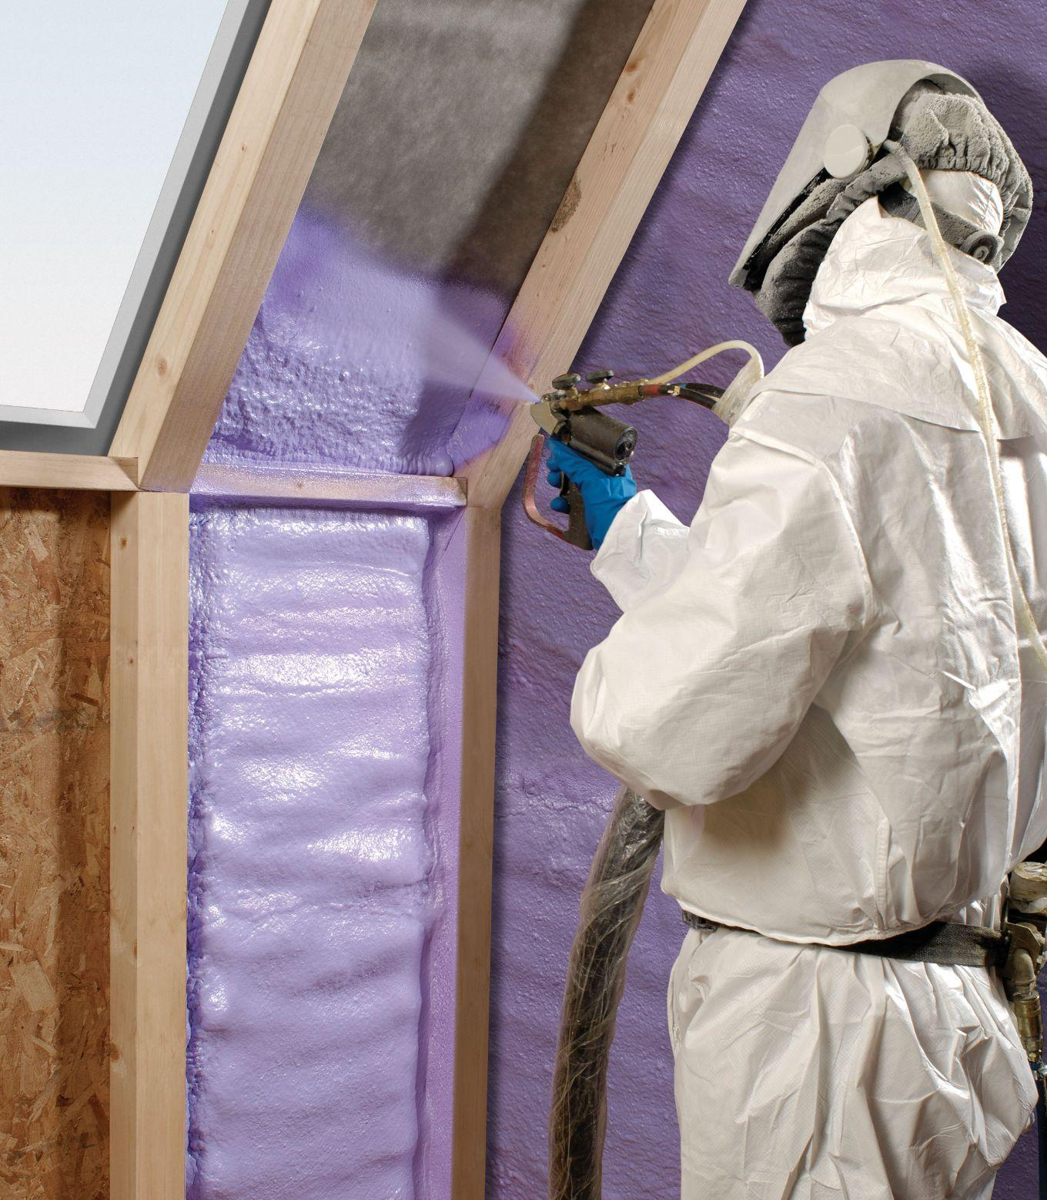
Materials with poor thermal conductivity, such as insulating foams, are used to fill cavities in walls and reduce the rate of thermal energy transfer. This form of insulation makes homes more energy efficient and can save money on heating bills.
For more help, please visit www.exampaperspractice.co.uk
© 2025 Exams Papers Practice. All Rights Reserved

