Slide 1
Edexcel IGCSE Physics
18 - Energy
Energy Stores, Efficiency and Sankey Diagrams

Slide 2
Stores of Energy
Specification Points 4.1 and 4.2
  Use the following units: kilogram (kg), joule (J), metre (m), metre/second (m/s), metre/second2 (m/s2), newton (N), second (s) and watt (W).
  Describe energy transfers involving energy stores.
Energy is the capacity to do work.
  It's the power that enables us to perform actions and make things move or change.
Energy can be stored in a variety of ways.
  Energy is held in a number of different energy stores.
Energy can be transferred from one store to another in four main ways:
  Mechanical transfer.
  Electrical transfer.
  Heat transfer.
  Radiation transfer.
Energy is released during an explosion. This is a form of chemical energy being converted into other forms of energy.

Slide 3
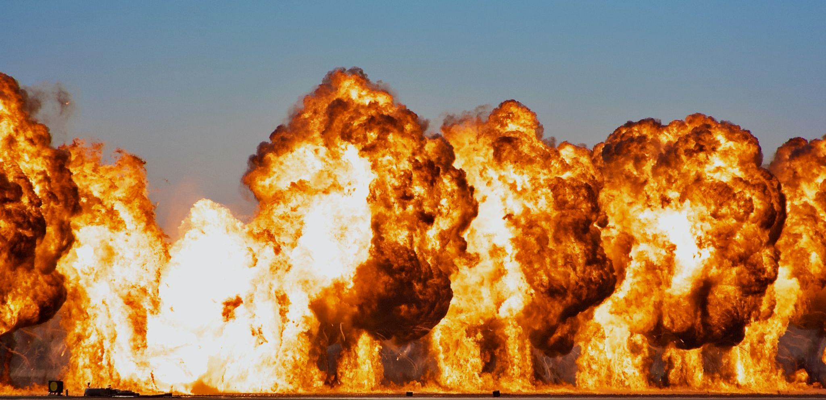
During an explosion, chemical energy is transformed into other energy forms like heat, light and kinetic energy.

Slide 4
Energy Stores
An energy store is a way of describing something that has energy which can be changed or transferred.
  There are lots of different energy stores:
Thermal energy stores related to the energy a system has due to its temperature.
  It's the total potential and kinetic energy of all the particles in a system.
  For example, a hot cup of tea has more energy in its thermal energy store than a cold one.
Kinetic energy stores refer to the energy an object possesses because of its motion.
  For example, a moving car or a rolling ball have energy in their kinetic energy stores.
Gravitational potential energy stores describe the energy an object has due to its position in a gravitational field.
  For example, if you lift a book off the ground, it has energy in its gravitational potential energy store because it has the potential to fall.

Slide 5
Any moving object possesses kinetic energy.

Slide 6
All objects contain some thermal energy.
The hotter a substance is, the more thermal energy it possesses.

Slide 7
Any object that is has the potential to fall from a height has gravitational potential energy. In this instance, a tennis ball is the example.
DROPPED FROM 2 m

Slide 8
Energy Stores
Chemical energy stores are the energy stored in the bonds between atoms and molecules.
  For example, the food we eat or the petrol we use in cars have energy in their chemical energy stores, which is released during chemical reactions.
Elastic potential energy stores refer to the energy stored in an object when it is stretched, compressed, or generally deformed.
  For instance, a stretched rubber band or a compressed spring have energy in their elastic potential energy stores.
Electrostatic energy stores relate to the energy an object has due to its position in an electric field.
  For instance, when you rub a balloon on your hair, it becomes charged and has energy in its electrostatic energy store.
Magnetic energy stores refer to the energy stored within a magnetic field.
  For example, fridge magnets or the Earth's magnetic field have energy in their magnetic energy stores.
A nuclear energy store is the energy stored in the nucleus of an atom.
  This type of energy is released during nuclear reactions, such as those in the sun (nuclear fusion) or in nuclear power plants (nuclear fission).

Slide 9
Fossils fuels like petrol have lots of chemical energy stored in their bonds.
This is released when the fuel is burnt.
PETROLEUM

Slide 10
Positively and negatively charged objects are attracted to each other. This creates electrostatic energy.
+
-

Slide 11

Elastic objects, such as rubber bands, will store energy when stretched. This is referred to as elastic potential energy.

Slide 12
Objects that are attracted to or repulsed by each other using magnetic fields are storing magnetic energy.

Slide 13
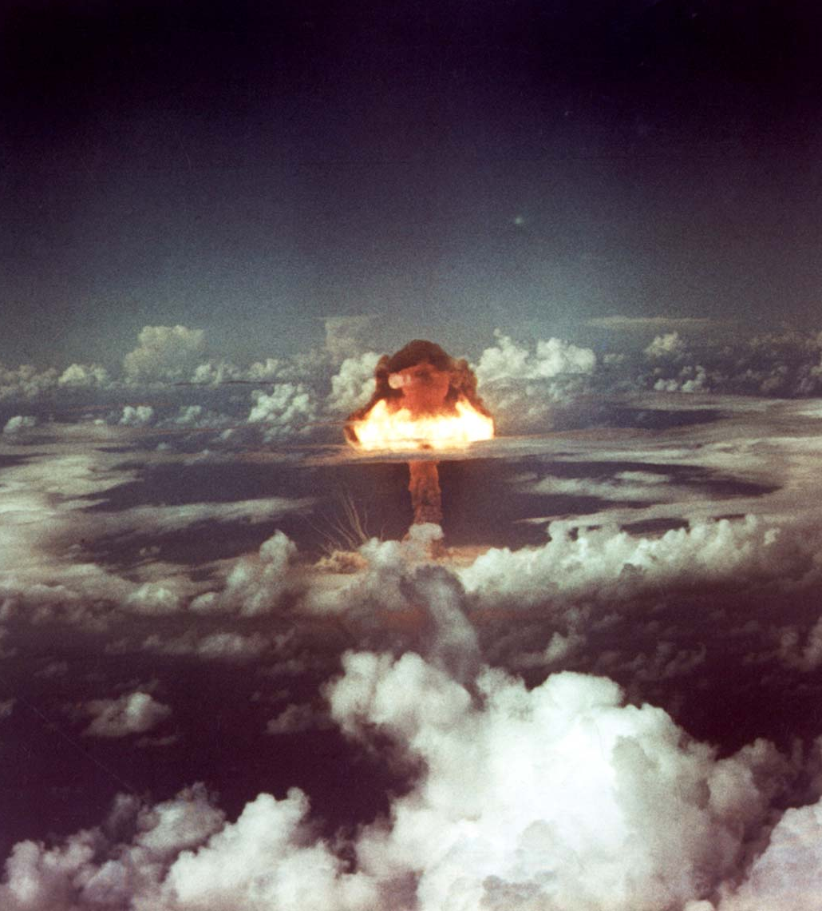
The energy contained within the nucleus of an atom is referred to as nuclear power.
This has been harnessed in devices like nuclear weapons.

Slide 14
Store of Energy | Description | Example
Kinetic | Any object that is moving has kinetic energy. | A moving car.
Thermal | All substances hold a certain amount of thermal energy. The hotter the substance is, the more energy it holds. | A radiator.
Chemical | Anything that can release energy during a chemical reaction. This is due to energy held in chemical bonds. | Fossil fuels.
Gravitational Potential | Any object that is held above the ground. As the object falls, it loses energy. | A raised weight.
Elastic Potential | Any object that is stretched. Energy is released when the object recoils. | A rubber band.
Electrostatic | Any two objects that are attracted or repulsed by each other due to electrostatic charges. | Hair and a brush.
Magnetic | Any two objects Any two objects that are attracted or repulsed by each other due to magnetic fields. | Two magnets.
Nuclear | Any atom that can release energy from its nucleus during nuclear reactions. | Uranium.

Slide 15
Energy Transfer
Mechanical transfer occurs when a force acts on a body.
  Mechanical transfer may occur by pushing, pulling, stretching or squashing.
Electrical transfer occurs when electricity moves around a circuit.
  Electricity may be transferred from a power source (such as a battery) to an electrical component.
Heat transfer occurs when thermal energy is transferred from a hotter object to a colder one.
  Heat transfer may occur by conduction, convection or radiation.
Radiation transfer occurs when energy is transferred by light or sound waves.
  IR radiation from the sun may be transferred to heat when it reaches the Earth’s atmosphere.

Slide 16
SUN
Infrared radiation is emitted from the Sun and then travels through the vacuum of space to Earth.
When IR radiation hits the atmosphere, it is transferred into thermal energy.
IR RADIATION

Slide 17
The Conservation of Energy
Specification Point 4.3
  Use the principle of conservation of energy.
The principle of conservation of energy states that energy cannot be created or destroyed.
  This means that, in a closed system, the total energy remains constant.
  A closed system is one that does not interact with its surroundings.
It also states that energy can be transferred from one store to another.
  Energy is only useful when is is transferred from one store to another.
The conservation of energy is a fundamental scientific principle.
  James Prescott Joule showed energy conservation by measuring the heat generated by mechanical work in his famous paddle-wheel experiments.
  Joule published this research in 1845.

Slide 18
Useful Energy
Specification Point 4.4
  Know and use the relationship between efficiency, useful energy output and total energy output.
In most energy transfer systems, energy is lost as heat.
  Whilst most of the electrical energy supplied to a television will be converted to useful light and sound energy, some will be wasted as thermal energy.
  In an electric motor, some of the energy supplied will be converted to useful kinetic energy, but some will be wasted as thermal energy.
Systems that are efficient will waste less energy.
  Efficiency is a measure of how much of the total energy is converted into useful energy.
There is an equation linking efficiency, useful energy output and total energy input:
E = efficiency
UO = useful energy output
TO = total energy input

Slide 19
This engine converts most of its 30 kJ of chemical energy into useful kinetic energy. 5 kJ of energy is lost as heat. Calculate the efficiency of this engine.
Useful energy output = 30 - 5 = 25 kJ
Total energy input = 30 kJ
25 ÷ 30 = 0.83
0.83 × 100 = 83%

Slide 20
Examples of Energy Transfer
Specification Point 4.5
  Describe a variety of everyday and scientific devices and situations, explaining the transfer of the input energy in terms of the above relationship, including their representation by Sankey diagrams.
There are a number of examples that demonstrate energy transfer:
  A bunsen burner heating up a beaker.
  A bat hitting a ball.
  An electric car.
THERMAL → THERMAL + LIGHT
When a bunsen burner is used to heat up a flask of water, some of the useful heat energy is wasted by heating up the surroundings. Some energy is also lost as light energy.

Slide 21


When a bat is used to hit a ball most of the kinetic energy is transferred efficiently.
Some energy is lost as thermal energy and sound energy.
KINETIC → KINETIC + THERMAL + SOUND

Slide 22
When an electric car is used, chemical energy from the battery is converted into the kinetic energy of movement, as well as light energy for the headlamps.
Some energy is wasted as thermal energy as well as sound.
CHEMICAL → KINETIC + THERMAL + SOUND + LIGHT

Slide 23
Sankey Diagrams
Energy transfer is represented graphically using Sankey diagrams.
Sankey diagrams reveal how much energy is being wasted.
  The arrow coming in from the left hand side is the energy input.
  The arrow leaving on the right hand side is the useful energy transferred.
  The arrow coming off the bottom is the energy wasted.
Take the example of a light bulb. 4 joules of energy is supplied to the bulb.
ENERGY CONVERTED TO LIGHT (1 J)
ENERGY INPUT (4 J)
ENERGY WASTED AS HEAT (3 J)
As only 1 of the 4 joules is converted to light, the efficiency of this system is 25%.

