Slide 1
Edexcel IGCSE Physics
17 - Sound Waves
Speed, Frequency, Pitch and Amplitude
Paper 2

Slide 2
Sound Waves
Specification Point 3.24P
Know that the frequency range for human hearing is 20–20,000 Hz.
Sound travels as a longitudinal wave.
Sound is caused by vibrating objects, such as speakers.
The human ear can detect the vibrations caused by sound waves.
The frequency range for human hearing is between 20-20,000 Hz.
Anything lower than 20 Hz is called infrasound.
Anything higher than 20,000 Hz is called ultrasound.
Other animals can detect different frequencies of sound wave.
Bats can use echolocation to detect object at up to 200,000,000 Hz.
Humans can detect frequencies between 20-20,000 Hz.

Slide 3
Oscilloscopes and Microphones
Specification Point 3.26P
Understand how an oscilloscope and microphone can be used to display a sound wave.
Microphones can detect sound waves travelling through the air.
Microphones are sometimes referred to as sound wave receivers.
Sound waves can be displayed using an oscilloscope.
An oscilloscope is a device that can display rapidly changing signals.
Oscilloscopes display sound waves as a trace on a screen.
An oscilloscope, in combination with a microphone, can be used to detect and visualise sound waves.

Slide 4
Frequency and Pitch
Specification Point 3.28P
Understand how the pitch of a sound relates to the frequency of vibration of the source.
The frequency of a wave can be defined as the number of complete vibrations per second.
Frequency is measured in hertz (Hz).
High frequency sounds have a high pitch.
Pitch is defined as the highness or lowness of a sound.
For example, a squeaking mouse will have a high pitch.
Low frequency sounds have a low pitch.
Pitch can be estimated using an oscilloscope.
If many waves are displayed on the screen at any one time, the sound is of a high frequency, and therefore a high pitch.

Slide 5
LOW FREQUENCY/PITCH
Sound waves at a low frequency will have a longer wavelength (λ) than those at a high frequency.
HIGH FREQUENCY/PITCH

Slide 6
Loudness and Amplitude
Specification Point 3.29P
Understand how the loudness of a sound relates to the amplitude of vibration of the source.
Sound waves with a higher amplitude carry more energy.
The more energy a sound wave carries, the louder it appears.
The amplitude of a sound wave can also be displayed on an oscilloscope.
Louder sounds will have a bigger trace than quieter ones.
QUIETER
LOUDER

Slide 7
The Speed of Sound
Specification Point 3.25P
Practical: investigate the speed of sound in air.
An experiment can be carried out to measure the speed of sound between 2 points.
The speed of sound in air is around 340 m/s.
Move 2 students at least 100 m away from each other.
This distance can be measured out using a measuring wheel.
Have the first student clap their hands together.
This will generate a sound wave that will travel through the air.
The second student should start a stopwatch when they see the first student clap their hands.
The second student should stop the stopwatch when they hear the first student clap their hands.
The difference in time between seeing and hearing the clap should be recorded.
Speed of sound video.

Slide 8
STUDENT A (OBSERVING)
STUDENT B (CLAPPING)
In this example, student A recorded an average time to hear the clap of 0.3 seconds.
Speed = distance ÷ time.
100 ÷ 0.3 = 345 m/s
100 m

Slide 9
Using an Oscilloscope
Specification Point 3.27P
Practical: investigate the frequency of a sound wave using an oscilloscope.
An oscilloscope can be used to calculate the frequency (f) of a sound wave.
The horizontal axis on an oscilloscope display shows time (T).
There is an equation linking frequency and time:
ONE COMPLETE CYCLE INVOLVES BOTH UPWARD AND DOWNWARD PORTIONS OF THE WAVE
f = frequency (Hz)
T = time (s)
In this example, 1 complete cycle takes 0.02 seconds. 1 ÷ 0.02 = 50 Hz.

Slide 10
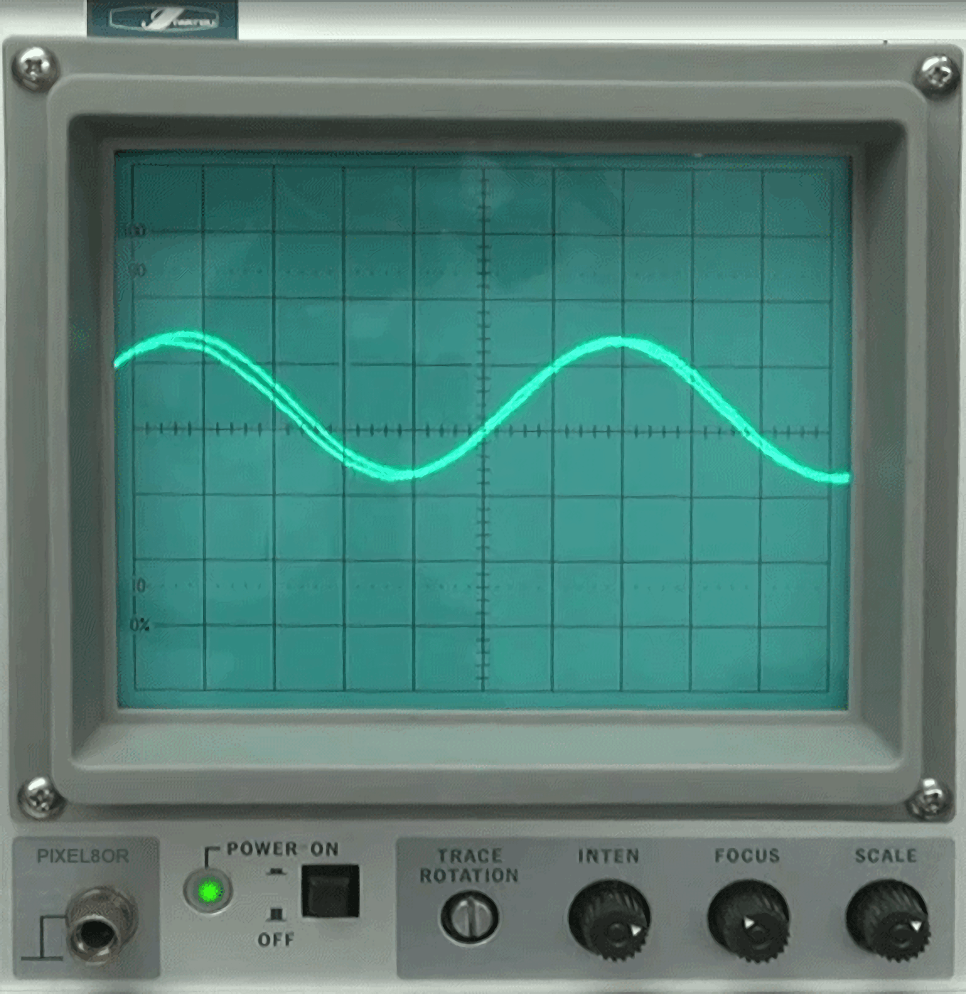
Oscilloscopes contain scales, called time divisions, which allow an observer to quickly determine the frequency of a particular sound wave.

