Slide 1
Edexcel IGCSE Physics
16 - Reflection and Refraction
Light and Sound Waves, Ray Diagrams and the Critical Angle

Slide 2
Light, Reflection and Refraction
Specification Points 3.9 and 3.14
Explain that all waves can be reflected and refracted
Know that light waves are transverse waves and that they can be reflected and refracted.
Visible light is a transverse wave.
This means that the vibrations of the wave are at 90° to the direction of energy transfer.
Visible light can be reflected off of most surfaces.
This means that light will bounce off the object.
When light bounces off a smooth surface (like a mirror), a clear reflection will form.
When light bounces off a rough surface (like a piece of paper), a diffuse reflection will form.
Light can also be refracted when passing through objects of different densities.
Waves will travel at different speeds through different mediums (such as air and water.)
This will cause the wave to change direction.

Slide 3
The Law of Reflection
MIRROR
Specification Points 3.15 and 3.16
Use the law of reflection.
Draw ray diagrams to illustrate reflection and refraction.
When waves are reflected, they are adhering to the law of reflection.
The law of reflection states that the angle of incidence is always equal to the angle of reflection.
The angle of incidence (i) can be defined as the angle of the wave approaching the boundary.
The boundary is what reflects the wave, such as a mirror.
The boundary is always perpendicular to the normal.
The normal is an imaginary line at 90° to the boundary.
The angle of reflection (r) can be defined as the angle of the wave leaving the boundary.
The law of reflection can be visualised using a ray diagram.
NORMAL
i
r

Slide 4
Reflections on the surface of Mirror Lake in Oregon.

Slide 5
Refraction
Refraction occurs when light passes through media of different densities.
During refraction, light crosses the boundary.
Light waves travel more slowly through denser substances.
Light travels at around 300 million m/s through air.
Light slows to around 200 million m/s through glass.
When light passes through a denser material, it bends towards the normal.
This is because the light waves slow down.
When light passes through a less dense material, it bends away from the normal.
This is because the light waves speed up.
INCIDENT RAY
NORMAL
GLASS BLOCK
REFRACTED RAY
In this ray diagram, waves of light are refracted when they pass through a glass block.

Slide 6
Light, Reflection and Refraction
Specification Point 3.17
Practical: investigate the refraction of light, using rectangular blocks, semi-circular blocks and triangular prisms.
The refraction of light can be investigated using a ray box.
A ray box is a lamp containing plastic combs.
These are used to create rays of light.
Place a rectangular glass block on a piece of paper.
Using a pencil, draw in the normal (perpendicular to the glass block).
This can also be replicated using semi-circular blocks.
Shine a light ray through the block.
Trace the incident and emergent rays on the piece of paper.
Join the lines together to create the refracted ray.
Calculate the angles of incidence and refraction.
This can be done using a protractor.
The angle of incidence should be greater than the angle of refraction.
ANGLE OF INCIDENCE
ANGLE OF REFRACTION

Slide 7
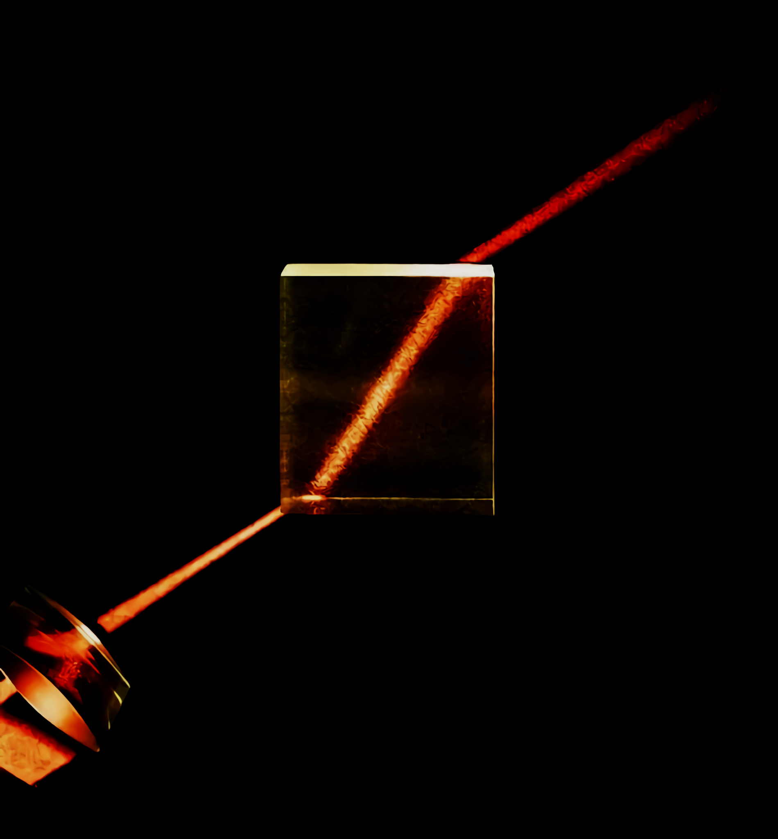
When a light ray passes through a glass block, it is said to be refracted.
The ray bends towards the imaginary normal. The angles of incidence, emergence and refraction can be calculated using a pencil, paper and protractor.

Slide 8
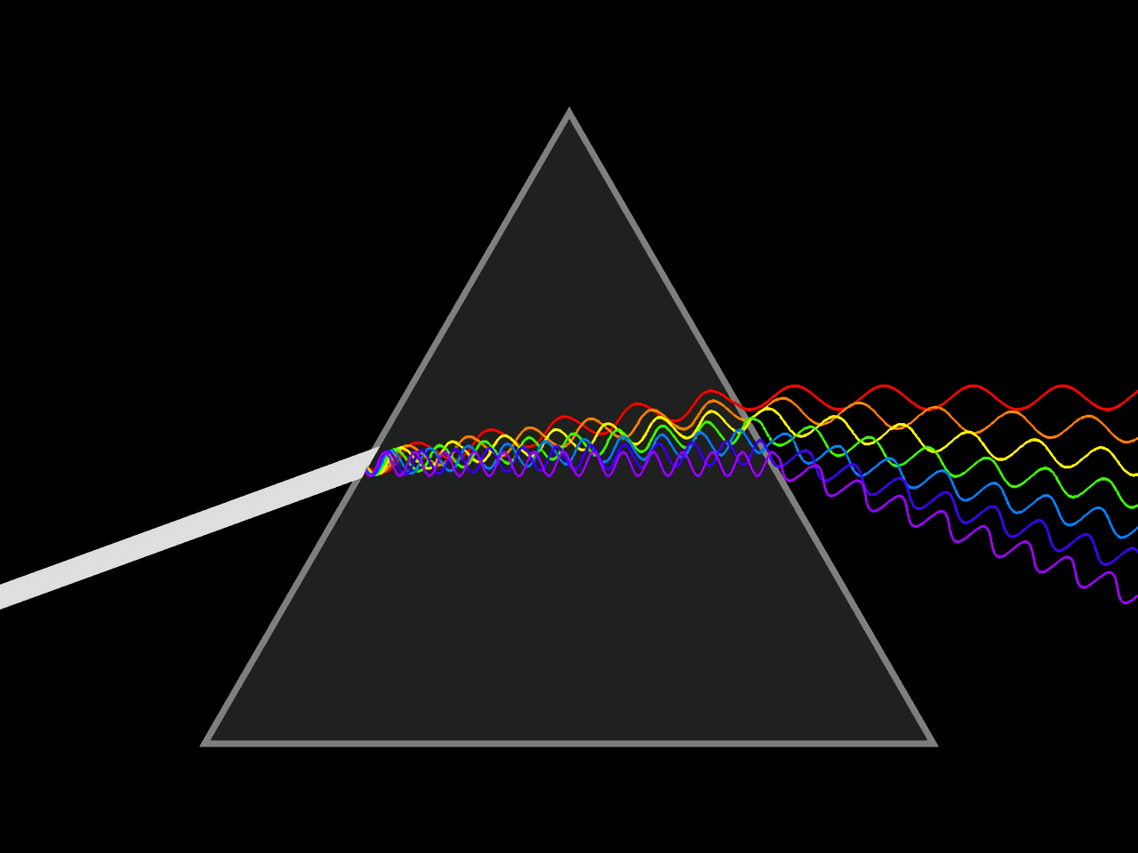
Prisms
The refraction of light can also be investigated using a prism.
A prism has several polished surfaces which refract light at different angles.
When white light is shone through a prism, it will split into different colours.
White light is a mixture of various frequencies of visible light.
As the light leaves the prism, a rainbow effect can be observed.
When light is shone through a prism, it will split into different frequencies, and therefore colours.

Slide 9
The Refractive Index
Specification Points 3.18 and 3.19
Know and use the relationship between refractive index, angle of incidence and angle of refraction.
Practical: investigate the refractive index of glass, using a glass block.
All transparent materials have a refractive index (n).
The refractive index reveals how quickly light is travelling through that particular material.
The refractive index can be calculated using the angles of incidence (i) and refraction (r).
This is sometimes referred to as Snell’s law:
SIN i
n
SIN r
n = refractive index
i = angle of incidence (°)
r = angle of refraction (°)
Using a formula triangle, the refractive index (n) can be calculated as sin i ÷ sin r.

Slide 10
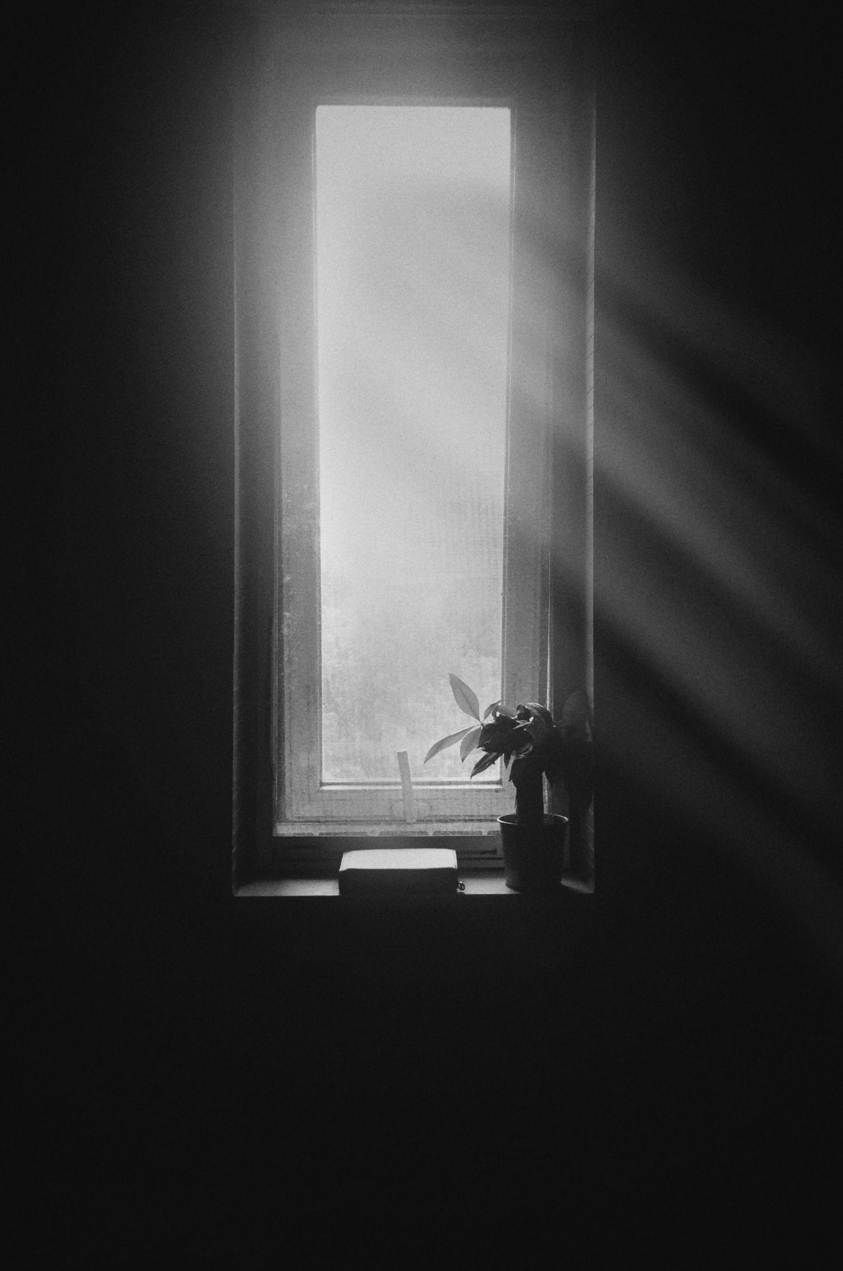
Consider light entering a glass window at 80° - this is the angle of incidence (i).
The density of the glass causes the light to refract to 40° - this is the angle of refraction (r).
Therefore, sin (80) ÷ sin (40) = 1.53.
The refractive index (r) of this pane of glass is 1.53

Slide 11
Total Internal Reflection
Specification Points 3.20 and 3.21
Describe the role of total internal reflection in transmitting information along optical fibres and in prisms.
Explain the meaning of critical angle c.
When light waves move from a denser material to a less dense material, all of the light can be reflected.
This phenomenon is referred to as total internal reflection (TIR).
TIR occurs when the angle of incidence exceeds the critical angle (c).
Past a certain angle, all of the light waves will be reflected.
In glass, c is around 42°.
TIR is used in optical fibres to carry data. Optical fibres are made of plastic or glass. Light will always hit a boundary at a value higher than c.

Slide 12
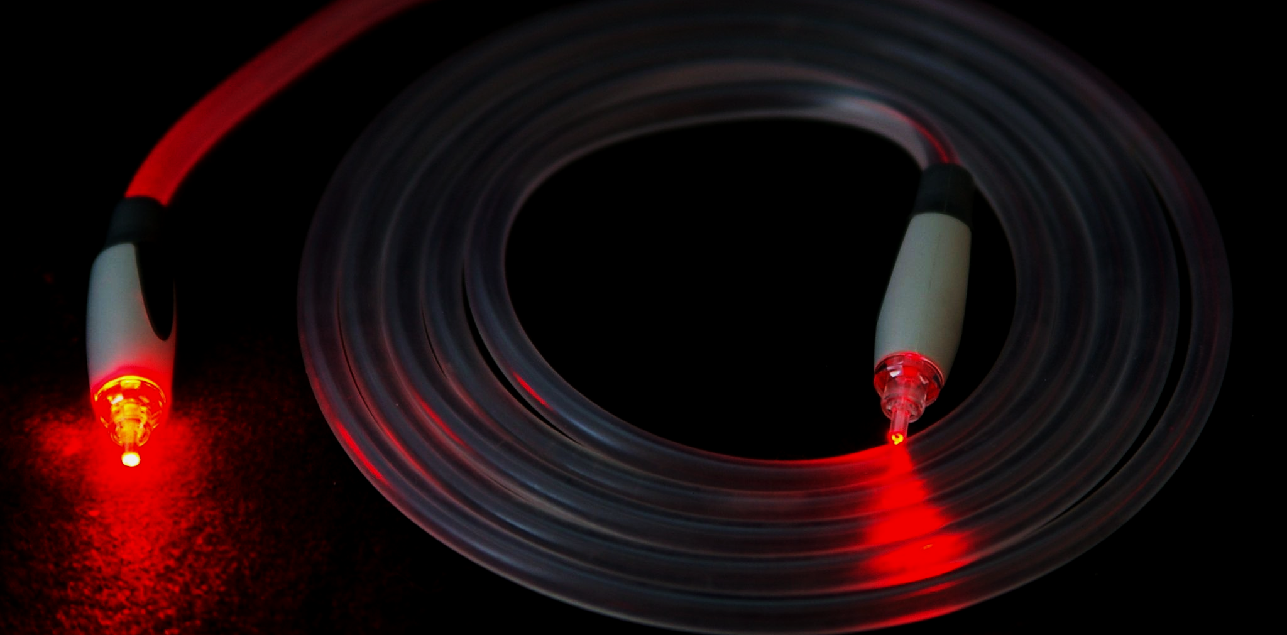
Optical fibres are used to transmit different forms of data by light.

Slide 13
In a right-angled prism, light is totally internally reflected. The image appears as a reflection at 90° to and below the real object.

Slide 14
Critical Angles and the Refractive Index
Specification Point 3.22
Know and use the relationship between critical angle and refractive index.
There is a relationship between c and the refractive index.
The higher the refractive index, the lower the critical angle.
Take the example of water. The critical angle for water is 49°.
This equation can be rearranged to find n.
n = 1 ÷ sin (c) = 1 ÷ sin (49) = 1.32
c = critical angle (°)
n = refractive index

Slide 15
Sound Waves
Specification Point 3.23
Know that sound waves are longitudinal waves which can be reflected and refracted.
Sound waves travel as a longitudinal wave.
This means that the wave travels in the same direction to the transfer of energy.
Sound waves are created when objects (such as speakers) vibrate.
Sound waves can be reflected when they hit hard and flat surfaces.
This will cause a phenomenon known as an echo.
Sound waves can also be refracted when they enter a different medium.
Sound waves will speed up when they enter a denser material.
Sound waves speed up when they move from air to water.

