Slide 1
Edexcel IGCSE Physics
15 - Electromagnetic Waves
The Doppler Effect, The EM Spectrum, Uses and Risks

Slide 2
The Doppler Effect
Specification Points 3.7 and 3.8
  Use the relationship between frequency and wavelength in different contexts including sound waves and electromagnetic waves.
  Explain why there is a change in the observed frequency and wavelength of a wave when its source is moving relative to an observer, and that this is known as the Doppler effect.
The Doppler effect can be defined as the change in frequency of a wave experienced by an observer moving relative to the source of the wave.
  The Doppler effect can be observed when listening to police sirens.
    As the police car drives past, the frequency of the sound waves change from a high pitch to a lower pitch.
When waves are emitted by a stationary object, the waves spread out symmetrically.
  The frequency of the waves are constant.
As an object moves, it appears to catch up with the waves it is emitting.
  The frequency and wavelength of the waves appears to be shortened for an observer standing in front of an approaching object.

Slide 3
OBJECT STATIONARY. WAVELENGTH AND FREQUENCY ARE CONSTANT
OBJECT TRAVELLING. WAVELENGTH AND FREQUENCY APPEAR TO CHANGE
In a travelling police car, the wavelength appears to shorten. This is because the car is catching up with the sound waves it emits. This is referred to as the Doppler effect.

Slide 4
The Electromagnetic Spectrum
Specification Points 3.10 and 3.11
  Know that light is part of a continuous electromagnetic spectrum that includes radio, microwave, infrared, visible, ultraviolet, x-ray and gamma ray radiations and that all these waves travel at the same speed in free space.
  Know the order of the electromagnetic spectrum in terms of decreasing wavelength and increasing frequency, including the colours of the visible spectrum.
The electromagnetic (EM) spectrum is a continuous range of different wavelengths.
  EM waves are transverse.
  EM waves all travel at the same speed (about 300 million m/s.).
  EM waves can travel in a vacuum.
There are seven distinct types of EM wave:
  Radio waves.
  Microwaves.
  Infrared (IR) radiation.
  Visible light waves.
  Ultraviolet (UV) radiation.
  X-rays.
  Gamma (γ) rays.

Slide 5
The electromagnetic (EM) spectrum consists of seven distinct waves, each with different frequencies and wavelengths. Visible light is one part of the EM spectrum and can itself be divided into seven colours. In order of increasing frequency, they are: red, orange, yellow, green, blue, indigo and violet.

Slide 6
Radio Waves
Specification Point 3.12
  Explain some of the uses of electromagnetic radiations.
Radio waves are mainly used for communications.
  Both traditional radio and television use radio waves to transmit data.
Longwave radio can transmit information around the Earth.
  Longwave radio has a wavelength of 1-10 km.
Shortwave radio can be bounced off the atmosphere.
  Shortwave radio has a wavelength of 10-100 m.
  Shortwave radio signals are then picked up by transmitters.
Radio transmitters are used to send and receive shortwave radio signals.

Slide 7
Microwaves
Microwaves are also used in communications.
  Microwaves have a wavelength of 1-10 cm.
Microwaves are often used by satellites.
  Satellite TV and satellite phones both used microwaves.
Microwaves are used in mobile phones and WiFi.
Microwaves are also used to heat food.
  Microwaves heat up the water molecules inside food, causing it to cook.
Microwaves are used in satellite communications (such as satellite TV and satellite phones). The satellite transmits a signal to a receiving dish on the ground.

Slide 8
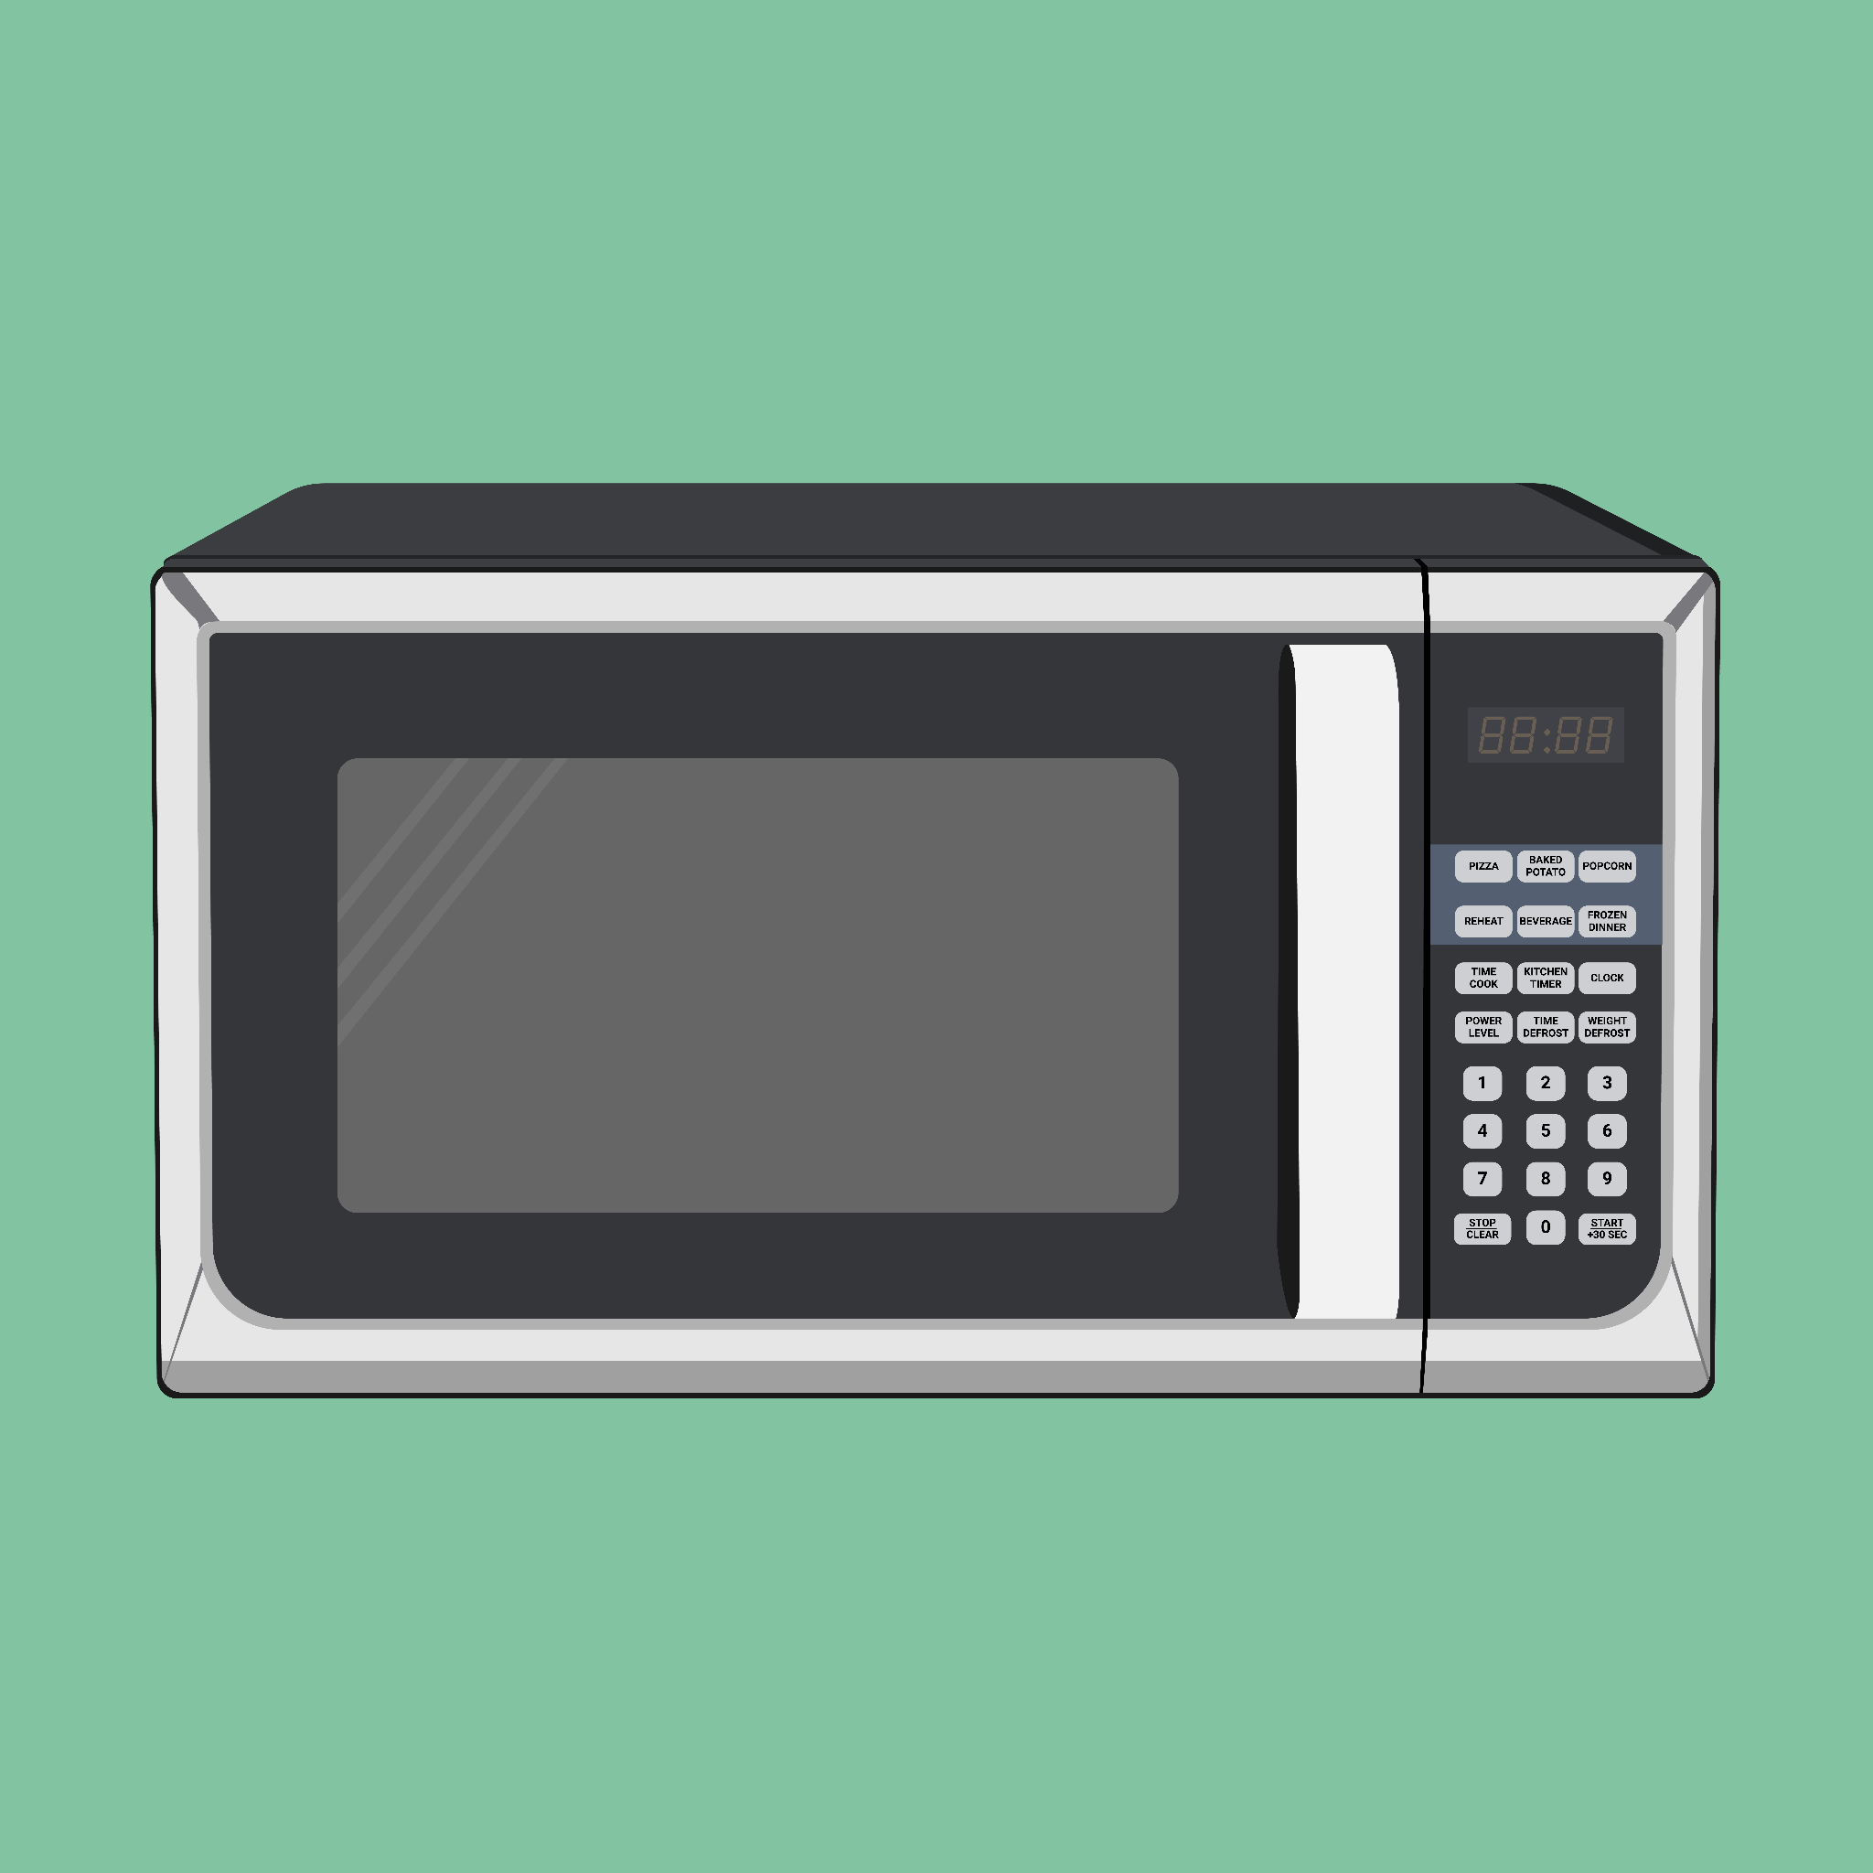
Microwaves are used for heating food.
Water molecules inside the food are bombarded with microwaves. This conducts energy to the rest of the food, causing it to cook.

Slide 9
Infrared Radiation
Infrared (IR) radiation is sometimes referred to as heat radiation.
  IR radiation is used in convection cooking.
  It is also used in electric heaters.
All objects release IR radiation.
  Hot objects will release more IR radiation than cool ones.
IR radiation can be detected using specialised equipment.
  Night-vision goggles use IR radiation to help people see in the dark.
IR radiation is used by radiators to conduct heat.

Slide 10
Visible Light
Visible light is used in optical fibres.
  Optical fibres (often referred to as fibreoptics) use visible light to carry data.
  Light is bounced off the inside of an optical core.
  Optical fibres are used in broadband and telephone lines.
Visible light is used for photography.
  Cameras use lenses which focus light onto a sensor.
  The sensor captures the image and stores it as digital information.
  The amount of light that hits the sensor is controlled by both aperture and shutter speed.
Visible light is used in photography to capture images.

Slide 11
UV Radiation
Ultraviolet (UV) radiation is often used in combination with fluorescent bulbs.
  Fluorescent bulbs absorb UV radiation and then emit visible light.
Fluorescent bulbs are very energy-efficient.
  They are much more efficient than traditional filament light bulbs.
UV radiation is also found in sunlight.
  Many people sunbathe in order to achieve a suntan.
UV radiation is used in fluorescent bulbs. These are more energy-efficient than traditional filament bulbs.

Slide 12
X-Rays
X-rays are used in medical imaging.
  X-rays are used to look at the internal structure of the human body.
X-rays can penetrate the body.
  The x-rays are then detected using a detector plate.
Denser regions of the body absorb more x-rays.
  Fewer x-rays reach the detector from these regions.
  These areas show up more brightly on a photograph.
X-rays are used to diagnose broken bones.
  Bones are dense so will show up as a bright white on a photograph.
X-rays are used to diagnose broken bones.

Slide 13
Gamma Rays
Gamma rays (γ) are harmful to all forms of life.
Gamma rays are used to sterilise medical equipment.
  Gamma rays are useful to kill pathogens and other microorganisms.
  Gamma rays are used to sterilise sensitive medical equipment, which may be damage by more traditional methods like boiling.
Gamma rays are also used to sterilise food.
  Gamma rays can be used to preserve food for longer periods of time.

Slide 14
Dangers of EM Radiation
Specification Point 3.13
  Explain the detrimental effects of excessive exposure of the human body to electromagnetic waves and describe simple protective measures against the risks.
As the frequency of the EM wave increases, so does the energy.
  EM waves with a high frequency have the ability to knock electrons off atoms.
  These EM waves are sometimes referred to as ionising.
IR radiation can cause skin burns.
  IR radiation has a heating effect.
  In extreme circumstances this can lead to skin burns.
  This risk can be reduced by wearing insulating materials.
UV radiation can damage cells and cause blindness.
  UV radiation can cause direct damage to cells, leading to burns and potentially skin cancer.
  UV radiation can also permanently damage cells in the retina of the eye, leading to blindness.
  These risks can be reduced by avoiding eye contact with the sun, and wearing appropriate sunscreen when outside.

Slide 15
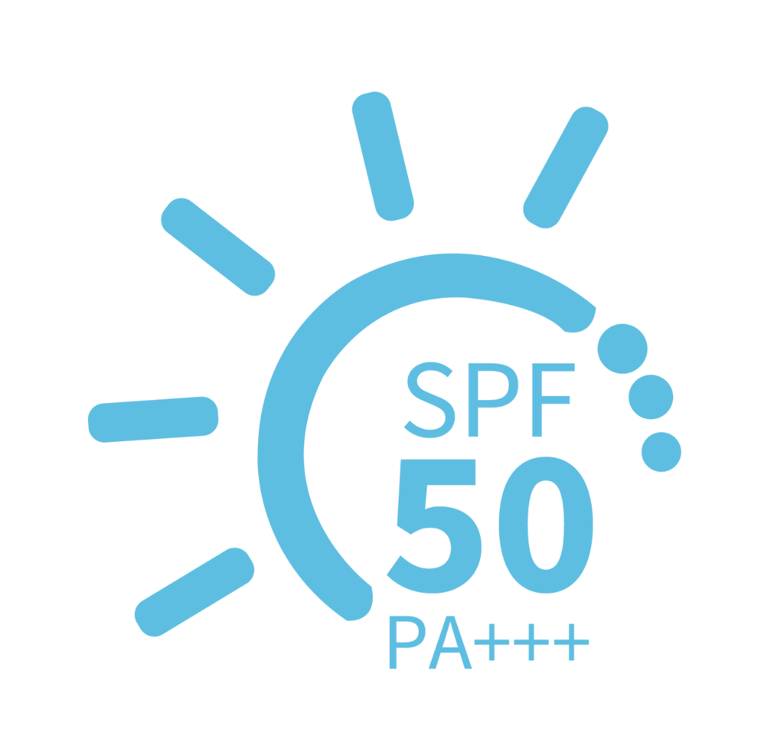
Wearing sunscreen with an appropriate sun protection factor (SPF) can help reduce the risk of sun-damage by UV radiation.

Slide 16
Dangers of EM Radiation
X-rays can cause damage to cells.
  X-rays are ionising and can lead to cell damage and cancers.
  However, the levels of x-rays used in medical procedures is very small and poses almost no risk to patients.
  Doctors who are regularly exposed to x-rays are routinely tested to ensure they are receiving a safe dose of radiation.
Gamma radiation is very dangerous.
  Gamma radiation is the most ionising form of EM radiation.
  Gamma radiation can penetrate deep into the body, causing cell damage and cancers.
  Sources of gamma radiation should be kept in lead-lined containers to minimise their risk.
  Patients who are receiving gamma radiation (for radiation treatments) should ensure their time exposed is as short as possible.

Slide 17
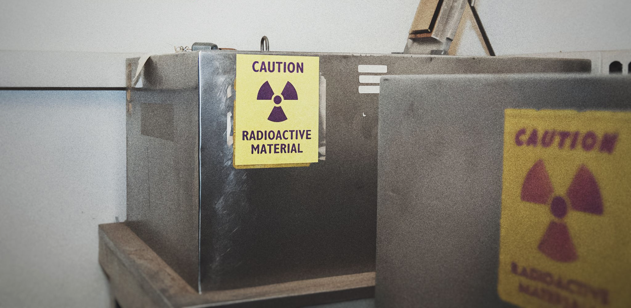
Sources of gamma radiation should be kept shielded, using dense materials such as lead.

