Slide 1
Edexcel IGCSE Physics
14 - Waves
Transverse and Longitudinal Waves, The Wave Equation

Slide 2
Waves
Specification Points 3.1 and 3.3
  Use the following units: degree (°), hertz (Hz), metre (m), metre/second (m/s) and second (s).
  Know the definitions of amplitude, wavefront, frequency, wavelength and period of waves.
Energy can be transferred through waves.
  A wave can be defined as an oscillation or vibration around a rest position.
The amplitude of a wave can be defined as its height.
  This is measured from rest to crest.
  Amplitude is measured in metres (m).
Wavelength can be defined as the distance from one point on a wave to the same point on the next wave.
  Wavelength is measured in m and given the symbol λ.
The frequency of a wave can be defined as the number of complete waves that occur in one second.
  Frequency is measured in hertz (Hz) and given the symbol f.

Slide 3
AMPLITUDE (m)
WAVELENGTH (λ)
DISPLACEMENT
DISTANCE →
A diagram showing the wavelength and amplitude of a wave.

Slide 4
Waves
DIRECTION OF TRAVEL →
The speed or velocity of a wave can be defined as how fast a wave travels in a given time.
  Speed is measured in metres per second (m/s) and given the symbol v.
The time period of a wave can be defined as how long it takes for one complete wave to pass a certain point.
  Time is measured in seconds (s) and given the symbol T.
A wavefront visualises waves from above.
  A wavefront is drawn to imagine the vibrating part of a wave.
  When wavefronts are close together, the wavelength is short.
  When wavefronts are far apart, the wavelength is long.
Wavefronts help to visualise how waves move through space.

Slide 5
Transverse and Longitudinal Waves
Specification Point 3.2
  Explain the difference between longitudinal and transverse waves.
Waves can exist in one of two forms.
  A transverse wave.
  A longitudinal wave.
In transverse waves, vibrations are at 90° to the direction of energy transfer.
  Examples of transverse waves include light waves and ripples on the surface of water.
In longitudinal waves, vibrations are in the same direction as energy transfer.
  Examples of longitudinal waves include sound waves and shockwaves.

Slide 6
TRANSVERSE WAVE
In a transverse wave, the wave is vibrating at 90° to the direction of wave travel.
DIRECTION OF VIBRATIONS →
DIRECTION OF WAVE TRAVEL →

Slide 7
DIRECTION OF WAVE TRAVEL
AND VIBRATIONS →
LONGITUDINAL WAVE
In a longitudinal wave, the wave is travelling in the same direction as the vibrations. This is often demonstrated using a silky spring.
AREAS OF THE WAVE THAT ARE CLOSE TOGETHER ARE CALLED COMPRESSIONS
AREAS OF THE WAVE THAT ARE FAR APART ARE CALLED RAREFACTIONS

Slide 8
The Wave Equation
Specification Point 3.5
  Know and use the relationship between the speed, frequency and wavelength of a wave.
The wave equation links wave speed, frequency and wavelength:
Frequency is often measured in kilohertz (kHz) or megahertz (MHz).
  There are 1,000 Hz in a kHz.
  There are 1,000,000 Hz in a MHz.
WAVE SPEED
v = wave speed (m/s)
f = frequency (Hz)
λ = wavelength (m)
FREQUENCY
WAVELENGTH
Using a formula triangle, wave speed can be calculated as frequency × wavelength.

Slide 9
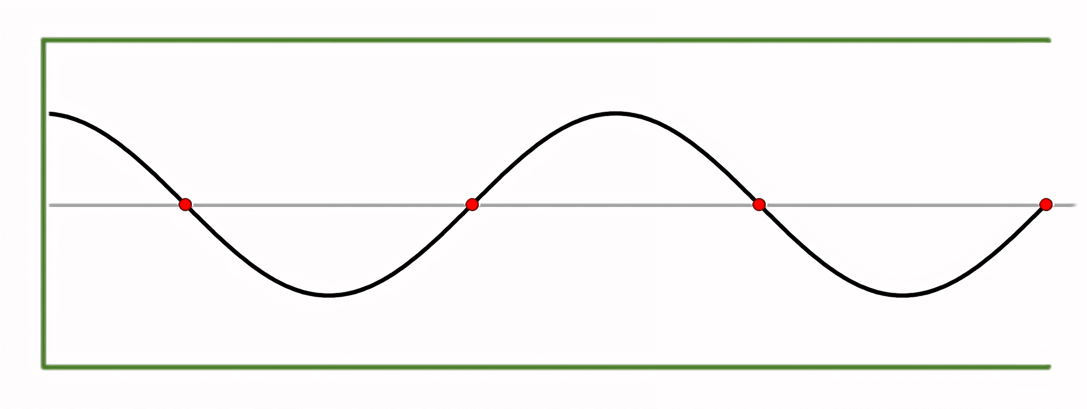
Consider a wave with a frequency (f) of 20 kHz and a wavelength (λ) of 0.02 m. Calculate the wave speed (v).
20 kHz = 20,000 Hz.
20,000 × 0.02 = 400 m/s

Slide 10
Wave Frequency and Time
Specification Point 3.6
  Use the relationship between frequency and time period.
The frequency of a wave can be calculated from its time period:
Consider a wave with a time period of 0.02 seconds.
The frequency is thus 1 ÷ 0.02 = 50 Hz
This equation can also be rearranged to solve for T (T = 1 ÷ f).
f = frequency (Hz)
T = time period (s)

Slide 11
If a wave has a wavelength of 0.1 m and a period of 0.005 s, calculate its velocity.
f = 1 ÷ T
1 ÷ 0.005 = 200 Hz
v = f × λ
200 × 0.1 = 20 m/s

Slide 12
Waves, Energy and Matter
Specification Point 3.4
  Know that waves transfer energy and information without transferring matter.
Waves transfer energy from one place to another.
  Waves transfer energy without moving matter.
    For example, an ocean wave travels many miles without the water itself moving.
    The water moves up and down in a motion known as a disturbance.
Waves can also transfer information from one place to another.
  Waves can be used as signals to transmit large packets of information.
  Examples include light waves in optical fibres or radio waves.

Slide 13
Radio waves can be used to transmit information across thousands of miles.

Slide 14

Fiber optic cables transmit data as light waves. This enables high-speed, long-distance communication with minimal signal loss.

