Slide 1
Edexcel IGCSE Physics
13 - Static Electricity
Conductors, Insulators, Friction and Applications
Paper 2

Slide 2
Conductors and Insulators
Specification Point 2.22P
Identify common materials which are electrical conductors or insulators, including metals and plastics.
Conductors are materials that allow electrical charge to flow through them.
Conductors allow current to flow through them.
Most metals are good conductors of electricity.
Copper, silver and gold are all examples of conductors.
Insulators are materials that do not allow electrical charge to flow through them.
Current cannot flow through insulators.
Examples of insulators include plastics and rubbers.
METAL CONDUCTOR
PLASTIC INSULATOR

Slide 3
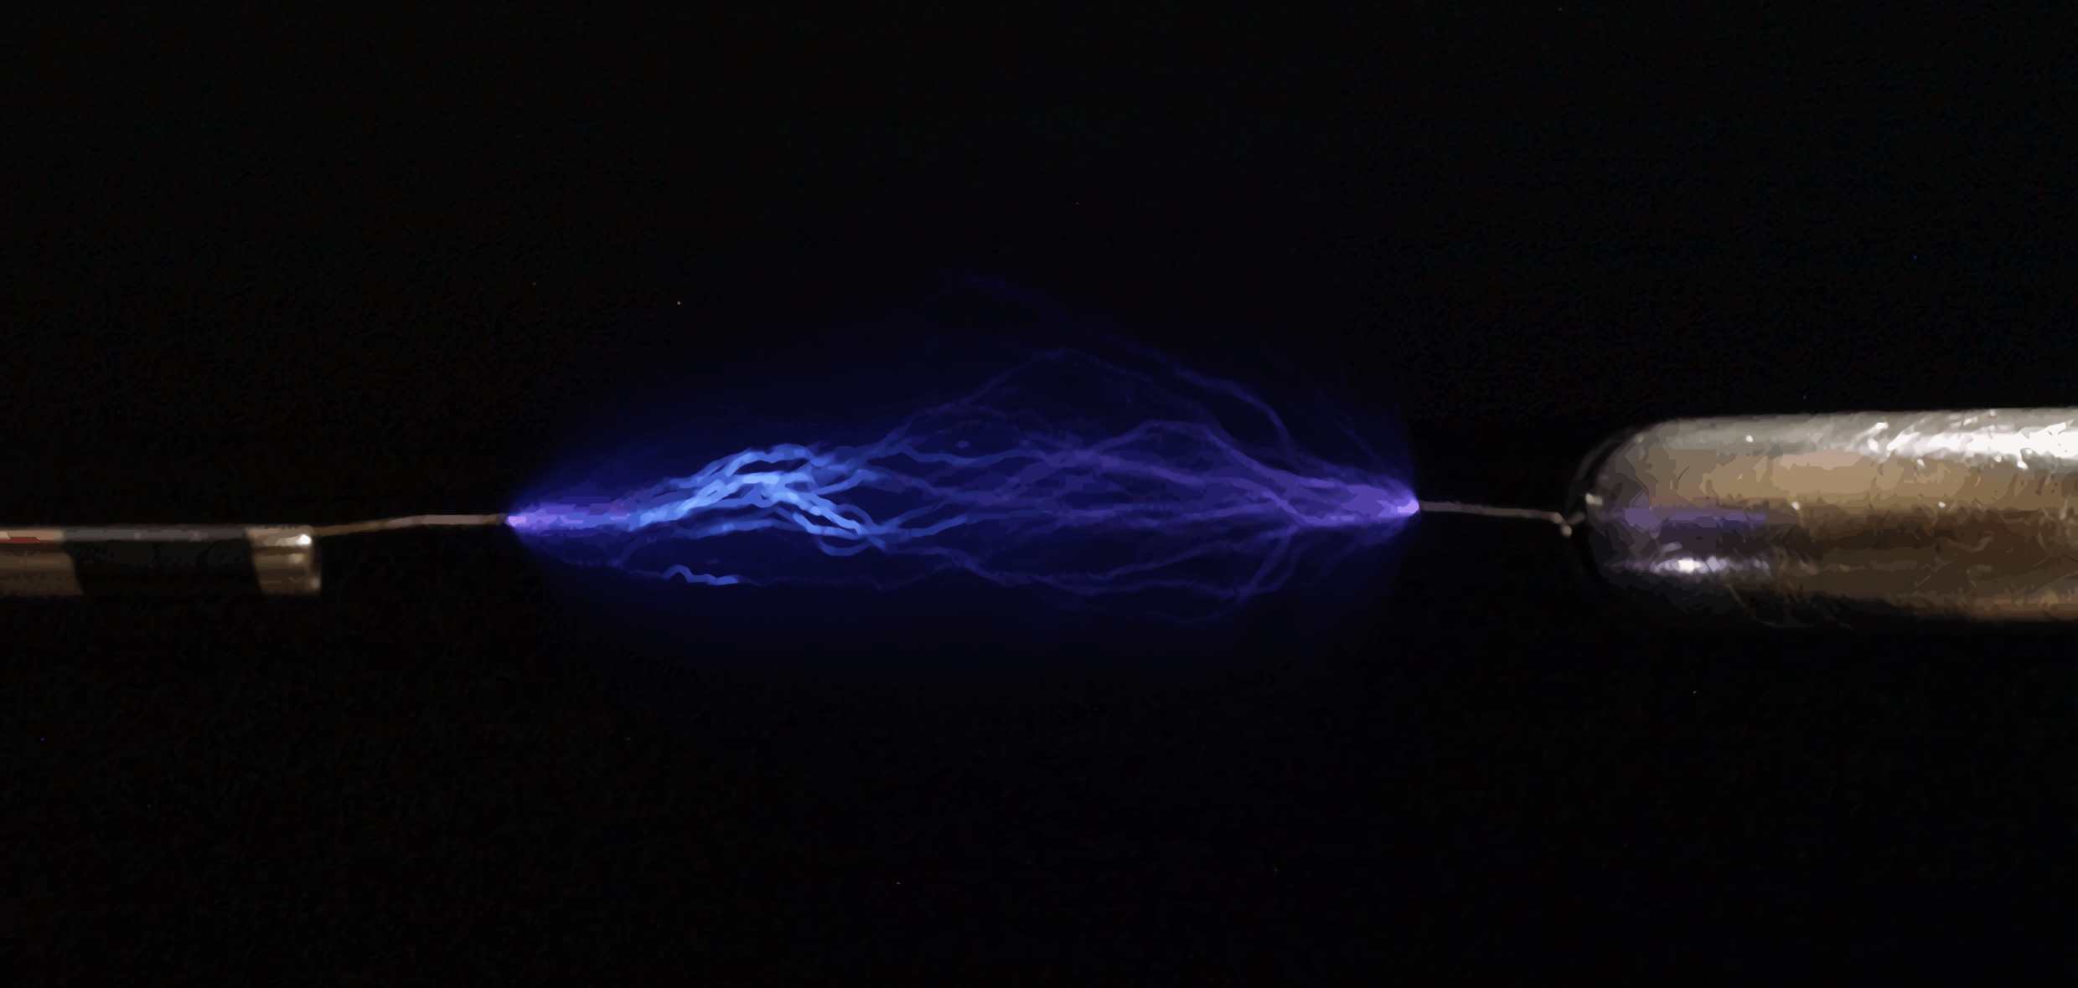
Good conductors, like metal wires, allow current to flow through them.

Slide 4
Electrostatic Charges
Specification Points 2.24P and 2.25P
Explain how positive and negative electrostatic charges are produced on materials by the loss and gain of electrons.
Know that there are forces of attraction between unlike charges and forces of repulsion between like charges.
Atoms consist of three subatomic particles:
Positively charged protons.
Negatively charged electrons.
Uncharged neutrons.
Particles with opposite charges will be attracted to each other.
This is referred to as electrostatic attraction.
Particles with similar charges will repel each other.
This is referred to as electrostatic repulsion.
Like charges repel and opposite charges attract.

Slide 5
Static Charge
Specification Point 2.23P
Practical: investigate how insulating materials can be charged by friction.
A static charge is one that builds up and is not free to move.
Static buildup is much more common in insulators, rather than conductors.
Static electricity is often caused by friction.
When two insulating materials are rubbed together, electrons are removed from one insulator and deposited on the other.
One insulator will become positively charged.
The other insulator will become negatively charged.
Static electricity can be investigated using a polythene and acetate rods.
Rubbing the rod with a cloth duster will create friction.
When the polythene rod is rubbed, electrons will move from the duster to the rod.
When the acetate rod is rubbed, electrons will move from the rod to the duster.

Slide 6
In this experiment, electrons are transferred from the cloth duster to the polythene rod. The rod becomes negatively charged.
In this experiment, electrons are transferred from the acetate rod to the cloth duster. The rod becomes positively charged.
CLOTH DUSTER
CLOTH DUSTER
EXPERIMENT A
EXPERIMENT B
DUSTER IS MOVED BACK AND FORTH
DUSTER IS MOVED BACK AND FORTH
POLYTHENE ROD
ACETATE ROD

Slide 7
If the two rods are then suspended the opposite charges present on each will cause the rods to tilt towards each other. This demonstrates electrostatic attraction.
ACETATE ROD
ELECTROSTATIC ATTRACTION
POLYTHENE ROD

Slide 8
The Movement of Electrons
Specification Point 2.26P
Explain electrostatic phenomena in terms of the movement of electrons.
When electrons are transferred between objects, they become charged.
The object donating the electrons becomes positively charged.
The object receiving the electrons becomes negatively charged.
As electric charge builds, the voltage between the object and the earth increases.
When the voltage is large enough, electrons may jump across the gap between the object and the earth.
This is what happens when a spark is created.
Electrons may also jump to any earthed conductor.
This is what happens when you receive a static shock.

Slide 9
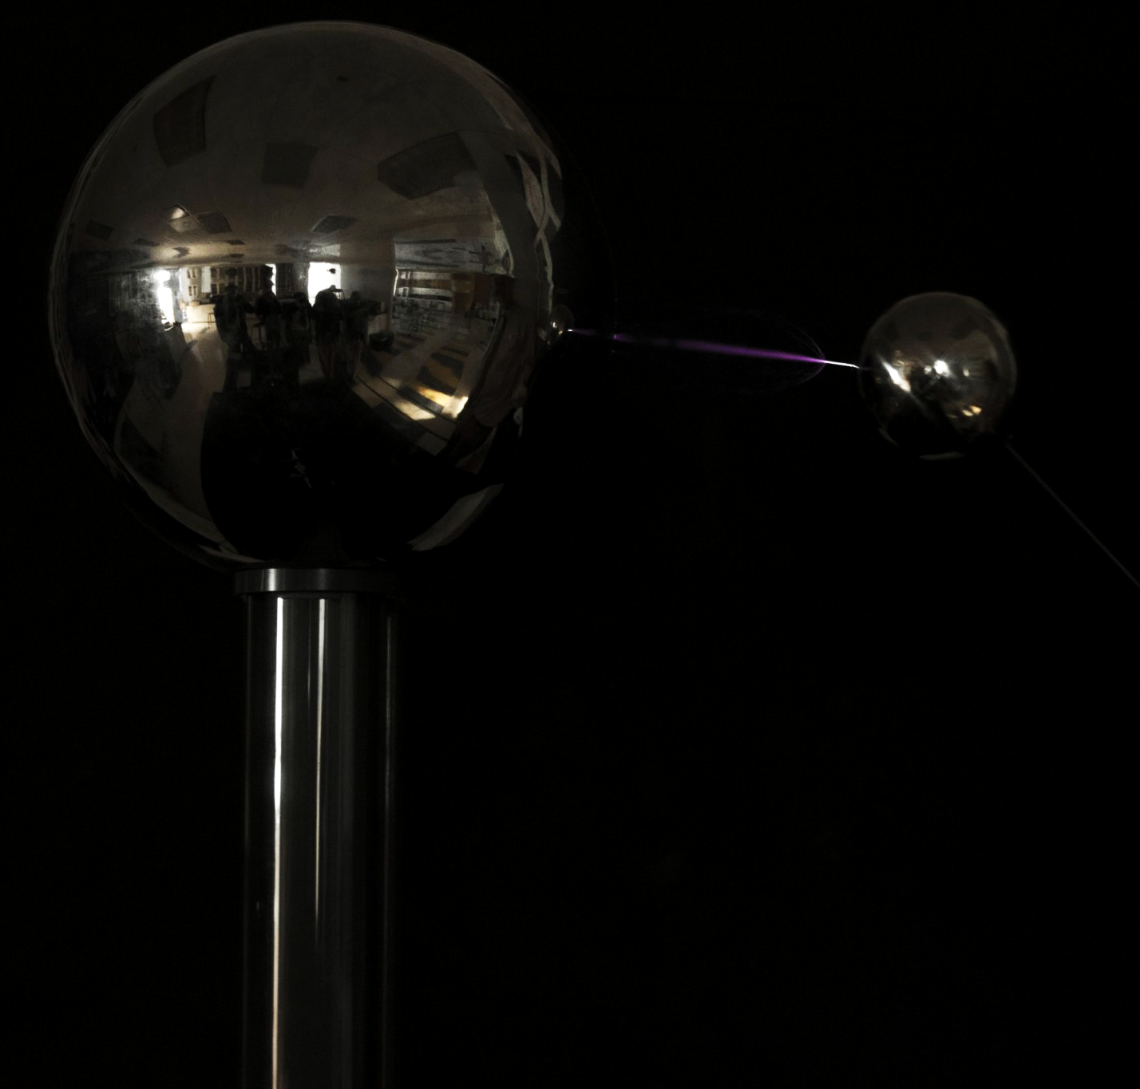
Static electricity is often demonstrated using a device called a Van de Graaff generator.

Slide 10
Dangers of Static
Specification Point 2.27P
Explain the potential dangers of electrostatic charges.
Static electricity can easily lead to sparks.
Sparks are of particular concern when working near flammable materials.
One particular concern is when fueling vehicles like oil tankers and aircraft.
Friction occurs between the liquid fuel and the pipe.
A spark could easily ignite the fuel and lead to an explosion.
Several solutions to this problem have been implemented:
An earthing strap is attached to the fuel tank when refuelling.
This causes the charge to be dissipated through the ground.
A metal nozzle is used when refuelling.
This also helps to prevent charge building up.
Fossil fuels, the kind used to power aircraft and ships, are highly flammable. Sparking from static buildup would lead to disastrous consequences.

Slide 11
Storm clouds contain both water droplets and ice crystals that rub against each other.
This friction leads to a huge buildup of static charge and can lead to lightning strikes.

Slide 12
Uses of Static
Specification Point 2.28P
Explain some uses of electrostatic charges.
Static electricity has a number of applications.
Static electricity is used in inkjet printers.
As the droplets of ink are forced out through a fine nozzle, they become electrostatically charged.
The droplets are then passed through two metal plates.
One plate is positively charged, the other negatively charged.
The droplets are deflected depending on their charge.
The magnitude and direction of the voltage is constantly altered.
This determines where the droplets land on the page - a printout.
Static electricity is also used in photocopiers.
The image of the document to be copied is projected onto a positively charged image plate.
Light areas of the image lose their charge, dark areas keep their charge.
Negatively charged toner is attracted to the positive regions of the plate.
The toner is transferred to a blank piece of paper.
The tonor is then heated so it sticks to the paper.

Slide 13
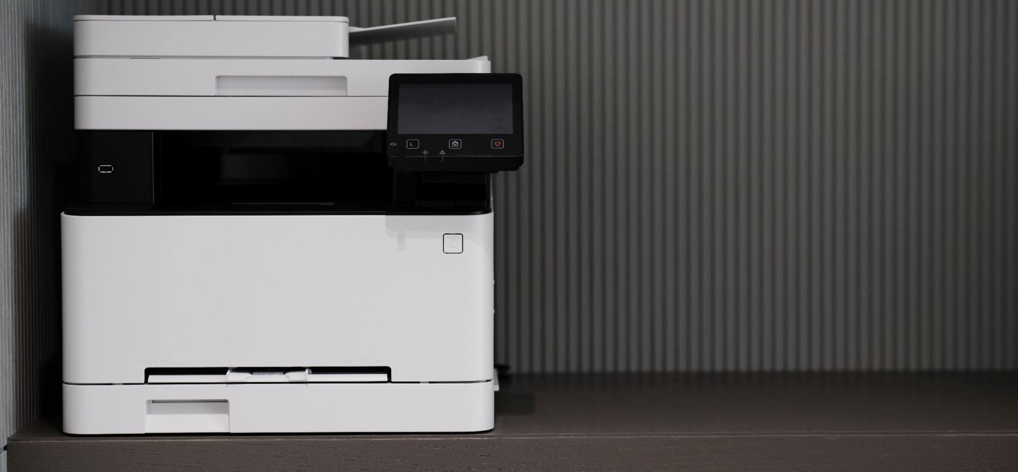
Inkjet printers use static electricity to control the direction of tiny ink droplets. The droplets are electrically charged and steered onto the paper by electrostatic forces (forming precise images or text).

Slide 14
In a photocopier, dark regions of the image result in positively charged regions of the image plate.
This attracts negatively charged toner, creating a copy of the original image.

