Slide 1
Edexcel IGCSE Physics
12 - Circuits Part 2
Charge, Junctions and Parallel Circuits
For more help, please visit www.exampaperspractice.co.uk
© 2025 Exams Papers Practice. All Rights Reserved

Slide 2
Charge, Current and Time
Specification Points 2.15 and 2.16
Know and use the relationship between charge, current and time.
Know that electric current in solid metallic conductors is a flow of negatively charged electrons.
Current can be defined as the rate of flow of electrical charge around a circuit.
Current is measured in amps (A).
Electrical charge is carried in the form of negatively charged electrons.
Electrons will flow through a good conductor, such as a copper wire.
Charge is measured in coulombs (C).
There is a relationship between charge, current and time:
CHARGE
CURRENT
TIME
Using a formula triangle, charge can be calculated as current × time.
Q = charge (C)
I = current (A)
t = time (s)
For more help, please visit www.exampaperspractice.co.uk
© 2025 Exams Papers Practice. All Rights Reserved

Slide 3
Current can be defined as the rate of flow of negatively charged electrons through a conductor.
FLOW OF NEGATIVELY CHARGED ELECTRONS
Consider this wire has a current of 5 A flowing through it for 45 seconds.
The charge created is 5 × 45 = 225 C
For more help, please visit www.exampaperspractice.co.uk
© 2025 Exams Papers Practice. All Rights Reserved

Slide 4
Current at Junctions
Specification Point 2.17
Understand why current is conserved at a junction in a circuit.
Some circuits are in series.
This means that the components in the circuit are connected to each other, in a line.
Other circuits are in parallel.
In parallel circuits, each component is attached to the power supply separately.
Parallel circuits contain junctions.
A junction is where wires branch off in a circuit.
Each junction is likely to contain its own components.
Current is conserved at junctions.
The total current (I_{total}) of a circuit is the sum of the currents found at each junction (I₁, I₂ and so on).
For more help, please visit www.exampaperspractice.co.uk
© 2025 Exams Papers Practice. All Rights Reserved

Slide 5
I_{TOTAL} = 10 A
Parallel circuits contain junctions. The total current (recorded by the ammeter next to the battery) is the sum of the currents found at both junctions:
I_{total} = I₁ + I₂
I₁ = 6 A
I₂ = 4 A
For more help, please visit www.exampaperspractice.co.uk
© 2025 Exams Papers Practice. All Rights Reserved

Slide 6
Voltage in Series and Parallel Circuits
Specification Points 2.18 and 2.19
Know that the voltage across two components connected in parallel is the same.
Calculate the currents, voltages and resistances of two resistive components connected in a series circuit.
In a series circuit, the voltage is shared across all components.
This means that each component will receive a fraction of the total voltage (V_{total}).
If a battery provides a voltage of 10 V, and there are 2 components, each component receives 5 V (10 ÷ 2 = 5).
In a parallel circuit, the voltage is the same across all the junctions.
Each junction receives the full voltage provided by the circuit’s battery.
If a battery provides 10 V, each junction receives 10 V.
This can be summarised as V_{total} = V₁ = V₂ and so on.
Working with circuits video.
For more help, please visit www.exampaperspractice.co.uk
© 2025 Exams Papers Practice. All Rights Reserved

Slide 7
V_{TOTAL} = 10 V
The voltage provided by a battery in parallel circuits is the same across every junction.
V_{total} = V₁ = V₂
V₁ = 10 V
V₂ = 10 V
For more help, please visit www.exampaperspractice.co.uk
© 2025 Exams Papers Practice. All Rights Reserved

Slide 8
V_{TOTAL} = 12 V
In a series circuit the current is the same throughout.
The voltage is shared across components.
The total resistance (R_{total}) in the circuit is calculated by adding the resistances (R₁, R₂) of all of the components together.
In this instance 12 V = 6 A × 2 Ω
I₁ = 6 A
I₂ = 6 A
R₁ = 1 Ω
R₂ = 1 Ω
V₁ = 6 V
V₂ = 6 V
For more help, please visit www.exampaperspractice.co.uk
© 2025 Exams Papers Practice. All Rights Reserved

Slide 9
Parallel circuits are often more useful than series circuits in domestic settings. Each bulb in this example can be turned on and off independently, using its own switch.
For more help, please visit www.exampaperspractice.co.uk
© 2025 Exams Papers Practice. All Rights Reserved

Slide 10
Energy Transfer
Specification Points 2.20 and 2.21
Know that voltage is the energy transferred per unit charge passed and that the volt is a joule per coulomb.
Know and use the relationship between energy transferred, charge and voltage.
The amount of energy transferred between a battery and its components depends on both charge and voltage.
Voltage can be defined as the energy transferred per unit of charge passed.
The unit for voltage, the volt, can also be defined as one joule per coulomb.
There is a relationship between energy transferred, charge and voltage:
E = energy transferred (J)
Q = charge (C)
V = voltage (V)
For more help, please visit www.exampaperspractice.co.uk
© 2025 Exams Papers Practice. All Rights Reserved

Slide 11
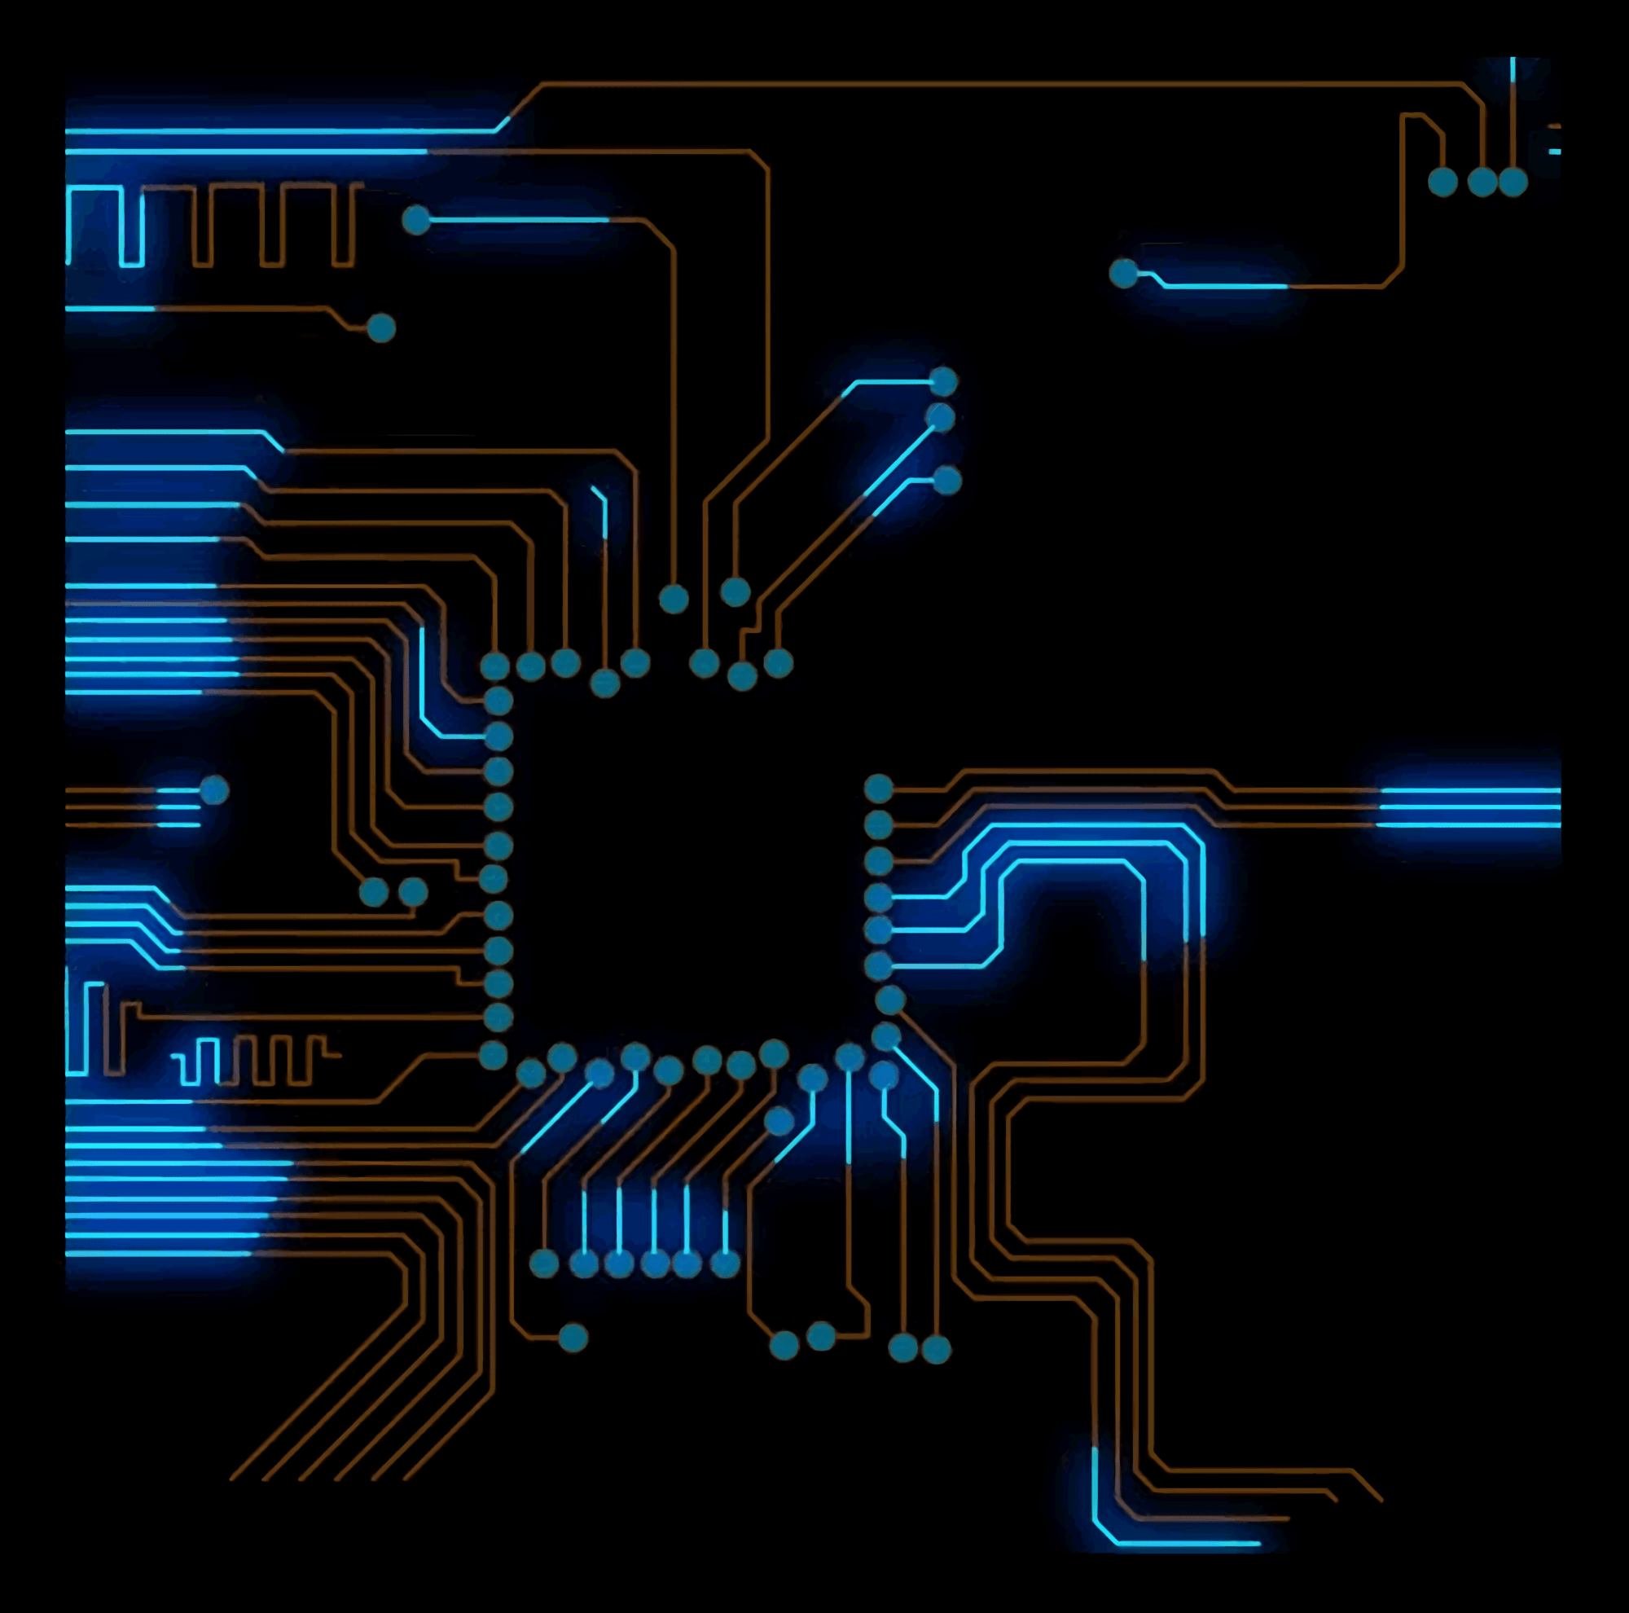
ENERGY TRANSFERRED
CHARGE
VOLTAGE
Using a formula triangle, energy transferred can be calculated as charge × voltage.
Consider a circuit that receives 5 V. When the charge is 3 C, what is the energy transferred?
5 × 3 = 15 J
For more help, please visit www.exampaperspractice.co.uk
© 2025 Exams Papers Practice. All Rights Reserved

