Slide 1
Edexcel IGCSE Physics
11 - Circuits Part 1
Symbols, Circuitry and V = IR
For more help, please visit www.exampaperspractice.co.uk
© 2025 Exams Papers Practice. All Rights Reserved

Slide 2
Series Circuits
Specification Points 2.7, 2.8 and 2.12
Explain why a series or parallel circuit is more appropriate for particular applications, including domestic lighting.
Understand how the current in a series circuit depends on the applied voltage and the number and nature of other components.
Know that lamps and LEDs can be used to indicate the presence of a current in a circuit.
In a series circuit, components are connected to each other in a line.
In a series circuit, the current is the same at any point.
If a component is disconnected from a series circuit, the circuit is said to have been broken.
All the other components in the circuit will also stop working.
Because of this, series circuits are inappropriate for most applications.
Series circuits are rarely used for domestic situations, such as lighting or heating.
A different kind of circuit, called a parallel circuit, is used instead.
For more help, please visit www.exampaperspractice.co.uk
© 2025 Exams Papers Practice. All Rights Reserved

Slide 3
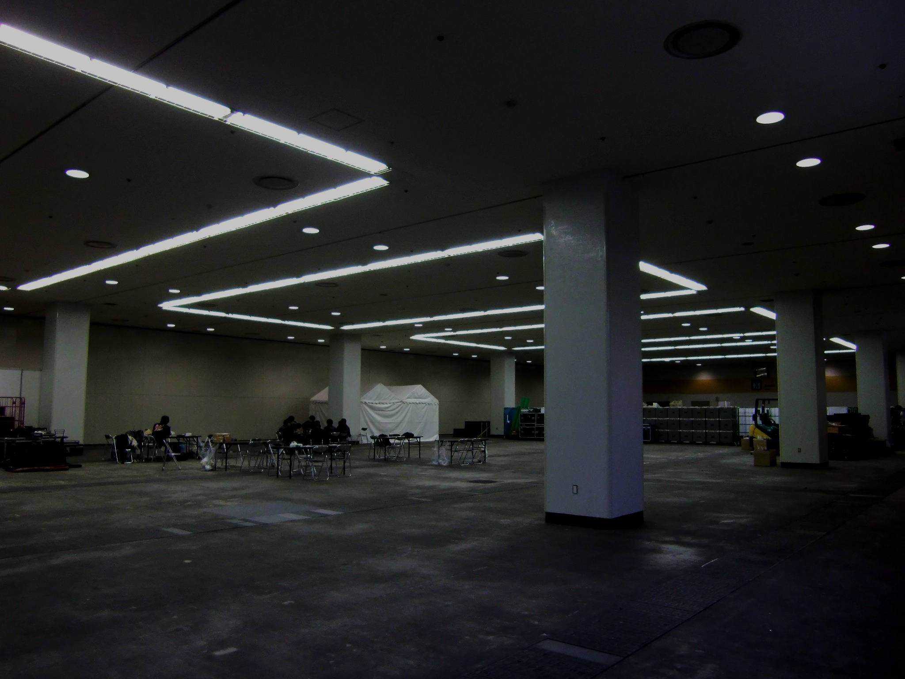
Lights in domestic and industrial settings are unlikely to be wired using series circuits. If one light fails, the circuit will be broken and all the lights will cease to work.
For more help, please visit www.exampaperspractice.co.uk
© 2025 Exams Papers Practice. All Rights Reserved

Slide 4
There are a variety of circuitry symbols that are used throughout electrical physics.
For more help, please visit www.exampaperspractice.co.uk
© 2025 Exams Papers Practice. All Rights Reserved

Slide 5
Series Circuits and Current
The amount of current flowing through a circuit depends on the level of voltage supplied.
Increasing the voltage will drive more current through the circuit.
The amount of current flowing through a circuit also depends on the number of components present in the circuit.
Increasing the number of components will increase the resistance in the circuit.
This, in turn, will decrease the amount of current that flows through the circuit.
Current is measured using an ammeter.
An ammeter measures the amount of current flowing through a circuit in amps.
The ammeter is placed in series with the other components in the circuit.
Lamps and LEDs can be used to estimate the current flowing through a circuit.
If the current is high, the lamp will glow brightly.
If the current is low, the lamp will glow dimly.
For more help, please visit www.exampaperspractice.co.uk
© 2025 Exams Papers Practice. All Rights Reserved

Slide 6
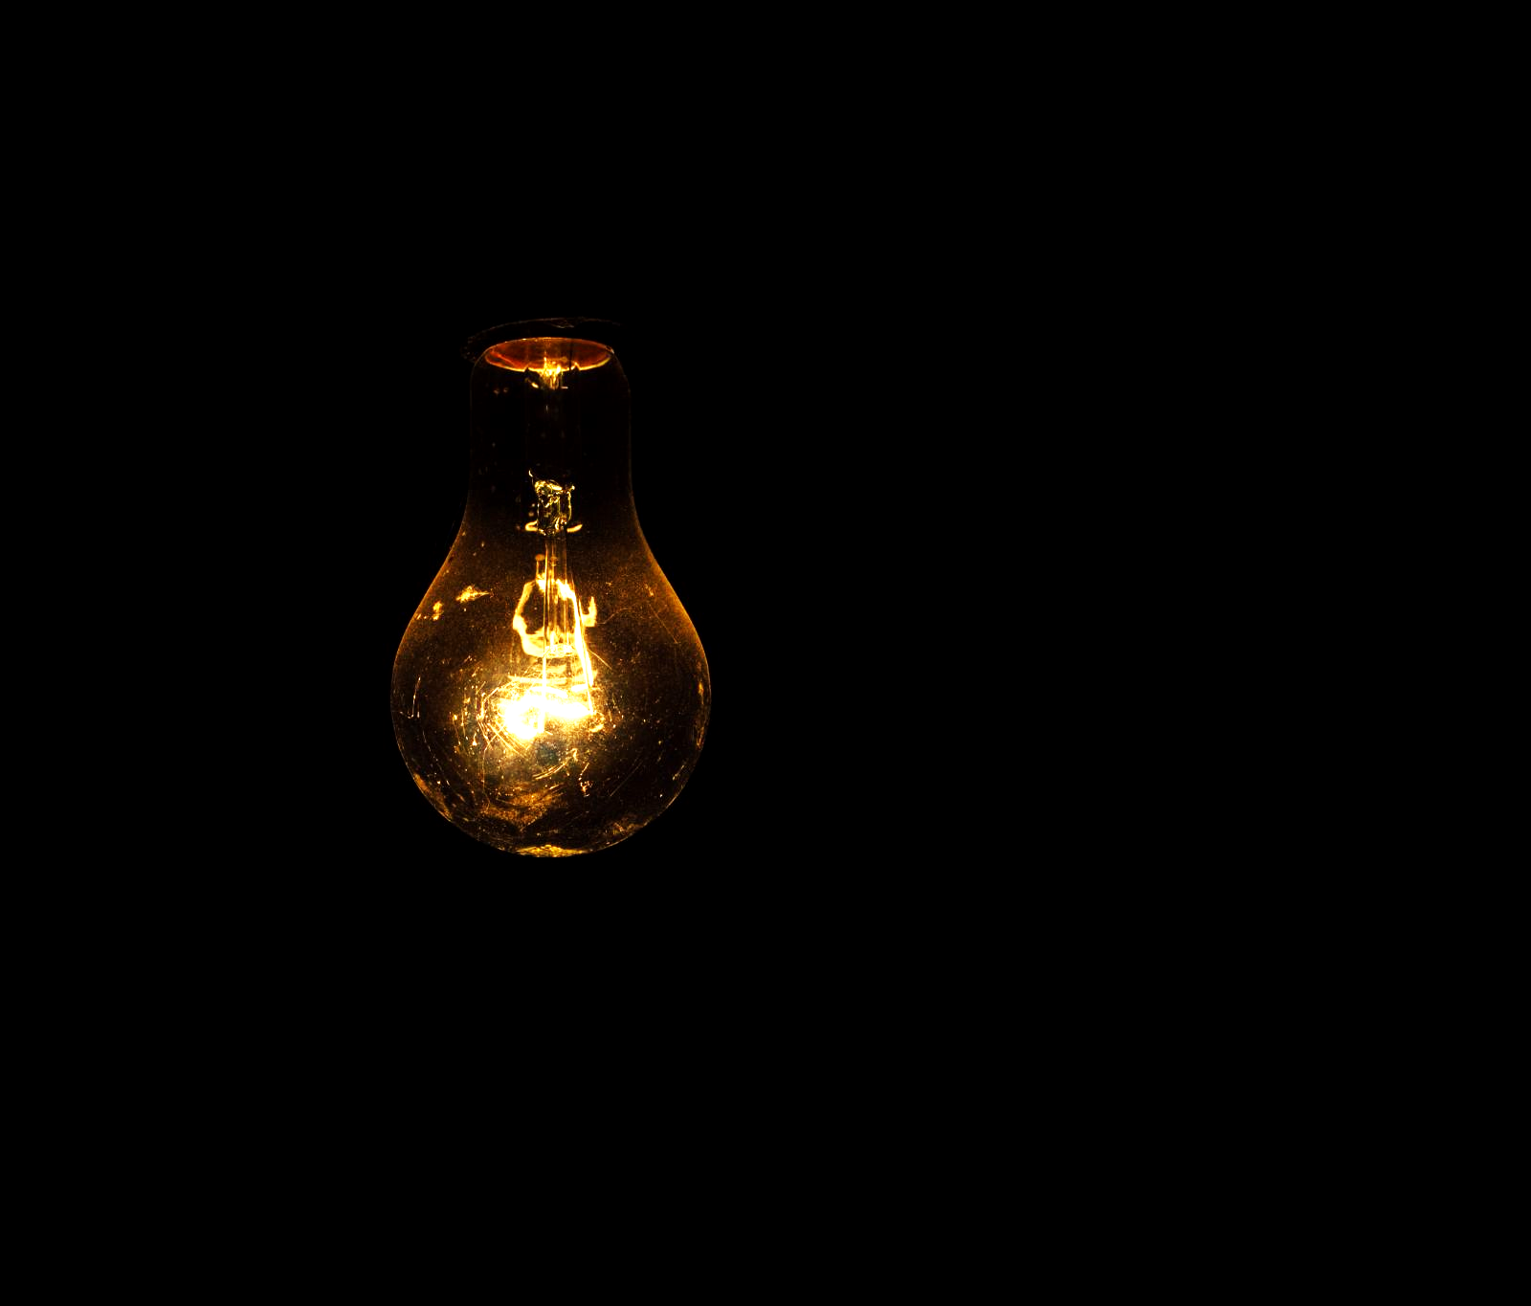
Lamps and LEDs can be used to estimate the current flowing through a circuit. The higher the current, the brighter the bulb.
For more help, please visit www.exampaperspractice.co.uk
© 2025 Exams Papers Practice. All Rights Reserved

Slide 7
1 CELL
2 CELLS
2 A
4 A
This circuit only has 1 cell supplying a voltage. The current is low and the bulb is dim.
This circuit has 2 cells (referred to as a battery) supplying a voltage. The current is higher. And the bulb is brighter.
For more help, please visit www.exampaperspractice.co.uk
© 2025 Exams Papers Practice. All Rights Reserved

Slide 8
Increasing the number of components in the circuit increases the resistance, reducing the current.
1 A
BULB 1
BULB 2
For more help, please visit www.exampaperspractice.co.uk
© 2025 Exams Papers Practice. All Rights Reserved

Slide 9
Voltage, Current and Resistance
Specification Point 2.13
Know and use the relationship between voltage, current and resistance.
There is a relationship between voltage, current and resistance.
This can be summarised using the following equation:
VOLTAGE
CURRENT
RESISTANCE
V = voltage (V)
I = current (A)
R = resistance (Ω)
Using a formula triangle, voltage can be calculated as current × resistance.
For more help, please visit www.exampaperspractice.co.uk
© 2025 Exams Papers Practice. All Rights Reserved
For more help, please visit www.exampaperspractice.co.uk
© 2025 Exams Papers Practice. All Rights Reserved

Slide 10
BATTERY PROVIDING 12 V
We can rearrange the values given to calculate the current flowing through this circuit.
Current = voltage ÷ resistance.
12 ÷ 8 = 1.5 A
RESISTOR PROVIDING 8 Ω

Slide 11
Current-Voltage Graphs
Specification Point 2.9
Describe how current varies with voltage in wires, resistors, metal filament lamps and diodes, and how to investigate this experimentally.
Depending on the component, the relationship between current and voltage will vary significantly.
These can be illustrated graphically using current-voltage (I-V) graphs.
In a wire, the current is directly proportional to the voltage.
This means that if the current increases, the voltage increases by the same amount.
The current in resistors is also proportional to voltage.
Different resistors have different resistances.
This will alter the gradient when looking at the relationship.
As the temperature of a metal filament lamp increases, the resistance also increases.
As current and temperature are directly related, this leads to a sigmoid or s-shaped curve.
In a diode, current will only flow in a single direction.
This leads to a curve that is flat at first and then rises sharply.
For more help, please visit www.exampaperspractice.co.uk
© 2025 Exams Papers Practice. All Rights Reserved

Slide 12
DIODE
RESISTOR 1
WIRE
RESISTOR 2
METAL FILAMENT LAMP
I-R plots for a variety of different circuit components.
CURRENT
VOLTAGE
For more help, please visit www.exampaperspractice.co.uk
© 2025 Exams Papers Practice. All Rights Reserved

Slide 13
Resistance and Current
Specification Points 2.10 and 2.11
Describe the qualitative effect of changing resistance on the current in a circuit.
Describe the qualitative variation of resistance of light-dependent resistors (LDRs) with illumination and thermistors with temperature.
Resistance can be defined as anything that slows the flow of current.
Increasing the resistance in a circuit causes the current to decrease.
A light dependent resistor (LDR) changes its resistance depending on the amount of light present.
At low light intensities, the amount of resistance provided by the LDR is very high.
At high light intensities, the amount of resistance provided by the LDR is very low.
LDRs are useful in circuits where the change in light intensity is predictable.
LDRs are used in security lights and burglar alarms.
The standard circuitry symbol for a light-dependent resistor.
For more help, please visit www.exampaperspractice.co.uk
© 2025 Exams Papers Practice. All Rights Reserved

Slide 14
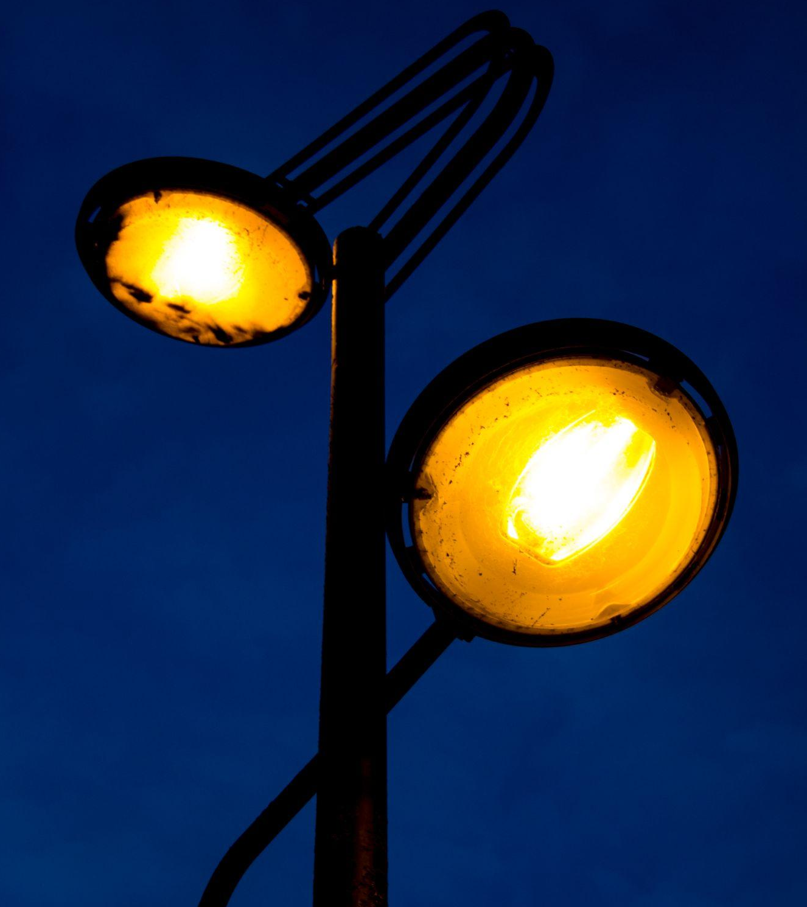
LDRs are useful in a variety of electronic circuits. In this example, when the resistance is high, the switch operating the security light is turned on. When the resistance is low, the switch operating the security light is turned off.
RESISTANCE (Ω)
LIGHT INTENSITY (LUX)
For more help, please visit www.exampaperspractice.co.uk
© 2025 Exams Papers Practice. All Rights Reserved

Slide 15
Thermistors
A thermistor changes its resistance depending on the temperature.
In cool conditions, the resistance provided by the thermistor is very high.
In hot conditions, the resistance provided by the thermistor is very low.
Thermistors are useful in circuits where the temperature changes frequently.
Thermistors are used in car engines.
Thermistors are also used in fire alarms.
The standard circuitry symbol for a thermistor.
For more help, please visit www.exampaperspractice.co.uk
© 2025 Exams Papers Practice. All Rights Reserved

Slide 16
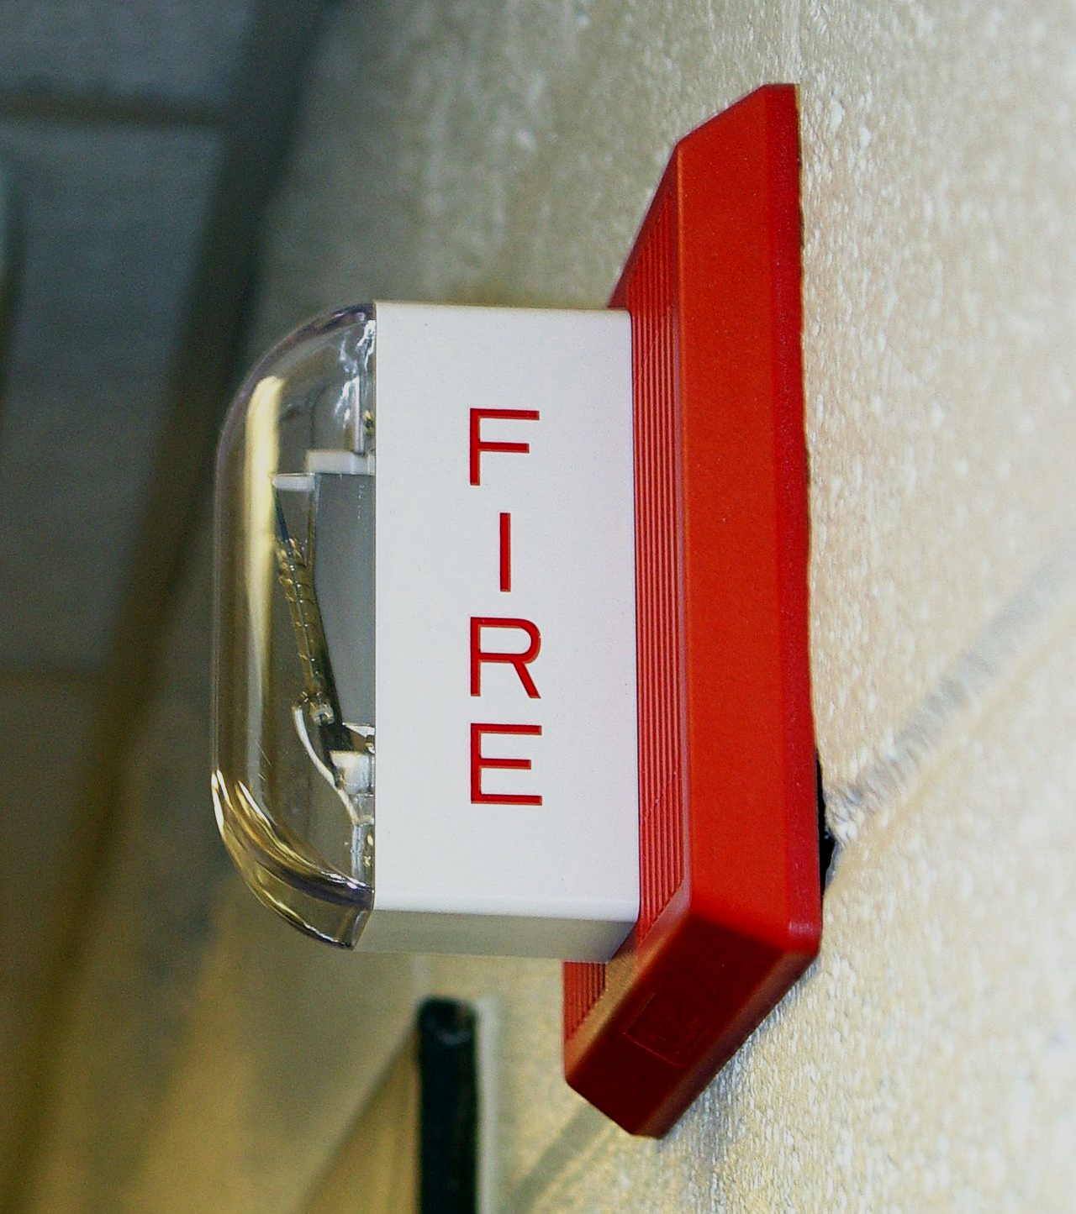
Thermistors are also useful in a variety of electronic circuits. In this example, when the resistance is high, the switch operating the fire alarm is turned off. When the resistance is low, the switch operating the fire alarm is turned on.
RESISTANCE (Ω)
TEMPERATURE (K)
For more help, please visit www.exampaperspractice.co.uk
© 2025 Exams Papers Practice. All Rights Reserved

