Slide 1
Edexcel IGCSE Physics
10 - Power, Current and Voltage
Energy Transfer, A.C. and D.C.
For more help, please visit www.exampaperspractice.co.uk
© 2025 Exams Papers Practice. All Rights Reserved

Slide 2
Power, Current and Voltage
Specification Point 2.4
Know and use the relationship between power, current and voltage and apply the relationship to the selection of appropriate fuses.
Electrical power can be defined as the rate at which an appliance transfers energy.
Appliances that have a high power will transfer lots of energy in a short period of time.
Power is measured in watts (W).
There is a relationship between power, current and voltage:
POWER
CURRENT
VOLTAGE
P = power (W)
I = current (A)
V = voltage (V)
Using a formula triangle, power can be calculated as current × voltage.
For more help, please visit www.exampaperspractice.co.uk
© 2025 Exams Papers Practice. All Rights Reserved

Slide 3
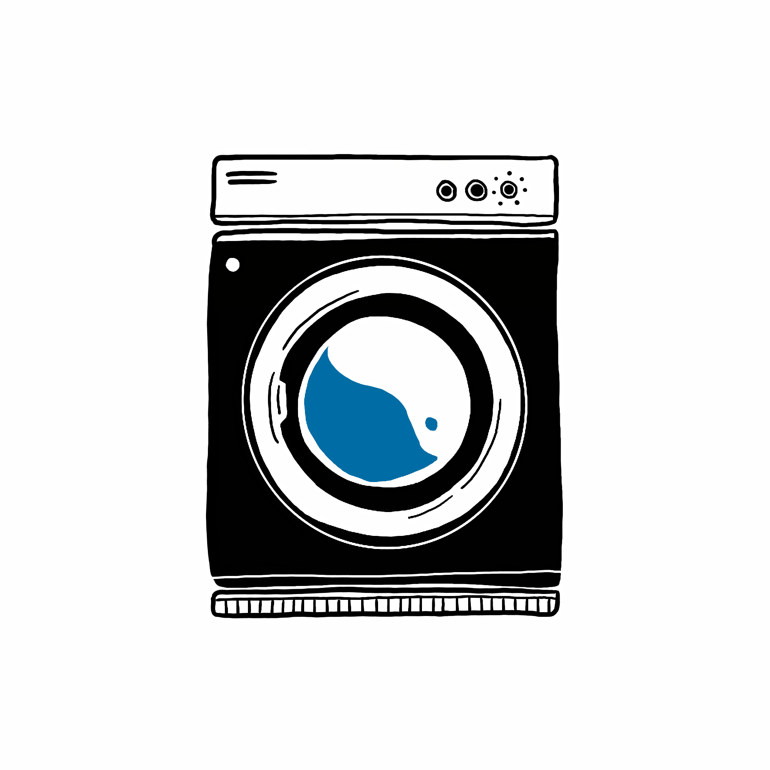
If a washing machine has a supplied voltage of 230 V and runs a current of 2.5 A, What is the power supplied to the washing machine?
230 × 2.5 = 575 W
For more help, please visit www.exampaperspractice.co.uk
© 2025 Exams Papers Practice. All Rights Reserved

Slide 4
Fuses and Current Ratings
All electrical appliances come supplied with a fuse.
A fuse is a section of wire, surrounded by a glass cylinder.
If the current running through the appliance gets too high, the fuse will blow.
As current increases, the temperature running through the wire in the fuse also increases.
Eventually, the temperature will sufficient to melt the wire.
This will break the circuit and the appliance will turn off immediately.
Different fuses will have different current ratings.
The current rating is the maximum current the fuse can carry without blowing.
In order to operate as efficiently as possible, the fuse should be rated just above the operating current of the circuit.
This fuse is rated to 13 A. Any appliance should have an operating current just below this value.
13 A
For more help, please visit www.exampaperspractice.co.uk
© 2025 Exams Papers Practice. All Rights Reserved

Slide 5
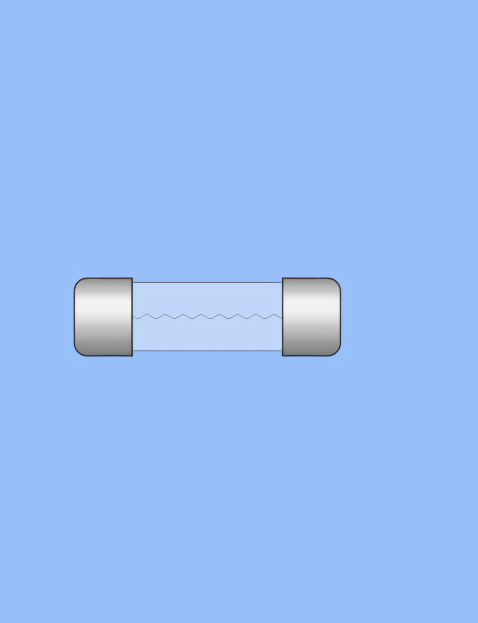
If the current is too high, the wire in the fuse will melt and the circuit will be broken. Fuses are a vital safety feature to prevent appliances from overheating.
For more help, please visit www.exampaperspractice.co.uk
© 2025 Exams Papers Practice. All Rights Reserved

Slide 6
Energy Transferred
Specification Point 2.5
Use the relationship between energy transferred, current, voltage and time.
Energy is transferred by an appliance.
Electrical energy is converted into a variety of other useful forms.
The energy transferred by an appliance, measured in joules (J), depends on the current and voltage of the appliance, as well as the time it is applied for.
There is a relationship between energy transfer, current, voltage and time:
ENERGY TRANSFERRED
CURRENT
VOLTAGE
TIME
E = energy transferred (J)
I = current (A)
V = voltage (V)
t = time (s)
Using a formula triangle, energy transferred can be calculated as current × voltage × time.
For more help, please visit www.exampaperspractice.co.uk
© 2025 Exams Papers Practice. All Rights Reserved

Slide 7
If a power drill with a voltage of 230 V and a current of 5 A is used for 10 minutes, what is the value of the energy transferred?
230 × 5 × (10 × 60) = 690,000 J or 690 kJ
For more help, please visit www.exampaperspractice.co.uk
© 2025 Exams Papers Practice. All Rights Reserved

Slide 8
A.C and D.C.
Specification Point 2.6
Know the difference between mains electricity being alternating current (A.C.) and direct current (D.C.) being supplied by a cell or battery.
Alternating current (A.C.) is one that constantly changes direction.
The UK mains supply uses an A.C. with a voltage of around 230 V.
The UK mains supply has an alternating frequency of around 50 Hz.
This means the current changes direction 50 times per second.
Direct current (D.C.) is one that constantly flows in the same direction.
Cells and batteries supply D.C. to electrical appliances like phones and laptops.
A D.C. power supply has a fixed positive and negative end.
For more help, please visit www.exampaperspractice.co.uk
© 2025 Exams Papers Practice. All Rights Reserved

Slide 9
+
+
A.C.
D.C.
CURRENT
CURRENT
TIME
TIME
-
-
Alternating current (A.C.) is cheaper to generate and more efficient to use than D.C. This makes it ideal for use as the UK mains supply.
Direct current (D.C.) provides a more reliable, steady flow of electricity than A.C. This makes D.C. more useful in delicate electronics.
For more help, please visit www.exampaperspractice.co.uk
© 2025 Exams Papers Practice. All Rights Reserved

