Slide 1
Edexcel IGCSE Chemistry
9 - Formulae and Calculations
Balancing Equations, A_{r} and M_{r}, Moles
For more help, please visit www.exampaperspractice.co.uk
© 2025 Exams Papers Practice. All Rights Reserved

Slide 2
Chemical Equations
Specification Point 1.25
Understand how to write word equations and balanced chemical equations (including state symbols).
During a chemical reaction, new substances are created.
The same number of atoms are present before and after a reaction.
This is referred to as the law of conservation of mass.
Chemical equations show how reactants are converted into products.
Equations can be represented using words or chemical symbols.
C _{(s)} + O_{2 (g)} → CO_{2 (g)}
CARBON + OXYGEN → CARBON DIOXIDE
Equations often contain state symbols.
This indicates the physical state of the reactants and products - they may be solid (s), liquid (l), gaseous (g) or aqueous (aq).
Aqueous compounds are dissolved in water.
For more help, please visit www.exampaperspractice.co.uk
© 2025 Exams Papers Practice. All Rights Reserved

Slide 3
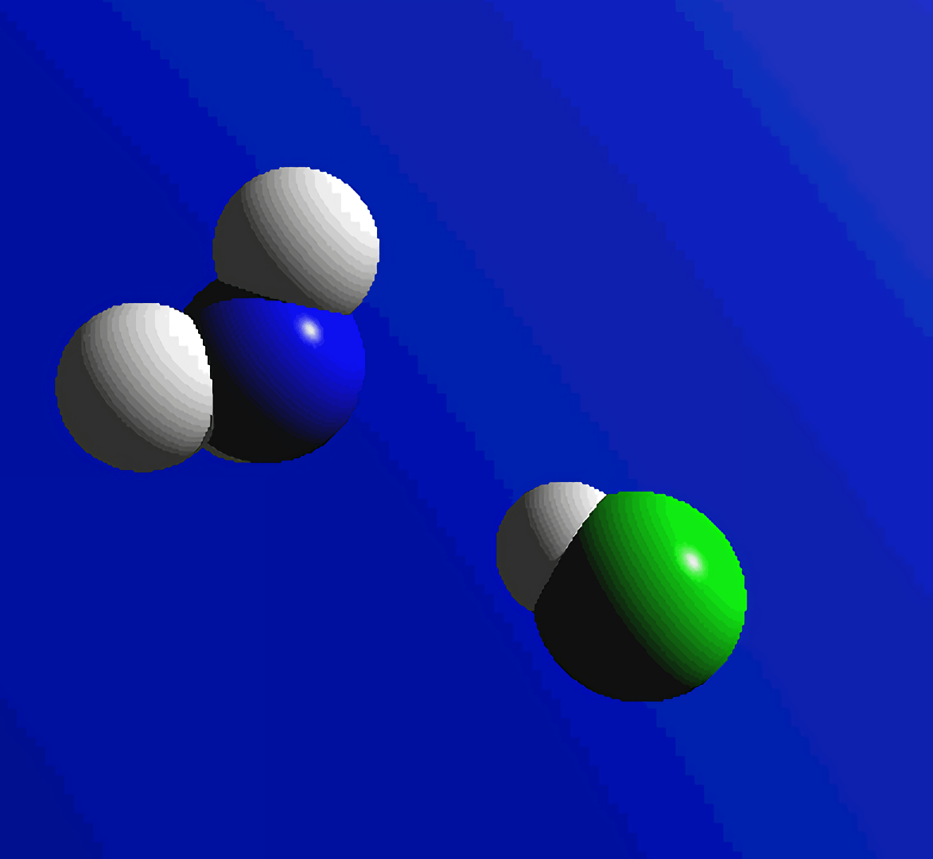
During a chemical reaction, new substances are created.
For more help, please visit www.exampaperspractice.co.uk
© 2025 Exams Papers Practice. All Rights Reserved

Slide 4
Balancing Equations
There must be the same number of atoms on both sides of the equation.
The equation is now said to be balanced.
Equations are balanced by placing numbers in front of elements or compounds.
A number of practice equations can be found here.
N_{2 (g)} + H_{2 (g)} → NH_{3 (g)}
This equation is not balanced.
There are 2 nitrogen atoms on the left hand side of the equation but only 1 on the right.
N_{2 (g)} + H_{2 (g)} → 2NH_{3 (g)}
There are now the correct number of nitrogen atoms. However there are now 2 hydrogen atoms on the left and 6 on the right.
N_{2 (g)} + 3H_{2 (g)} → 2NH_{3 (g)}
The equation is now correctly balanced.
For more help, please visit www.exampaperspractice.co.uk
© 2025 Exams Papers Practice. All Rights Reserved

Slide 5
A_{r} and M_{r}
Specification Point 1.26
Calculate relative formula masses (including relative molecular masses) (M_{r}) from relative atomic masses (A_{r}).
The relative atomic mass (A_{r}) of an element is a measure of its atomic weight.
A_{r} is calculated using the mass number of an element, as well as the relative abundance of all of that elements isotopes.
For example, the A_{r} of carbon (C) is 12.
The relative molecular mass (M_{r}) of a compound is the sum of all atomic masses of its component atoms.
For example, the M_{r} of ammonia (NH₃) is 17.
This is because there is 1 nitrogen (N) atom, which has an A_{r} of 14.
There are also 3 hydrogen (H) atoms, which each have an A_{r} of 1.
For more help, please visit www.exampaperspractice.co.uk
© 2025 Exams Papers Practice. All Rights Reserved

Slide 6
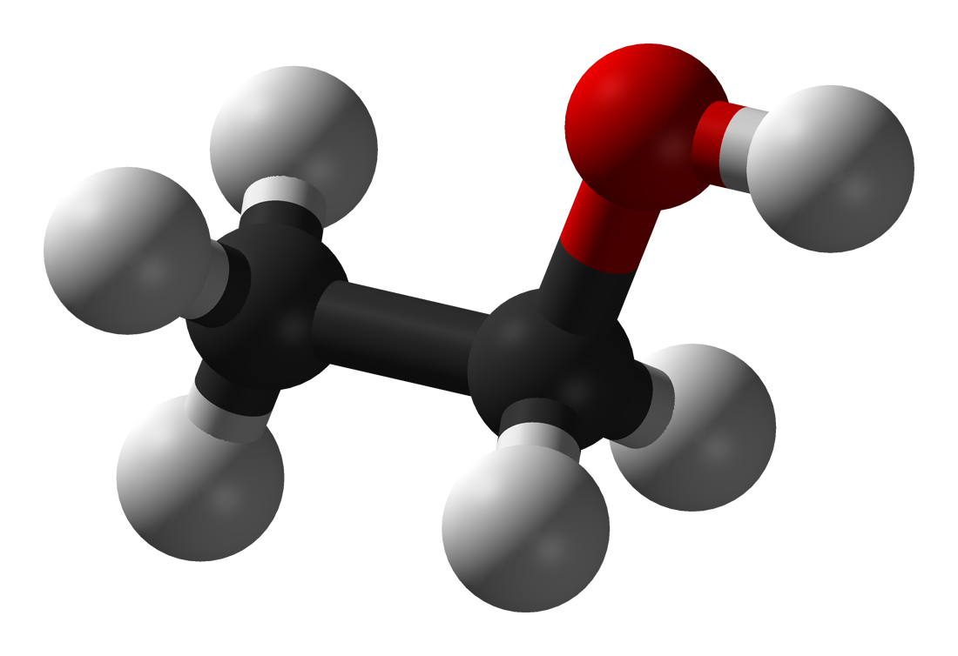
Ethanol (C₂H₅OH) has an M_{r} of 46.
2 carbon atoms - (2 × 12 = 24)
6 hydrogen atoms - (6 × 1 = 6)
1 oxygen atom - (1 × 16 = 16)
24 + 6 + 16 = 46
For more help, please visit www.exampaperspractice.co.uk
© 2025 Exams Papers Practice. All Rights Reserved

Slide 7
Moles
Specification Point 1.27
Know that the mole is the unit for the amount of a substance.
A mole is a measure of the amount of an element or compound.
The unit for the mole is mol.
There are a certain number of atoms or molecules in 1 mole of a substance.
This is called the Avogadro constant.
The value of the Avogadro constant is 6.02 × 10²³ per mole.
This means that 1 mole of any substance contains 6.02 × 10²³ particles.
1 mole of atoms or molecules will have a mass in grams that is equal to the A_{r} or M_{r} of that particular substance.
NH₃ has an M_{r} of 17.
As a result, 1 mole of NH₃ will weigh 17g.
For more help, please visit www.exampaperspractice.co.uk
© 2025 Exams Papers Practice. All Rights Reserved

Slide 8
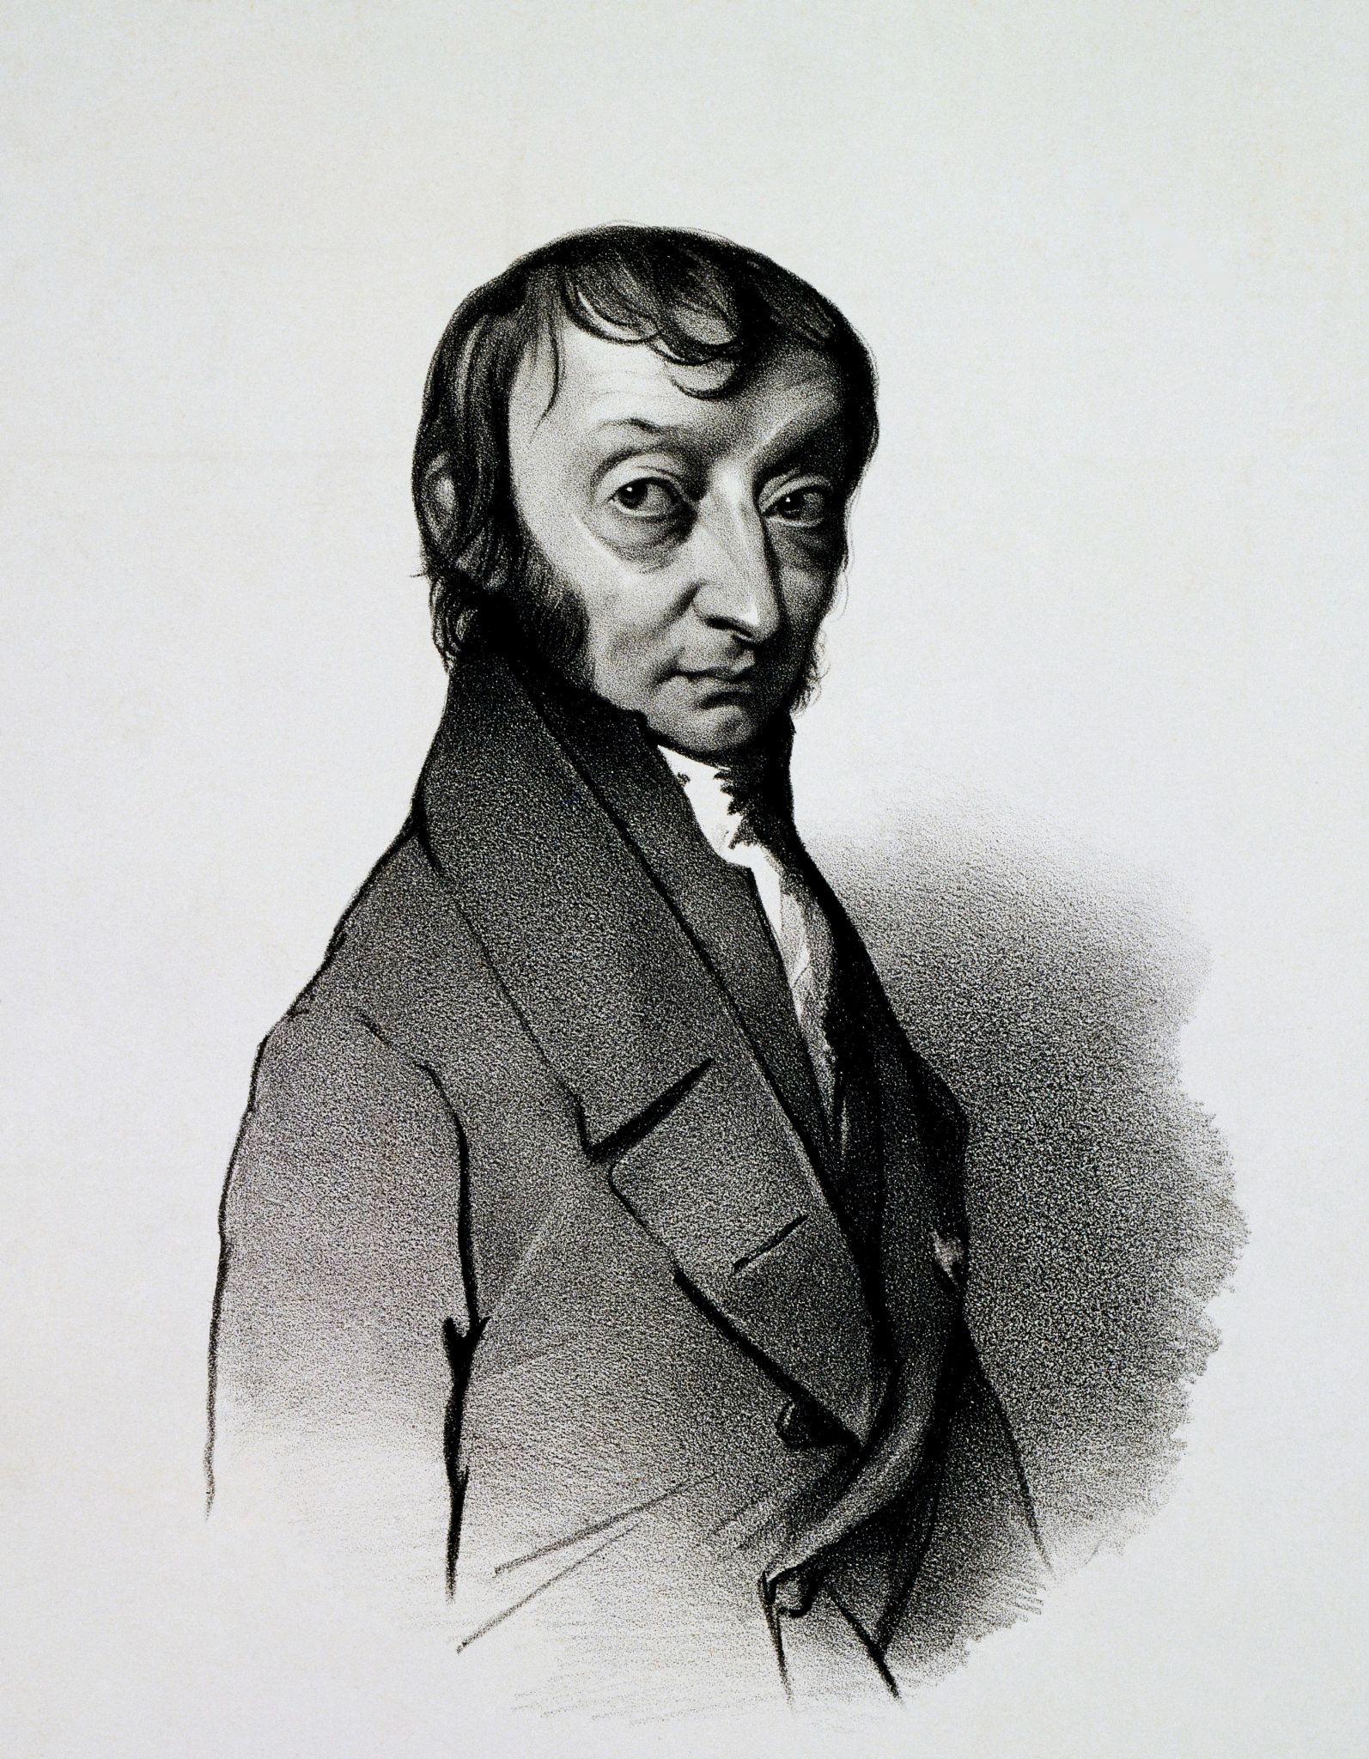
The Avogadro constant, named after the 18th century Italian chemist, states that a mole of any substance will contain 6.02 × 10²³ particles.
For more help, please visit www.exampaperspractice.co.uk
© 2025 Exams Papers Practice. All Rights Reserved

Slide 9
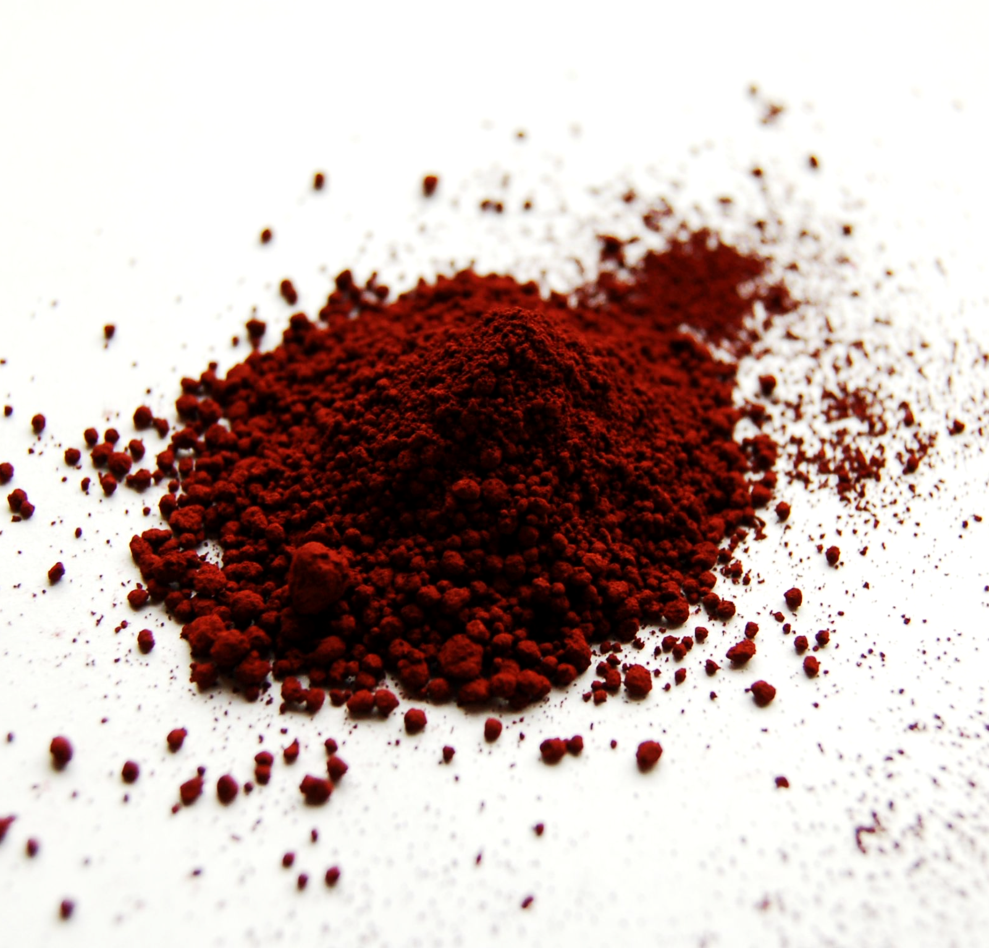
Iron oxide (Fe₂O₃), more commonly known as rust, has an M_{r} of 160.
This means that 1 mole of iron oxide will weigh exactly 160g.
For more help, please visit www.exampaperspractice.co.uk
© 2025 Exams Papers Practice. All Rights Reserved

Slide 10
Moles and Mass
Specification Point 1.28
Understand how to carry out calculations involving amount of substance, relative atomic mass (A_{r}) and relative formula mass (M_{r}).
There is a mathematical relationship between mass, moles and A_{r}/M_{r}:
A formula triangle can be used to rearrange equations involving mass, moles and M_{r} or A_{r}.
MASS
n = number of moles
m = mass (grams)
M = A_{r} or M_{r}
MOLES
A_{r}/M_{r}
For more help, please visit www.exampaperspractice.co.uk
© 2025 Exams Papers Practice. All Rights Reserved

Slide 11
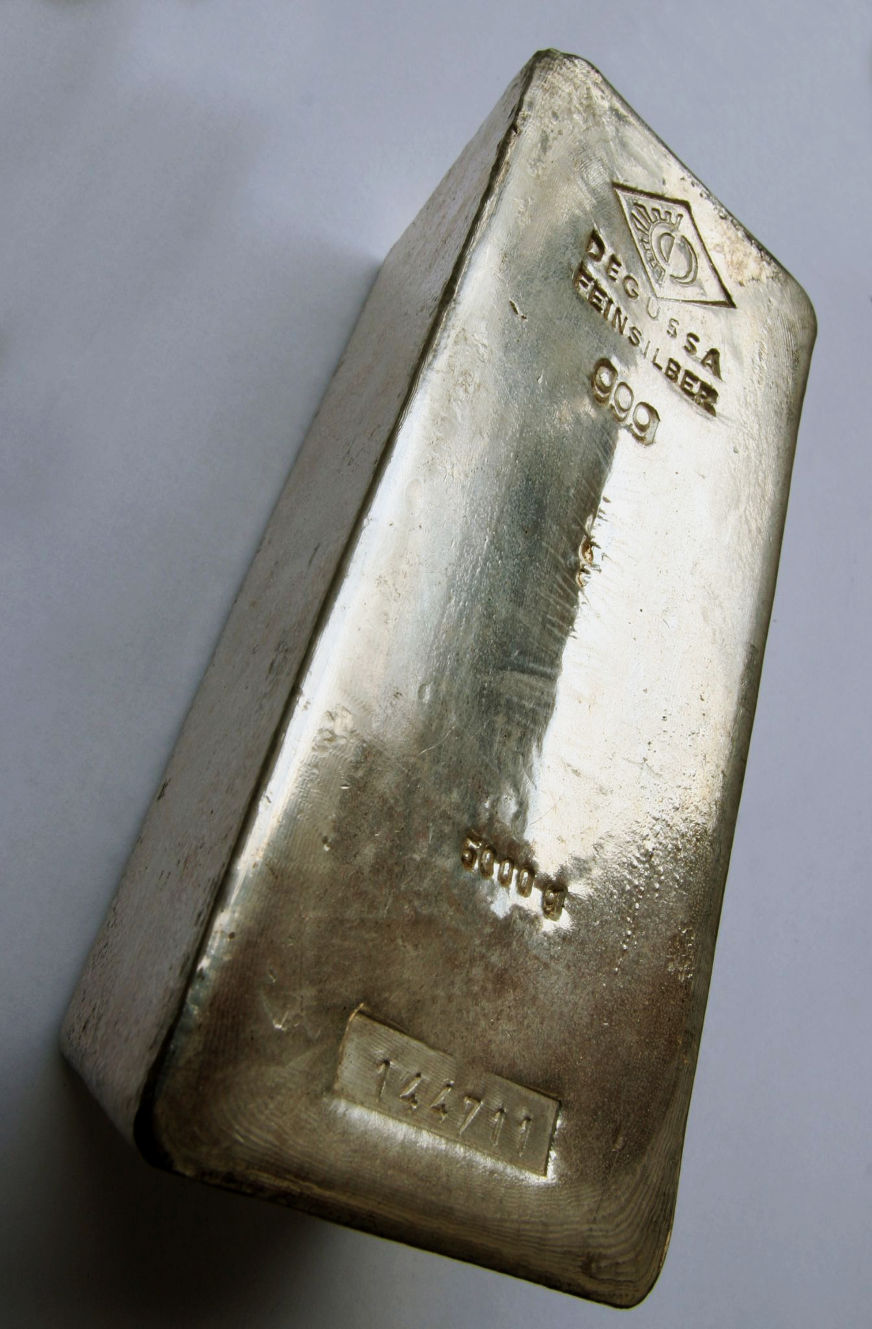
How many moles are present in 5000g of silver (Ag)?
Silver has an A_{r} of 108.
Moles = mass ÷ A_{r}
5000 ÷ 108 = 46.3 moles
For more help, please visit www.exampaperspractice.co.uk
© 2025 Exams Papers Practice. All Rights Reserved

Slide 12
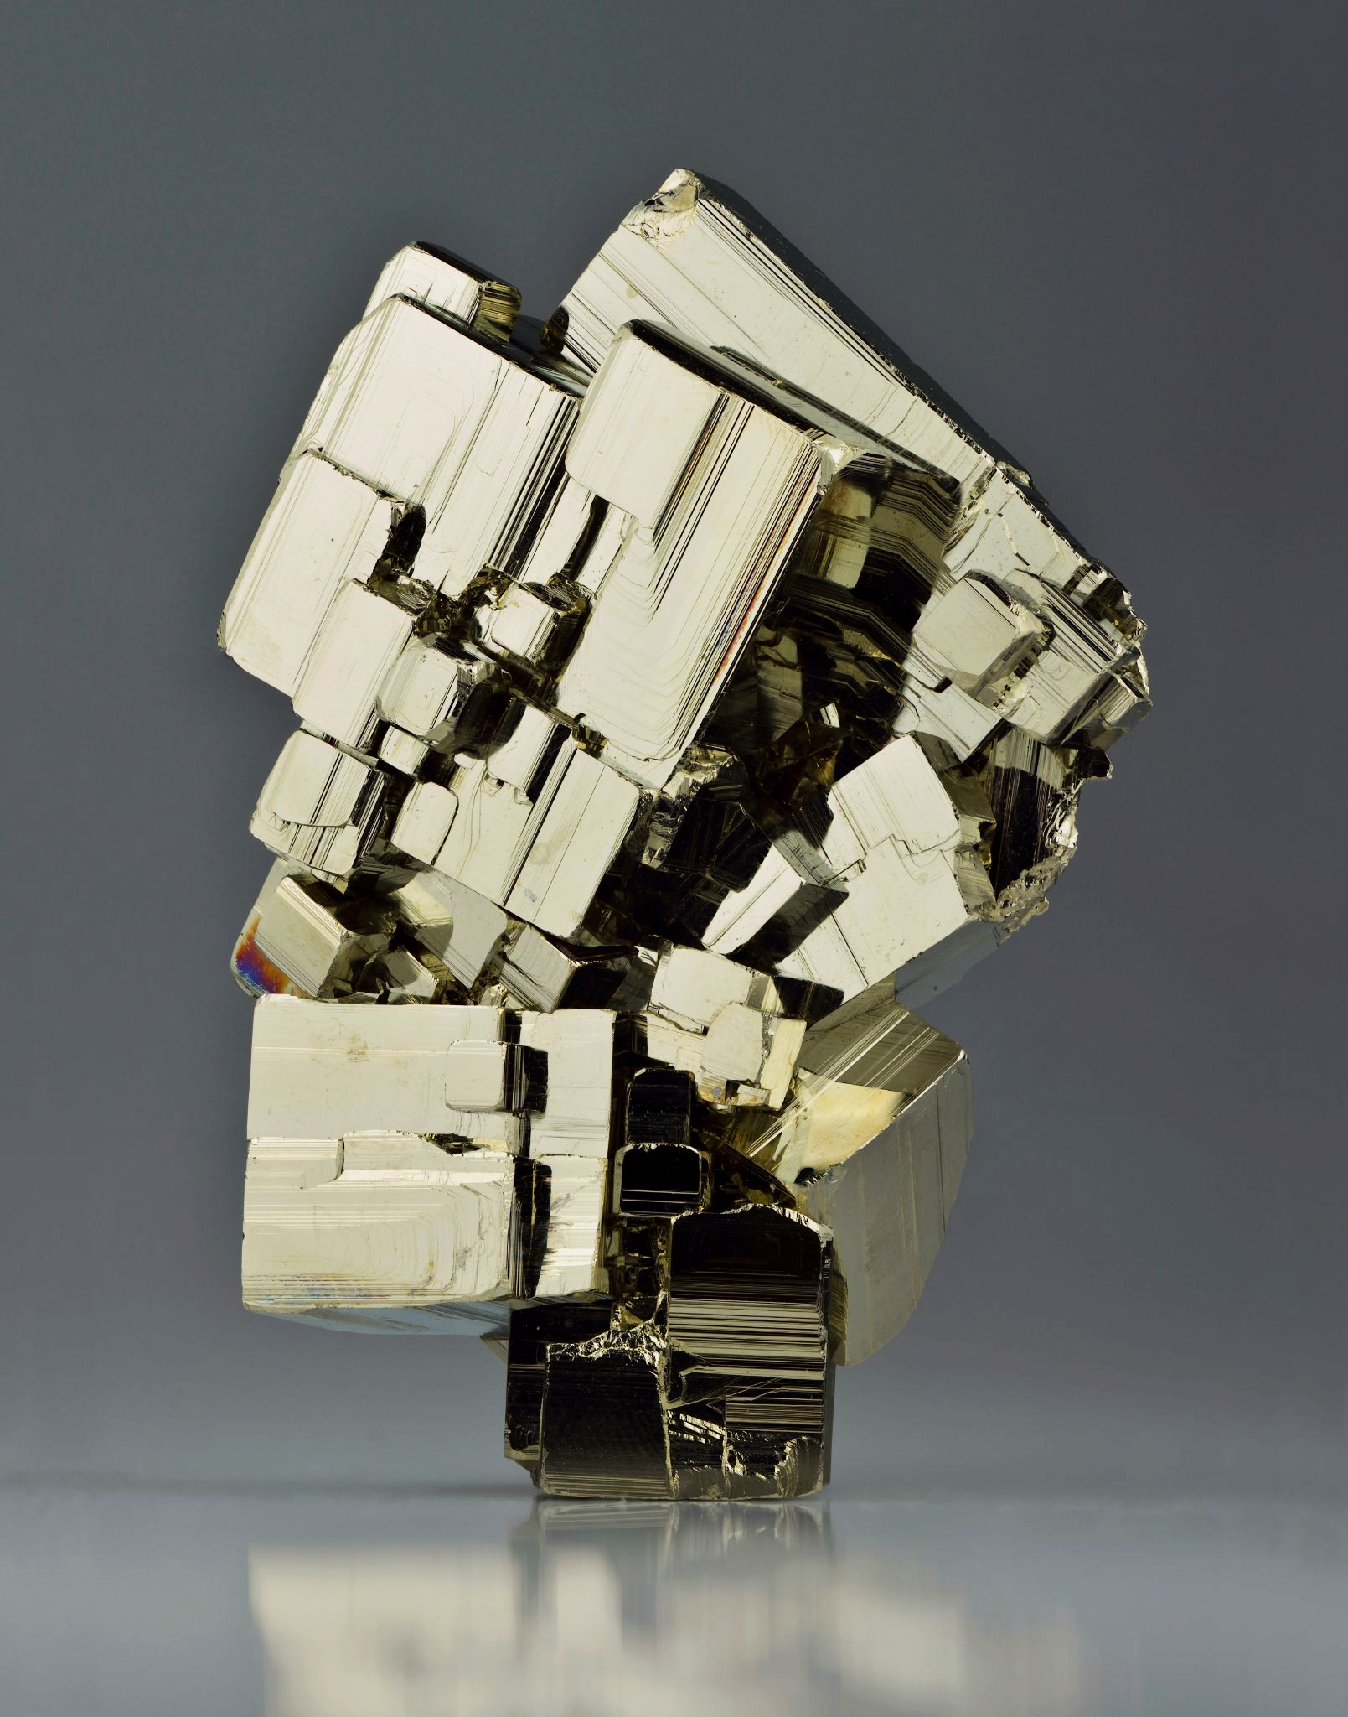
What is the mass of 6 moles of pyrite (FeS₂)?
Pyrite has an M_{r} of 120.
Mass = moles × M_{r}
6 × 120 = 720 grams
For more help, please visit www.exampaperspractice.co.uk
© 2025 Exams Papers Practice. All Rights Reserved

