Slide 1
Edexcel IGCSE Chemistry
8 - The Periodic Table
Groups, Periods and Electron Shells
For more help, please visit www.exampaperspractice.co.uk
© 2025 Exams Papers Practice. All Rights Reserved

Slide 2
The Periodic Table
Specification Points 1.18, 1.22 and 1.23
Understand how elements are arranged in the periodic table.
Understand how the electronic configuration of a main group element is related to its position in the periodic table.
Understand why elements in the same group of the periodic table have similar chemical properties.
The periodic table is a table that displays all known chemical elements.
There are around 100 known chemical elements.
Elements are arranged in order of increasing atomic number.
This means that each element has 1 more proton than the element before it.
The vertical columns of the periodic table are called groups.
The group an element belongs to depends on how many electrons are present in its outer shell.
Elements in group 1 have 1 electron in their outer shell.
Elements in the same group have similar properties.
The horizontal rows of the periodic table are called periods.
Each period indicates how many electron shells an element has.
Elements in period 3 will have 3 electron shells.
For more help, please visit www.exampaperspractice.co.uk
© 2025 Exams Papers Practice. All Rights Reserved

Slide 3
The periodic table. Groups 1 and 2 are called the reactive metals. The transition metals in the middle of the table are not given a group. The right hand side of the table (groups 3-7) are a mixture of metals and nonmetals. Elements in group 0 are called the noble gases.
GROUP 0
GROUP 1
GROUP 2
KEY
GROUP 3
GROUP 4
GROUP 5
GROUP 6
GROUP 7
PERIOD 2
PERIOD 3
TRANSITION METALS
PERIOD 4
PERIOD 5
PERIOD 6
PERIOD 7
For more help, please visit www.exampaperspractice.co.uk
© 2025 Exams Papers Practice. All Rights Reserved

Slide 4
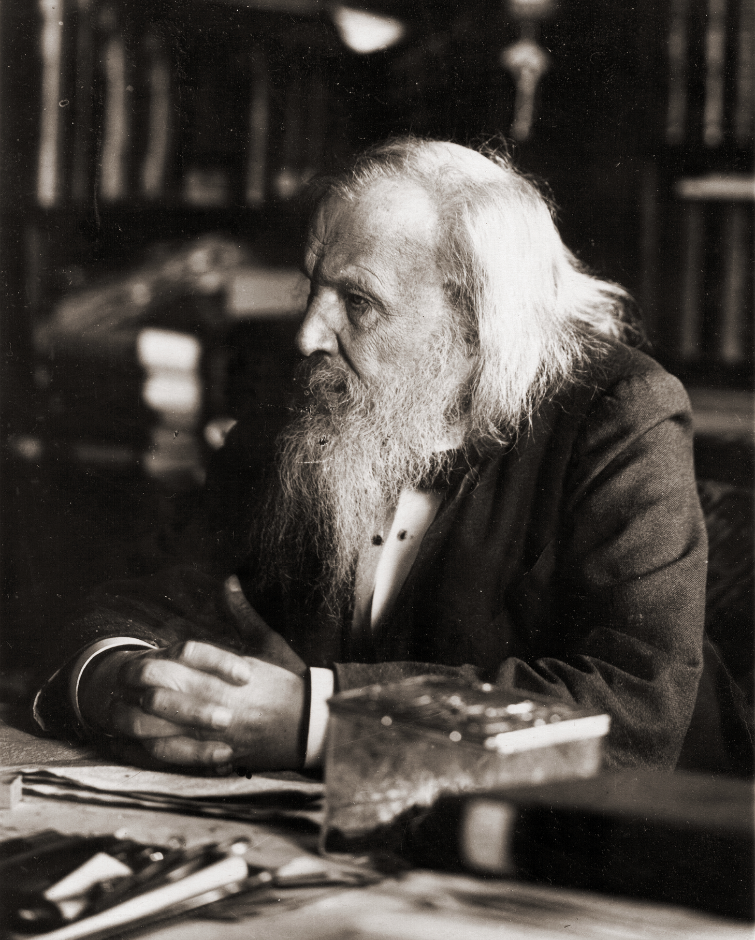
Dmitri Mendeleev proposed the first working model of the periodic table in 1869.
For more help, please visit www.exampaperspractice.co.uk
© 2025 Exams Papers Practice. All Rights Reserved

Slide 5
Electron Shells
The structure of an atom can be illustrated using electron shell diagrams.
Elements in the same group have the same number of electrons in their outer shell.
The number of electrons in the outer shell determines the chemical properties of the element.
Electrons orbit the nucleus of an atom in shells.
Shells that are closer to the nucleus have less energy than those which are further away.
The lowest energy shells are always filled first.
Only a certain number of electrons can fit in each shell.
2 electrons can fit in the first shell.
8 electrons can fit in any subsequent shell.
CARBON
The element carbon has 2 electron shells. 2 electrons are present in the first shell and 4 electrons are present in the second shell. The electron configuration of carbon is thus said to be 2.4.
For more help, please visit www.exampaperspractice.co.uk
© 2025 Exams Papers Practice. All Rights Reserved

Slide 6
Element | Atomic Number | Electron Configuration
Hydrogen | 1 | 1
Helium | 2 | 2
Lithium | 3 | 2.1
Beryllium | 4 | 2.2
Boron | 5 | 2.3
Carbon | 6 | 2.4
Nitrogen | 7 | 2.5
Oxygen | 8 | 2.6
Fluorine | 9 | 2.7
Neon | 10 | 2.8
Specification Point 1.19 - Understand how to deduce the electronic configurations of the first 20 elements from their positions in the periodic table.
For more help, please visit www.exampaperspractice.co.uk
© 2025 Exams Papers Practice. All Rights Reserved

Slide 7
Element | Atomic Number | Electron Configuration
Sodium | 11 | 2.8.1
Magnesium | 12 | 2.8.2
Aluminium | 13 | 2.8.3
Silicon | 14 | 2.8.4
Phosphorous | 15 | 2.8.5
Sulphur | 16 | 2.8.6
Chlorine | 17 | 2.8.7
Argon | 18 | 2.8.8
Potassium | 19 | 2.8.8.1
Calcium | 20 | 2.8.8.2
Specification Point 1.19 - Understand how to deduce the electronic configurations of the first 20 elements from their positions in the periodic table.
For more help, please visit www.exampaperspractice.co.uk
© 2025 Exams Papers Practice. All Rights Reserved

Slide 8
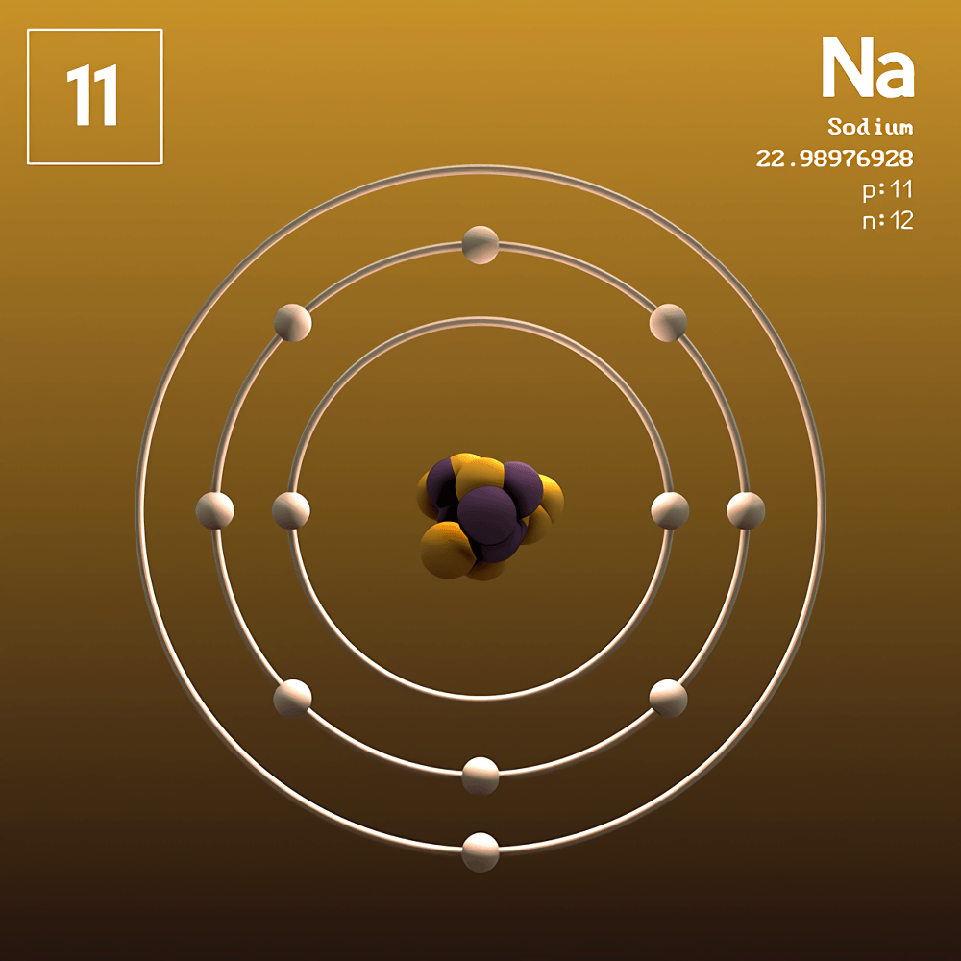
Sodium (Na) contains 3 electron shells so is placed within period 3. It also contains 1 outer shell electron, so is placed within group 1. The electron configuration of sodium is 2.8.1.
For more help, please visit www.exampaperspractice.co.uk
© 2025 Exams Papers Practice. All Rights Reserved

Slide 9
Metals and Non-Metals
Specification Points 1.20 and 1.21
Understand how to use electrical conductivity and the acid-base character of oxides to classify elements as metals or non-metals.
Identify an element as a metal or a non-metal according to its position in the periodic table.
Elements are classified as metals or non-metals.
In the periodic table, metals are on the left-hand side, non-metals are on the right-hand side.
Metals conduct electricity.
Electrical charge can easily pass through metallic elements.
Some metals react with oxygen to form metal oxides.
Metal oxides dissolve in water to form alkaline solutions.
Metal oxides are sometimes referred to as basic.
Non-metals do not conduct electricity.
Some non-metals react with oxygen to form non-metal oxides.
Non-metal oxides dissolve in water to form acidic solutions.
For more help, please visit www.exampaperspractice.co.uk
© 2025 Exams Papers Practice. All Rights Reserved

Slide 10
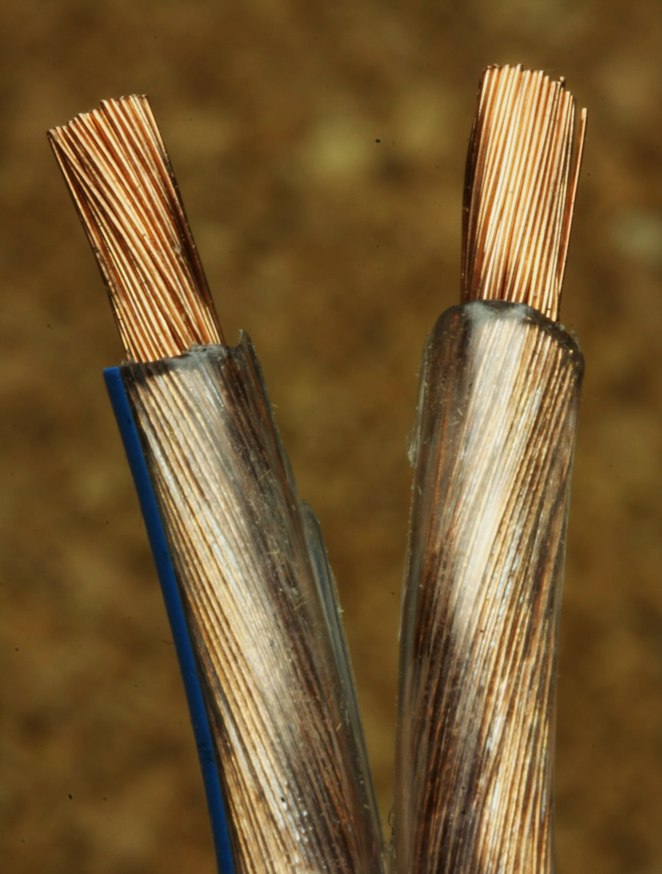
Copper (Cu) is a metal with a very high electrical conductivity.
As a consequence, copper is often used to create wiring looms.
For more help, please visit www.exampaperspractice.co.uk
© 2025 Exams Papers Practice. All Rights Reserved

Slide 11
The metallic elements occupy the left-hand side of the periodic table.
The non-metals (with the exception of hydrogen), occupy the right-hand side.
For more help, please visit www.exampaperspractice.co.uk
© 2025 Exams Papers Practice. All Rights Reserved

Slide 12
The Noble Gases
Specification Point 1.24
Understand why the noble gases do not readily react.
Elements in group 0 are called the noble gases.
Group 0 is to the far right of the periodic table.
The noble gases include helium (He), neon (Ne) and argon (Ar), among others.
The noble gases are inert.
This means that they do not react with other elements.
Noble gases have a complete outer shell of electrons.
Their outer shells contain 8 electrons.
This means a lot of energy is required to add or remove an electron.
For more help, please visit www.exampaperspractice.co.uk
© 2025 Exams Papers Practice. All Rights Reserved

Slide 13
Neon (Ne) is a noble gas that yields a distinctive orange glow when a voltage is passed through it.
Neon is often used to illuminate signs.
For more help, please visit www.exampaperspractice.co.uk
© 2025 Exams Papers Practice. All Rights Reserved

