Slide 1
Edexcel IGCSE Chemistry
7 - Atoms and Molecules
Definitions and Structure
For more help, please visit www.exampaperspractice.co.uk
© 2025 Exams Papers Practice. All Rights Reserved

Slide 2
Atoms and Molecules
Specification Point 1.14
Know what is meant by the terms atom and molecule.
An atom is the smallest particle of an element.
An atom contains three subatomic particles:
Protons - these are heavy and positively charged.
Neutrons - these are heavy and neutral.
Electrons - these have hardly any mass and are negatively charged.
Atoms can join together to form molecules.
Some molecules consist of just one element - hydrogen gas for example (H₂).
Some molecules, like water (H₂O) consist of two or more different elements.
For more help, please visit www.exampaperspractice.co.uk
© 2025 Exams Papers Practice. All Rights Reserved

Slide 3
A helium atom. The nucleus houses the protons and neutrons whilst the negatively charged electrons orbit the nucleus as they spin.
For more help, please visit www.exampaperspractice.co.uk
© 2025 Exams Papers Practice. All Rights Reserved

Slide 4
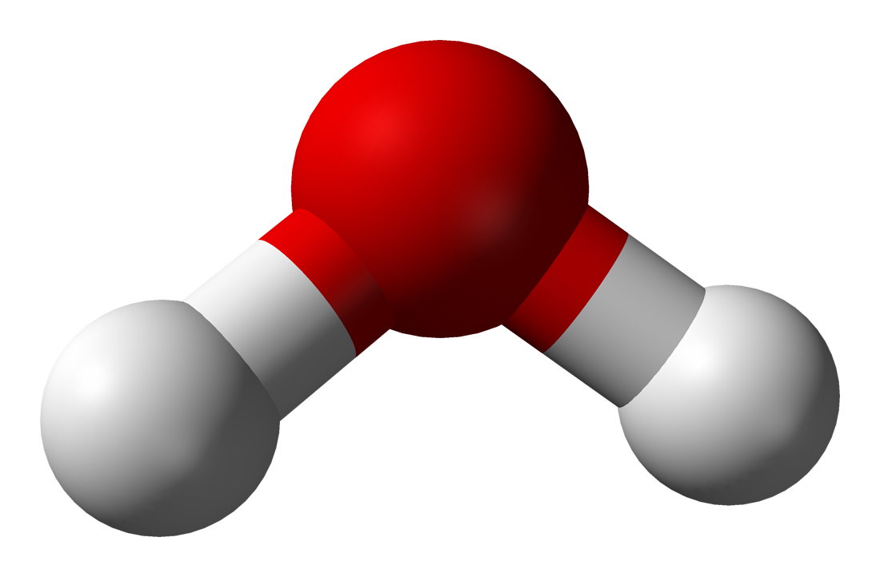
Molecules consist of more than one atom.
Some molecules, such as water, contain 2 or more elements.
Water contains 2 hydrogen atoms and 1 oxygen atom.
For more help, please visit www.exampaperspractice.co.uk
© 2025 Exams Papers Practice. All Rights Reserved

Slide 5
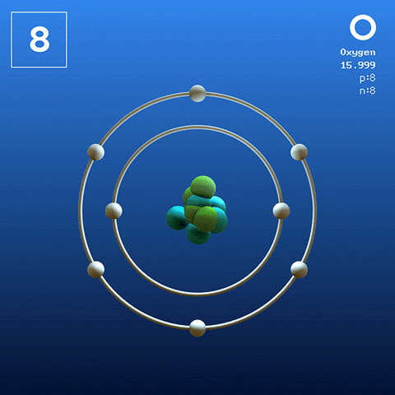
Protons and Neutrons
Specification Point 1.15
Know the structure of an atom in terms of the positions, relative masses and relative charges of subatomic particles.
Protons and neutrons are found in the nucleus.
The nucleus is in the centre of the atom and contains almost all of the mass.
The nucleus is positively charged.
This is due to the protons in the nucleus.
The nucleus is tiny compared to the overall size of the atom.
Most of the size of the atom is due to the orbiting electrons.
An oxygen atom with protons and neutrons in the nucleus. The nucleus is orbited by electrons.
For more help, please visit www.exampaperspractice.co.uk
© 2025 Exams Papers Practice. All Rights Reserved

Slide 6
The Electron
Electrons orbit the nucleus in energy levels called shells.
Electrons are negatively charged and tiny.
Their orbits do however cover a lot of space.
The size of the orbits determine the size of the atom.
Electrons have virtually no mass.
The mass of an electron is usually recorded as zero.
Particle | Relative Charge | Relative Mass
Proton | +1 | 1
Neutron | 0 | 1
Electron | -1 | 1/1836
For more help, please visit www.exampaperspractice.co.uk
© 2025 Exams Papers Practice. All Rights Reserved

Slide 7
Atomic Charge and Mass
Specification Point 1.16
Know what is meant by the terms atomic number, mass number, isotopes and relative atomic mass (A_{r}).
The number of electrons is the same as the number of protons.
If some electrons are added or removed, the atom is becomes charged and is referred to as an ion.
The number of protons in an atom is referred to as its atomic number.
This is the smaller number in the periodic table.
The number of protons and neutrons in an atom is referred to as its mass number.
This is the larger number in the periodic table.
For more help, please visit www.exampaperspractice.co.uk
© 2025 Exams Papers Practice. All Rights Reserved

Slide 8
Magnesium as summarised in the periodic table.
The chemical symbol of magnesium (Mg), atomic number and mass number are all present.
For more help, please visit www.exampaperspractice.co.uk
© 2025 Exams Papers Practice. All Rights Reserved

Slide 9
Isotopes
Isotopes are different atomic forms of the same element.
They contain the same number of protons and electrons but differing numbers of neutrons.
Isotopes have the same atomic number but a different mass number.
One example of an element that has a number of different isotopes is hydrogen.
Isotopes have very similar physical and chemical properties.
The three common isotopes of hydrogen (H). Common hydrogen (¹H) has 1 proton. Deuterium (²H) has 1 proton and 1 neutron. Tritium (³H) has 1 proton and 2 neutrons. Tritium, an unstable isotope, is radioactive.
For more help, please visit www.exampaperspractice.co.uk
© 2025 Exams Papers Practice. All Rights Reserved

Slide 10
Relative Atomic Mass (A_{r})
Relative atomic mass (A_{r}) accounts for all the isotopes of an element.
It is calculated as the average mass of all the isotopes of an element.
A_{r} must account for relative mass and relative abundance.
Relative mass is how much each isotope weighs.
For example carbon-13 has a relative mass of 13.
Relative abundance is how common the isotope is in the environment.
C¹³ has 1 extra neutron in its nucleus. This makes C¹³ heavier than regular carbon.
For more help, please visit www.exampaperspractice.co.uk
© 2025 Exams Papers Practice. All Rights Reserved

Slide 11
Calculating A_{r}
There are 3 atoms of ³⁵Cl for every 1 atom of ³⁷Cl.
Multiply the mass of each isotope by its abundance.
Add these together.
Divide by the sum of the relative abundances.
Element | Relative Mass of Isotope | Relative Abundance
Chlorine | 35 | 3
 | 37 | 1
For more help, please visit www.exampaperspractice.co.uk
© 2025 Exams Papers Practice. All Rights Reserved

Slide 12
Calculating A_{r}
In the periodic table, the mass number of chlorine is recorded as 35.5.
This is the case for many other elements as well.
Element | Relative Mass of Isotope | Relative Abundance
Chlorine | 35 | 3
 | 37 | 1
For more help, please visit www.exampaperspractice.co.uk
© 2025 Exams Papers Practice. All Rights Reserved

Slide 13
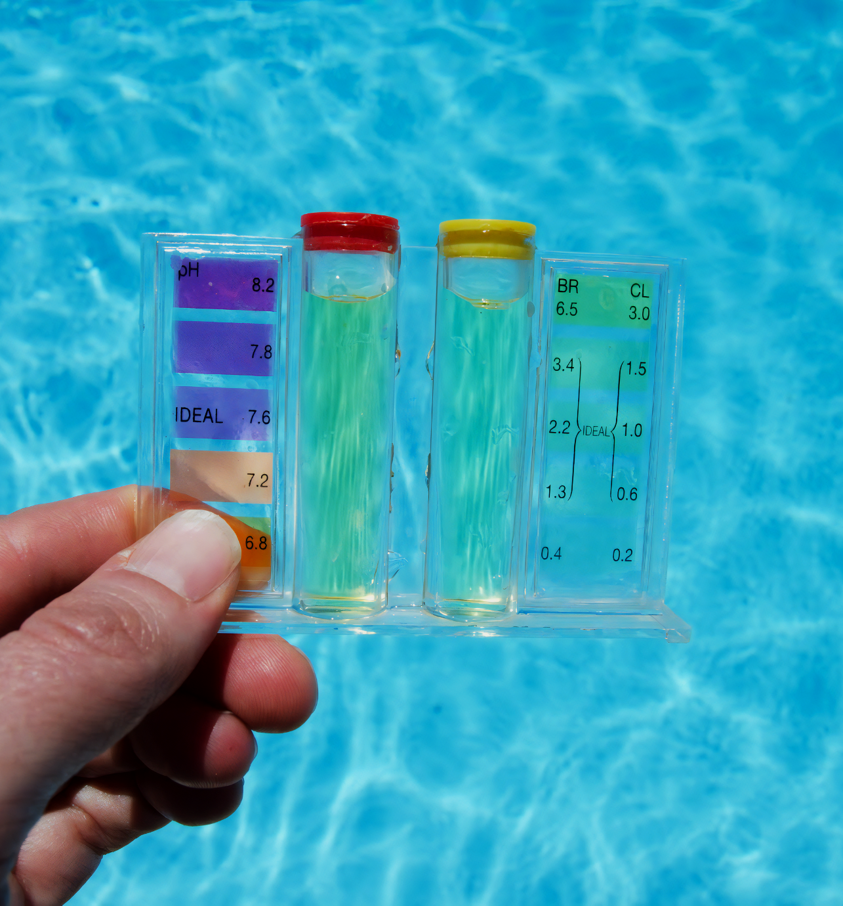
Chlorine, a famous disinfectant, exists as two major isotopes, Cl³⁵ and Cl³⁷.
For more help, please visit www.exampaperspractice.co.uk
© 2025 Exams Papers Practice. All Rights Reserved

