Slide 1
Edexcel IGCSE Chemistry
5 - Methods of Separation
Distillation, Filtration, Crystallization and Chromatography
For more help, please visit www.exampaperspractice.co.uk
© 2025 Exams Papers Practice. All Rights Reserved

Slide 2
Separating Mixtures
Specification Point 1.10
Describe the following experimental techniques for the separation of mixtures:
Simple distillation.
Fractional distillation.
Filtration.
Crystallisation.
Paper chromatography.
Distillation is used to separate out solutions.
Distillation is used to separate a liquid and a soluble solid from a solution.
One example is the separation of water (H₂O) and salt (NaCl) from saline solution.
For more help, please visit www.exampaperspractice.co.uk
© 2025 Exams Papers Practice. All Rights Reserved

Slide 3
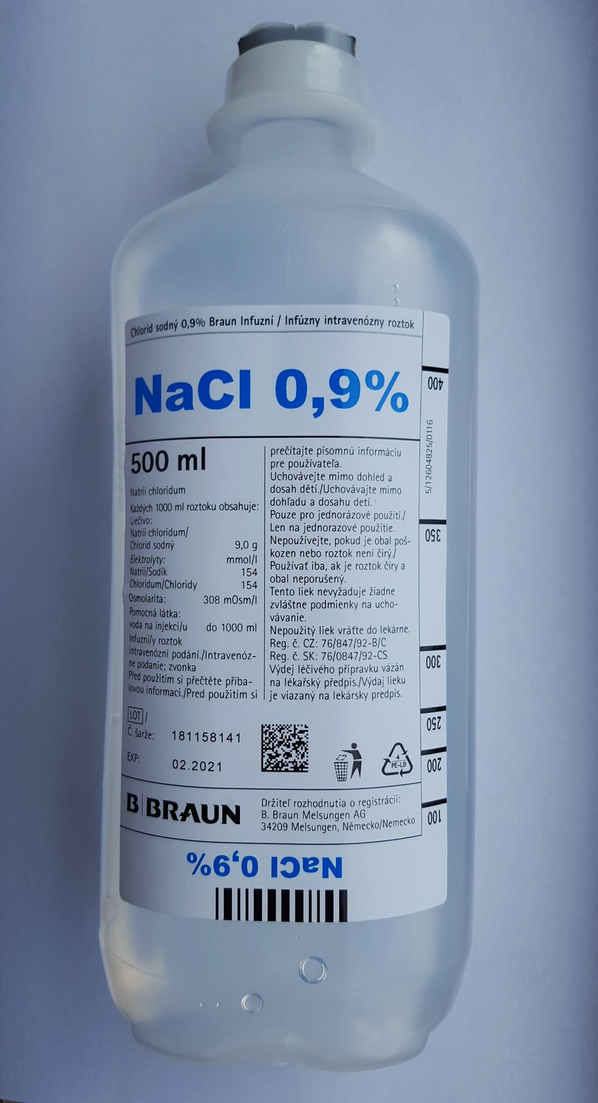
Saline is a solution of sodium chloride (NaCl) and water (H₂O).
Simple distillation is one way in which NaCl and H₂O can be separated from each other.
For more help, please visit www.exampaperspractice.co.uk
© 2025 Exams Papers Practice. All Rights Reserved

Slide 4
Simple Distillation
The solution is heated.
The part of the solution with the lowest boiling point will evaporate.
Heating can be carried out either using a bunsen burner or a water bath.
The vapour is cooled and condensed.
This is done with the aid of a cooling water jacket.
The newly condensed, pure liquid is collected in a new container.
The rest of the solution remains in the flask.
Simple distillation only works when the components have very different boiling points.
For more help, please visit www.exampaperspractice.co.uk
© 2025 Exams Papers Practice. All Rights Reserved

Slide 5
Simple distillation is used to separate out solutions. As the solution is heated, the water evaporates, leaving the salt behind. The gaseous water vapour then travels down a condensing tube and condenses back into liquid water, where it is collected in another flask.
WATER IN
WATER OUT
SALINE
SOLUTION
DISTILLATE OF PURE WATER
ELECTRIC HEATER
For more help, please visit www.exampaperspractice.co.uk
© 2025 Exams Papers Practice. All Rights Reserved

Slide 6
Fractional Distillation
Fractional distillation is used to separate mixtures of liquids.
One common experiment is the separation of ethanol (C₂H₅OH) and water.
These liquids will have different boiling points.
Ethanol boils at 78°C, water boils at 100°C.
The liquid with the lowest boiling point will evaporate first.
In this case the ethanol will boil first.
The evaporating liquid will rise up a fractionating column.
It will then be carried to a condenser.
Here it will reform as a liquid.
The temperature is then raised so the second liquid can be collected.
For more help, please visit www.exampaperspractice.co.uk
© 2025 Exams Papers Practice. All Rights Reserved

Slide 7
Fractional distillation is used to separate out mixtures of different liquids. Ethanol has a much lower boiling point than water so will evaporate first. The vaporised ethanol will travel up a fractionating column and will be passed to a condensing tube. Here the ethanol will condense back into its liquid form.
FRACTIONATING COLUMN
CONDENSING TUBE
MIXTURE OF WATER AND ETHANOL
PURE, DISTILLED ETHANOL
For more help, please visit www.exampaperspractice.co.uk
© 2025 Exams Papers Practice. All Rights Reserved

Slide 8
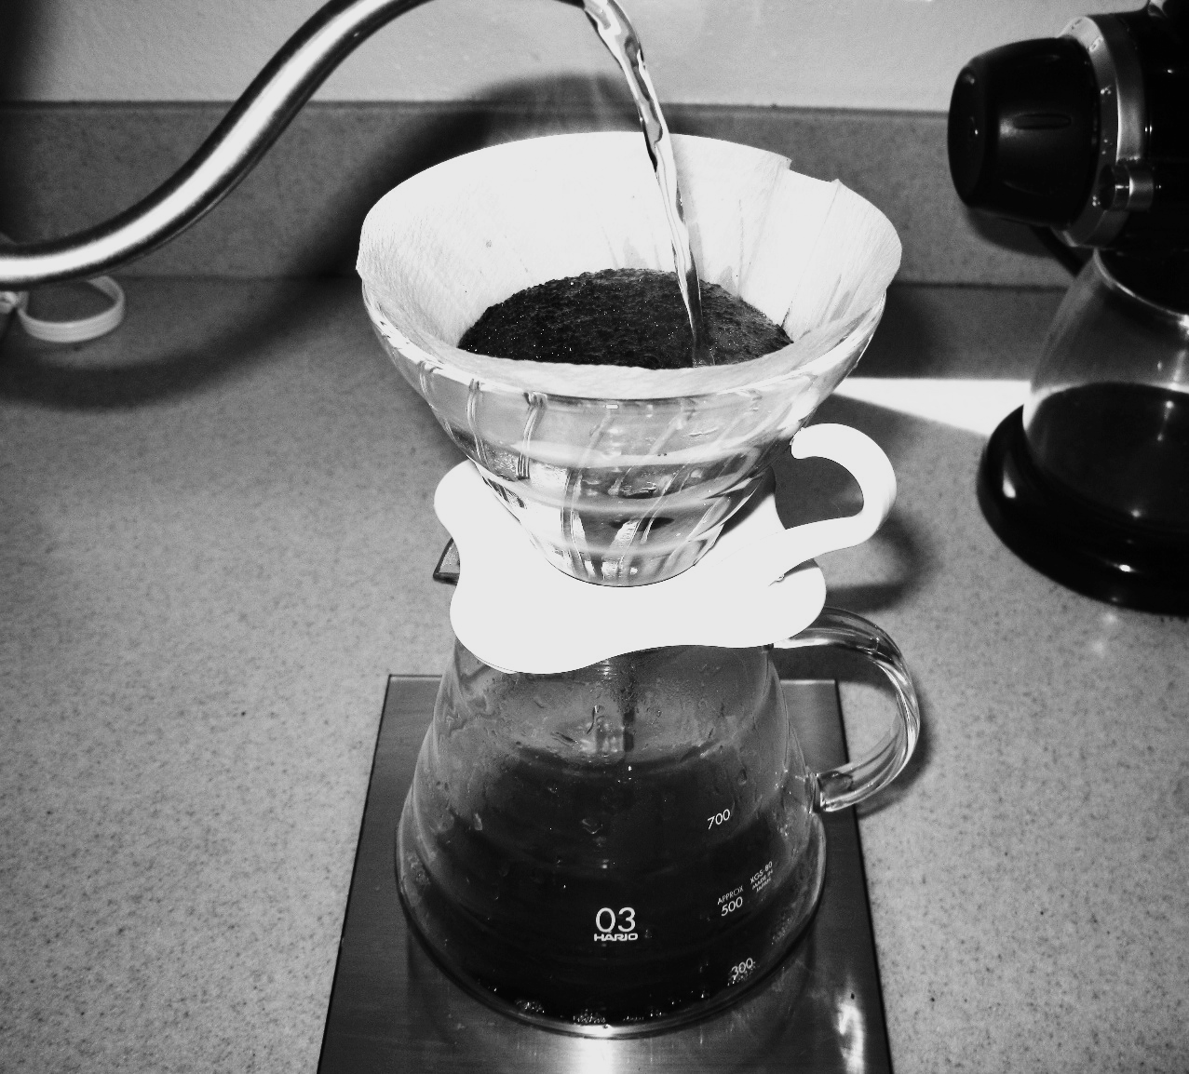
Filtration
Filtration is used to separate an insoluble solid from a liquid.
For example a mixture of coffee grounds and water.
The filter paper is placed in a funnel above a beaker.
The mixture is poured into the funnel.
The paper will only allow the smaller, liquid particles to pass through.
The solid particles will become trapped in the paper and remain as a residue.
One method of preparing coffee involves the pouring of water through filter paper. The coffee grounds remain as a residue in the paper.
For more help, please visit www.exampaperspractice.co.uk
© 2025 Exams Papers Practice. All Rights Reserved

Slide 9
Crystallization
Crystallization separates soluble solids from a solution.
The solution is heated in an evaporating dish.
Some of the liquid evaporates, creating a more concentrated solution.
As the solution cools, crystals of solute begin to form.
This is because the solute is much less soluble when it is cold.
The crystals are filtered from the solution, and dried.
This is most commonly demonstrated with copper sulphate (CuSO₄) crystals.
Crystallization video.
For more help, please visit www.exampaperspractice.co.uk
© 2025 Exams Papers Practice. All Rights Reserved

Slide 10
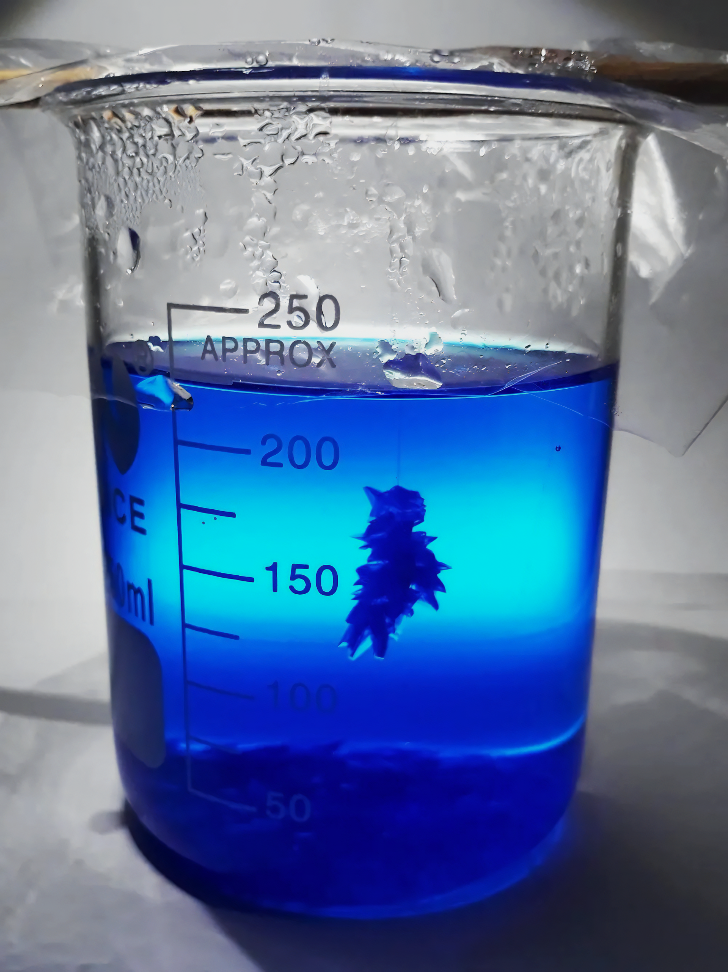
Crystals of copper sulphate in solution.
When transferred to an evaporating dish, the crystals can be isolated from water.
For more help, please visit www.exampaperspractice.co.uk
© 2025 Exams Papers Practice. All Rights Reserved

Slide 11
Chromatography
Chromatography is another way to separate mixtures.
Paper chromatography is the most common method.
Mixtures are separated based on their solubilities in a particular solvent.
A pencil line is drawn on a sheet of filter paper.
Pencil marks are insoluble so will not dissolve in the solvent.
Spots of different inks are added to the line at regular intervals.
The paper is lowered into the solvent.
This allows the solvent to travel up the paper.
As the solvent moves up the paper, it carries the dyes with it.
Some dyes will travel further than others based on their solubility.
Chromatography video.
For more help, please visit www.exampaperspractice.co.uk
© 2025 Exams Papers Practice. All Rights Reserved

Slide 12
These inks travelled different distances in the same solvent because of their varying solubilities.
For more help, please visit www.exampaperspractice.co.uk
© 2025 Exams Papers Practice. All Rights Reserved

