Slide 1
Edexcel IGCSE Chemistry
4 - Elements, Compounds and Mixtures
Classifications, Melting Points and Boiling Points
For more help, please visit www.exampaperspractice.co.uk
© 2025 Exams Papers Practice. All Rights Reserved

Slide 2
Elements, Compounds and Mixtures
Specification Point 1.8
Understand how to classify a substance as an element, compound or mixture.
Elements are made up of atoms.
An atom is the smallest unit of matter.
Elements consist of only one type of atom.
For example, hydrogen (H₂), nitrogen (N₂) and carbon (C) are all elements.
Compounds are made up of two or more different elements.
These elements are chemically bonded to one another.
For example carbon (C) and oxygen (O₂) can react with each other to form carbon dioxide (CO₂).
Mixtures are a combination of two or more different elements.
Mixtures are not chemically bonded to one another.
Instead they are physically in close proximity.
For example, sand and water can form a mixture.
For more help, please visit www.exampaperspractice.co.uk
© 2025 Exams Papers Practice. All Rights Reserved

Slide 3
Elements, such as hydrogen, consist of only one type of atom.
For more help, please visit www.exampaperspractice.co.uk
© 2025 Exams Papers Practice. All Rights Reserved

Slide 4
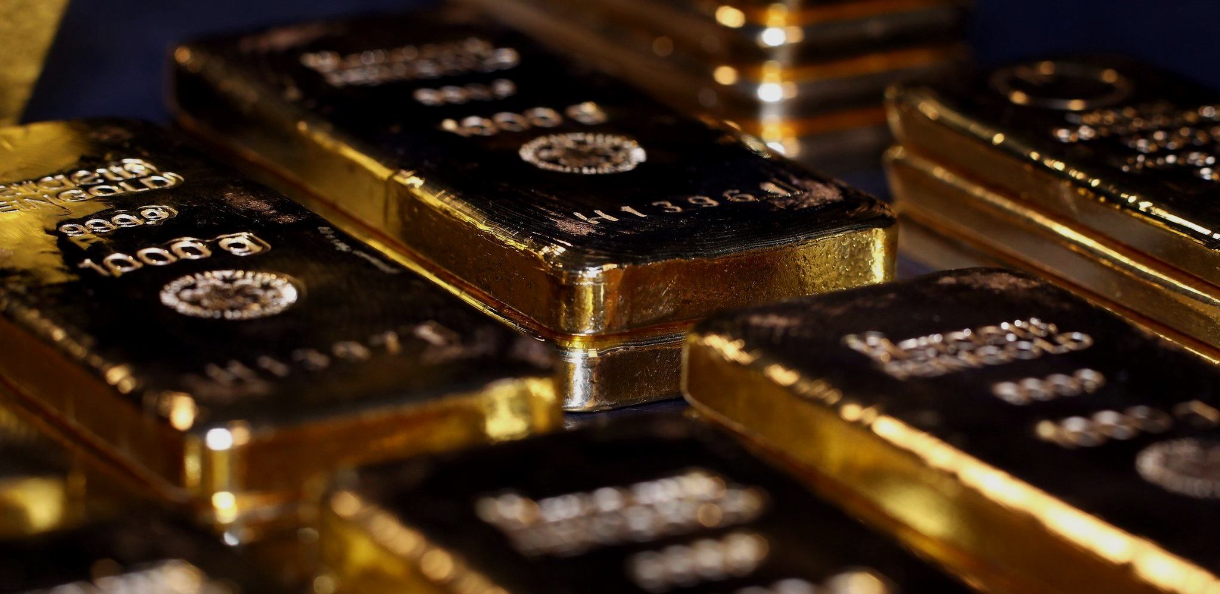
Gold (Au) is very unreactive and exists on its own as an element.
For more help, please visit www.exampaperspractice.co.uk
© 2025 Exams Papers Practice. All Rights Reserved

Slide 5
Compounds, such as carbon dioxide (CO₂) are made up of two or more elements that are chemically bonded to each other.
Carbon dioxide contains a central carbon atom bonded to two oxygen atoms.
For more help, please visit www.exampaperspractice.co.uk
© 2025 Exams Papers Practice. All Rights Reserved

Slide 6
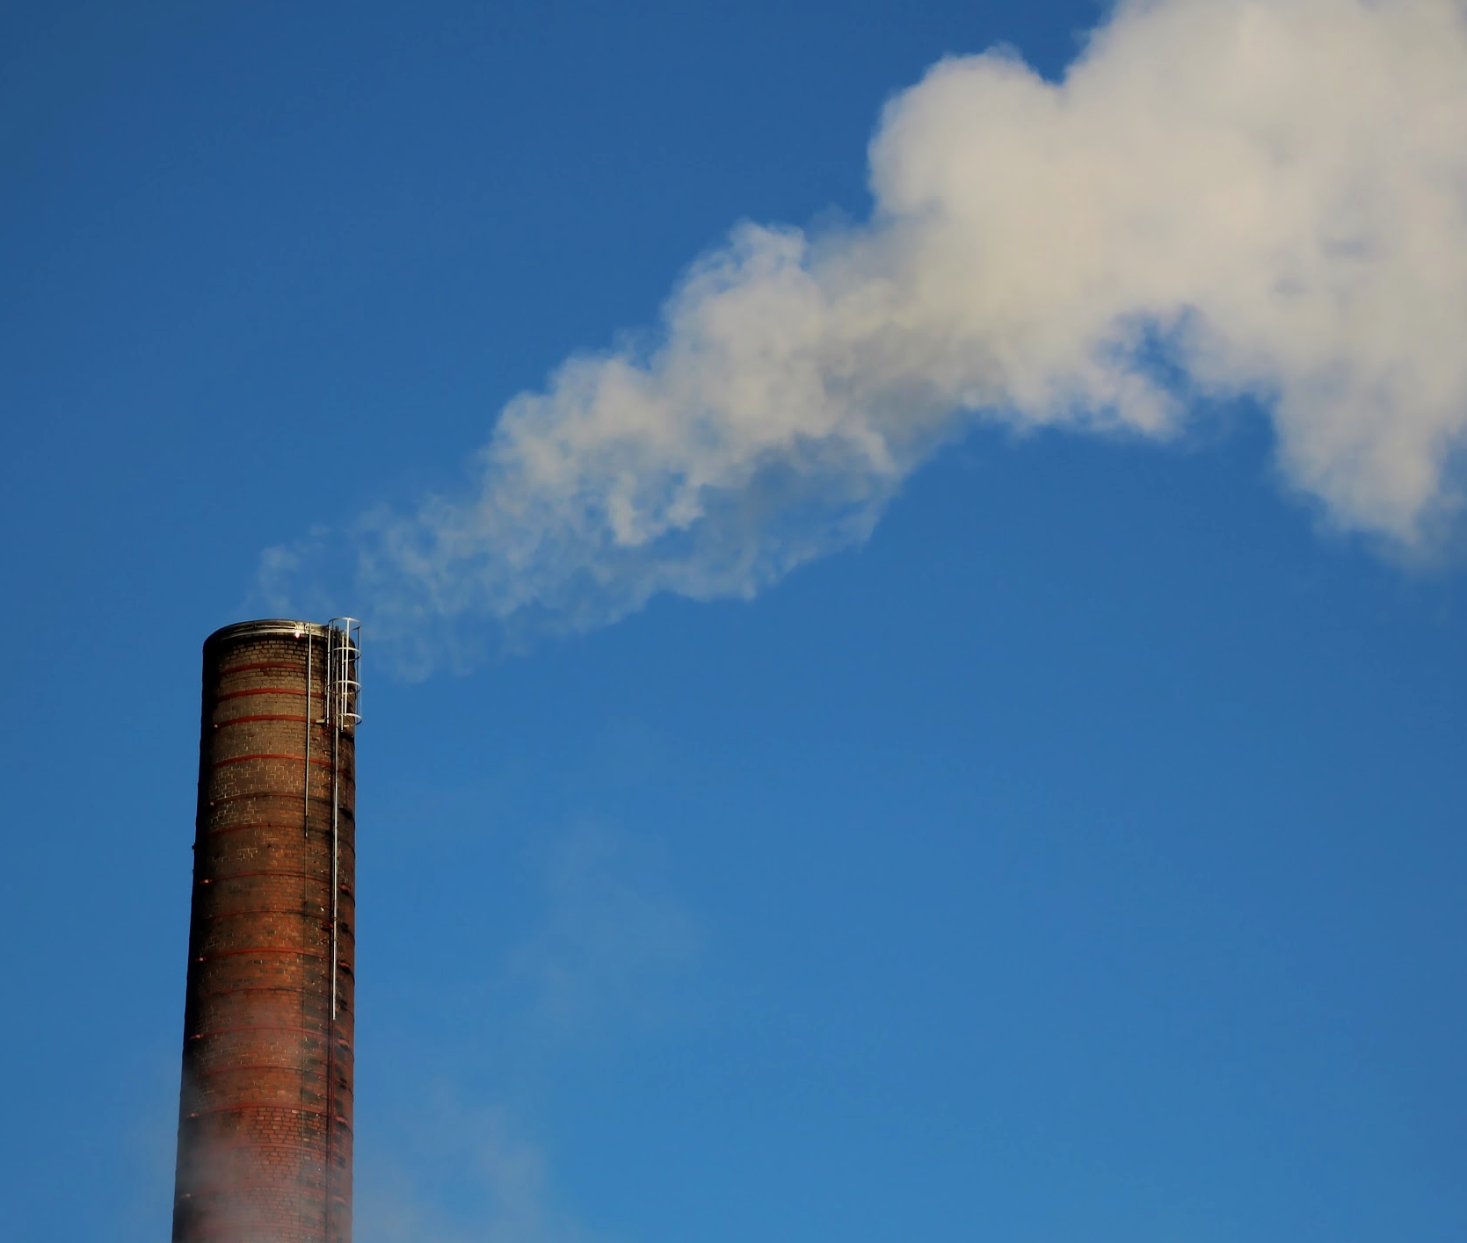
CO₂ is a compound formed in a chemical reaction.
For more help, please visit www.exampaperspractice.co.uk
© 2025 Exams Papers Practice. All Rights Reserved

Slide 7
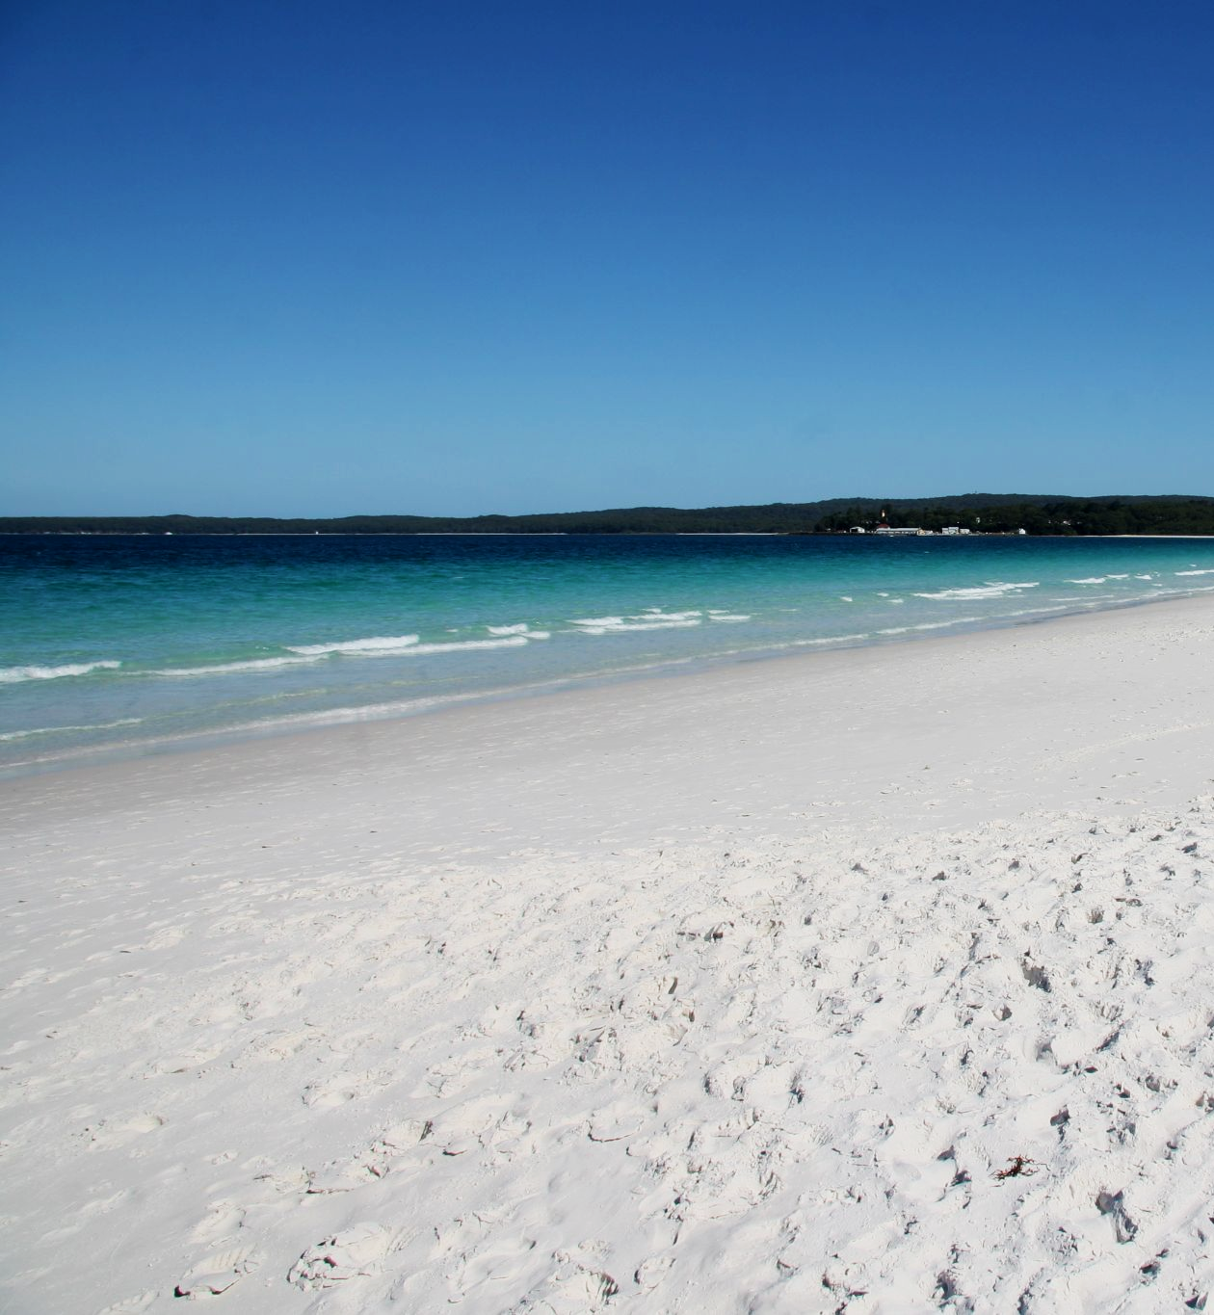
Sand and water don’t react with each other but instead can form a mixture.
Mixtures can be defined as two or more elements in close proximity with each other.
For more help, please visit www.exampaperspractice.co.uk
© 2025 Exams Papers Practice. All Rights Reserved

Slide 8
Properties of Compounds and Mixtures
The properties of compounds are often very different to their original elements.
When iron (Fe) and sulphur (S) are heated, iron sulphide (FeS) is formed.
FeS is unlike either iron or sulphur.
Sulphur is yellow, iron is magnetic, FeS is neither.
Mixtures will show the properties of both elements.
For example a mixture of iron and sulphur will contain magnetic regions (the iron) and yellow regions (the sulphur).
IRON AND SULPHUR REACT TO FORM THE COMPOUND IRON SULPHIDE
For more help, please visit www.exampaperspractice.co.uk
© 2025 Exams Papers Practice. All Rights Reserved

Slide 9
Pure Substances
Specification Point 1.9
Understand that a pure substance has a fixed melting and boiling point, but that a mixture may melt or boil over a range of temperatures.
A pure substance is one that contains only one element or compound.
Pure substances have melting points and boiling points that don’t change.
These points are fixed.
Water (H₂O) for example always melts at 0°C and always boils at 100°C.
Mixtures are not pure substances.
Mixtures contain a number of different elements or compounds.
Mixtures will melt or boil over a range of temperatures.
H₂O may boil at different temperatures if other elements or compounds are mixed with it.
For more help, please visit www.exampaperspractice.co.uk
© 2025 Exams Papers Practice. All Rights Reserved

Slide 10
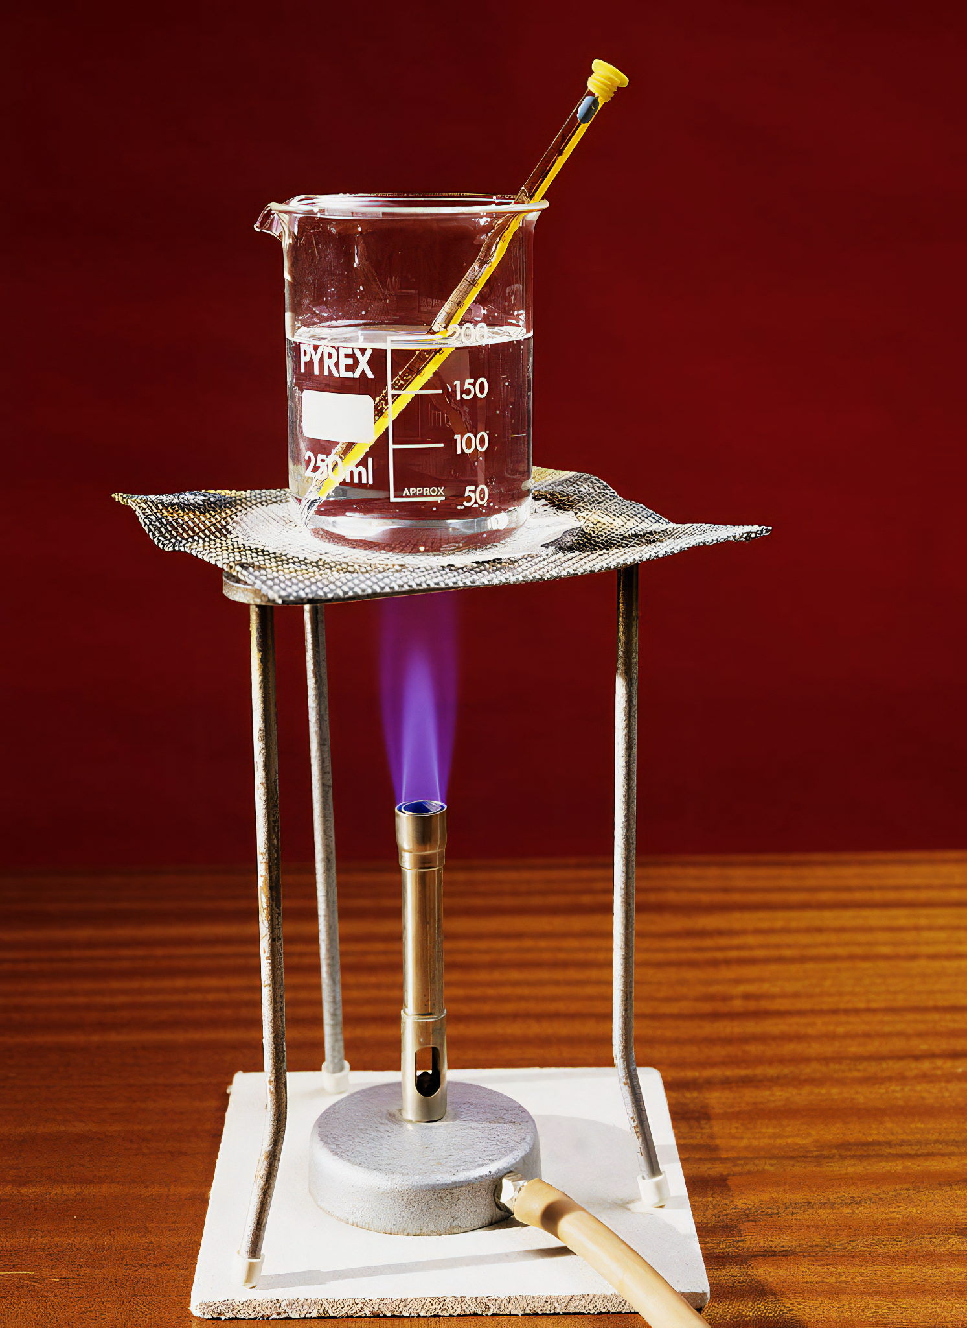
Pure substances have melting points and boiling points that will not change.
Pure water will always boil at precisely 100°C
For more help, please visit www.exampaperspractice.co.uk
© 2025 Exams Papers Practice. All Rights Reserved

Slide 11
Adding other elements or compounds to water makes it impure.
When salt is mixed with water it lowers the melting point of the water.
Seawater melts at -2°C.
For more help, please visit www.exampaperspractice.co.uk
© 2025 Exams Papers Practice. All Rights Reserved

