Slide 1
Edexcel IGCSE Chemistry
37 - Addition Polymers
Polymerisation and Problems
For more help, please visit www.exampaperspractice.co.uk
© 2025 Exams Papers Practice. All Rights Reserved

Slide 2
Monomers and Polymers
Specification Points 4.44 and 4.45
Know that an addition polymer is formed by joining up many small molecules called monomers.
Understand how to draw the repeat unit of an addition polymer, including polyethene, polypropene, polychloroethene and polytetrafluoroethene.
A polymer is a substance of high molecular mass.
Polymers are made up of smaller repeating units called monomers.
These monomers are joined to each other by covalent bonds.
Polymers can be formed during addition reactions.
The C=C bond in an alkene monomer can break to form a single bond with the adjacent monomer.
Polymers that are based on alkenes or haloalkenes have a wide range of uses.
Plastics, nylons and resins are all derived from addition polymerisation.
Polymers are formed from long chains of repeating units called monomers.
For more help, please visit www.exampaperspractice.co.uk
© 2025 Exams Papers Practice. All Rights Reserved

Slide 3
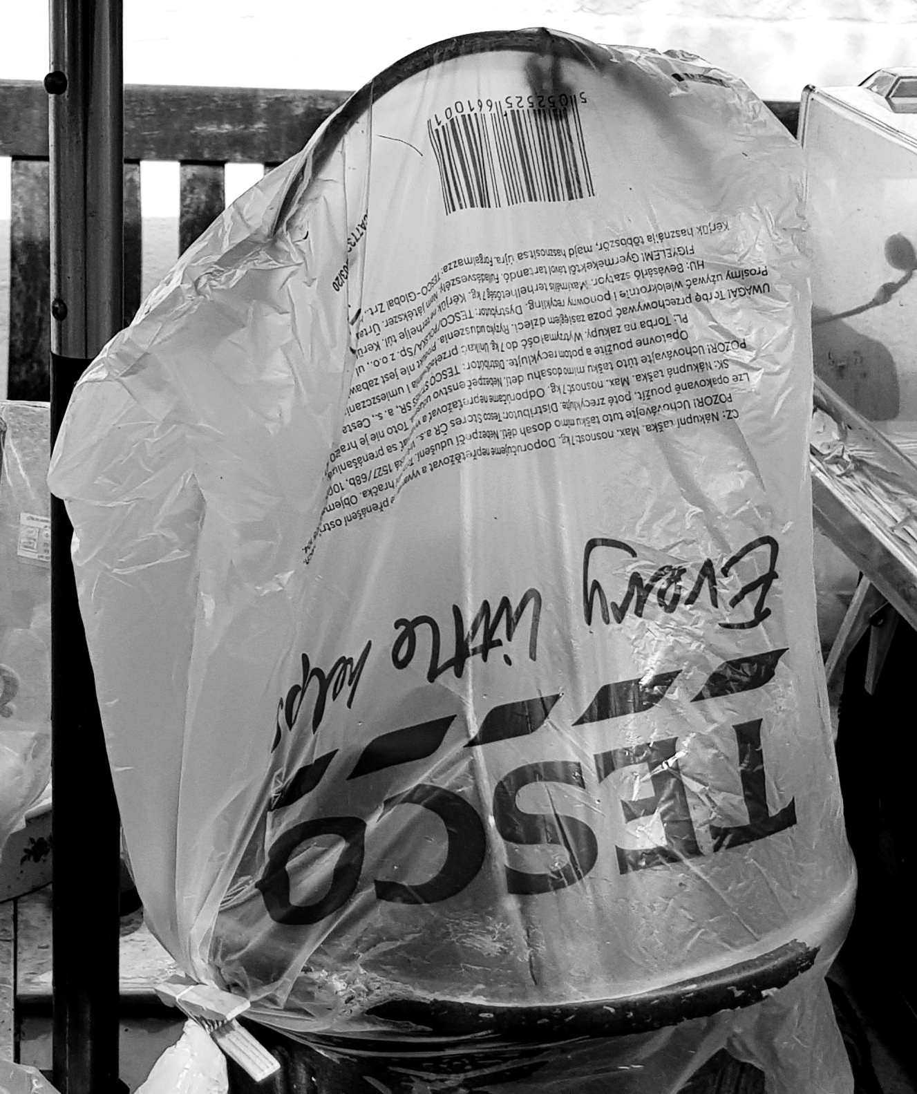
Most plastic bags are made of polyethene (PET).
PET is a polymer of the monomer ethene (C₂H₄).
For more help, please visit www.exampaperspractice.co.uk
© 2025 Exams Papers Practice. All Rights Reserved

Slide 4
Specification Point 4.46
Understand how to deduce the structure of a monomer from the repeat unit of an addition polymer and vice versa.
Addition polymers are drawn using specific conventions. The C=C bond is broken and a pair of square brackets are drawn surrounding the new polymer. Bonds are also drawn leaving the brackets. Finally, an n is added to indicate that this unit is 1 of many identical repeating units. In order to derive the formula of the monomer from the polymer, these steps are taken in reverse.
HIGH PRESSURE AND CATALYST
ETHENE
POLYETHENE
For more help, please visit www.exampaperspractice.co.uk
© 2025 Exams Papers Practice. All Rights Reserved

Slide 5
Specification Point 4.46
Understand how to deduce the structure of a monomer from the repeat unit of an addition polymer and vice versa.
Addition polymers are drawn using specific conventions. The C=C bond is broken and a pair of square brackets are drawn surrounding the new polymer. Bonds are also drawn leaving the brackets. Finally, an n is added to indicate that this unit is 1 of many identical repeating units. In order to derive the formula of the monomer from the polymer, these steps are taken in reverse.
HIGH PRESSURE AND CATALYST
CH₃
CH₃
PROPENE
POLYPROPENE
For more help, please visit www.exampaperspractice.co.uk
© 2025 Exams Papers Practice. All Rights Reserved

Slide 6
Specification Point 4.46
Understand how to deduce the structure of a monomer from the repeat unit of an addition polymer and vice versa.
Addition polymers are drawn using specific conventions. The C=C bond is broken and a pair of square brackets are drawn surrounding the new polymer. Bonds are also drawn leaving the brackets. Finally, an n is added to indicate that this unit is 1 of many identical repeating units. In order to derive the formula of the monomer from the polymer, these steps are taken in reverse.
HIGH PRESSURE AND CATALYST
Cl
Cl
CHLOROETHENE
POLYCHLOROETHENE
For more help, please visit www.exampaperspractice.co.uk
© 2025 Exams Papers Practice. All Rights Reserved

Slide 7
Specification Point 4.46
Understand how to deduce the structure of a monomer from the repeat unit of an addition polymer and vice versa.
Addition polymers are drawn using specific conventions. The C=C bond is broken and a pair of square brackets are drawn surrounding the new polymer. Bonds are also drawn leaving the brackets. Finally, an n is added to indicate that this unit is 1 of many identical repeating units. In order to derive the formula of the monomer from the polymer, these steps are taken in reverse.
F
F
F
F
HIGH PRESSURE AND CATALYST
F
F
F
F
TETRAFLUOROETHENE
POLYTETRAFLUOROETHENE
For more help, please visit www.exampaperspractice.co.uk
© 2025 Exams Papers Practice. All Rights Reserved

Slide 8
Concerns with Addition Polymers
Specification Point 4.47
Explain problems in the disposal of addition polymers.
Addition polymers are made up of long chains of C–C bonds.
This makes them very chemically stable.
Most addition polymers are completely inert.
Products made from addition polymers do not biodegrade.
This means that they can’t be broken down by decomposers.
Addition polymers have caused environmental problems.
Many waste products made from addition polymers are currently disposed in landfill sites.
If left unattended, these products will persist for thousands of years.
Millions of tonnes of plastics have also found their way into oceans, creating hazards for birds and aquatic species.
For more help, please visit www.exampaperspractice.co.uk
© 2025 Exams Papers Practice. All Rights Reserved

Slide 9
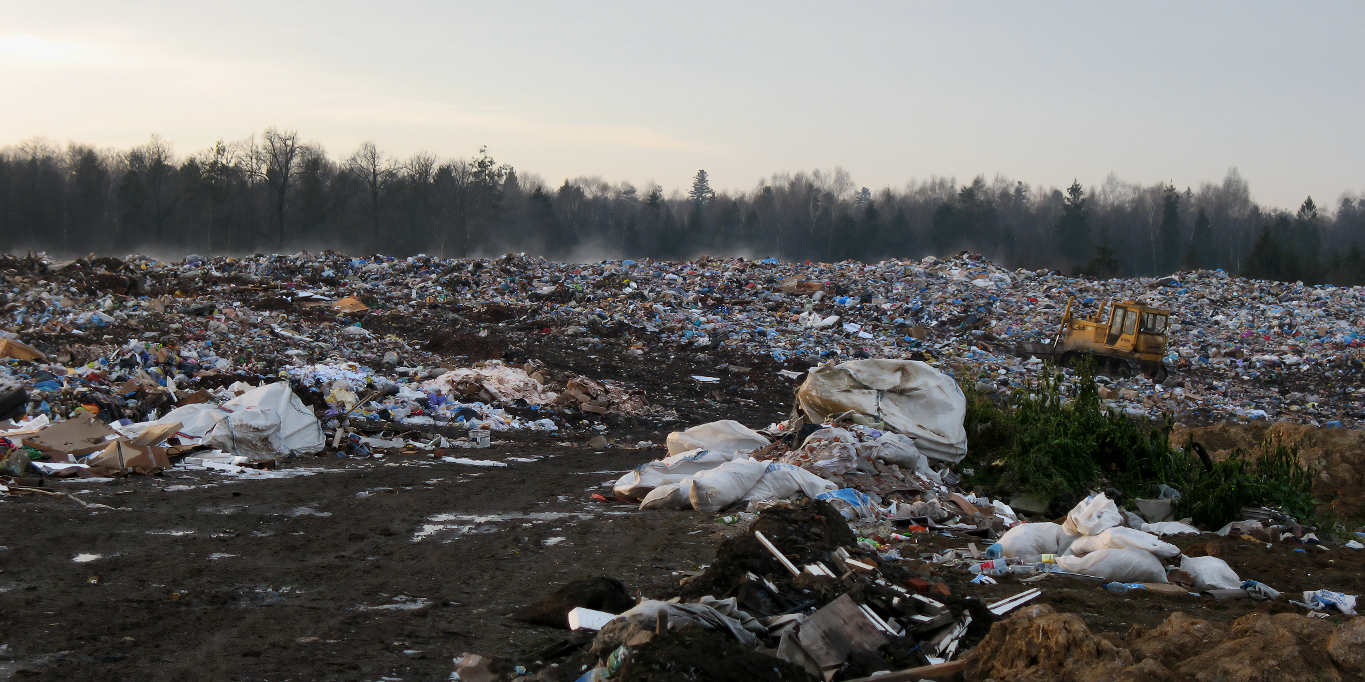
Many products containing addition polymers are dumped in landfill sites. Being non-biodegradable, they will persist in the environment for thousands of years.
For more help, please visit www.exampaperspractice.co.uk
© 2025 Exams Papers Practice. All Rights Reserved

Slide 10
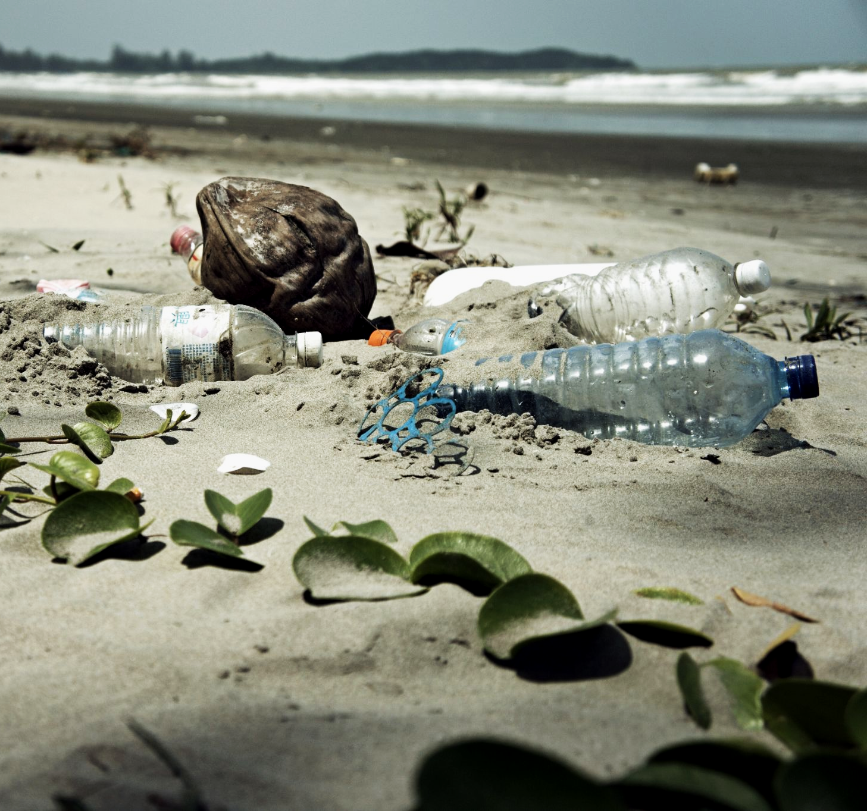
Plastics that make their way into waterways and oceans are a major ecological threat.
For more help, please visit www.exampaperspractice.co.uk
© 2025 Exams Papers Practice. All Rights Reserved

Slide 11
PLASTIC POLLUTION OVER TIME
The amount of plastic pollution has increased from almost nothing in 1950 to over 350 million tons per year in 2015
PLASTIC POLLUTION (MILLION TONNES) →
TIME →
For more help, please visit www.exampaperspractice.co.uk
© 2025 Exams Papers Practice. All Rights Reserved

Slide 12
Disposing of Addition Polymers
Addition polymers may be disposed of by burning them.
Greenhouse gases that contribute to global warming will be released as a result.
If the polymer contains a halogen, toxic gases are often created.
Incomplete combustion of polymers is also likely to yield carbon monoxide (CO).
Many addition polymers can be recycled.
This is a cost and labour-intensive process.
It is, however, the most environmentally friendly solution.
Widespread recycling is likely to be the best long-term solution for dealing with addition polymers.
For more help, please visit www.exampaperspractice.co.uk
© 2025 Exams Papers Practice. All Rights Reserved

Slide 13
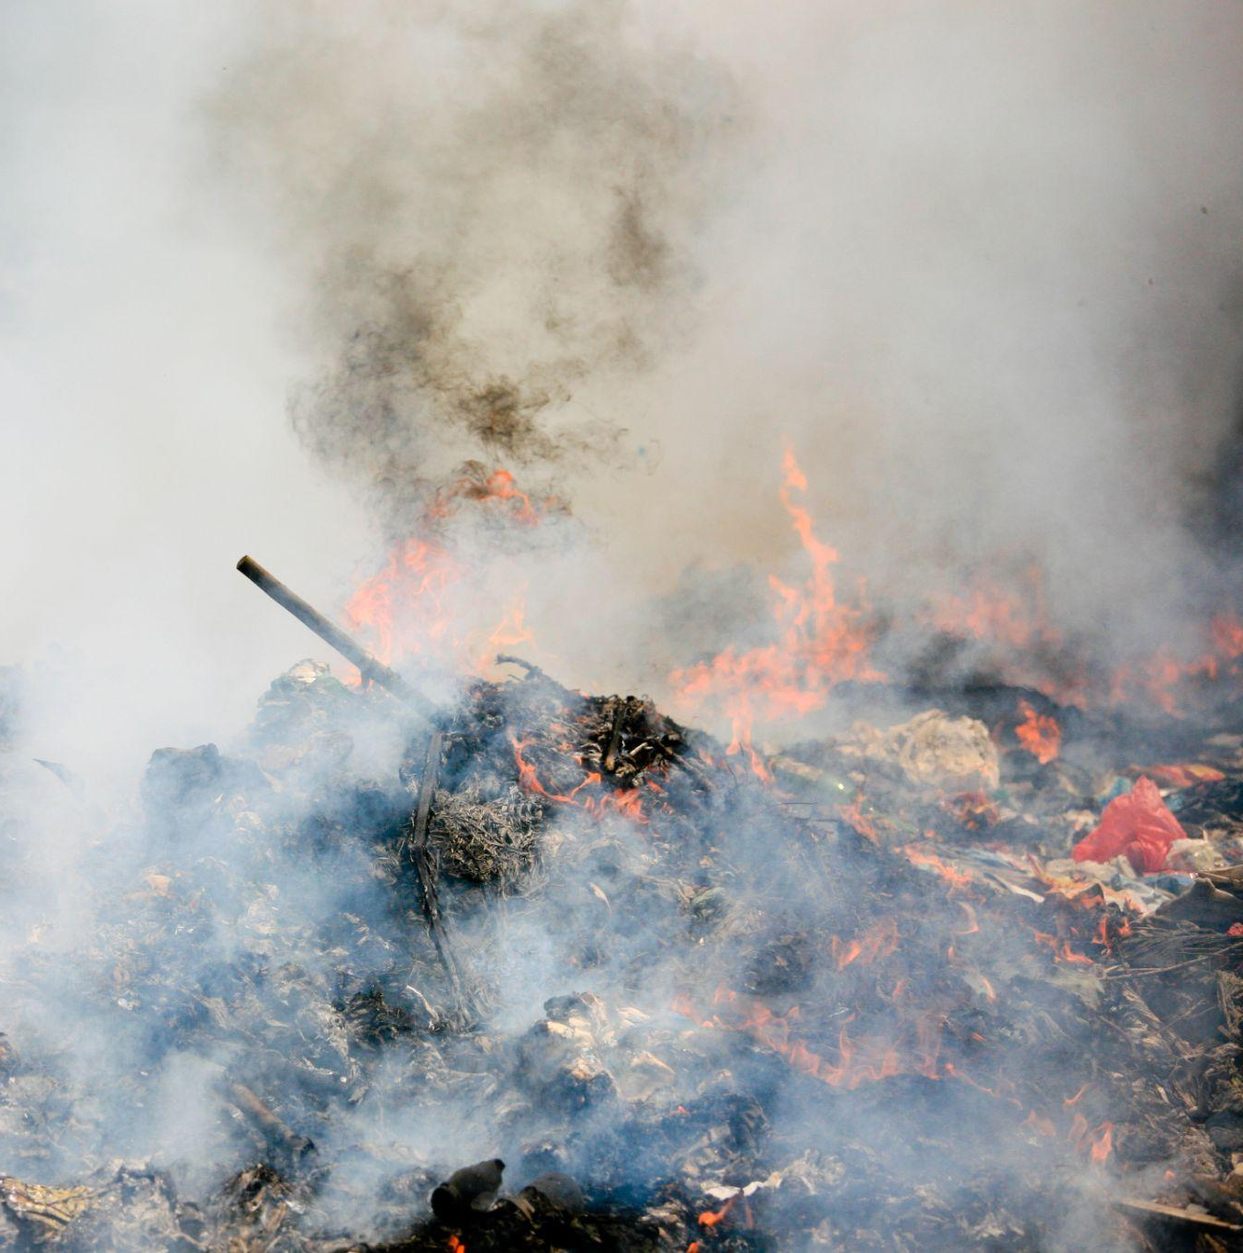
Burning plastics can cause major environmental damage.
For more help, please visit www.exampaperspractice.co.uk
© 2025 Exams Papers Practice. All Rights Reserved

Slide 14
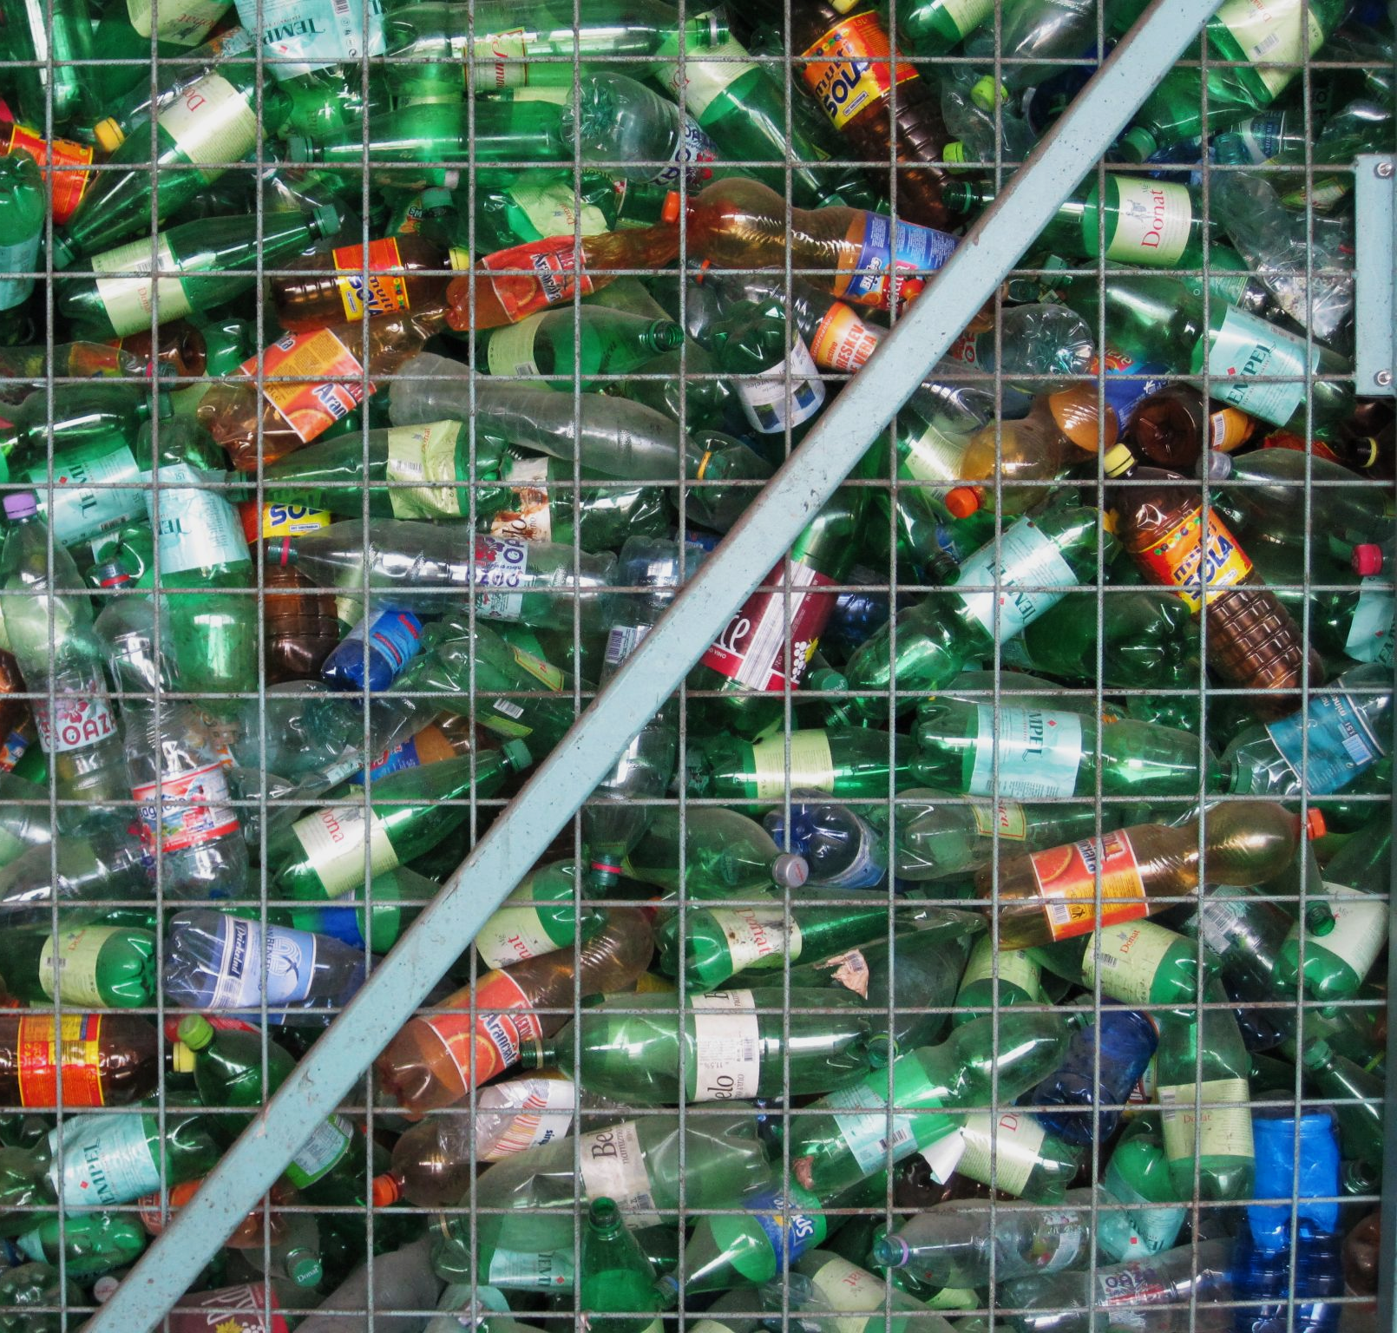
Widespread recycling, whilst time and labour-intensive, is the most ecologically viable way of reducing plastic pollution.
For more help, please visit www.exampaperspractice.co.uk
© 2025 Exams Papers Practice. All Rights Reserved

