Slide 1
Edexcel IGCSE Chemistry
34 - Alkanes and Alkenes
Saturated and Unsaturated Hydrocarbons, Tests
For more help, please visit www.exampaperspractice.co.uk
© 2025 Exams Papers Practice. All Rights Reserved

Slide 2
Alkanes
Specification Points 4.19 and 4.20
Know the general formula for alkanes.
Explain why alkanes are classified as saturated hydrocarbons.
One of the main groups of hydrocarbons are called the alkanes.
Alkanes all have the same general formula.
The general formula for alkanes is C_{n}H_{2n+2}.
Alkanes are saturated compounds.
This means that all the bonds between carbon atoms in an alkane are single bonds.
Alkanes burn in combustion reactions.
Most alkanes are highly flammable compounds.
H₃C
CH₂
CH₃
The basic structural formula of alkanes.
n
For more help, please visit www.exampaperspractice.co.uk
© 2025 Exams Papers Practice. All Rights Reserved

Slide 3
Alkanes
Specification Point 4.21
Understand how to draw the structural and displayed formulae for alkanes with up to five carbon atoms in the molecule, and to name the unbranched-chain isomers.
Number of Carbons in Longest Chain | Name | Molecular Formula | Structural Formula
1 | Methane | CH₄ | CH₄
2 | Ethane | C₂H₆ | CH₃CH₃
3 | Propane | C₃H₈ | CH₃CH₂CH₃
4 | Butane | C₄H₁₀ | CH₃CH₂CH₂CH₃
5 | Pentane | C₅H₁₂ | CH₃CH₂CH₂CH₂CH₃
For more help, please visit www.exampaperspractice.co.uk
© 2025 Exams Papers Practice. All Rights Reserved

Slide 4
The structural formulae of the first 5 alkanes.
METHANE
ETHANE
PROPANE
BUTANE
PENTANE
For more help, please visit www.exampaperspractice.co.uk
© 2025 Exams Papers Practice. All Rights Reserved

Slide 5
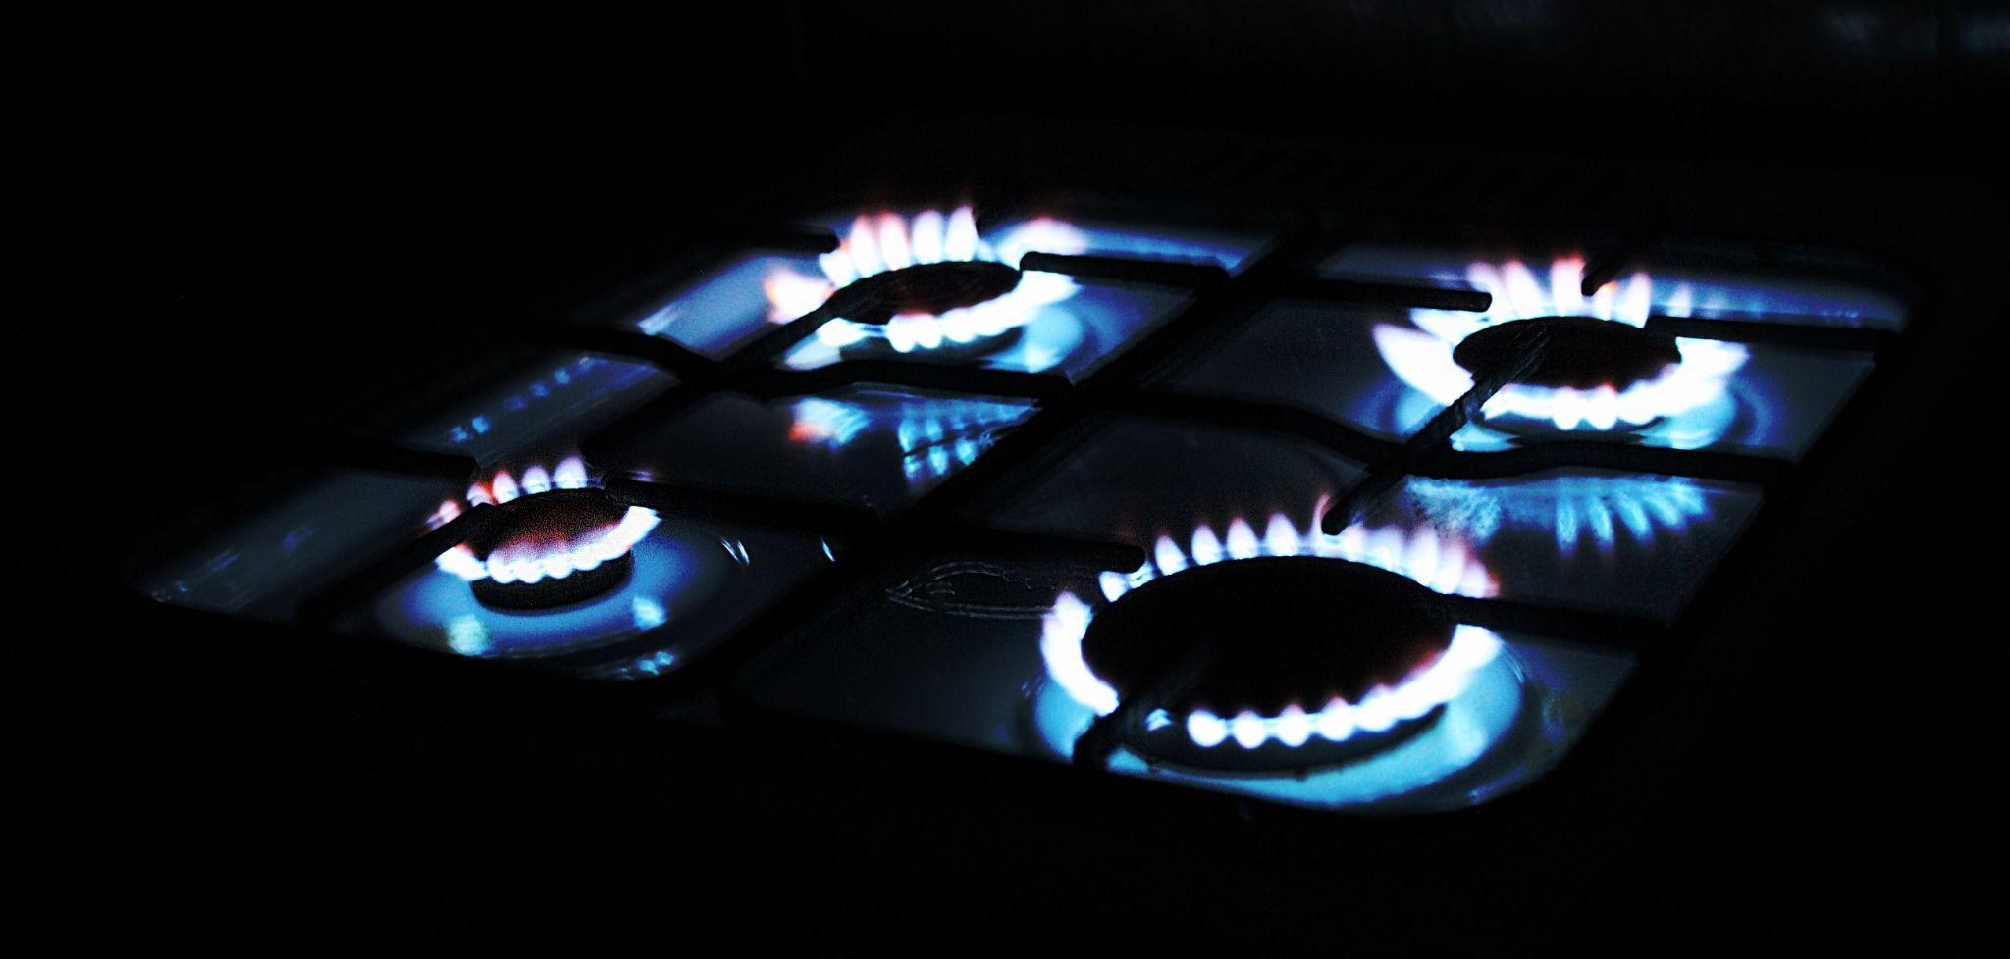
Alkanes such as propane (C₃H₈) are used in domestic heating and cooking.
For more help, please visit www.exampaperspractice.co.uk
© 2025 Exams Papers Practice. All Rights Reserved

Slide 6
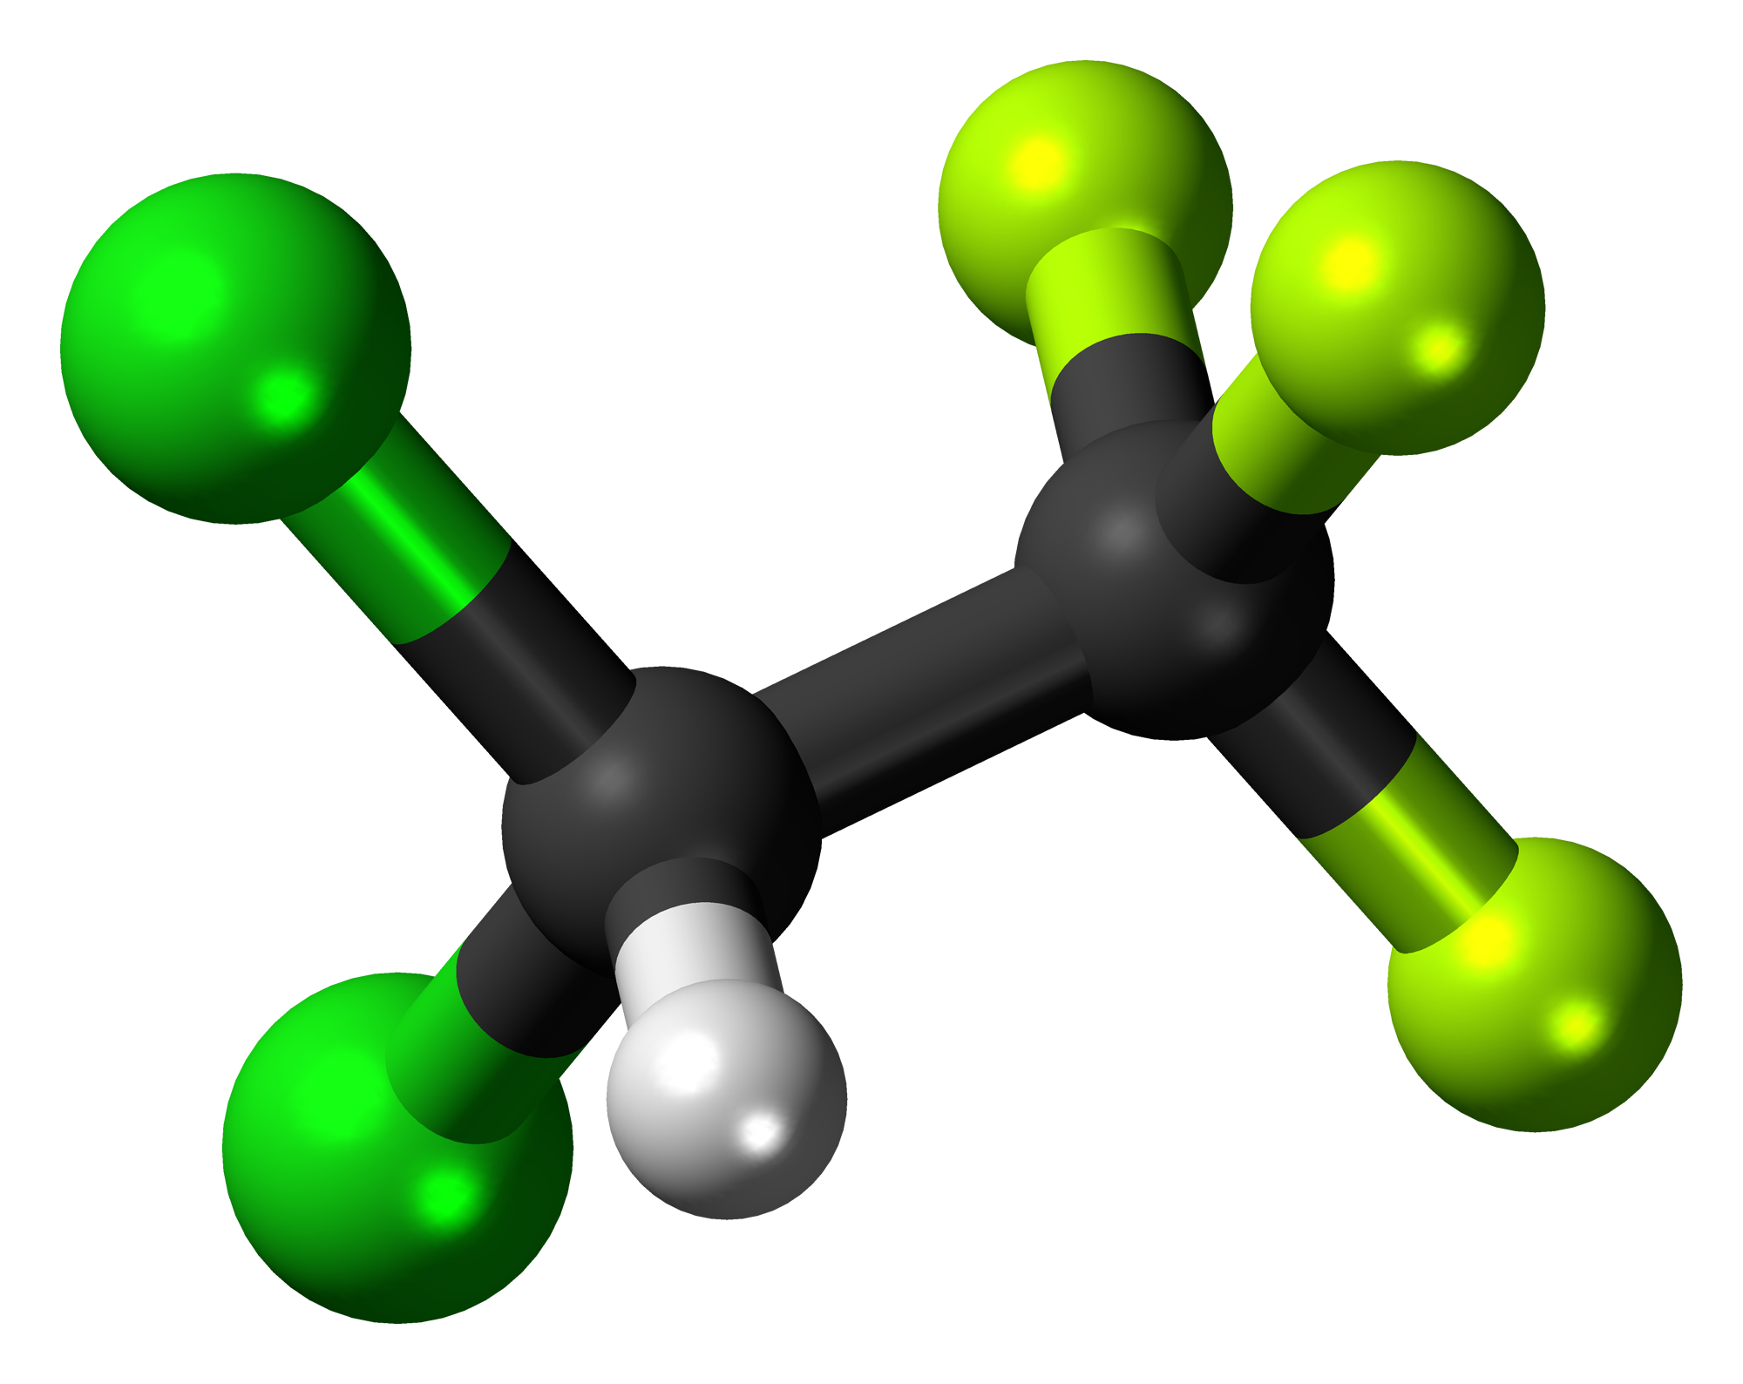
Alkanes and Halogens
Specification Point 4.22
Describe the reactions of alkanes with halogens in the presence of ultraviolet radiation, limited to mono-substitution.
Alkanes can react with halogens to form haloalkanes.
Haloalkanes are formed during substitution reactions.
UV light is required for alkanes to react with halogens.
Take the example of methane (CH₄) with bromine (Br₂):
CH_{4 (g)} + Br_{2 (l)} → CH₃Br _{(g)} + HBr _{(g)}
A haloalkane - in this case bromomethane (CH₃Br) - is formed, as well as hydrogen bromide (HBr).
Chlorofluorocarbons, or CFCs, are a well-known family of haloalkanes. Halogens are usually depicted as green atoms.
For more help, please visit www.exampaperspractice.co.uk
© 2025 Exams Papers Practice. All Rights Reserved

Slide 7
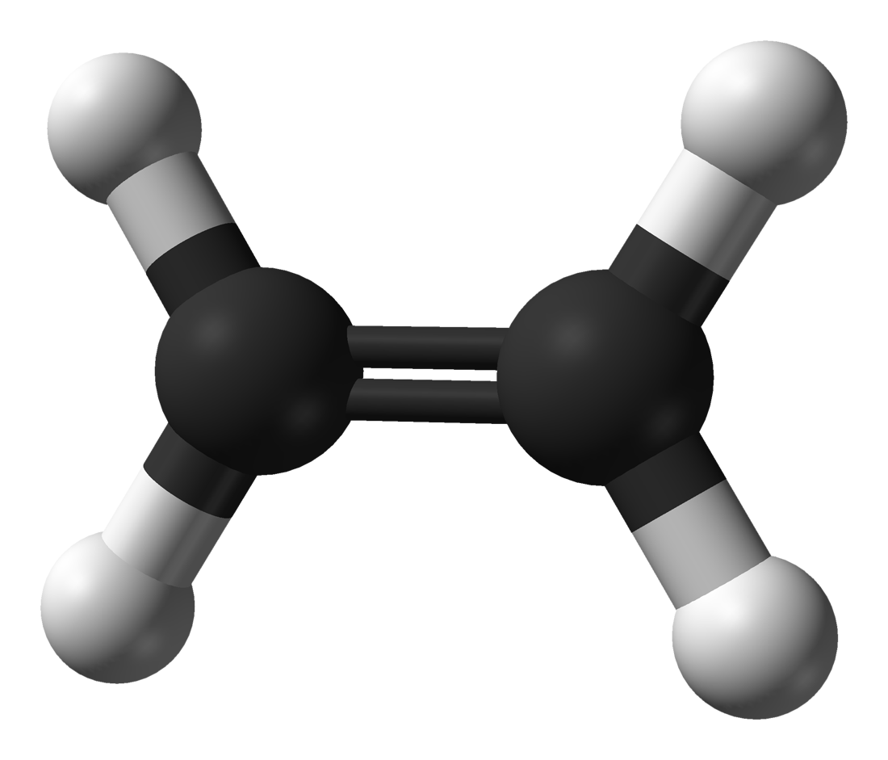
Alkenes
Specification Points 4.23, 4.24 and 4.25
Know that alkenes contain a particular functional group (C=C).
Know the general formula for alkenes.
Explain why alkenes are classified as unsaturated hydrocarbons.
Another group of hydrocarbons are called the alkenes.
Alkenes all have the same general formula.
The general formula for alkenes is C_{n}H_{2n}.
Alkenes are unsaturated compounds.
All alkenes contain at least 1 carbon-carbon double bond (C=C).
This is considered the functional group of the alkenes.
Ethene (C₂H₄) is smallest alkene. Note the presence of a carbon to carbon double bond.
For more help, please visit www.exampaperspractice.co.uk
© 2025 Exams Papers Practice. All Rights Reserved

Slide 8
Alkenes
Specification Point 4.26
Understand how to draw the structural and displayed formulae for alkenes with up to four carbon atoms in the molecule, and name the unbranched-chain isomers.
Number of Carbons in Longest Chain | Name | Molecular Formula | Structural Formula
2 | Ethene | C₂H₄ | CH₂CH₂
3 | Propene | C₃H₆ | CH₃CHCH₂
4 | But-1-ene or But-2-ene | C₄H₈ | CH₂CHCH₂CH₃ or CH₃CHCHCH₃
For more help, please visit www.exampaperspractice.co.uk
© 2025 Exams Papers Practice. All Rights Reserved

Slide 9
The structural formulae of the first 3 alkenes.
ETHENE
PROPENE
BUT-1-ENE
BUT-2-ENE
For more help, please visit www.exampaperspractice.co.uk
© 2025 Exams Papers Practice. All Rights Reserved

Slide 10
Alkenes and Halogens
Specification Point 4.27
Describe the reactions of alkenes with bromine to produce dibromoalkanes.
Halogens can also react with alkenes to form dihaloalkanes.
Dihaloalkanes have 2 halogens attached to adjacent carbon atoms.
Dihaloalkanes are formed during addition reactions.
The C=C double bond is broken and a halogen is added to each carbon atom.
Take the reaction of ethene (C₂H₄) with bromine (Br₂) to form dibromoethane (C₂H₄Br₂):
For more help, please visit www.exampaperspractice.co.uk
© 2025 Exams Papers Practice. All Rights Reserved

Slide 11
Tests for Alkenes
Specification Point 4.28
Describe how bromine water can be used to distinguish between an alkane and an alkene.
The presence of carbon-carbon double bonds forms the basis of the test for alkenes.
This is called the bromine water test.
Bromine water is an orange liquid.
When bromine water is added to an alkene, the double bond is broken.
2 bromine atoms are then added to the molecule to form a dihaloalkane.
This causes the bromine water to decolourise, leaving a colourless solution.
There are no double bonds to break in an alkane.
When bromine water is added to an alkane, the solution remains orange.
Br₂ ADDED TO ALKENE
Br₂ ADDED TO ALKANE
For more help, please visit www.exampaperspractice.co.uk
© 2025 Exams Papers Practice. All Rights Reserved

