Slide 1
Edexcel IGCSE Chemistry
33 - Burning Hydrocarbons
Combustion and Cracking
For more help, please visit www.exampaperspractice.co.uk
© 2025 Exams Papers Practice. All Rights Reserved

Slide 2
Fuels and Complete Combustion
Specification Points 4.11 and 4.12
Know that a fuel is a substance that, when burned, releases heat energy.
Know the possible products of complete and incomplete combustion of hydrocarbons with oxygen in the air.
When burned, fuels release energy as heat.
This is called a combustion reaction.
Combustion reactions are highly exothermic.
Hydrocarbons make excellent fuels.
Lots of energy is given out when hydrocarbons are burned.
Hydrocarbons are also very flammable, so they combust easily.
When hydrocarbons are burnt in a plentiful supply of oxygen (O₂), complete combustion occurs.
The products of complete combustion are carbon dioxide (CO₂) and water (H₂O).
For more help, please visit www.exampaperspractice.co.uk
© 2025 Exams Papers Practice. All Rights Reserved

Slide 3
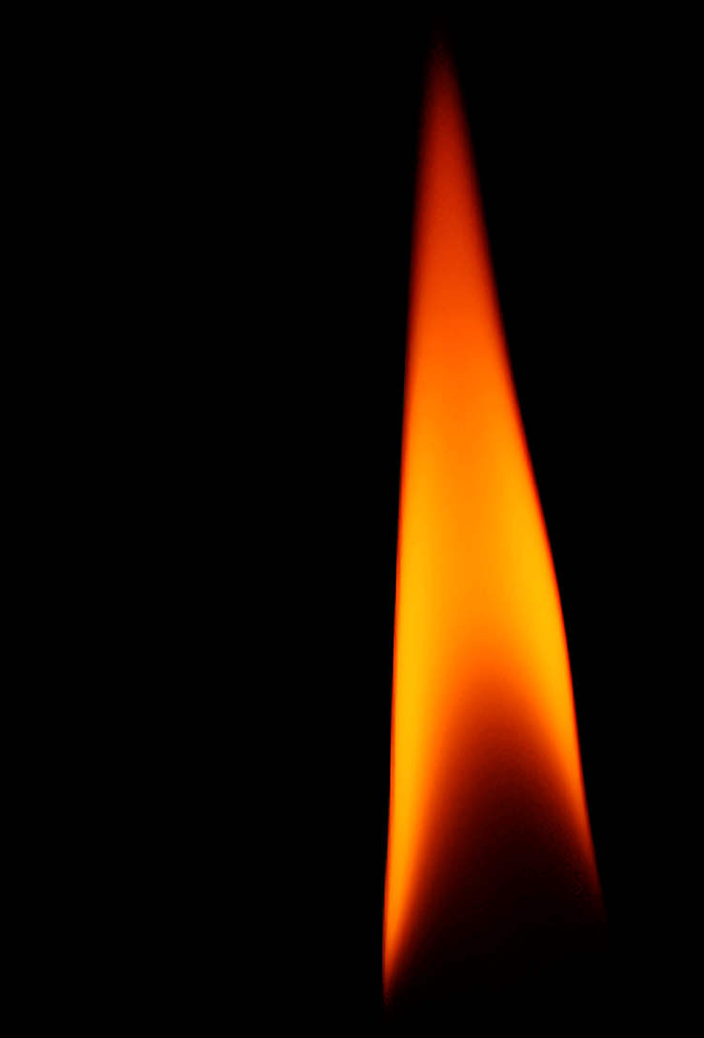
When a hydrocarbon is burnt in a plentiful supply of oxygen, complete combustion occurs.
Take the hydrocarbon methane (CH₄):
CH_{4 (g)} + 2O_{2 (g)} → CO_{2 (g)} + 2H₂O _{(l)}
Carbon dioxide and water are the only products.
For more help, please visit www.exampaperspractice.co.uk
© 2025 Exams Papers Practice. All Rights Reserved

Slide 4
Incomplete Combustion
When hydrocarbons are burnt in an inadequate supply of oxygen (O₂), incomplete combustion occurs.
There are a range of products that may result from incomplete combustion.
Carbon monoxide (CO) gas and water are formed.
Solid particulates of carbon (C), referred to as soot, may also be formed.
Take methane again:
CH_{4 (g)} + 1^{½}O_{2 (g)} → CO _{(g)} + 2H₂O _{(l)}
CH_{4 (g)} + O_{2 (g)} → C _{(s)} + 2H₂O _{(l)}
In 2 separate reactions both carbon monoxide and soot are formed.
For more help, please visit www.exampaperspractice.co.uk
© 2025 Exams Papers Practice. All Rights Reserved

Slide 5
Incomplete combustion occurs when fuel is starved of oxygen. This can happen inside faulty gas boilers.
This can lead to the production of toxic carbon monoxide gas (CO).
For more help, please visit www.exampaperspractice.co.uk
© 2025 Exams Papers Practice. All Rights Reserved

Slide 6
Carbon Monoxide
Specification Point 4.13
Understand why carbon monoxide is poisonous, in terms of its effect on the capacity of blood to transport oxygen.
Carbon monoxide is an odorless and tasteless gas that can cause loss of consciousness and death.
Carbon monoxide binds tightly to a protein inside red blood cells.
This protein is called haemoglobin.
A compound called carboxyhaemoglobin is formed.
Carbon monoxide prevents oxygen from binding to the red blood cells.
The ability for the body to carry oxygen is reduced.
In extreme cases, this can be fatal.
Carbon monoxide binds to haemoglobin inside red blood cells. This prevents the cell from carrying oxygen around the body.
For more help, please visit www.exampaperspractice.co.uk
© 2025 Exams Papers Practice. All Rights Reserved

Slide 7
Nitrogen Oxides
Specification Point 4.14
Know that, in car engines, the temperature reached is high enough to allow nitrogen and oxygen from air to react, forming oxides of nitrogen.
Many car engines run at over 200°C.
This is a sufficient temperature for nitrogen (N₂) and oxygen to react with each other.
Various oxides of nitrogen are formed:
N_{2 (g)} + O_{2 (g)} → 2NO_{(g)}
2NO_{(g)} + O_{2 (g)} → 2NO_{2 (g)}
Both nitrogen monoxide (NO) and nitrogen dioxide (NO₂) are then released into the atmosphere.
Contraptions called catalytic converters aim to prevent this.
For more help, please visit www.exampaperspractice.co.uk
© 2025 Exams Papers Practice. All Rights Reserved

Slide 8
Catalytic converters are attached to modern car engines to try and prevent the release of harmful oxides into the environment.
Nitrogen oxides are reduced back to nitrogen gas:
2NO _{(g)} → N_{2 (g)} + O_{2 (g)}
2NO_{2 (g)} → N_{2 (g)} + 2O_{2 (g)}
For more help, please visit www.exampaperspractice.co.uk
© 2025 Exams Papers Practice. All Rights Reserved

Slide 9
Sulphur Dioxide and Acid Rain
Specification Points 4.15 and 4.16
Explain how the combustion of some impurities in hydrocarbon fuels results in the formation of sulphur dioxide.
Understand how sulphur dioxide and oxides of nitrogen contribute to acid rain.
Sulphur (S) is found in trace quantities in many hydrocarbons.
When hydrocarbons are burnt at high temperatures, sulphur is oxidised to form sulphur dioxide (SO₂):
S _{(s)} + O_{2 (g)} → SO_{2 (g)}
Sulphur dioxide, as well as oxides of nitrogen, combine with water vapour in the atmosphere.
Dilute forms of sulphuric acid (H₂SO₄) and nitric acid (HNO₃) are formed.
Sulphuric acid and nitric acid may then fall as acid rain.
Acid rain causes a variety of environmental consequences.
For more help, please visit www.exampaperspractice.co.uk
© 2025 Exams Papers Practice. All Rights Reserved

Slide 10
Acid rain can strip the leaves off trees, pollute waterways and cause damage to limestone buildings.
For more help, please visit www.exampaperspractice.co.uk
© 2025 Exams Papers Practice. All Rights Reserved

Slide 11
Cracking
Specification Points 4.17 and 4.18
Describe how long-chain alkanes are converted to alkenes and shorter-chain alkanes by catalytic cracking.
Explain why cracking is necessary, in terms of the balance between supply and demand for different fractions.
There is limited demand for long-chain fractions of hydrocarbons.
Bitumen and fuel oil, for example, are relatively niche products, with only a handful of uses.
There is high demand for short-chain fractions of hydrocarbons.
Petrol, diesel and refinery gases all have a wide array of uses in transport and industry.
To meet demand, long-chain fractions of hydrocarbons are split into more useful, shorter chains.
This is achieved through a process called catalytic cracking.
For more help, please visit www.exampaperspractice.co.uk
© 2025 Exams Papers Practice. All Rights Reserved

Slide 12
PETROLEUM
NATURAL GAS
The demand for certain fractions of hydrocarbons far exceeds supply. Cracking provides a way to convert unwanted fractions into useful ones.
GLOBAL CONSUMPTION
1776
1900
2018
For more help, please visit www.exampaperspractice.co.uk
© 2025 Exams Papers Practice. All Rights Reserved

Slide 13
Catalytic Cracking
During cracking, a long-chain alkane is broken down into a shorter-chain alkane and an alkene.
Cracking is a form of thermal decomposition.
Take the example of decane (C₁₀H₂₂) being cracked to form octane (C₈H₁₈) and ethene (C₂H₄).
Catalytic cracking requires specific conditions.
A temperature between 600°C and 700°C.
An aluminium oxide or silica (Al₂O₃) catalyst.
+
For more help, please visit www.exampaperspractice.co.uk
© 2025 Exams Papers Practice. All Rights Reserved

