Slide 1
Edexcel IGCSE Chemistry
32 - Crude Oil
Fuels and Fractional Distillation
For more help, please visit www.exampaperspractice.co.uk
© 2025 Exams Papers Practice. All Rights Reserved

Slide 2
Crude Oil
Specification Point 4.7
Know that crude oil is a mixture of hydrocarbons.
Crude oil is a mixture of different hydrocarbons.
Crude oil is found as a liquid in natural underground reservoirs.
Crude oil is extracted from the ground using drilling wells.
Some of these wells are land-based, others are built offshore.
Crude oil is extremely valuable.
Many industrial processes, as well as transport, are reliant on the products from crude oil.
Crude oil is often extracted using offshore rigs.
For more help, please visit www.exampaperspractice.co.uk
© 2025 Exams Papers Practice. All Rights Reserved

Slide 3
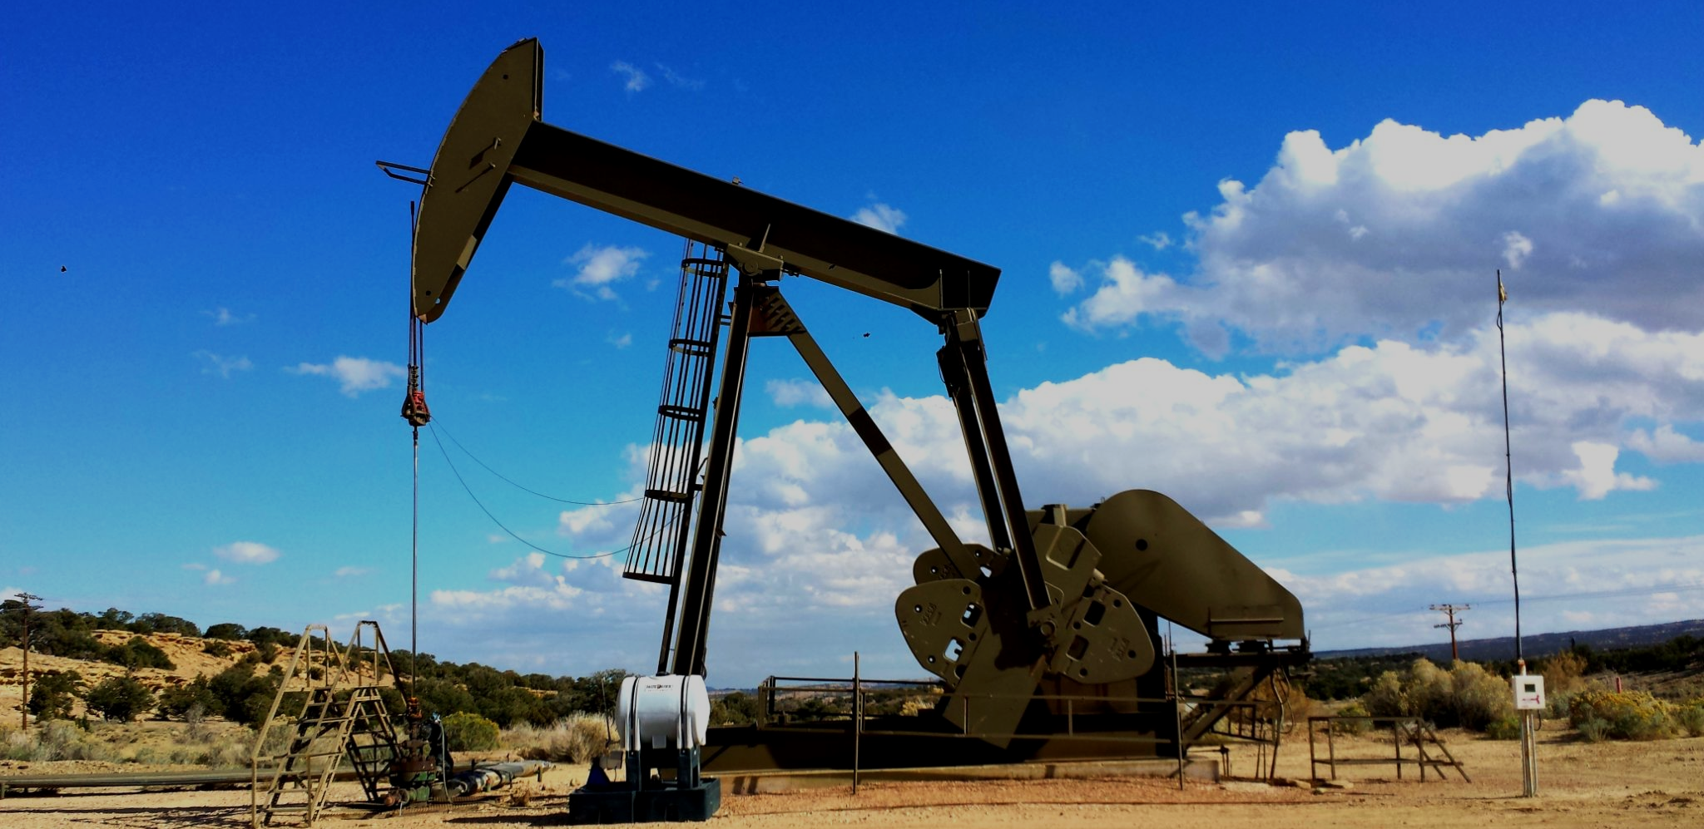
The products of crude oil have a vast array of uses in industry.
For more help, please visit www.exampaperspractice.co.uk
© 2025 Exams Papers Practice. All Rights Reserved

Slide 4
Fractional Distillation
Specification Points 4.8 and 4.9
Describe how the industrial process of fractional distillation separates crude oil into fractions.
Know the names and uses of the main fractions obtained from crude oil.
Crude oil can be separated into different fractions.
Each fraction consists of hydrocarbons of similar lengths.
Different fractions will have different melting and boiling points.
Fractions are separated using fractional distillation.
This is carried out in a fractional distillation column.
The size of the fraction determines where in the column it will be collected.
Larger fractions will be collected near the top of the column.
Smaller fractions will be collected near the bottom of the column.
For more help, please visit www.exampaperspractice.co.uk
© 2025 Exams Papers Practice. All Rights Reserved

Slide 5
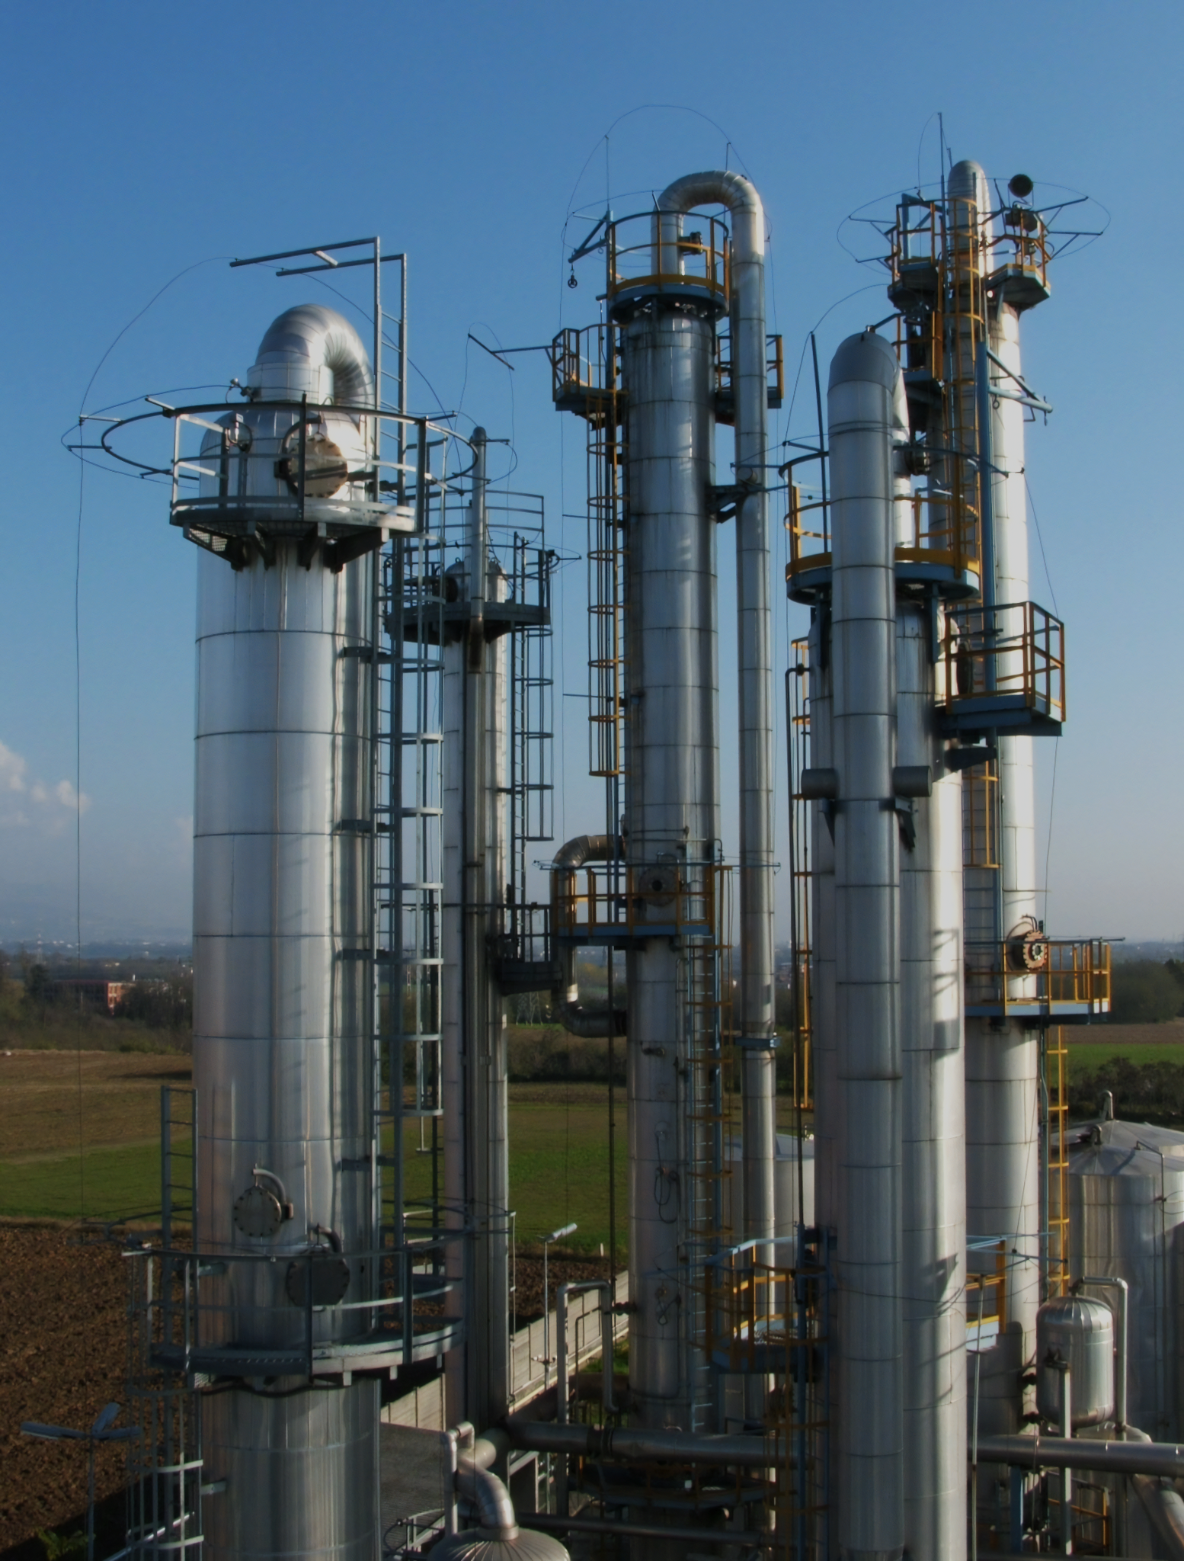
Fractionating columns are used on an industrial scale to separate crude oil into different fractions.
Fractional distillation is used to obtain useful fractions such as petrol or diesel.
For more help, please visit www.exampaperspractice.co.uk
© 2025 Exams Papers Practice. All Rights Reserved

Slide 6
REFINERY GASES
C₁ - C₄
GASOLINE
C₅ - C₁₀
A fractionating column. The column is hottest at the bottom and coolest at the top.
The longer hydrocarbons (such as fuel oil and bitumen) have higher boiling points, so are removed near the bottom of the column.
The shorter hydrocarbons (such as refinery gases and gasoline) have lower boiling points, so are removed near the top of the column.
120°C
NAPHTHA
C₈ - C₁₂
KEROSENE
C₈ - C₁₂
250°C
DIESEL
C₁₄ - C₂₀
CRUDE OIL HEATED TO 350°C
LUBRICANTS
C₂₀ - C₅₀
350°C
FUEL OIL
C₅₀ - C₇₀
BITUMEN
>C₇₀
For more help, please visit www.exampaperspractice.co.uk
© 2025 Exams Papers Practice. All Rights Reserved

Slide 7
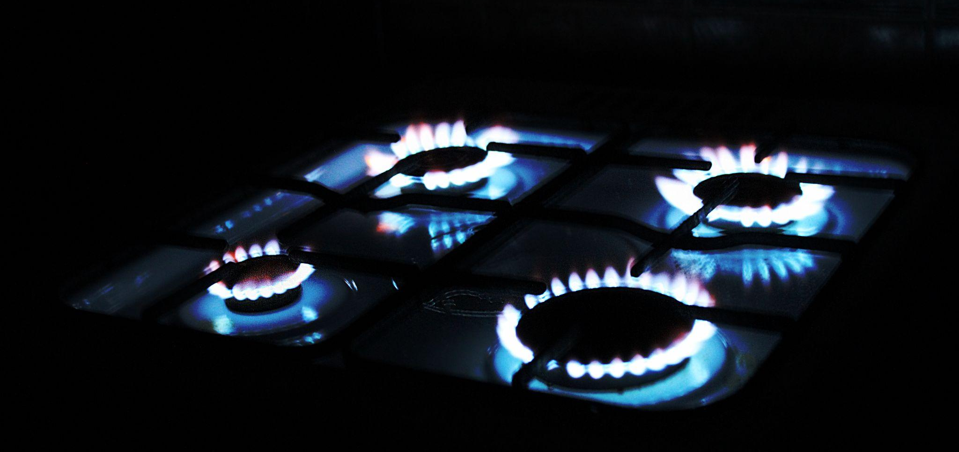
Refinery gases such as propane (C₃H₈) are used in domestic heating and cooking.
For more help, please visit www.exampaperspractice.co.uk
© 2025 Exams Papers Practice. All Rights Reserved

Slide 8
Gasoline (petrol) and diesel are used as fuels for motor vehicles such as cars and buses.
For more help, please visit www.exampaperspractice.co.uk
© 2025 Exams Papers Practice. All Rights Reserved

Slide 9
Kerosene is used as fuel for domestic and commercial aircraft.
For more help, please visit www.exampaperspractice.co.uk
© 2025 Exams Papers Practice. All Rights Reserved

Slide 10
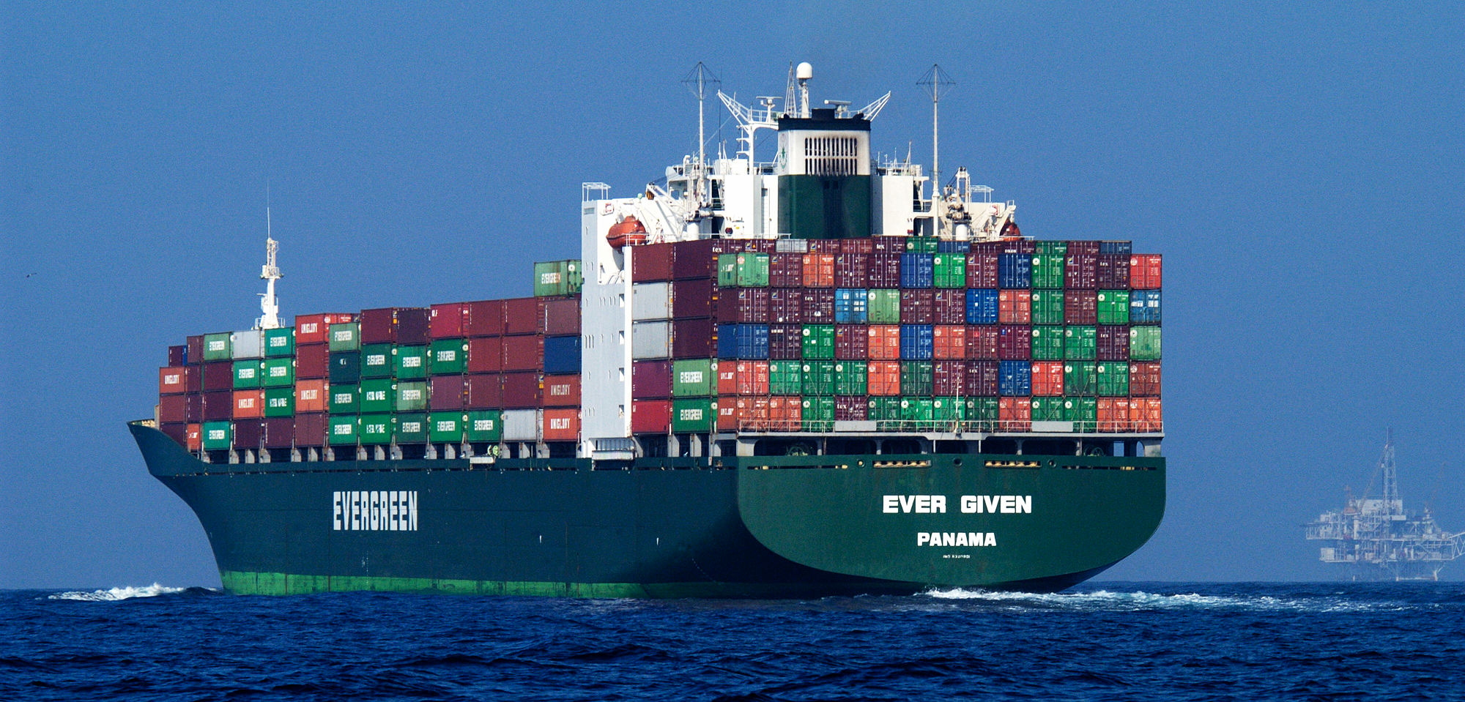
Fuel oil is used to power large ships.
For more help, please visit www.exampaperspractice.co.uk
© 2025 Exams Papers Practice. All Rights Reserved

Slide 11
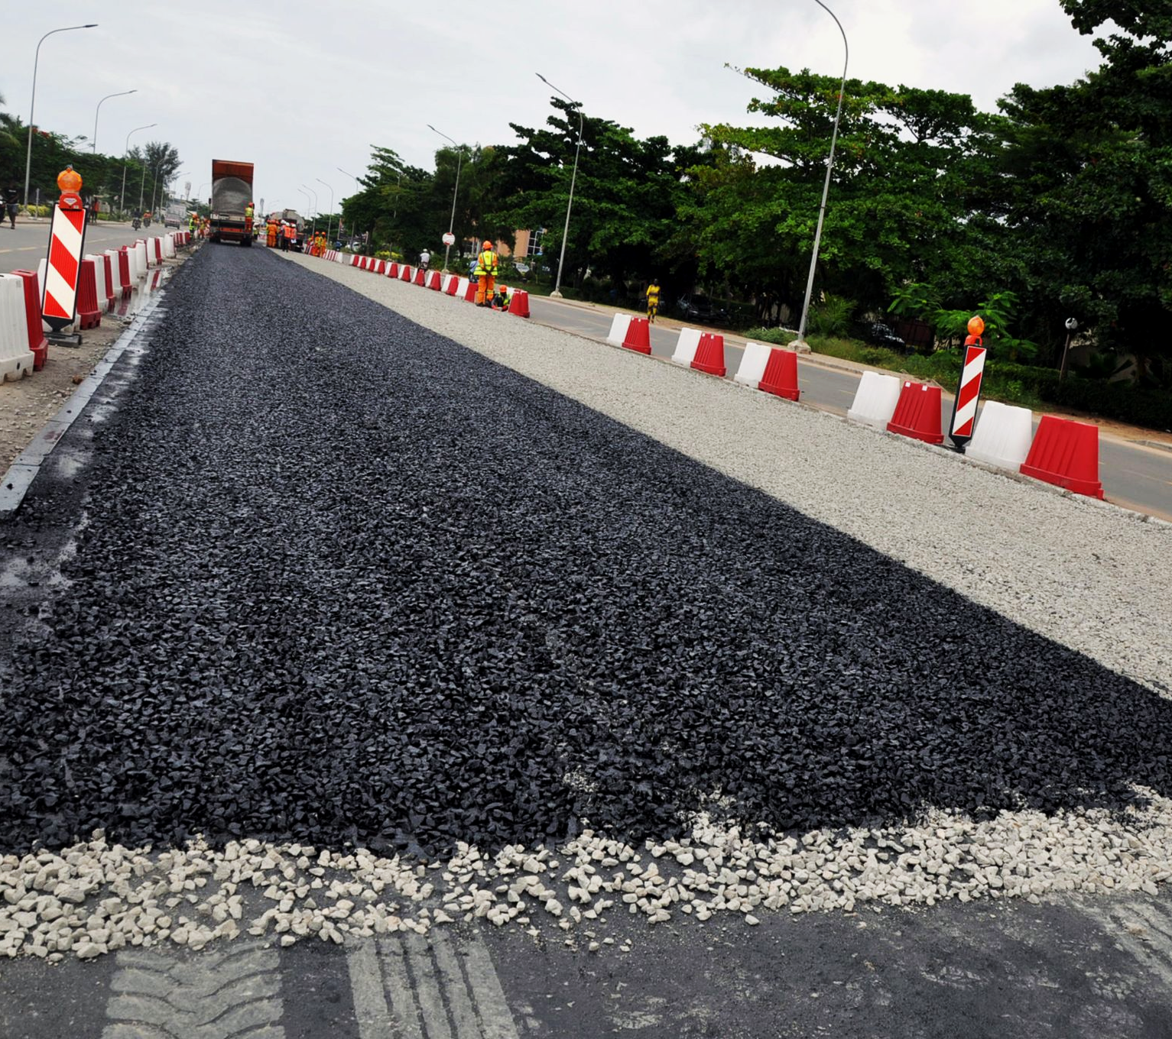
Bitumen is an important component of tarmac.
For more help, please visit www.exampaperspractice.co.uk
© 2025 Exams Papers Practice. All Rights Reserved

Slide 12
Trends in Fractions
Specification Point 4.10
Know the trend in colour, boiling point and viscosity of the main fractions.
There are several trends that can be identified in the main fractions of crude oil.
The physical properties of the fractions will change as the number of carbons increases.
As the length of the carbon chain increases, the colours of the fractions become darker.
Petrol, a mixture of short hydrocarbons, is lightly coloured.
Fuel oil, a mixture of long hydrocarbons, is darkly coloured.
As the length of the carbon chain increases, the fractions become more viscous.
Viscosity is a measure of how thick a liquid is.
Petrol is not very viscous and flows easily.
Fuel oil is very viscous and does not flow easily.
As the length of the carbon chain increases, the boiling points of the fractions increase.
Most blends of petrol boil at around 40°C.
Most blends of fuel oil boil at around 250°C.
For more help, please visit www.exampaperspractice.co.uk
© 2025 Exams Papers Practice. All Rights Reserved

Slide 13
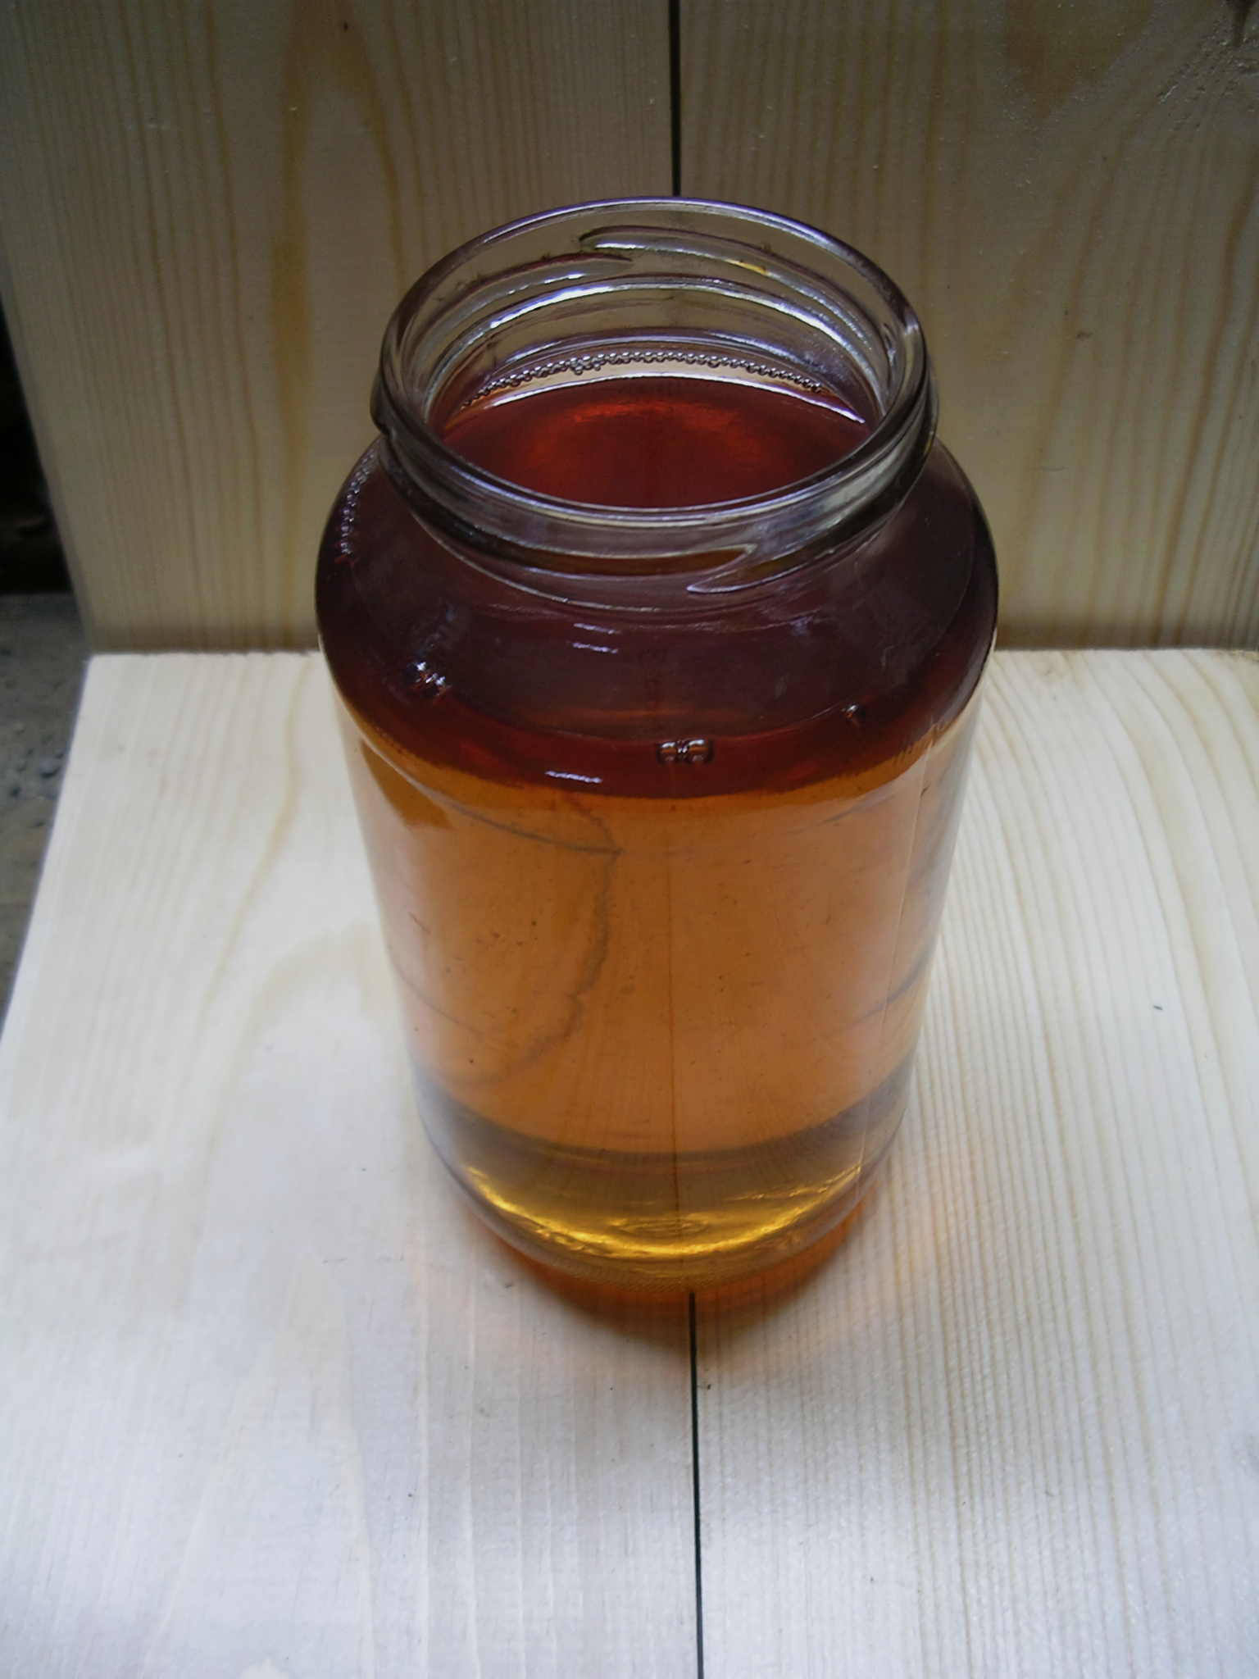
Diesel is a mixture of fairly short hydrocarbons with lengths between C₁₄ and C₂₀.
Diesel is lightly coloured and thin, with a boiling point of around 150°C.
For more help, please visit www.exampaperspractice.co.uk
© 2025 Exams Papers Practice. All Rights Reserved

Slide 14
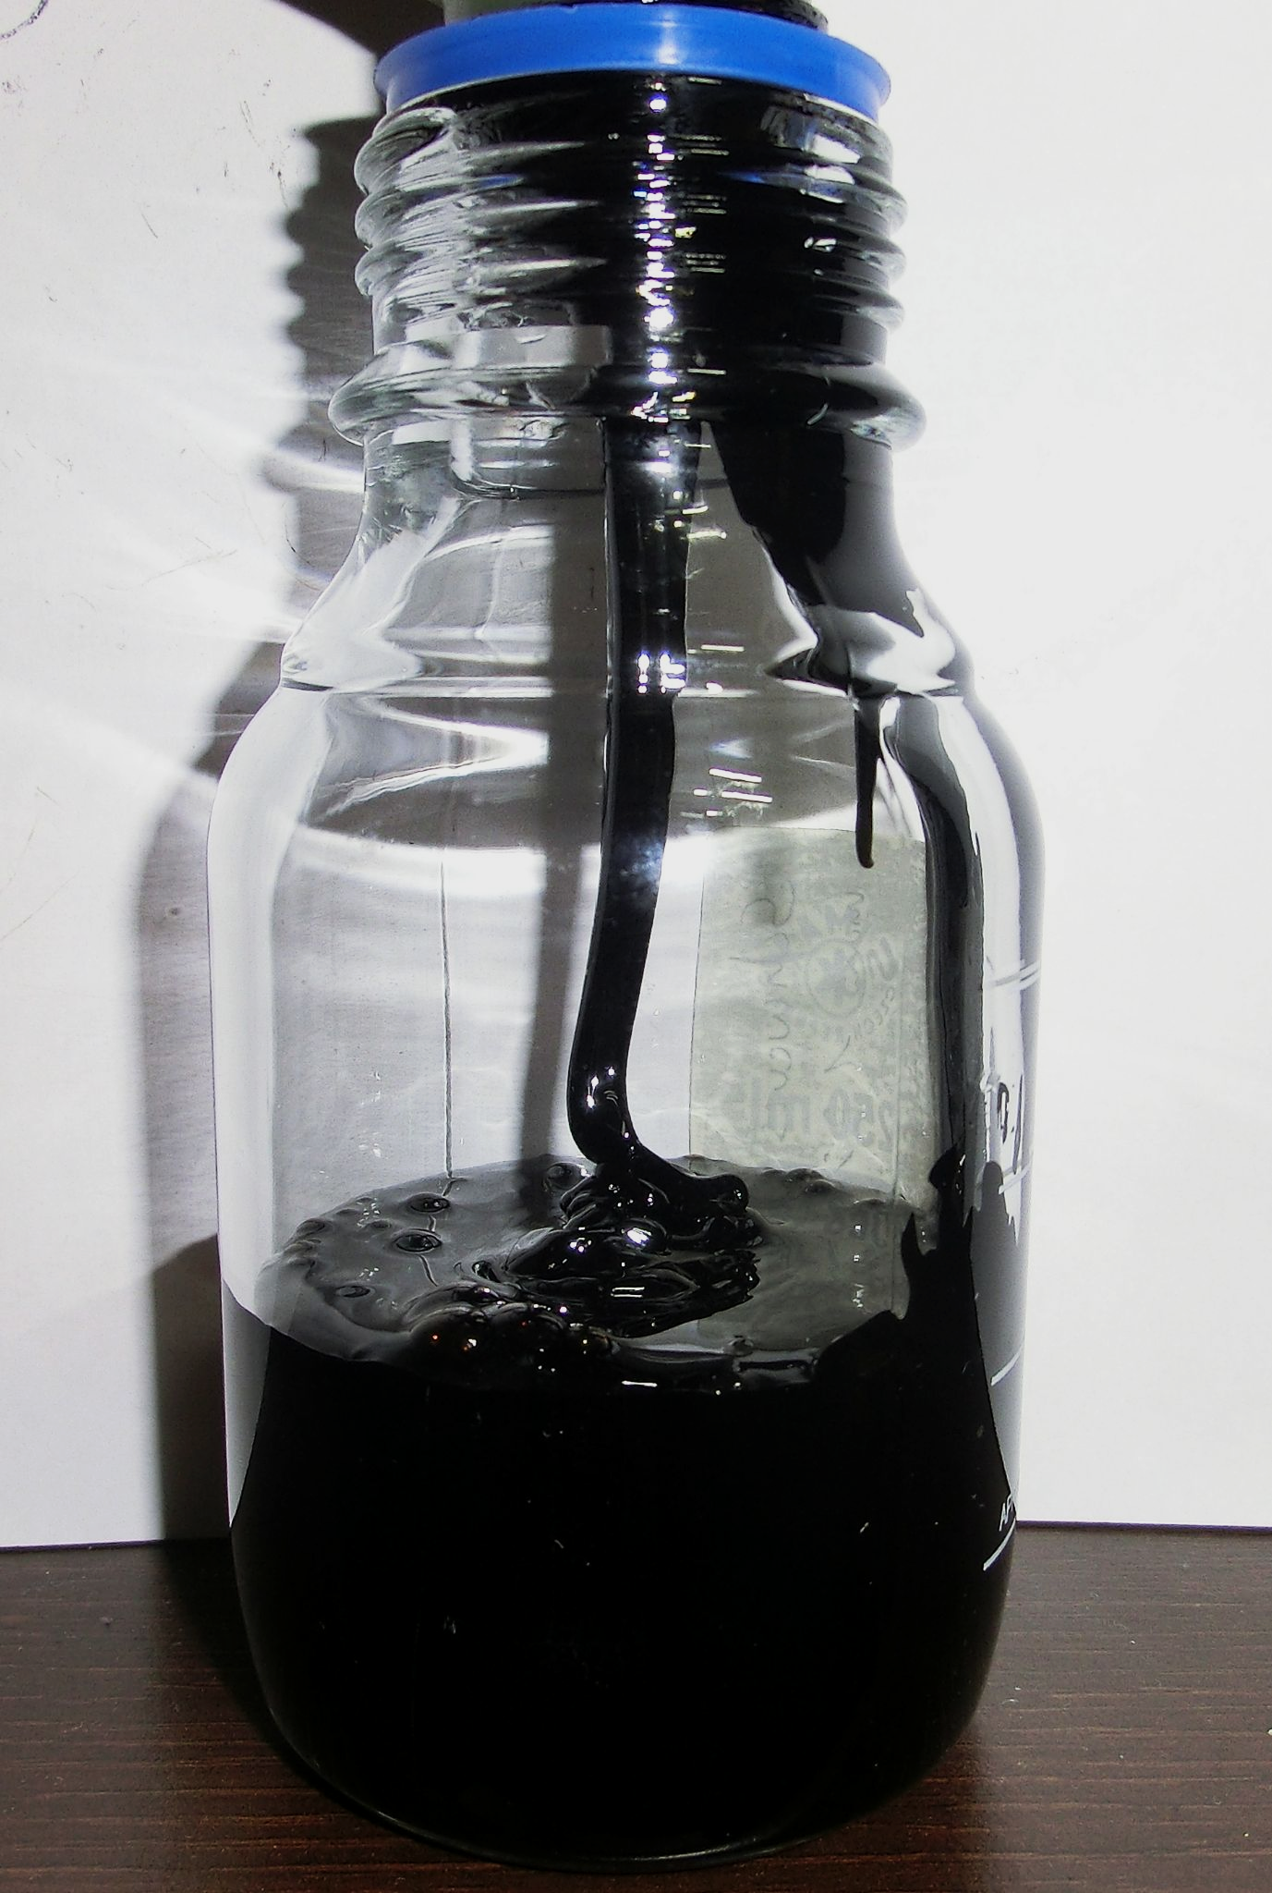
Fuel oil is a mixture of longer hydrocarbons with lengths between C₅₀ and C₇₀.
Fuel oil is darkly coloured and viscous, with a boiling point of around 350°C.
For more help, please visit www.exampaperspractice.co.uk
© 2025 Exams Papers Practice. All Rights Reserved

