Slide 1
Edexcel IGCSE Chemistry
31 - Organic Compounds
Hydrocarbons, Homologous Series and IUPAC
For more help, please visit www.exampaperspractice.co.uk
© 2025 Exams Papers Practice. All Rights Reserved

Slide 2
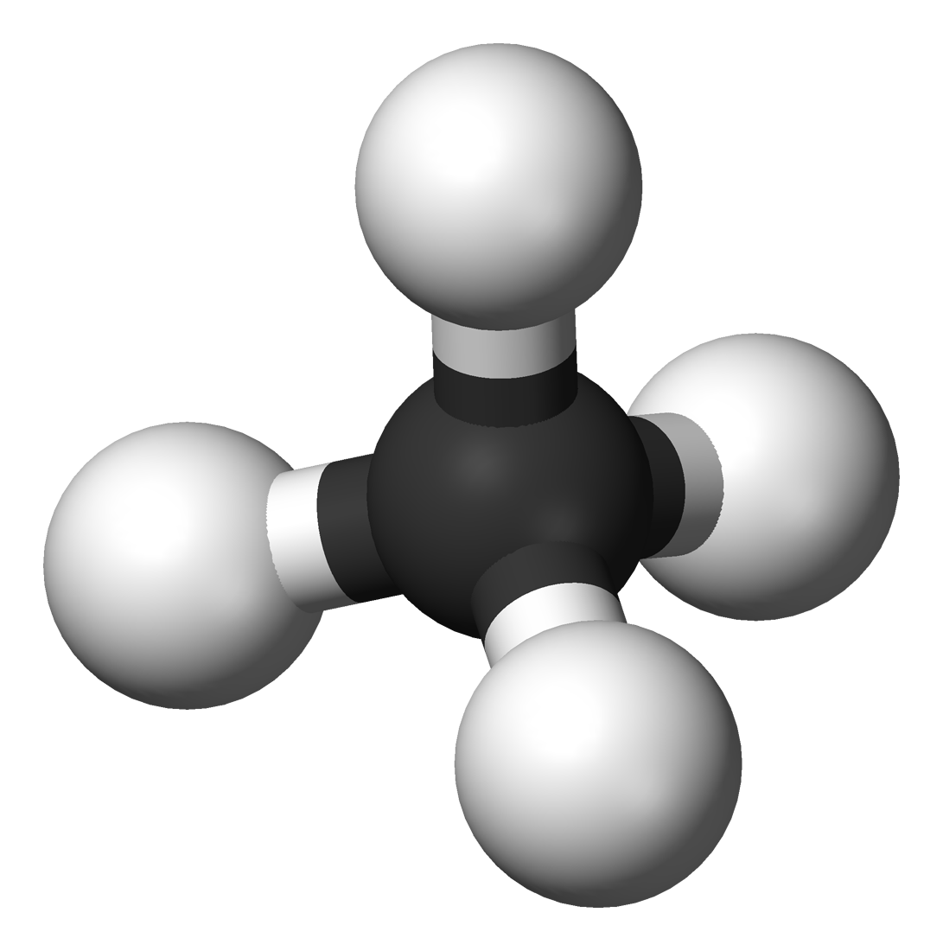
Hydrocarbons and Organic Chemistry
Specification Point 4.1
Know that a hydrocarbon is a compound of hydrogen and carbon only.
Organic chemistry is the study of compounds that contain carbon.
Carbon forms the skeleton of a huge number of compounds.
One of the largest groups of organic compounds are the hydrocarbons.
These are compounds that only contain carbon (C) and hydrogen (H).
There are several families of hydrocarbons.
These include the alkanes and the alkenes.
The hydrocarbon methane (CH₄). With a carbon core, methane is also an organic molecule.
For more help, please visit www.exampaperspractice.co.uk
© 2025 Exams Papers Practice. All Rights Reserved

Slide 3
Organic compounds all contain the element carbon (C).
The simplest organic compound is the alkane methane (CH₄).
For more help, please visit www.exampaperspractice.co.uk
© 2025 Exams Papers Practice. All Rights Reserved

Slide 4
Representing Organic Compounds
Specification Point 4.2
Understand how to represent organic molecules using empirical formulae, molecular formulae, general formulae, structural formulae and displayed formulae.
There are a number of ways of representing organic compounds.
To highlight this, we will be using the molecule butane.
The general formula applies to families of compounds.
This allows us to predict the formula of the molecule, based on the number of carbon atoms it contains.
Butane is an alkane, which has the general formula C_{n}H_{2n+2}.
For every carbon atom, there will be twice the number of hydrogen atoms, and a further 2 hydrogen atoms as well.
The empirical formula is the simplest whole number ratio of atoms of each element in a molecule.
Butane has the empirical formula C₂H₅.
The molecular formula is the actual number of atoms of each element in a molecule.
Butane has the molecular formula C₄H₁₀.
For more help, please visit www.exampaperspractice.co.uk
© 2025 Exams Papers Practice. All Rights Reserved

Slide 5
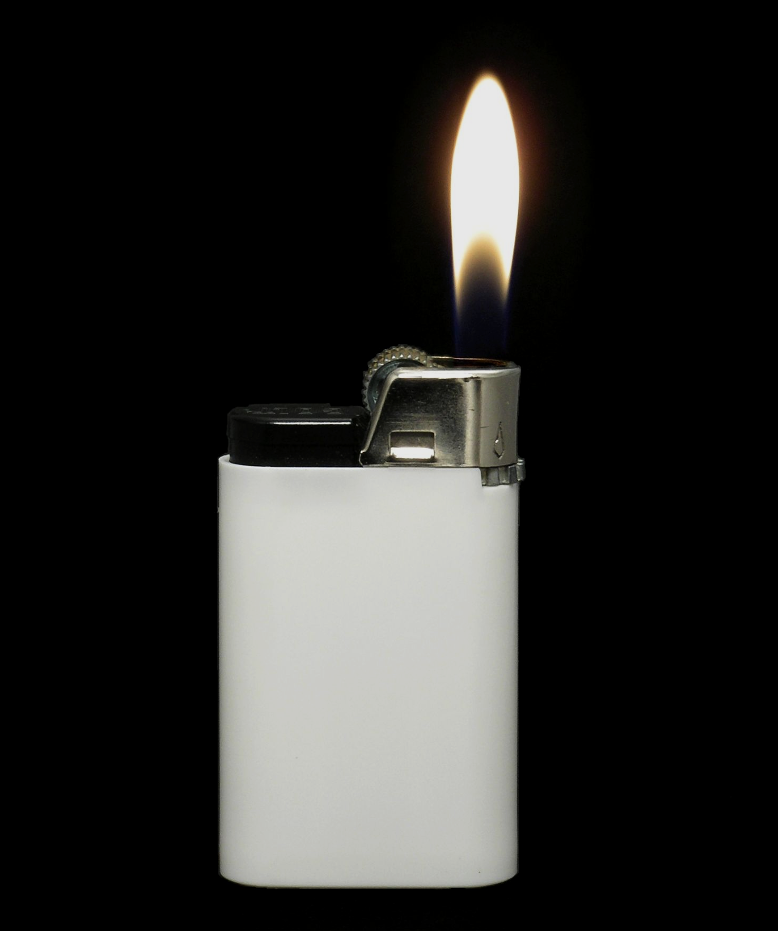
Butane (C₄H₁₀), like many hydrocarbons, has found use as a fuel.
For more help, please visit www.exampaperspractice.co.uk
© 2025 Exams Papers Practice. All Rights Reserved

Slide 6
Representing Organic Compounds
Organic molecules can also be represented graphically.
The displayed formula shows how the spatial arrangement of the atoms.
It also shows the bonds between the atoms.
The structural formula shows how the compound is arranged carbon by carbon, without showing the actual bonds.
Butane has the structural formula CH₃CH₂CH₂CH₃.
H
H
H
H
H
C
C
C
C
H
The displayed formula of butane.
H
H
H
H
For more help, please visit www.exampaperspractice.co.uk
© 2025 Exams Papers Practice. All Rights Reserved

Slide 7
Homologous Series
Specification Point 4.3
Know what is meant by the terms homologous series, functional group and isomerism.
A homologous series can be defined as a group of compounds that can be represented by the same general formula.
The alkanes are represented by the formula C_{n}H_{2n+2}.
The alkenes are represented by the formula C_{n}H_{2n}.
Molecules in a homologous series will also have the same functional group.
A functional group is a group of atoms that are bonded together in a specific arrangement.
This arrangement influences the physical and chemical properties of the series.
H
H
H
H
FUNCTIONAL GROUP OF AN ALKANE
FUNCTIONAL GROUP OF AN ALKENE
C
C
C
C
H
H
For more help, please visit www.exampaperspractice.co.uk
© 2025 Exams Papers Practice. All Rights Reserved

Slide 8
Isomers
BUTANE (C₄H₁₀)
H
H
H
H
Isomers are compounds that have the same molecular formula, but their atoms are arranged differently in space.
Isomers will have different structural formulas.
Isomers usually have similar chemical properties, but different physical properties.
Butane and methylpropane both have the molecular formula C₄H₁₀.
Butane has a boiling point of -1°C, methylpropane of -12°C.
H
C
C
C
C
H
H
H
H
H
METHYLPROPANE (C₄H₁₀)
H
H
C
H
H
H
H
C
C
C
H
H
H
H
For more help, please visit www.exampaperspractice.co.uk
© 2025 Exams Papers Practice. All Rights Reserved

Slide 9
Naming Organic Compounds
Specification Points 4.4 and 4.5
Understand how to name compounds relevant to this specification using the rules of IUPAC nomenclature.
Understand how to write the possible structural and displayed formulae of an organic molecule given its molecular formula.
Chemists name organic compounds using a system called nomenclature.
Organic nomenclature was devised by an organisation called the IUPAC.
IUPAC stands for the International Union of Pure and Applied Chemistry.
Organic compounds have a prefix and a suffix.
The prefix reveals how many carbon atoms there are in the longest chain of the compound.
The suffix reveals the functional group of the compound.
Alkanes have the suffix -ane.
Alkenes have the suffix -ene.
Number of Carbon Atoms | Prefix
1 | Meth-
2 | Eth-
3 | Prop-
4 | But-
5 | Pent-
6 | Hex-
For more help, please visit www.exampaperspractice.co.uk
© 2025 Exams Papers Practice. All Rights Reserved

Slide 10
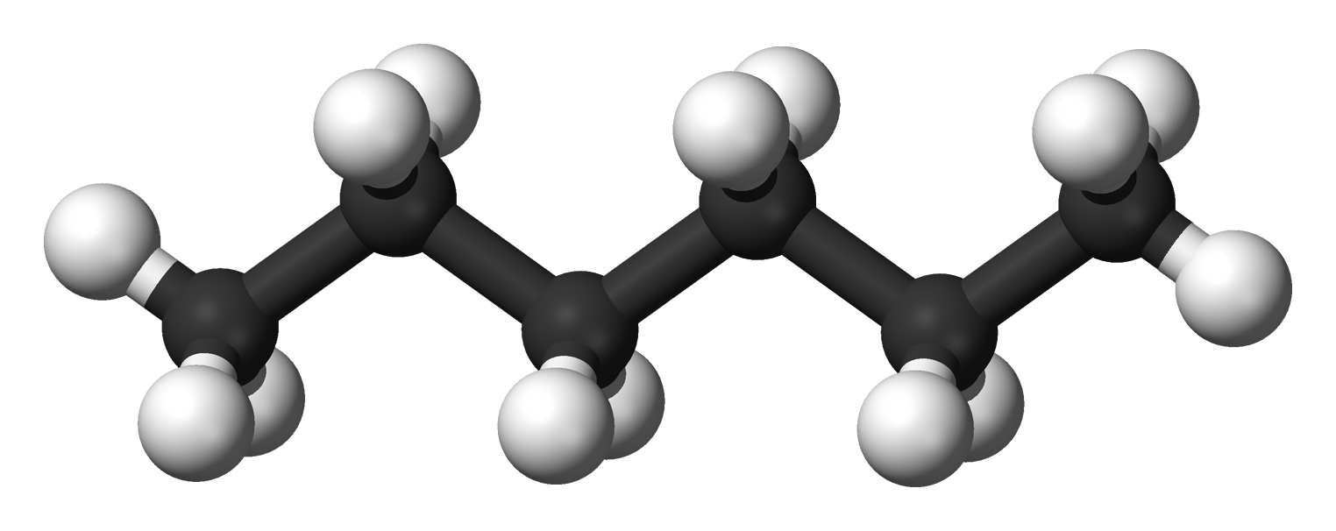
This molecule has 6 carbon atoms and 14 hydrogen atoms.
It has a straight chain of 6 carbon atoms so has the prefix hex.
It belongs to the alkane family and follows the homologous series C_{n}H_{2n+2}.
This molecule is hexane.
For more help, please visit www.exampaperspractice.co.uk
© 2025 Exams Papers Practice. All Rights Reserved

Slide 11
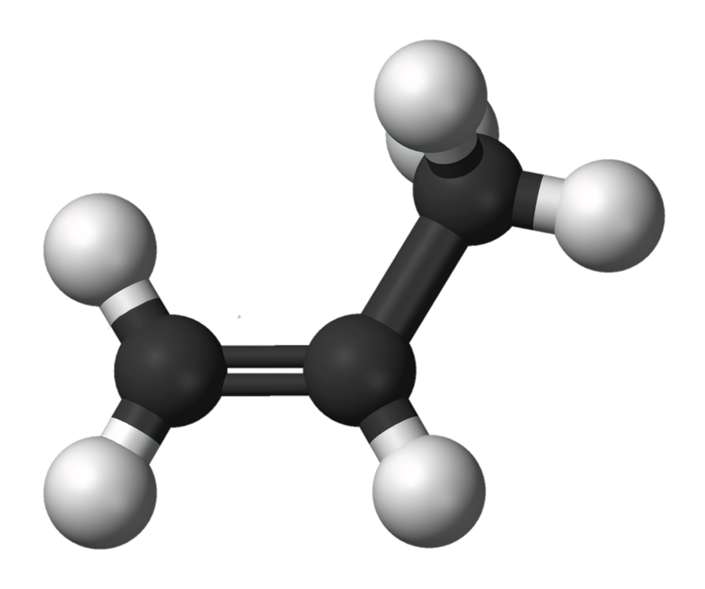
This molecule has 3 carbon atoms and 6 hydrogen atoms.
It has a straight chain of 3 carbon atoms so has the prefix prop.
It belongs to the alkene family and follows the homologous series C_{n}H_{2n}.
This molecule is propene.
For more help, please visit www.exampaperspractice.co.uk
© 2025 Exams Papers Practice. All Rights Reserved

Slide 12
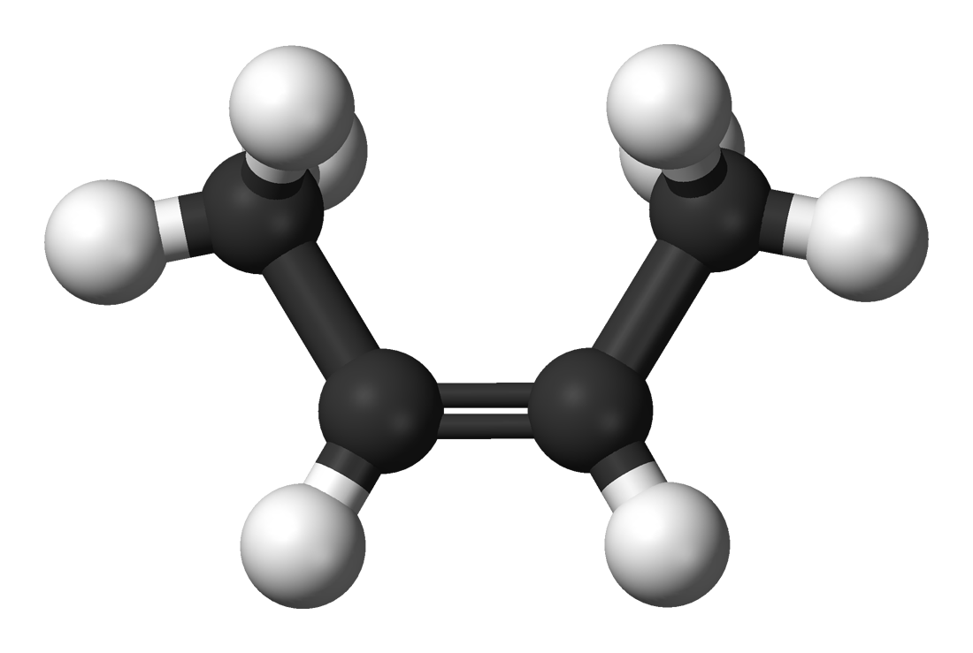
This molecule has 4 carbon atoms and 8 hydrogen atoms.
It has a straight chain of 4 carbon atoms so has the prefix but.
The functional group (the C=C bond) starts on the second carbon.
It belongs to the alkene family and follows the homologous series C_{n}H_{2n}.
This molecule is but-2-ene.
For more help, please visit www.exampaperspractice.co.uk
© 2025 Exams Papers Practice. All Rights Reserved

Slide 13
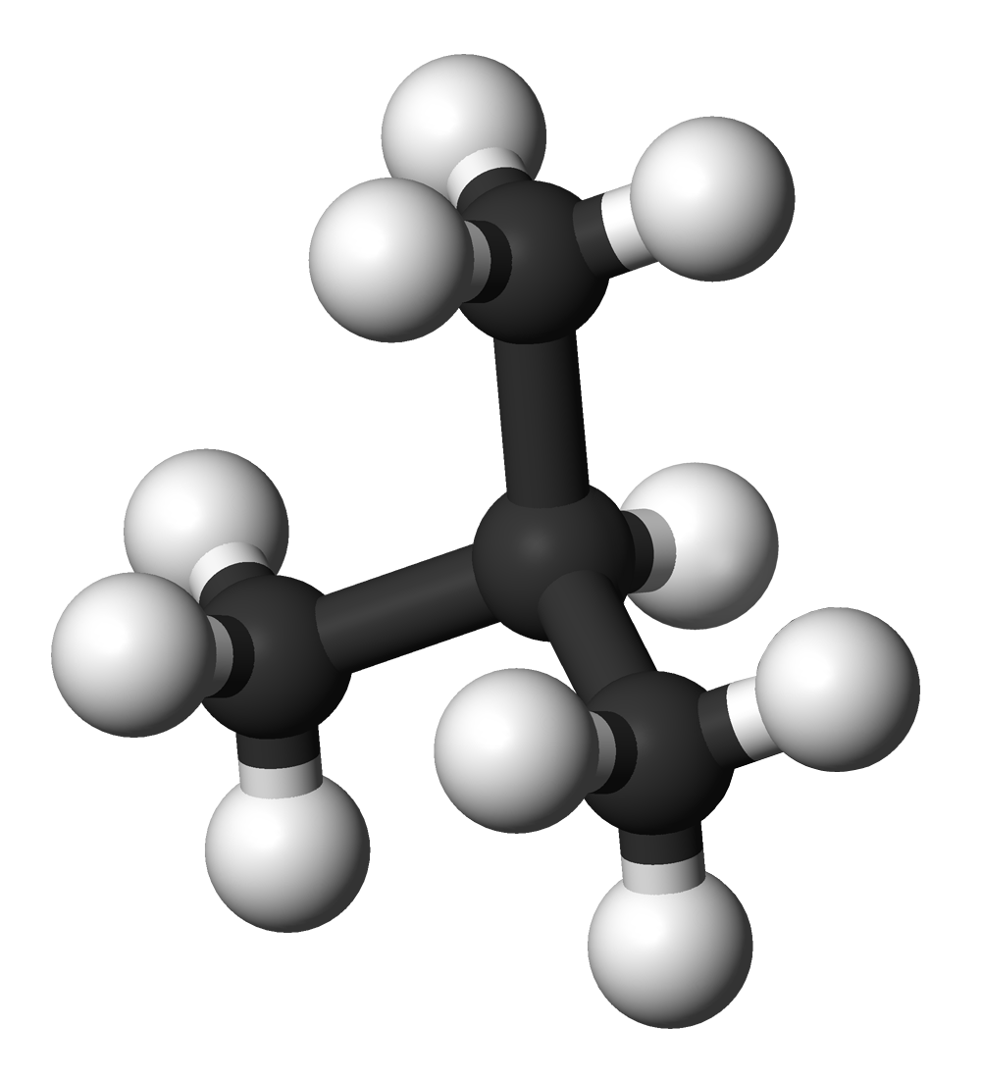
This molecule has 4 carbon atoms and 10 hydrogen atoms.
It has a straight chain of 3 carbon atoms so has the prefix prop.
There is a methyl group (CH₃) attached the second carbon in the chain.
It belongs to the alkane family and follows the homologous series C_{n}H_{2n+2}.
This molecule is 2-methylpropane.
For more help, please visit www.exampaperspractice.co.uk
© 2025 Exams Papers Practice. All Rights Reserved

Slide 14
Reactions Involving Organic Compounds
Specification Point 4.6
Understand how to classify reactions of organic compounds as substitution, addition and combustion.
Organic compounds take part in a variety of chemical reactions.
During substitution reactions, 1 functional group is replaced by another.
Take the substitution of methane by chlorine under UV light to form chloromethane (CH₃Cl):
CH_{4 (g)} + Cl_{2 (g)} → CH₃Cl _{(g)} + HCl _{(g)}
During addition reactions, 2 or more molecules combine to form a larger molecule.
Take the addition of ethene and steam to form ethanol (C₂H₅OH):
C₂H_{4 (g)} + H₂O _{(g)} → C₂H₅OH _{(l)}
For more help, please visit www.exampaperspractice.co.uk
© 2025 Exams Papers Practice. All Rights Reserved

Slide 15
Reactions Involving Organic Compounds
During combustion reactions, an organic compound reacts with oxygen (O₂) to form carbon-based products.
If the combustion is complete, carbon dioxide (CO₂) and water (H₂O) are formed.
If the combustion is incomplete, carbon monoxide (CO) may be formed.
Take the complete combustion of pentane to form carbon dioxide and water:
C₅H_{12 (g)} + 8O_{2 (g)} → 5CO_{2 (g)} + 6H₂O _{(l)}
Take the incomplete combustion of pentane to form carbon monoxide and water:
C₅H_{12 (g)} + 5^{½}O_{2 (g)} → 5CO _{(g)} + 6H₂O _{(l)}
For more help, please visit www.exampaperspractice.co.uk
© 2025 Exams Papers Practice. All Rights Reserved

Slide 16
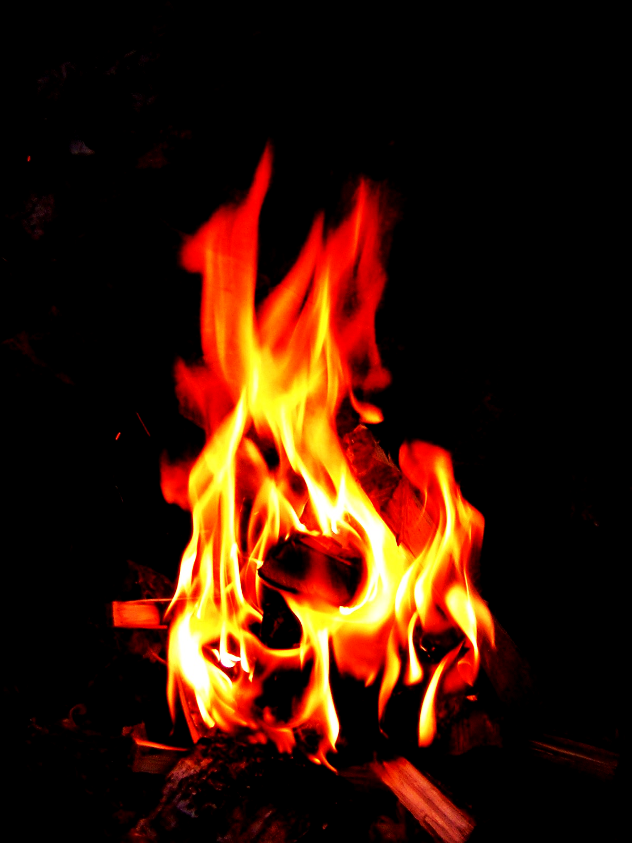
Hydrocarbons are most commonly associated with combustion reactions.
For more help, please visit www.exampaperspractice.co.uk
© 2025 Exams Papers Practice. All Rights Reserved

