Slide 1
Edexcel IGCSE Chemistry
2 - Solutions and Solubility
Bromine and Potassium Permanganate
For more help, please visit www.exampaperspractice.co.uk
© 2025 Exams Papers Practice. All Rights Reserved

Slide 2
Dilution and Diffusion
Specification Point 1.3
Understand how the results of experiments involving the dilution of coloured solutions and diffusion of gases can be explained.
Diffusion is the movement of particles from an area of high concentration to an area of lower concentration.
Diffusion can be demonstrated using potassium permanganate (KMnO₄).
KMnO₄ is bright purple.
If placed in a beaker of water KMnO₄ will diffuse until it is evenly spread out.
If you were to add more water to this solution, it would appear less purple.
This is because there are fewer KMnO₄ particles compared to the number of water particles.
This is called dilution.
For more help, please visit www.exampaperspractice.co.uk
© 2025 Exams Papers Practice. All Rights Reserved

Slide 3
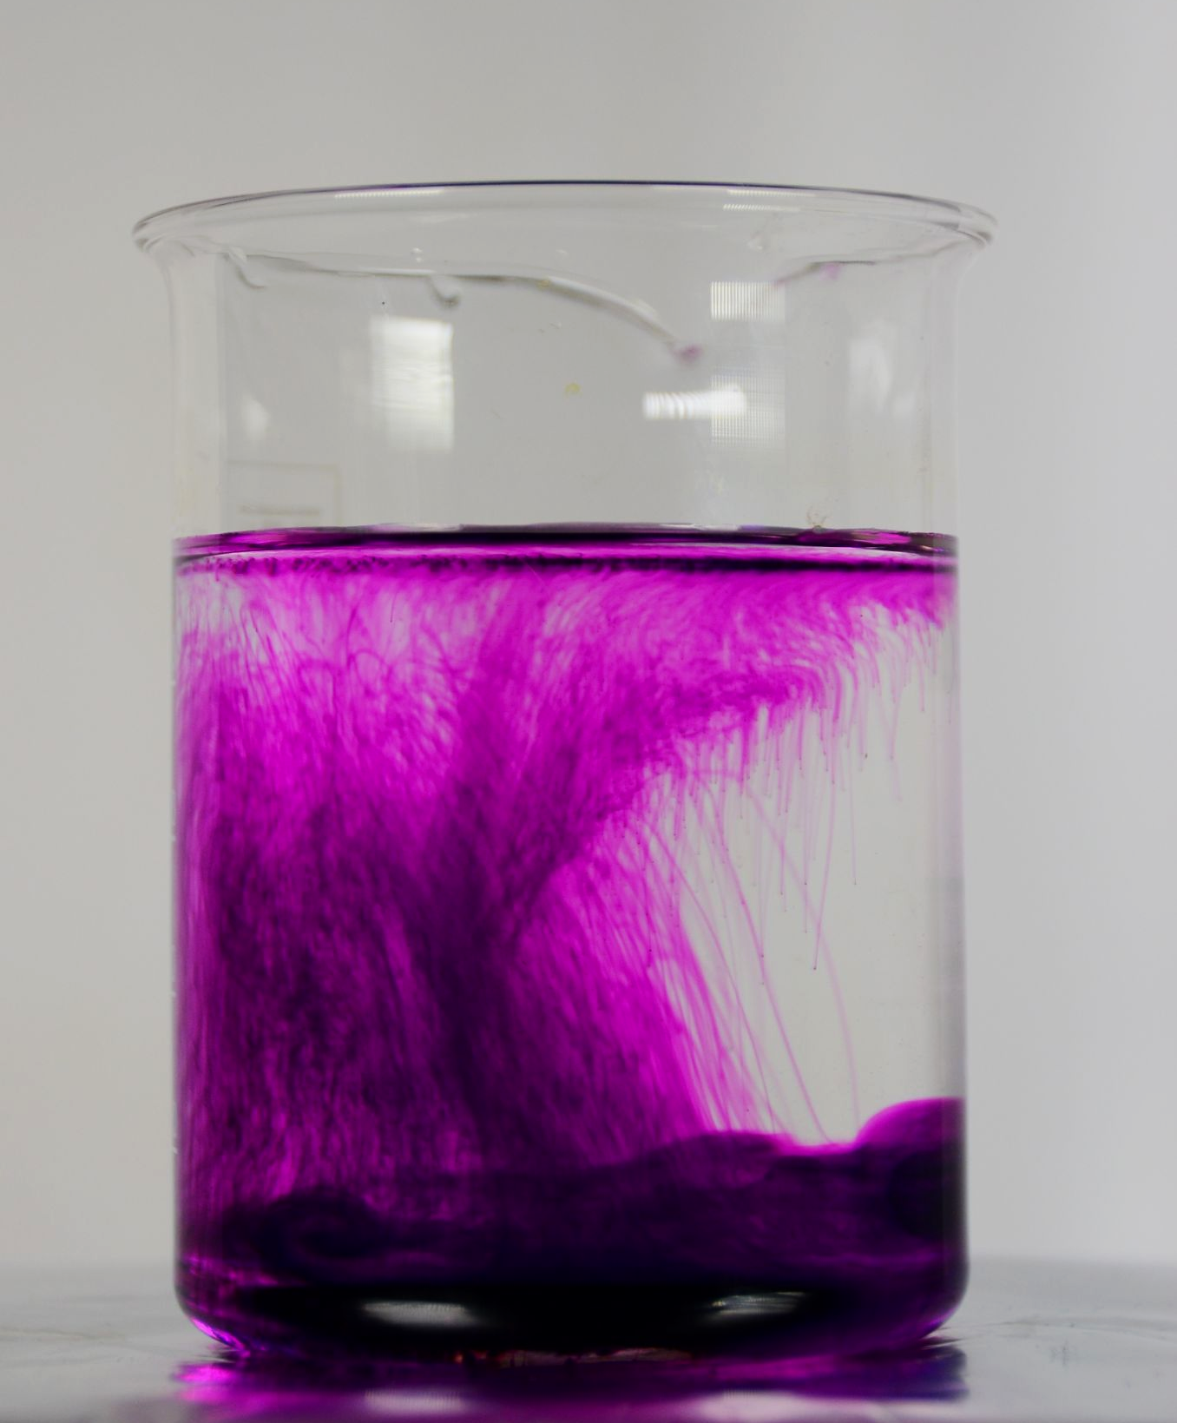
Potassium permanganate dissolves in water and then diffuses throughout the beaker.
For more help, please visit www.exampaperspractice.co.uk
© 2025 Exams Papers Practice. All Rights Reserved

Slide 4
Bromine Gas
Bromine (Br₂) is commonly seen as a brown gas.
Bromine can be used to demonstrate diffusion.
A gas jar is half filled with Br₂ gas.
The other half is filled with air.
A glass plate separates the two halves.
When the plate is removed, the Br₂ gas will diffuse through the air.
As the movement of particles is random, the Br₂ will eventually be evenly distributed through the air.
For more help, please visit www.exampaperspractice.co.uk
© 2025 Exams Papers Practice. All Rights Reserved

Slide 5
When a plate separating two halves of a gas jar is removed, the bromine gas will diffuse and fill the empty space.
This will dilute the bromine, making it appear paler.
For more help, please visit www.exampaperspractice.co.uk
© 2025 Exams Papers Practice. All Rights Reserved

Slide 6
Solutes and Solutions
Specification Point 1.4
Know what is meant by the terms: solvent, solute, solution and saturated solution.
A solvent is a liquid in which a solute dissolves.
Water is a very common solvent.
Ethanol is another common solvent.
A solute is the substance being dissolved - it is usually a solid.
Many salts will dissolve in water.
A solution is the mixture formed when a solute dissolves in a solvent.
Substances that are soluble dissolve in liquids.
Substances that are insoluble don’t dissolve in liquids.
A solution becomes saturated when no more solute can dissolve.
Different solvents have different saturation points.
For more help, please visit www.exampaperspractice.co.uk
© 2025 Exams Papers Practice. All Rights Reserved

Slide 7
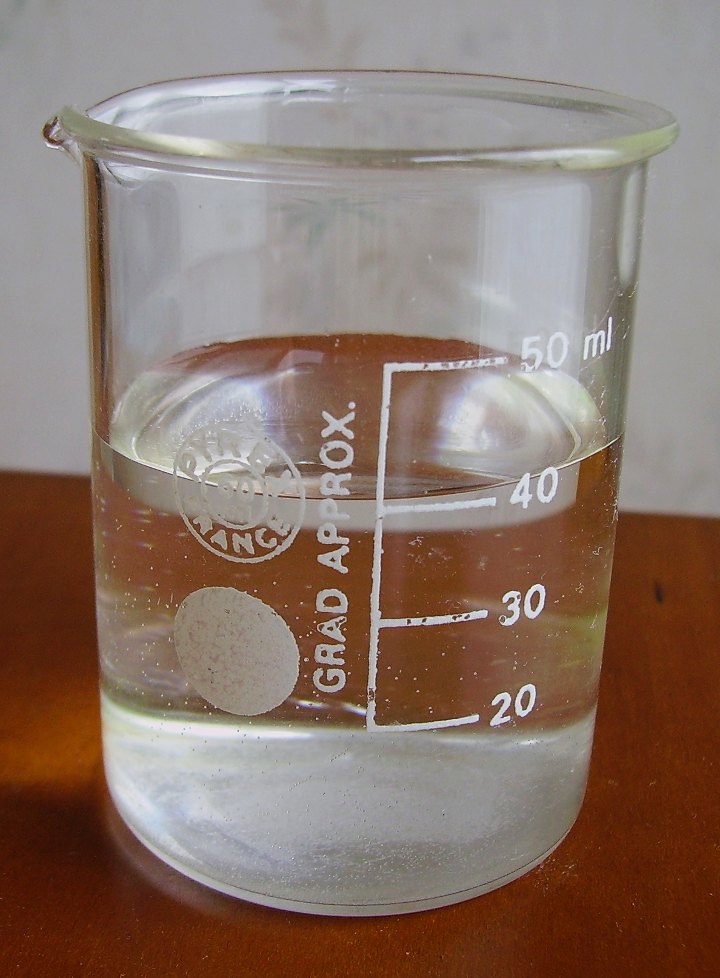
Lots of different solutes will dissolve in water.
Water is therefore described as a good solvent.
For more help, please visit www.exampaperspractice.co.uk
© 2025 Exams Papers Practice. All Rights Reserved

Slide 8
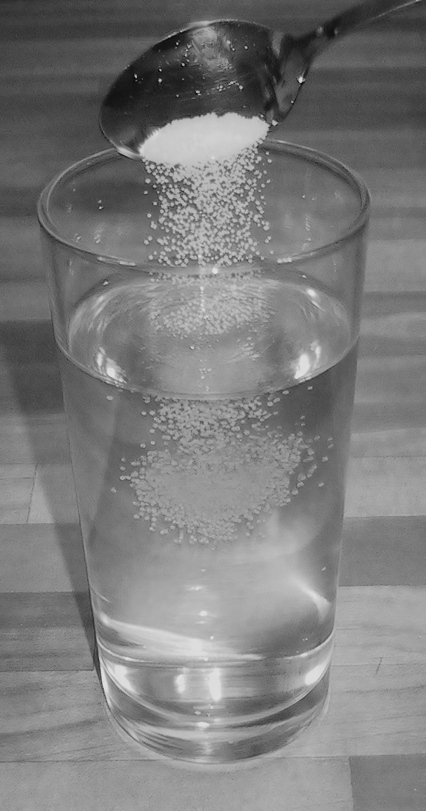
A solution becomes saturated when no more solute can dissolve in a solvent.
At 20°C, one liter of water can dissolve about 357 grams of salt.
For more help, please visit www.exampaperspractice.co.uk
© 2025 Exams Papers Practice. All Rights Reserved

