Slide 1
Edexcel IGCSE Chemistry
29 - Reversible Reactions
Forwards and Backwards Reactions
For more help, please visit www.exampaperspractice.co.uk
© 2025 Exams Papers Practice. All Rights Reserved

Slide 2
Reversible Reactions
Specification Points 3.17 and 3.18
Know that some reactions are reversible and this is indicated by the symbol ⇌ in equations.
Describe reversible reactions such as the dehydration of hydrated copper (II) sulphate and the effect of heat on ammonium chloride.
Some chemical reactions go to completion.
This means that the reaction stops once the reactants are converted to products.
Other chemical reactions are reversible.
This means that the products of the reaction are able to react with each other.
Often the products are converted back into the reactants.
Reversible reactions can go forwards or backwards.
A reversible reaction is denoted using the symbol ⇌.
For more help, please visit www.exampaperspractice.co.uk
© 2025 Exams Papers Practice. All Rights Reserved

Slide 3
⇌
Reversible reactions are ones that can occur in both directions.
In the forwards direction, reactants are converted to products.
In the backwards direction, products are converted to reactants.
For more help, please visit www.exampaperspractice.co.uk
© 2025 Exams Papers Practice. All Rights Reserved

Slide 4
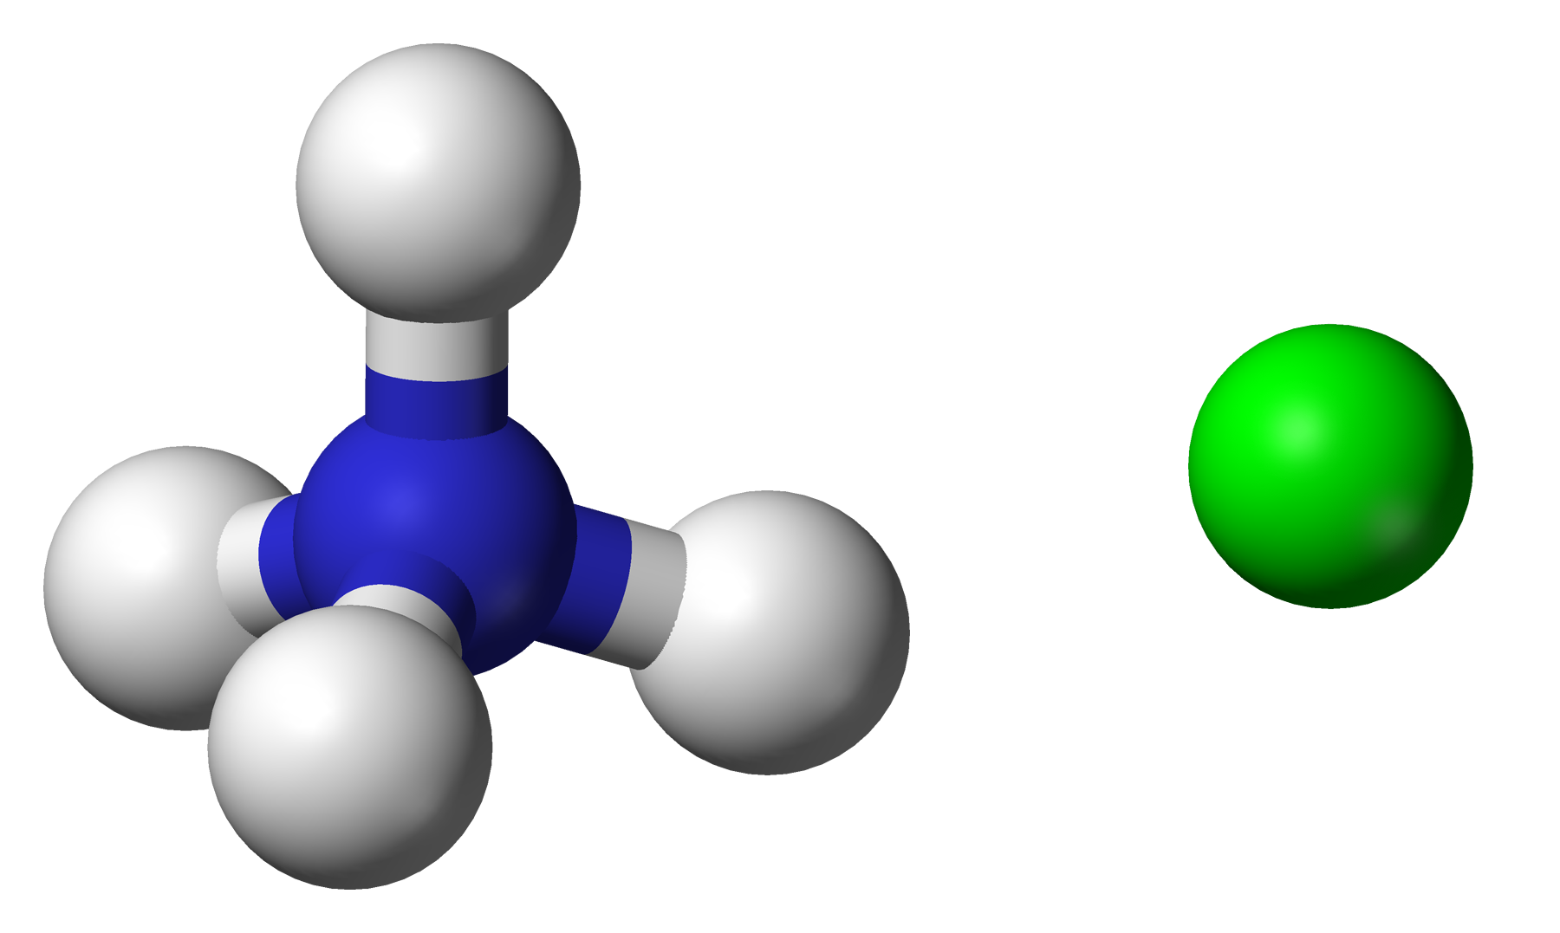
Take the example of ammonium chloride (NH₄Cl):
Ammonium chloride is a white solid that decomposes when heated into ammonia (NH₃) and hydrogen chloride (HCl).
This is called the forward reaction.
NH₄Cl_{(s)} → NH_{3 (g)} + HCl_{(g)}
When the products cool, the ammonia and hydrogen chloride reform into ammonium chloride.
This is called the backward reaction.
NH_{3 (g)} + HCl_{(g)} → NH₄Cl _{(g)}
The forwards and the backwards reactions are combined to form a reversible reaction.
NH₄Cl_{(s)} ⇌ NH_{3 (g)} + HCl_{(g)}
An ionic molecule of ammonium chloride.
For more help, please visit www.exampaperspractice.co.uk
© 2025 Exams Papers Practice. All Rights Reserved

Slide 5
Reversible Reactions
Reversible reactions are often seen in hydrated salts.
Hydrated copper sulphate (CuSO₄.5H₂O) forms bright blue crystals.
When heated, copper sulphate becomes anhydrous.
This is accompanied by a colour change from blue to white.
When rehydrated, the blue copper sulphate crystals are reformed.
This is thus another example of a reversible reaction:
CuSO₄.5H₂O _{(s)} ⇌ CuSO_{4 (s)} + 5H₂O _{(l)}
For more help, please visit www.exampaperspractice.co.uk
© 2025 Exams Papers Practice. All Rights Reserved

Slide 6
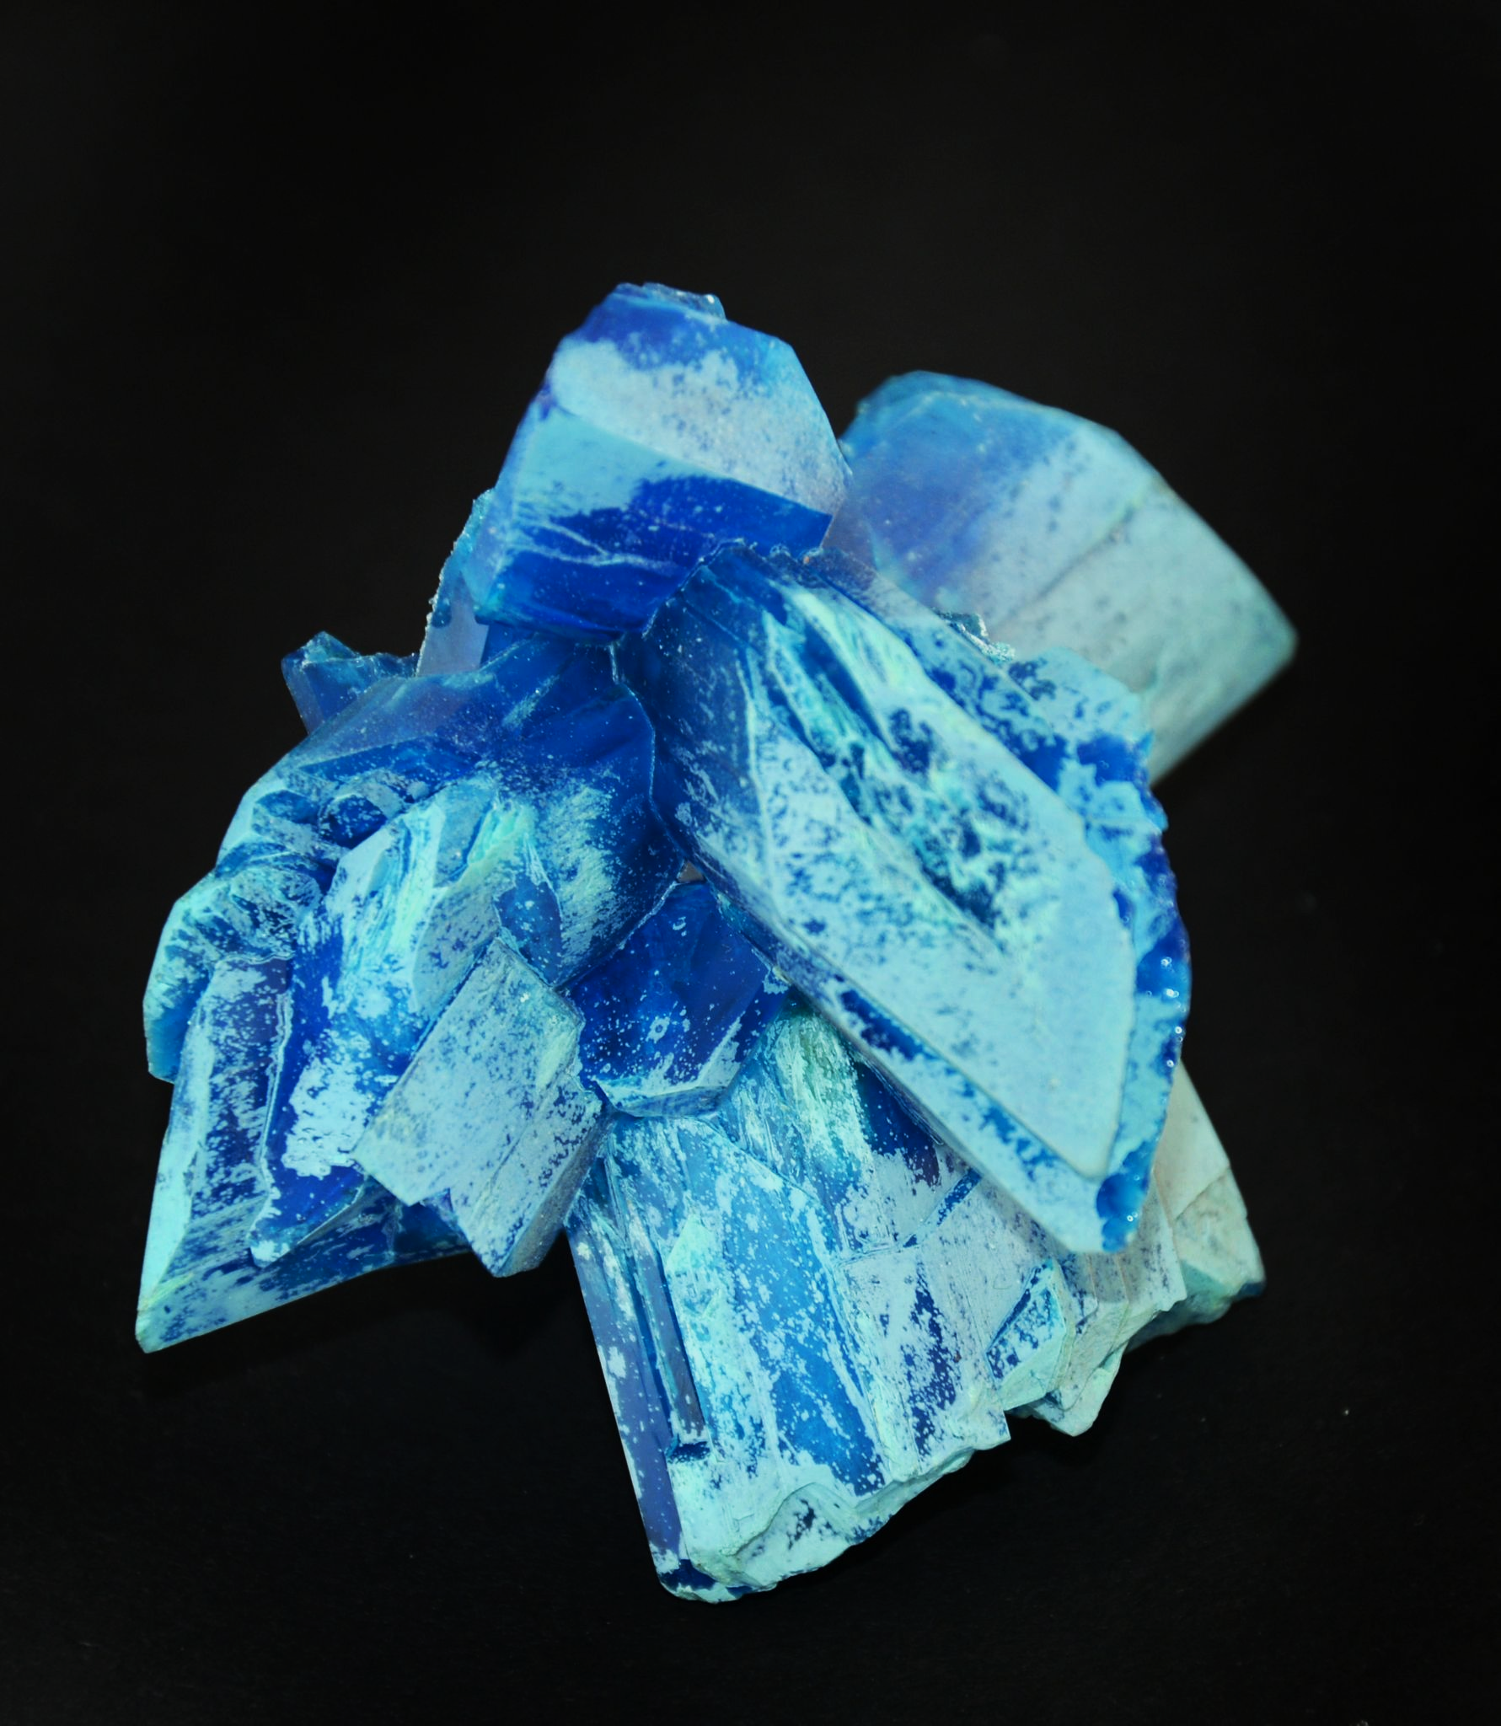
When hydrated, copper sulphate crystals are a distinctive bright blue colour.
For more help, please visit www.exampaperspractice.co.uk
© 2025 Exams Papers Practice. All Rights Reserved

Slide 7
As the hydrated copper sulphate crystals are heated, the water is removed and the crystals turn white. If water is then added to the anhydrous copper sulphate the blue colour returns.
CuSO₄.5H₂O
CuSO₄.5H₂O _{(s)} ⇌ CuSO_{4 (s)} + 5H₂O _{(l)}
CuSO₄
For more help, please visit www.exampaperspractice.co.uk
© 2025 Exams Papers Practice. All Rights Reserved

