Slide 1
Edexcel IGCSE Chemistry
28 - Rates of Reaction
Factors Affecting Rates, Catalysts
For more help, please visit www.exampaperspractice.co.uk
© 2025 Exams Papers Practice. All Rights Reserved

Slide 2
Rate of Reactions
Specification Points 3.9, 3.10 and 3.11
Describe experiments to investigate the effects of changes in surface area of a solid, concentration of a solution, temperature and the use of a catalyst on the rate of a reaction.
Describe the effects of changes in surface area of a solid, concentration of a solution, pressure of a gas, temperature and the use of a catalyst on the rate of a reaction.
Explain the effects of changes in surface area of a solid, concentration of a solution, pressure of a gas and temperature on the rate of a reaction in terms of particle collision theory.
The rate of a chemical reaction can be defined as how quickly the reactants are converted into products.
This is often very important in industrial reactions.
There are a number of conditions that can affect how quickly a reaction proceeds:
Temperature.
The surface area of a solid reactant.
The concentration of a solution or the pressure of a gas.
The presence or absence of a catalyst.
For more help, please visit www.exampaperspractice.co.uk
© 2025 Exams Papers Practice. All Rights Reserved

Slide 3
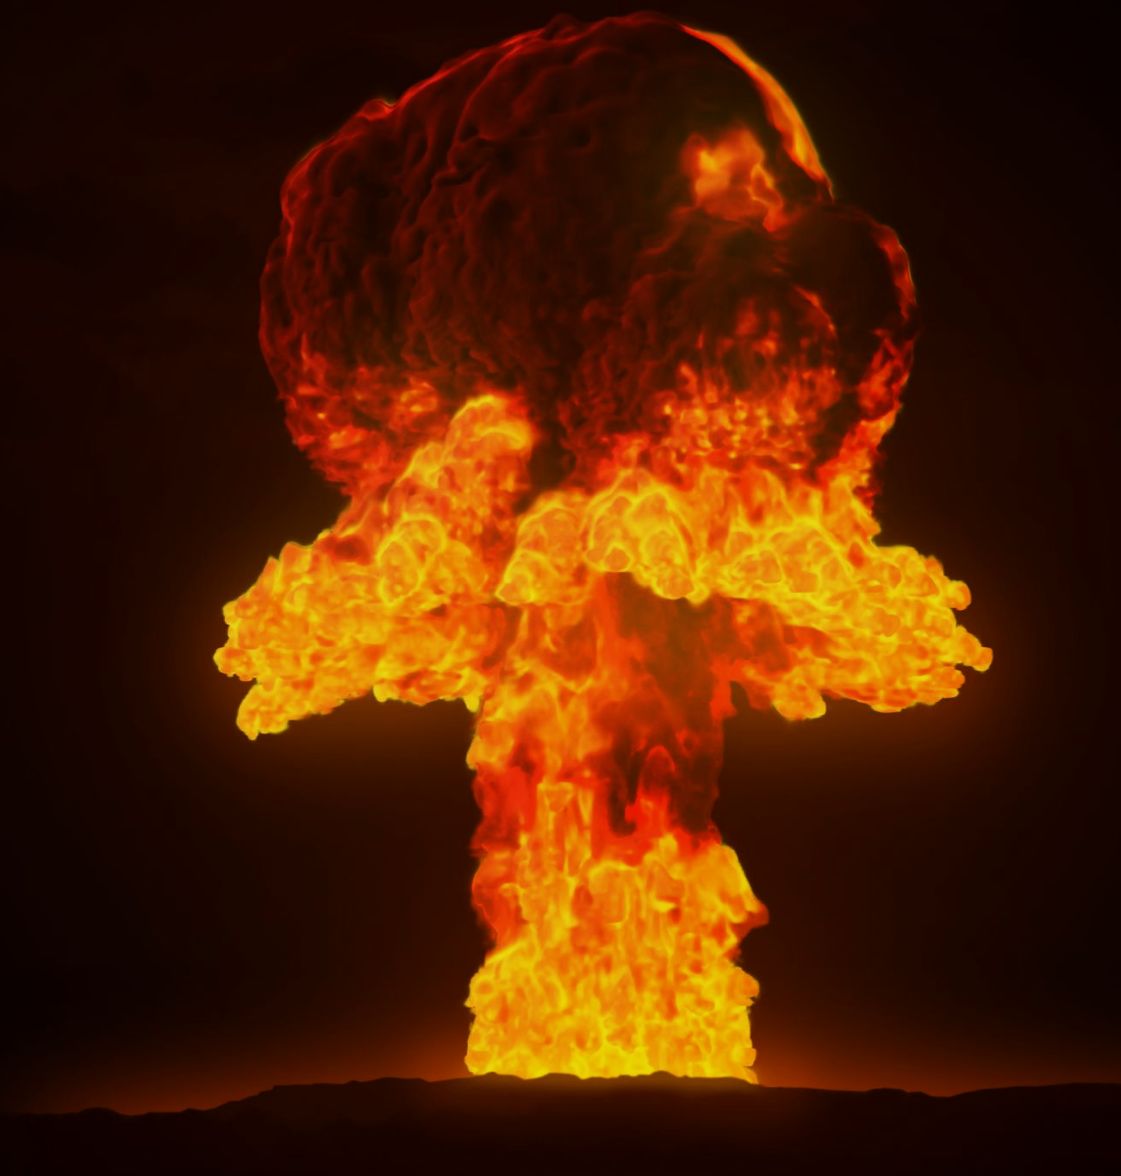
Explosions are very fast chemical reactions that are often completed within a fraction of a second.
For more help, please visit www.exampaperspractice.co.uk
© 2025 Exams Papers Practice. All Rights Reserved

Slide 4
The Effect of Temperature
In order for a reaction to take place, particles must collide with each other.
They must also collide with sufficient energy to kickstart the reaction.
Increasing the temperature will cause the rate of reaction to increase.
At higher temperatures particles are moving more quickly.
This increases the likelihood of a successful collision taking place.
LOW TEMPERATURE
HIGH TEMPERATURE
For more help, please visit www.exampaperspractice.co.uk
© 2025 Exams Papers Practice. All Rights Reserved

Slide 5
RATE OF REACTION (LOG) →
The rate of a chemical reaction approximately doubles for every increase of 10°C.
TEMPERATURE →
For more help, please visit www.exampaperspractice.co.uk
© 2025 Exams Papers Practice. All Rights Reserved

Slide 6
The Effect of Temperature
The effect of temperature on the rate of reaction can be illustrated using the reaction between sodium thiosulphate (Na₂S₂O₃) and hydrochloric acid (HCl).
Both compounds are colourless solutions.
Add a black mark to the bottom of a volumetric flask.
Combine both solutions.
Sodium thiosulphate and hydrochloric acid react together to form a yellow precipitate.
Time how long it takes for the precipitate to form.
This can be calculated by timing how long it takes for the black mark to become invisible.
Repeat the experiment at different temperatures.
At higher temperatures, it will take less time for the black mark to disappear.
COLOURLESS SOLUTION WITH MARK VISIBLE
YELLOW PRECIPITATE WITH MARK INVISIBLE
For more help, please visit www.exampaperspractice.co.uk
© 2025 Exams Papers Practice. All Rights Reserved

Slide 7
Changing Concentrations and Pressures
Increasing the concentration of a solution increases the rate of reaction.
This is because there are more particles in the same volume.
This makes collisions between reactants become more likely.
Increasing the pressure of a gas also increases the rate of a reaction.
This is because there are more particles in the same area.
This makes collisions between reactants become more likely.
LOW PRESSURE
HIGH PRESSURE
For more help, please visit www.exampaperspractice.co.uk
© 2025 Exams Papers Practice. All Rights Reserved

Slide 8
The Effect of Surface Area
Specification Point 3.15
Practical: investigate the effect of changing the surface area of marble chips and of changing the concentration of hydrochloric acid on the rate of reaction between marble chips and dilute hydrochloric acid.
Increasing the surface area of a solid reactant will cause the rate of reaction to increase.
This is because a greater surface area of 1 reactant will be exposed to the other reactant.
This increases the number of collisions between reactants.
Fill a conical flask with dilute hydrochloric acid.
Add a few chips of of calcium carbonate (CaCO₃) to the flask and attach to a gas syringe.
The hydrochloric acid will react with the calcium carbonate to release carbon dioxide (CO₂) gas.
The CO₂ is collected in the gas syringe.
Measure the rate of carbon dioxide produced.
This can be calculated by dividing the volume of CO₂ produced by the time taken.
Repeat the experiment using ground calcium carbonate.
This has a higher surface area so will have a higher rate of reaction.
For more help, please visit www.exampaperspractice.co.uk
© 2025 Exams Papers Practice. All Rights Reserved

Slide 9
CO₂ GAS COLLECTED
CO₂ GAS COLLECTED
Calcium carbonate chips have a relatively low surface area. The reaction with hydrochloric acid is slower.
Calcium carbonate powder has a relatively high surface area. The reaction with hydrochloric acid is faster.
CaCO₃ CHIPS
CaCO₃ POWDER
For more help, please visit www.exampaperspractice.co.uk
© 2025 Exams Papers Practice. All Rights Reserved

Slide 10
Catalysts
Specification Points 3.12 and 3.13
Know that a catalyst is a substance that increases the rate of a reaction, but is chemically unchanged at the end of the reaction.
Know that a catalyst works by providing an alternative pathway with lower activation energy.
A catalyst is any substance that increases the rate of a chemical reaction.
A catalyst is not used up during the reaction.
Because of this, only small amounts of catalyst are needed.
All reactions require a certain amount of energy to begin.
This is referred to as the activation energy (E_{a}) of the reaction.
The more energy required to start the reaction, the higher the activation energy.
Catalysts work by decreasing the activation energy of a reaction.
Catalysts do this by providing an alternative reaction pathway.
More particles now have the required activation energy needed for a reaction to proceed.
For more help, please visit www.exampaperspractice.co.uk
© 2025 Exams Papers Practice. All Rights Reserved

Slide 11
Catalysts
Specification Point 3.16
Practical: investigate the effect of different solids on the catalytic decomposition of hydrogen peroxide solution.
Hydrogen peroxide (H₂O₂) readily decomposes into hydrogen (H₂) and oxygen (O₂).
The rate of this reaction can be increased using a manganese oxide (MnO₂) catalyst.
Fill a conical flask with hydrogen peroxide and attach to a gas syringe.
Measure the rate of gas produced.
This can be calculated by dividing the volume of gas produced by the time taken.
Repeat the experiment using a manganese oxide catalyst.
The catalyst will lower the activation energy and thus increase the rate of the reaction.
For more help, please visit www.exampaperspractice.co.uk
© 2025 Exams Papers Practice. All Rights Reserved

Slide 12
GAS COLLECTED
GAS COLLECTED
Without the manganese oxide catalyst, hydrogen peroxide decomposes slowly.
With the manganese oxide catalyst, hydrogen peroxide decomposes quickly.
H₂O₂ WITHOUT CATALYST
H₂O₂ WITH CATALYST
For more help, please visit www.exampaperspractice.co.uk
© 2025 Exams Papers Practice. All Rights Reserved

