Slide 1
Edexcel IGCSE Chemistry
26 - Energetics
Exothermic and Endothermic Reactions, Calorimetry
For more help, please visit www.exampaperspractice.co.uk
© 2025 Exams Papers Practice. All Rights Reserved

Slide 2
Exothermic and Endothermic Reactions
Specification Point 3.1
Know that chemical reactions in which heat energy is given out are described as exothermic, and those in which heat energy is taken in are described as endothermic.
An exothermic reaction is one that gives out heat to the surroundings.
Exothermic reactions are accompanied by an increase in temperature.
Neutralisations are examples of exothermic reactions.
An endothermic reaction is one that takes in heat from the surroundings.
Endothermic reactions are accompanied by a decrease in temperature.
Evaporations and sublimations are examples of endothermic reactions.
For more help, please visit www.exampaperspractice.co.uk
© 2025 Exams Papers Practice. All Rights Reserved

Slide 3
During exothermic reactions, energy is given out as heat.
A neutralisation reaction between an acid and a base is an example of an exothermic reaction.
ENERGY IN →
→ ENERGY OUT
For more help, please visit www.exampaperspractice.co.uk
© 2025 Exams Papers Practice. All Rights Reserved

Slide 4
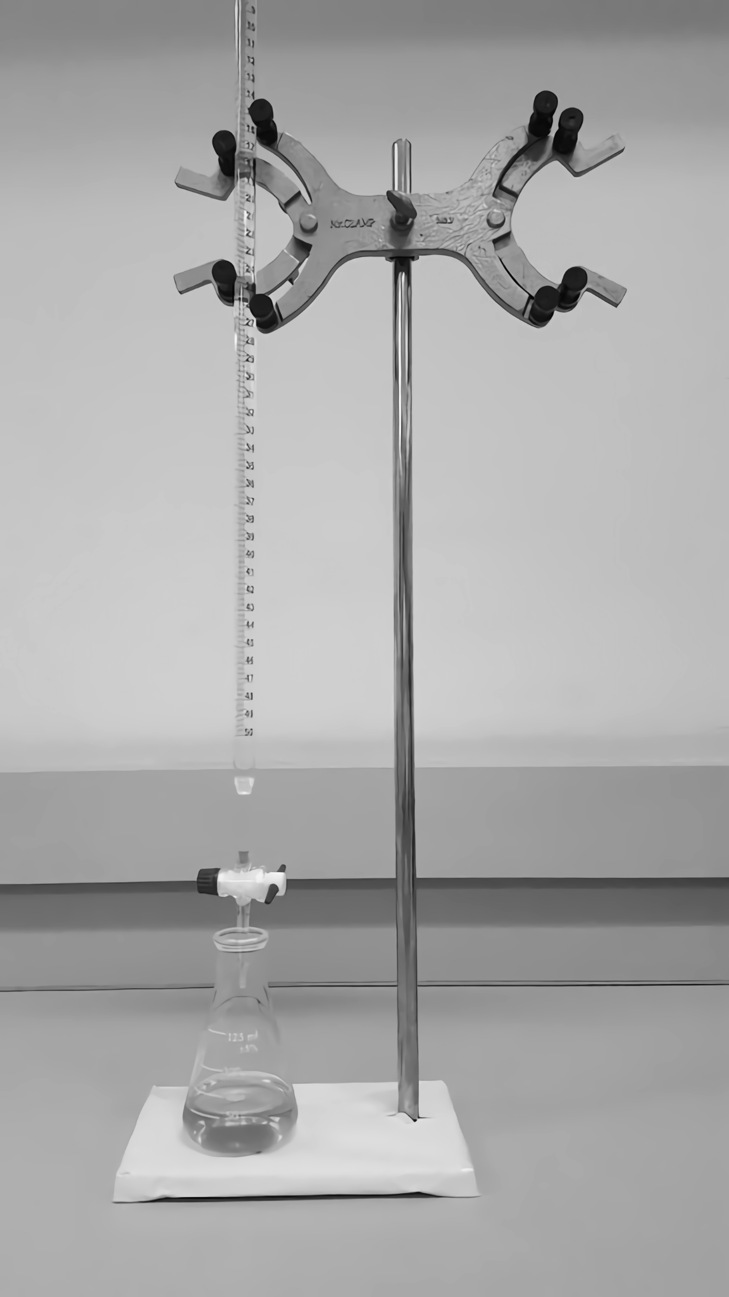
During exothermic reactions, energy is given out as heat.
A neutralisation reaction between an acid and a base is an example of an exothermic reaction.
For more help, please visit www.exampaperspractice.co.uk
© 2025 Exams Papers Practice. All Rights Reserved

Slide 5
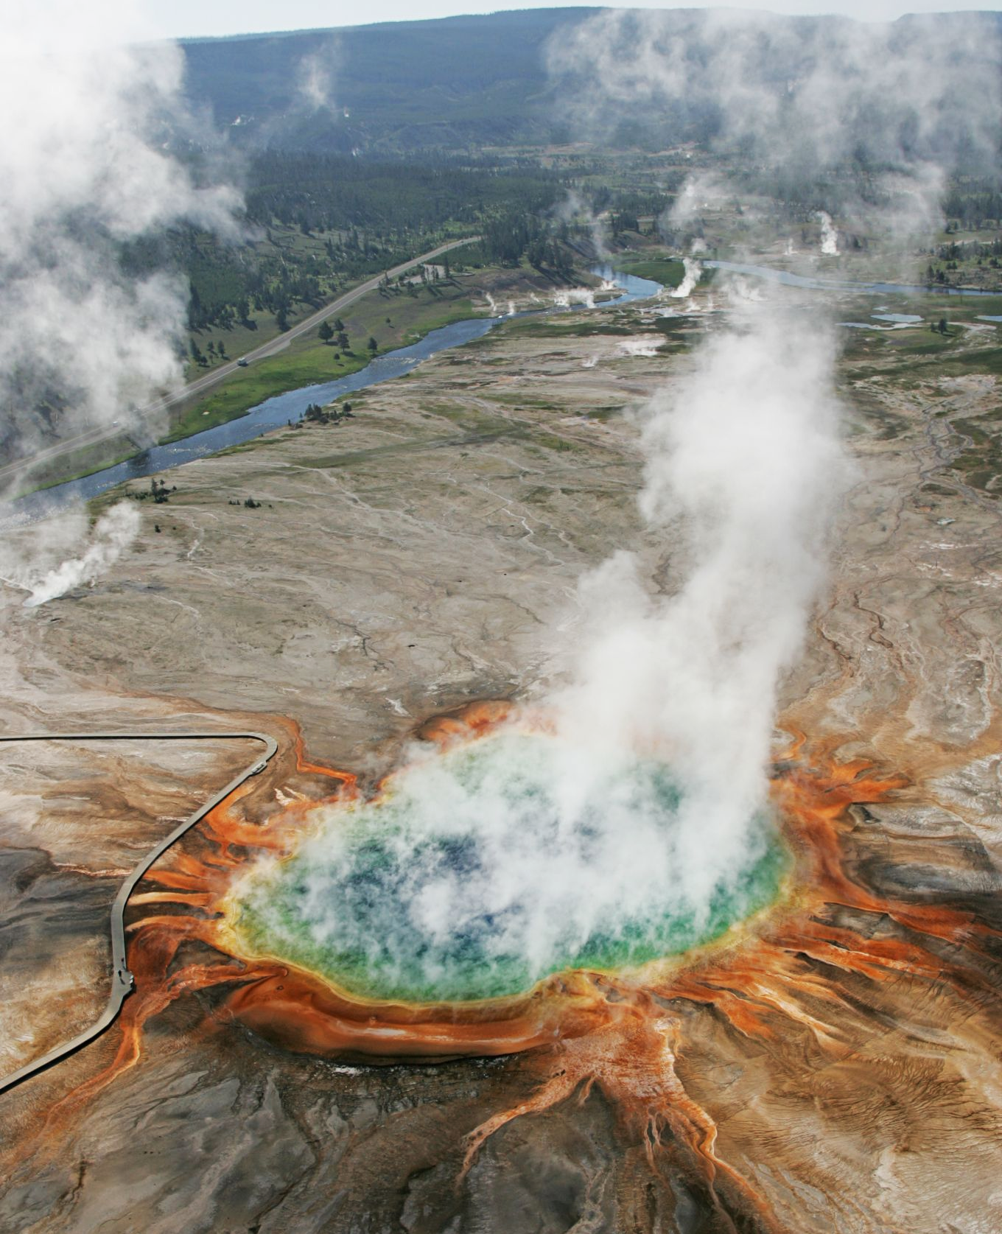
During endothermic reactions, heat energy is taken in from the environment.
The evaporation of liquid water is an example of an endothermic reaction.
For more help, please visit www.exampaperspractice.co.uk
© 2025 Exams Papers Practice. All Rights Reserved

Slide 6
Enthalpy Change and Calorimetry
Specification Points 3.2 and 3.8
Describe simple calorimetry experiments for reactions such as combustion, displacement, dissolving and neutralisation.
Practical: investigate temperature changes accompanying some of the following types of change: salts dissolving in water, neutralisation reactions, displacement reactions and combustion reactions.
The amount of energy transferred during a chemical reaction is referred to as the enthalpy change (ΔH).
Enthalpy change is measured in kJ/mol.
Reactions with a positive enthalpy value are endothermic.
Reactions with a negative enthalpy value are exothermic.
Calorimetry is a technique used to measure enthalpy change.
Calorimetry involves measuring the temperature change that occurs during a chemical reaction.
For more help, please visit www.exampaperspractice.co.uk
© 2025 Exams Papers Practice. All Rights Reserved

Slide 7
Calorimetry and Solutions
Calorimetry can be used to measure the enthalpy change that occurs when 2 solutions are mixed together.
This is commonly seen during neutralisation reactions.
Heat separate beakers of 0.1 mol/dm³ hydrochloric acid (HCl) and sodium hydroxide (NaOH) to 25°C.
This can be achieved using a water bath.
Combine the HCl and the NaOH to a polystyrene cup.
Add a lid to the cup and surround with cotton wool to minimise heat loss to the environment.
Measure the increase in temperature using a thermometer.
Measure the temperature every 20 seconds and record the highest temperature.
THERMOMETER
COTTON WOOL
POLYSTYRENE CUP
WITH SOLUTION OF HCl AND NaOH
For more help, please visit www.exampaperspractice.co.uk
© 2025 Exams Papers Practice. All Rights Reserved

Slide 8
Calorimetry and Combustion
Calorimetry can also be used to measure the enthalpy change that occurs when a fuel is burnt in oxygen (O₂).
This is referred to as the enthalpy of combustion.
This method involves the use of a metal container, referred to as a bomb calorimeter.
Add a known mass of fuel to the metal container.
Being an excellent conductor of heat, this is usually made out of copper.
Submerge the metal container in a larger container.
Fill this container with a known volume of water.
Ignite the fuel and measure the increase in temperature of the surrounding water, using a thermometer.
Stop the experiment once the temperature has risen by about 20°C.
Reweigh the fuel to see how much mass has been lost.
This can be used to calculate the enthalpy change.
Calorimetry video.
IGNITION WIRES
STIRRER
THERMOMETER
COPPER CONTAINER
FUEL
For more help, please visit www.exampaperspractice.co.uk
© 2025 Exams Papers Practice. All Rights Reserved

Slide 9
Calculating Enthalpy Change
Specification Point 3.3
Calculate the heat energy change from a measured temperature change using the expression Q = mcΔT.
The amount of energy transferred during a combustion reaction can be calculated using the following equation:
Water has a specific heat capacity of 4.2 J/g/°C.
This means it takes 4.2 joules of energy to raise 1 gram of water by 1°C.
1 gram of water is equivalent to 1 ml.
Q = heat energy transferred in joules.
m = the mass of water heated in grams.
c = the specific heat capacity of water (measured in J/g/°C).
ΔT = the temperature change in °C.
For more help, please visit www.exampaperspractice.co.uk
© 2025 Exams Papers Practice. All Rights Reserved

Slide 10
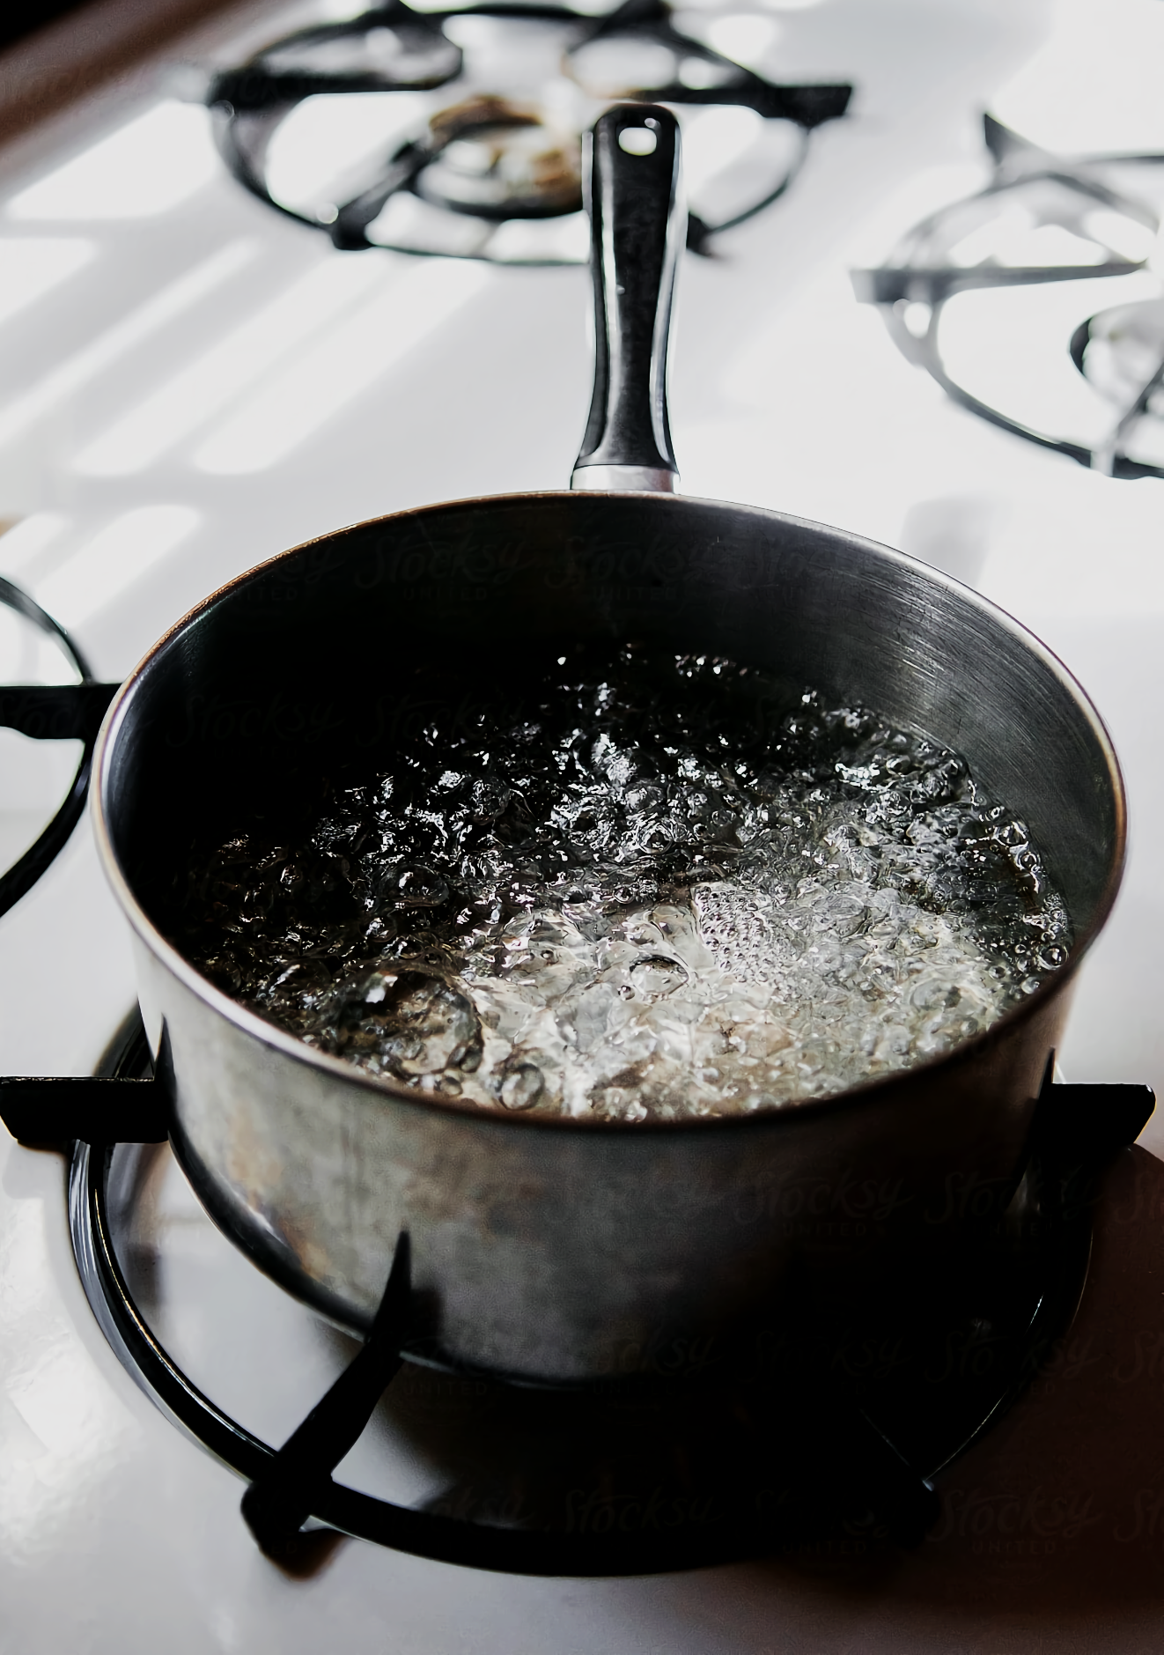
Assume that 24.8 grams of butane were used to heat a bowl of water containing 250 ml from 25°C to 90°C.
Calculate the heat energy change per gram of fuel.
1. Calculate the temperature change of the water (ΔT); 90 - 25 = 65°C.
2. Use the equation: Q = m × c × ΔT; 250 × 4.2 × 65 = 68,250 J.
3. Calculate the heat energy per gram; 68,250 ÷ 24.8 = 2752 J/g.
For more help, please visit www.exampaperspractice.co.uk
© 2025 Exams Papers Practice. All Rights Reserved

Slide 11
Molar Enthalpy Change
Specification Point 3.4
Calculate the molar enthalpy change (ΔH) from the heat energy change, Q.
It is also possible to calculate the heat energy change from a reaction per mole.
This is referred to as the molar enthalpy change.
Calculate the heat energy change from the reaction (Q).
From the previous example this was 68,250 J.
Calculate how many moles of fuel were present.
The M_{r} of butane (C₄H₁₀) is 58.
Moles = mass ÷ M_{r} (24.8 ÷ 58 = 0.43 moles).
Calculate the amount of energy transferred by 1 mole of fuel.
As this reaction is exothermic, there will be a negative enthalpy value.
68,250 ÷ 0.43 = -158,721 J/mol or -158.7 kJ/mol.
For more help, please visit www.exampaperspractice.co.uk
© 2025 Exams Papers Practice. All Rights Reserved

Slide 12
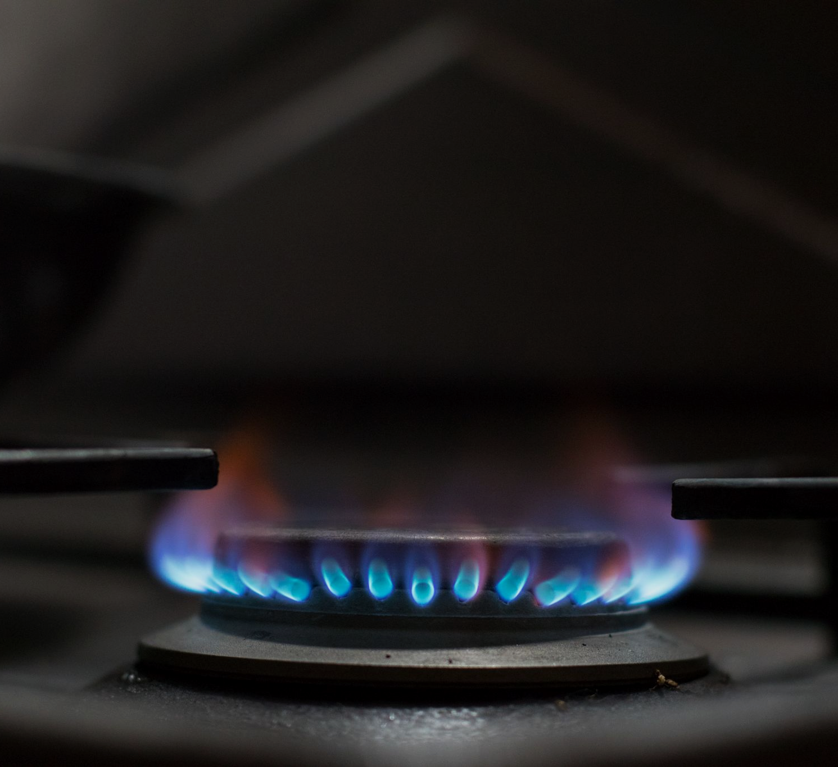
As the combustion of butane is an exothermic reaction, the molar enthalpy change will have a negative value.
For more help, please visit www.exampaperspractice.co.uk
© 2025 Exams Papers Practice. All Rights Reserved

