Slide 1
Edexcel IGCSE Chemistry
25 - Chemical Tests
Gases, Flame Tests, Anions and Cations
For more help, please visit www.exampaperspractice.co.uk
© 2025 Exams Papers Practice. All Rights Reserved

Slide 2
Tests for Gases
Specification Point 2.44
Describe tests for these gases: hydrogen, oxygen, carbon dioxide, ammonia and chlorine.
Many chemical reactions produce gases.
There are tests for a number of common gases.
Hydrogen (H₂) makes a squeaky pop sound when a lit splint is brought near.
Carry out this test by bringing a lit splint near to the mouth of a test tube.
Oxygen (O₂) relights a glowing splint.
Hold a glowing splint near the test tube.
Carbon dioxide (CO₂) turns limewater cloudy.
Bubble CO₂ through a test tube containing limewater.
Ammonia (NH₃) turns damp red litmus paper blue.
Dip damp red litmus paper in a test tube containing NH₃.
Chlorine (Cl₂) bleaches damp blue litmus paper.
Dip damp blue litmus paper in a test tube containing Cl₂.
The paper will turn white.
For more help, please visit www.exampaperspractice.co.uk
© 2025 Exams Papers Practice. All Rights Reserved

Slide 3
Wooden splints are used to test for both hydrogen and oxygen gas.
For more help, please visit www.exampaperspractice.co.uk
© 2025 Exams Papers Practice. All Rights Reserved

Slide 4
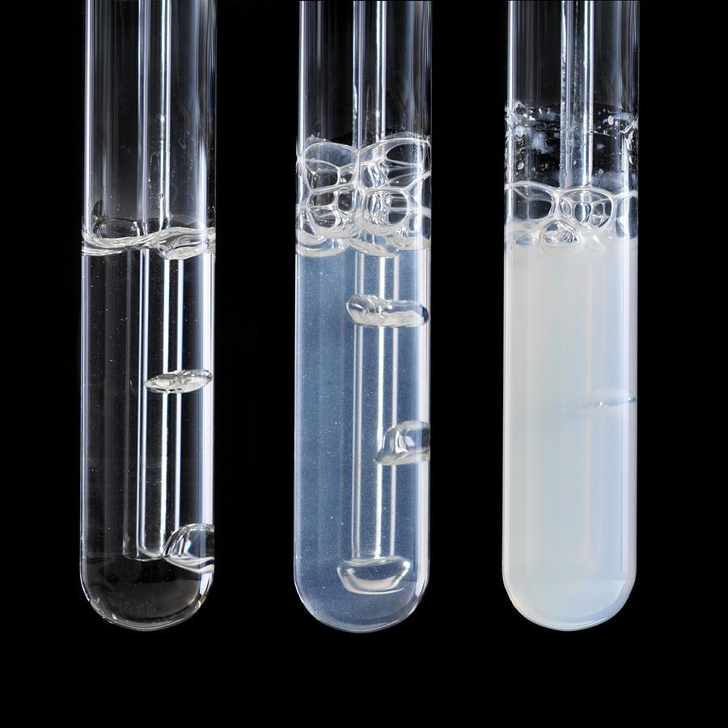
When bubbled through limewater, carbon dioxide causes the solution to turn cloudy.
For more help, please visit www.exampaperspractice.co.uk
© 2025 Exams Papers Practice. All Rights Reserved

Slide 5
When immersed in ammonia, red litmus paper turns blue.
Litmus paper is also bleached in the presence of chlorine.
For more help, please visit www.exampaperspractice.co.uk
© 2025 Exams Papers Practice. All Rights Reserved

Slide 6
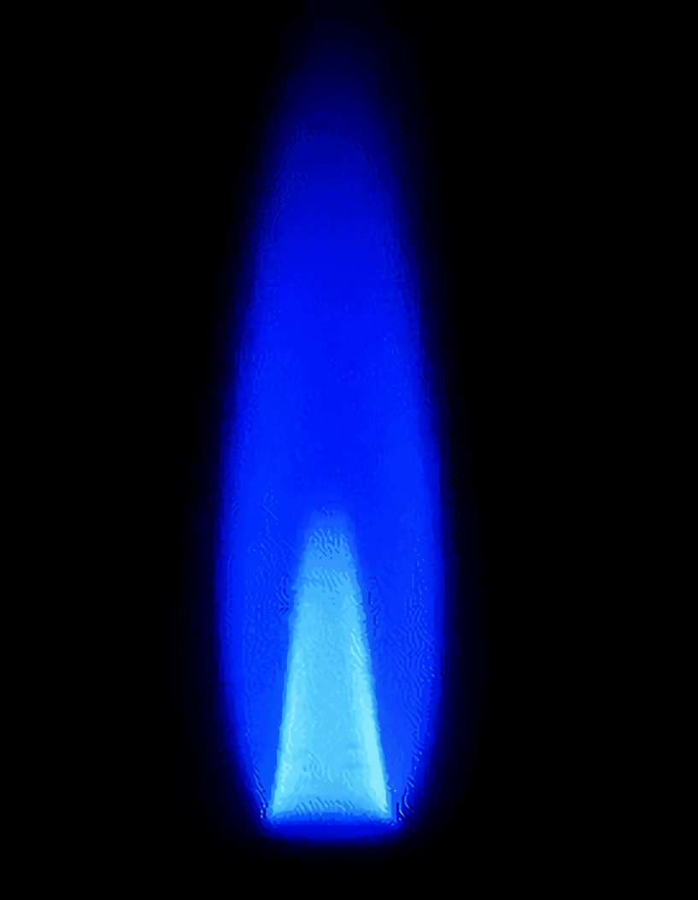
Flame Tests
Specification Point 2.45
Describe how to carry out a flame test.
Some metals produce a distinctive colour when heated.
Ions from different metals produce different colours.
Flame tests are used to identify metals.
Dip a wire loop made from an unreactive metal into a dilute solution of acid.
Loops made from platinum (Pt) are commonly used.
The acid will clean the loop and ensure there are no other ions present.
Dip the loop into a sample of metal and insert it into the centre of a blue bunsen flame.
Record the colour present.
For more help, please visit www.exampaperspractice.co.uk
© 2025 Exams Papers Practice. All Rights Reserved

Slide 7
Flame Tests
Specification Point 2.46
Know the colours formed in flame tests for the following cations: Li⁺, Na⁺, K⁺, Ca²⁺ and Cu²⁺.
Metal ions are positively charged.
Positively charged ions are called cations.
Lithium (Li⁺) burns with a red flame.
Sodium (Na⁺) burns with a yellow flame.
Potassium (K⁺) burns with a lilac flame.
Calcium (Ca²⁺) burns with an orange-red flame.
Copper (Cu²⁺) burns with a blue-green flame.
LITHIUM (Li⁺)
SODIUM (Na⁺)
POTASSIUM (K⁺)
CALCIUM (Ca²⁺)
COPPER (Cu²⁺)
For more help, please visit www.exampaperspractice.co.uk
© 2025 Exams Papers Practice. All Rights Reserved

Slide 8
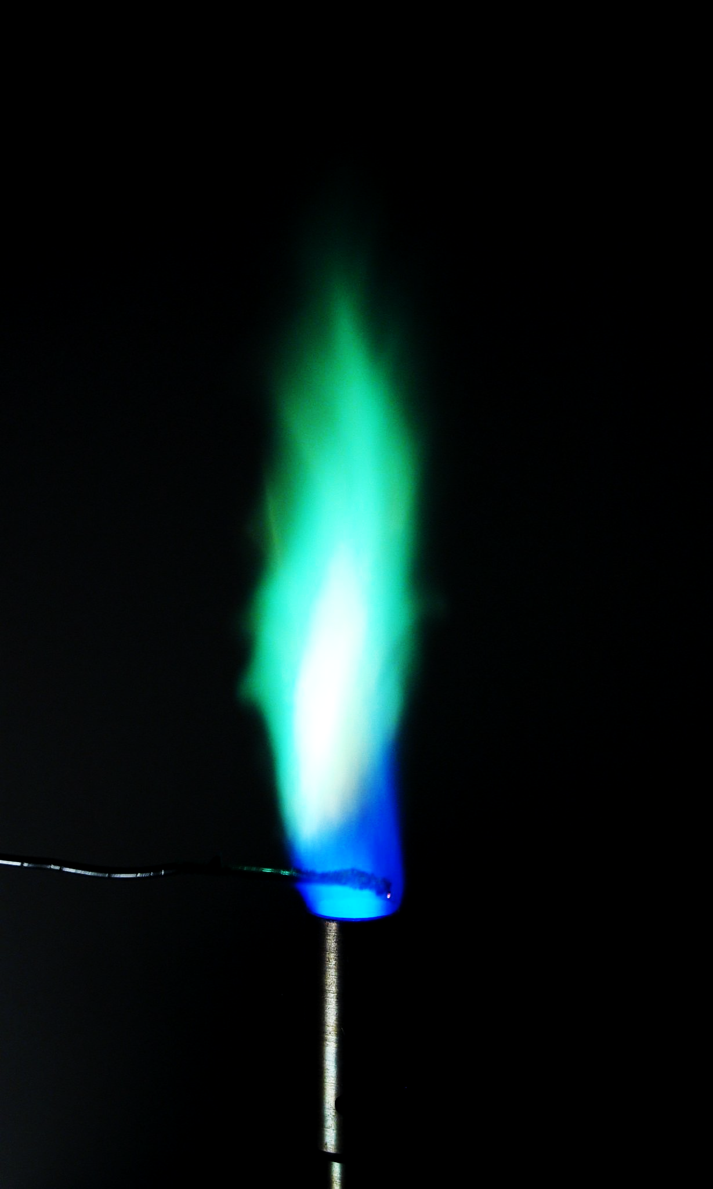
Flame tests involve inserting an unreactive wire loop coated in reactive metal into the centre of a blue bunsen flame. This test reveals the presence of copper (Cu²⁺) ions.
For more help, please visit www.exampaperspractice.co.uk
© 2025 Exams Papers Practice. All Rights Reserved

Slide 9
Cations and Hydroxides
Specification Point 2.47
Describe tests for these cations:
NH⁴⁺ using sodium hydroxide solution and identifying the gas evolved.
Cu²⁺, Fe²⁺ and Fe³⁺ using sodium hydroxide solution.
Some metal ions form coloured precipitates when reacted with sodium hydroxide (NaOH).
Adding a few drops of the aqueous metal salt to a solution of NaOH will cause a metal hydroxide to form.
Most metal hydroxides are insoluble and will form a precipitate.
Copper (Cu²⁺) reacts with NaOH to form a blue precipitate.
This is copper hydroxide (Cu(OH)₂).
Iron (II) (Fe²⁺) reacts with NaOH to form a sludgy green precipitate.
This is iron (II) hydroxide (Fe(OH)₂).
Iron (III) (Fe³⁺) reacts with NaOH to form a red-brown precipitate.
This is iron (III) hydroxide (Fe(OH)₃).
Ammonium (NH₄⁺) ions also react with NaOH to release ammonia gas (NH₃).
If NH₃ is present, it will turn damp red litmus paper blue.
For more help, please visit www.exampaperspractice.co.uk
© 2025 Exams Papers Practice. All Rights Reserved

Slide 10
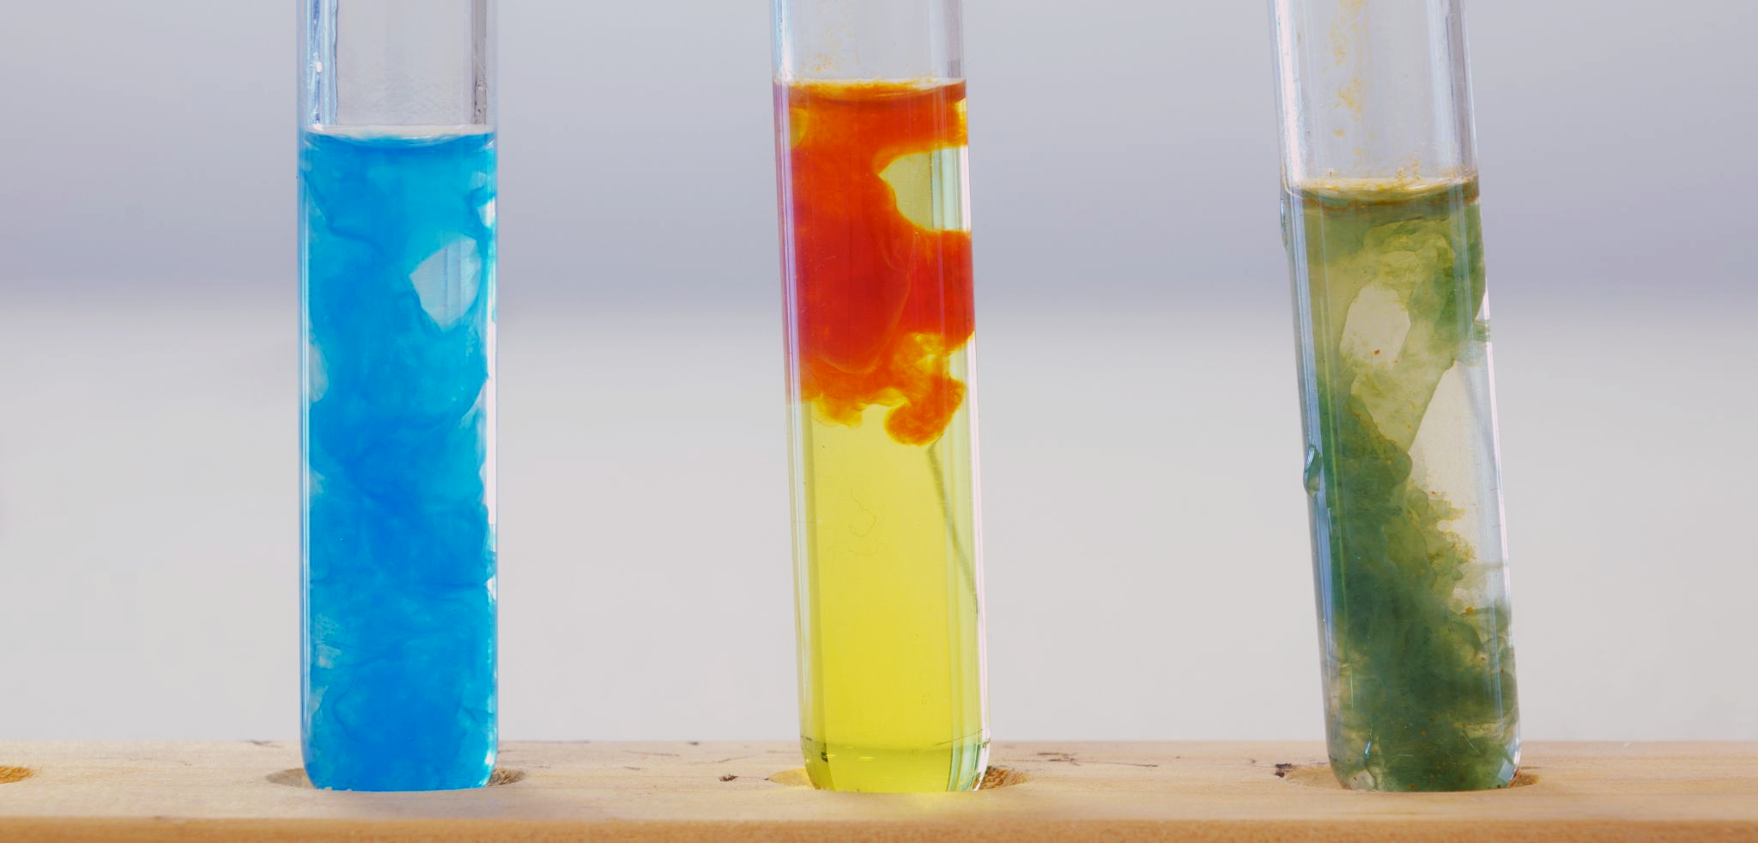
Precipitates of copper hydroxide, iron (III) hydroxide and iron (II) hydroxide.
For more help, please visit www.exampaperspractice.co.uk
© 2025 Exams Papers Practice. All Rights Reserved

Slide 11
Tests for Anions
Specification Point 2.48
Describe tests for these anions:
Cl⁻, Br⁻ and I⁻ using acidified silver nitrate solution.
SO₄²⁻ using acidified barium chloride solution.
CO₃²⁻ using hydrochloric acid and identifying the gas evolved.
Some ions are negatively charged.
These are called anions.
Ionic compounds that contain halogens are called halides.
Chloride (Cl⁻), bromide (Br⁻) and iodide (I⁻) are examples of halide ions.
To test for halides, add nitric acid (HNO₃), followed by silver nitrate (AgNO₃).
A silver halide will form from this reaction.
Ag⁺ _{(aq)} + Cl⁻ _{(aq)} → AgCl _{(s)}
Silver chloride (AgCl) is a white precipitate.
Ag⁺ _{(aq)} + Br⁻ _{(aq)} → AgBr _{(s)}
Silver bromide (AgBr) is a cream precipitate.
Ag⁺ _{(aq)} + I⁻ _{(aq)} → AgI _{(s)}
Silver iodide (AgI) is a yellow precipitate.
For more help, please visit www.exampaperspractice.co.uk
© 2025 Exams Papers Practice. All Rights Reserved

Slide 12
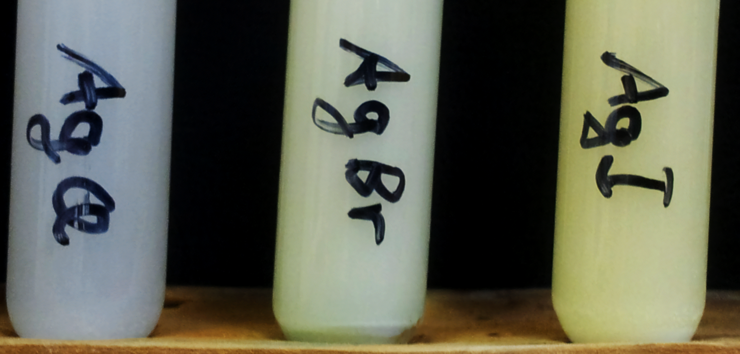
Precipitates of silver chloride, silver bromide and silver iodide.
For more help, please visit www.exampaperspractice.co.uk
© 2025 Exams Papers Practice. All Rights Reserved

Slide 13
Test for Anions
Sulphate ions (SO₄²⁻) form white precipitates.
To test for sulphate ions, add dilute hydrochloric acid (HCl), followed by a solution of barium chloride (BaCl₂):
Ba²⁺ _{(aq)} + SO₄²⁻ _{(aq)} → BaSO_{4 (s)}
A white precipitate of barium sulphate (BaSO₄) is formed.
Carbonate ions (CO₃²⁻) release CO₂ gas when reacted with hydrochloric acid.
To test for carbonate ions, add dilute hydrochloric acid.
CO₃²⁻ _{(aq)} + 2H⁺ _{(aq)} → CO_{2 (g)} + H₂O _{(l)}
The presence of CO₂ can be confirmed using the limewater test.
For more help, please visit www.exampaperspractice.co.uk
© 2025 Exams Papers Practice. All Rights Reserved

Slide 14
Tests for Water
Specification Points 2.49 and 2.50
Describe a test for the presence of water using anhydrous copper (II) sulphate.
Describe a physical test to show whether a sample of water is pure.
Water (H₂O) can be identified using both chemical and physical tests.
Anhydrous copper sulphate (CuSO₄) is a white crystalline solid.
Anhydrous means without water.
When water is added to the copper sulphate, the crystals turn a bright blue.
This is called a hydration reaction:
CuSO_{4 (s)} + 5H₂O _{(l)} → CuSO₄.5H₂O _{(s)}
Pure water will always have the same melting and boiling points.
Pure water will freeze at exactly 0°C.
Pure water will boil at exactly 100°C.
For more help, please visit www.exampaperspractice.co.uk
© 2025 Exams Papers Practice. All Rights Reserved

Slide 15
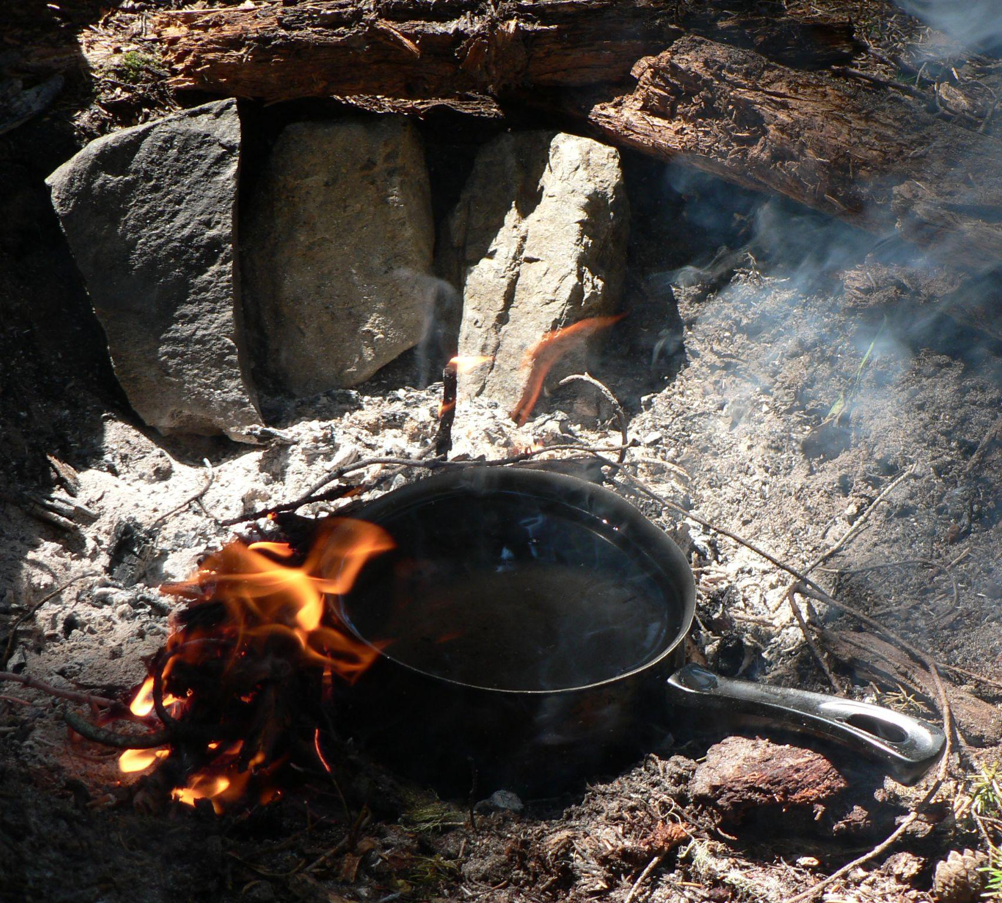
Pure water will always boil at 100°C.
This is considered the physical test for water.
For more help, please visit www.exampaperspractice.co.uk
© 2025 Exams Papers Practice. All Rights Reserved

