Slide 1
Edexcel IGCSE Chemistry
23 - Acids, Bases and Salts
Soluble and Insoluble Salts, Reactions
For more help, please visit www.exampaperspractice.co.uk
© 2025 Exams Papers Practice. All Rights Reserved

Slide 2
Salts and Solubility
Specification Point 2.34
Know the general rules for predicting the solubility of ionic compounds in water.
Metals react with non-metals to form ionic salts.
Most ionic salts are soluble in water.
When dissolved in water, a soluble salt will appear see-through.
Some salts are insoluble.
Insoluble salts form precipitates in water.
A precipitate is a mixture of solid particles suspended in a liquid.
Precipitates appear cloudy.
For more help, please visit www.exampaperspractice.co.uk
© 2025 Exams Papers Practice. All Rights Reserved

Slide 3
Salt | Soluble/Insoluble
Common salts of sodium (Na), potassium (K) and ammonium (NH₄⁺) | All soluble
Nitrates | All soluble
Chlorides | Mostly soluble apart from silver chloride (AgCl) and lead chloride (PbCl₂)
Sulphates | Mostly soluble apart from lead sulphate (PbSO₄), barium sulphate (BaSO₄) and calcium sulphate (CaSO₄)
Carbonates | Mostly insoluble apart from sodium carbonate (Na₂CO₃), potassium carbonate (K₂CO₃) and ammonium carbonate ((NH₄)₂CO₃)
Hydroxides | Mostly insoluble apart from sodium hydroxide (NaOH), potassium hydroxide (KOH) and calcium hydroxide (Ca(OH)₂)
The solubility of some common salts.
For more help, please visit www.exampaperspractice.co.uk
© 2025 Exams Papers Practice. All Rights Reserved

Slide 4
Acids and Bases
Specification Points 2.35 and 2.36
Understand acids and bases in terms of proton transfer.
Understand that an acid is a proton donor and a base is a proton acceptor.
An acid can be defined as a proton donor.
This means that it is a source of hydrogen ions or protons (H⁺).
Hydrochloric acid (HCl), sulphuric acid (H₂SO₄) and nitric acid (HNO₃) are all examples of proton donors.
A base can be defined as a proton acceptor.
Bases are referred to as alkalis when in solution.
Bases are a source of hydroxide ions (OH⁻).
Acids and bases react with each other during neutralisation.
Water is formed as a product.
Neutralisation reactions involve the transfer of protons.
H⁺ _{(aq)} + OH⁻ _{(aq)} → H₂O _{(l)}
For more help, please visit www.exampaperspractice.co.uk
© 2025 Exams Papers Practice. All Rights Reserved

Slide 5
Acids and Metals
Specification Points 2.37 and 2.38
Describe the reactions of hydrochloric acid, sulfuric acid and nitric acid with metals, bases and metal carbonates to form salts.
Know that metal oxides, metal hydroxides and ammonia can act as bases, and that alkalis are bases that are soluble in water.
Acids react with metals to form an ionic salt and hydrogen gas (H₂).
The type of salt formed depends on the acid used:
Reactions with hydrochloric acid form chlorides.
Reactions with sulphuric acid form sulphates.
Reactions with nitric acid form nitrates.
Take the example of sodium metal with sulphuric acid:
2Na _{(s)} + H₂SO_{4 (aq)} → Na₂SO_{4 (aq)} + H_{2 (g)}
Sodium sulphate salt and hydrogen gas are formed.
For more help, please visit www.exampaperspractice.co.uk
© 2025 Exams Papers Practice. All Rights Reserved

Slide 6
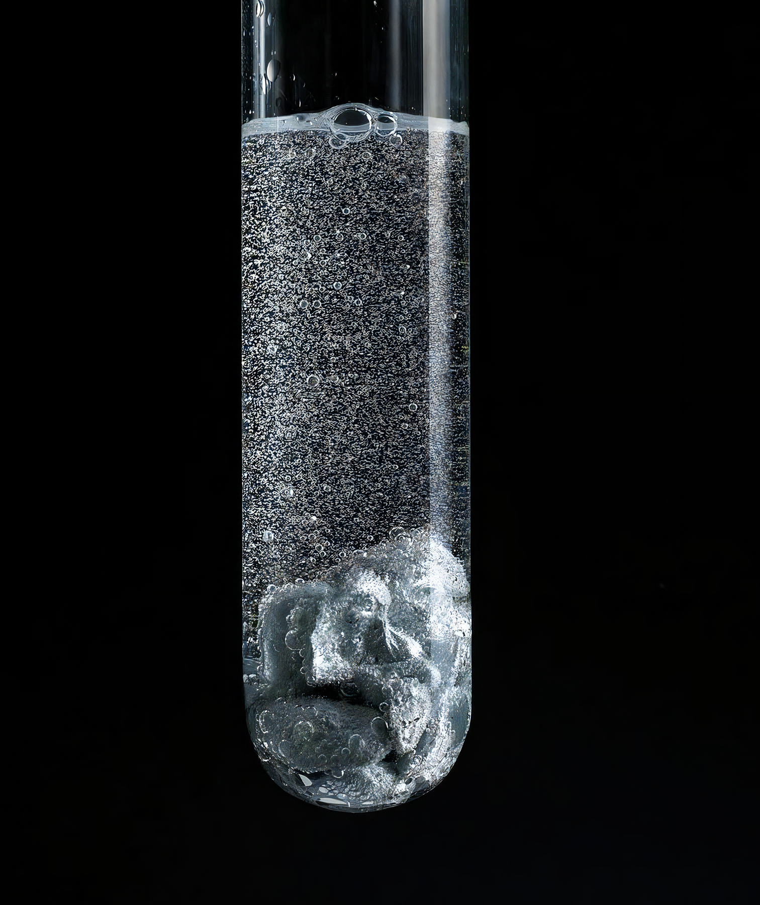
Many metals react with acids to form ionic salts.
In this example zinc metal (Zn) reacts with hydrochloric acid to form zinc chloride (ZnCl₂) and hydrogen gas.
For more help, please visit www.exampaperspractice.co.uk
© 2025 Exams Papers Practice. All Rights Reserved

Slide 7
Acids and Metal Oxides/Hydroxides
Acids react with metals oxides and metal hydroxides to form a salt and water.
Metal oxides and metal hydroxides are basic in solution.
Acid | Basic Metal Oxide/Hydroxide | Reaction | Products
Hydrochloric acid | Copper oxide | HCl_{(aq)} + CuO_{(s)} → CuCl_{(aq)} + H₂O_{(l)} | Copper chloride and water
 | Sodium hydroxide | HCl_{(aq)}+ NaOH_{(aq)} → NaCl_{(aq)} + H₂O_{(l)} | Sodium chloride and water
Sulphuric acid | Zinc oxide | H₂SO_{4 (aq)}+ ZnO_{(s)} → ZnSO_{4 (aq)} + H₂O_{(l)} | Zinc sulphate and water
 | Potassium hydroxide | H₂SO_{4 (aq)}+ 2KOH_{(s)} → K₂SO_{4 (aq)} + 2H₂O_{(l)} | Potassium sulphate and water
Nitric Acid | Magnesium oxide | 2HNO_{3 (aq)}+ MgO_{(s)} → Mg(NO₃)_{2 (aq)} + H₂O_{(l)} | Magnesium nitrate and water
 | Iron (III) hydroxide | 3HNO_{3 (aq)}+ Fe(OH)_{3 (s)} → Fe(NO₃)_{3 (aq)} + 3H₂O_{(l)} | Iron (III) nitrate and water
For more help, please visit www.exampaperspractice.co.uk
© 2025 Exams Papers Practice. All Rights Reserved

Slide 8
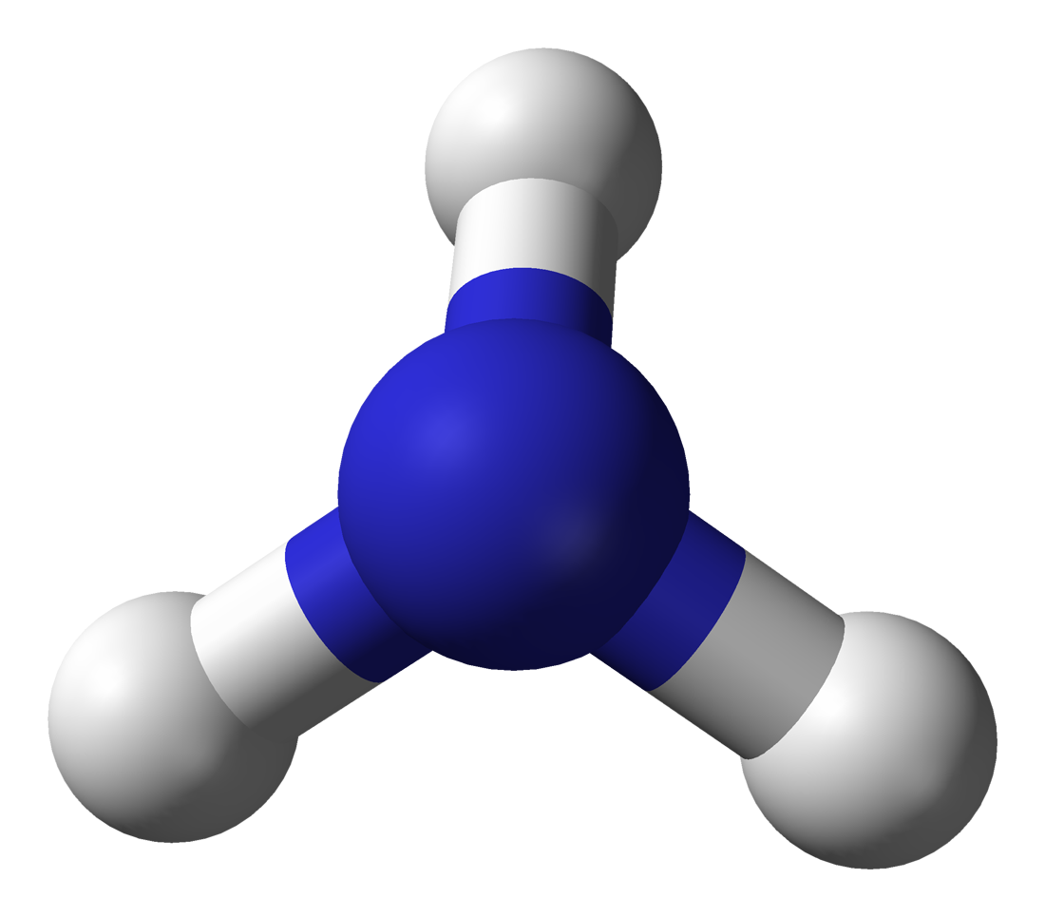
Acids and Ammonia
Ammonia (NH₃) is also an example of a base.
When dissolved in water, ammonia releases both NH⁴⁺ and OH⁻ ions.
Ammonia reacts with acids to form an ammonium salt.
Take the example of ammonia with nitric acid:
NH_{3 (aq)} + HNO_{3 (aq)} → NH₄NO_{3 (aq)}
Ammonium nitrate is formed.
Ammonia (NH₃) is a covalent molecule that forms ammonium salts when reacted with acids.
For more help, please visit www.exampaperspractice.co.uk
© 2025 Exams Papers Practice. All Rights Reserved

Slide 9
Acids and Metal Carbonates
Acids react with metal carbonates to form a salt, water and carbon dioxide (CO₂).
As carbon dioxide is released, the reaction will bubble or fizz.
This is called effervescence.
Acid | Metal Carbonate | Reaction | Products
Hydrochloric acid | Copper carbonate | 2HCl_{(aq)} + CuCO_{3 (s)} → CuCl_{2 (aq)} + H₂O_{(l)} + CO_{2 (g)} | Copper chloride, water and CO₂
 | Sodium carbonate | 2HCl_{(aq)} + Na₂CO_{3 (aq)} → 2NaCl_{(aq)} + H₂O_{(l)} + CO_{2 (g)} | Sodium chloride, water and CO₂
Sulphuric acid | Zinc carbonate | H₂SO_{4 (aq)}+ ZnCO_{3 (s)} → ZnSO₄ _{(aq)} + H₂O_{(l)} + CO_{2 (g)} | Zinc sulphate, water and CO₂
 | Potassium carbonate | H₂SO_{4 (aq)} + K₂CO_{3 (aq)} → K₂SO₄ _{(aq)} + H₂O_{(l)} + CO_{2 (g)} | Potassium sulphate, water and CO₂
Nitric Acid | Magnesium carbonate | 2HNO_{3 (aq)} + MgCO_{3 (s)} → Mg(NO₃)_{2 (aq)} + H₂O_{(l)} + CO_{2 (g)} | Magnesium nitrate, water and CO₂
 | Iron (II) carbonate | 2HNO_{3 (aq)}+ FeCO_{3 (s)} → Fe(NO₃)_{2 (aq)} + H₂O_{(l)} + CO_{2 (g)} | Iron (II) nitrate, water and CO₂
For more help, please visit www.exampaperspractice.co.uk
© 2025 Exams Papers Practice. All Rights Reserved

Slide 10
Acids and carbonates react to form carbon dioxide gas. This is released through the process of effervescence.
For more help, please visit www.exampaperspractice.co.uk
© 2025 Exams Papers Practice. All Rights Reserved

Slide 11
Making Soluble Salts
Specification Points 2.39 and 2.42
Describe an experiment to prepare a pure, dry sample of a soluble salt, starting from an insoluble reactant.
Practical: prepare a sample of pure, dry hydrated copper (II) sulphate crystals starting from copper (II) oxide.
Soluble salts can be prepared by reacting an acid with an insoluble base.
Take the example of copper oxide reacting with sulphuric acid to form aqueous copper sulphate.
CuO _{(s)} + H₂SO_{4 (aq)} → CuSO_{4 (aq)} + H₂O _{(l)}
Add the copper oxide to the sulphuric acid.
This can be done in a water bath to speed up the rate of reaction.
Filter the excess copper oxide to yield a pure solution of copper sulphate.
Gently heat the solution using a bunsen burner to evaporate most of the water.
Leave the remaining solution to cool for several days.
This will allow the salt to crystallise.
For more help, please visit www.exampaperspractice.co.uk
© 2025 Exams Papers Practice. All Rights Reserved

Slide 12
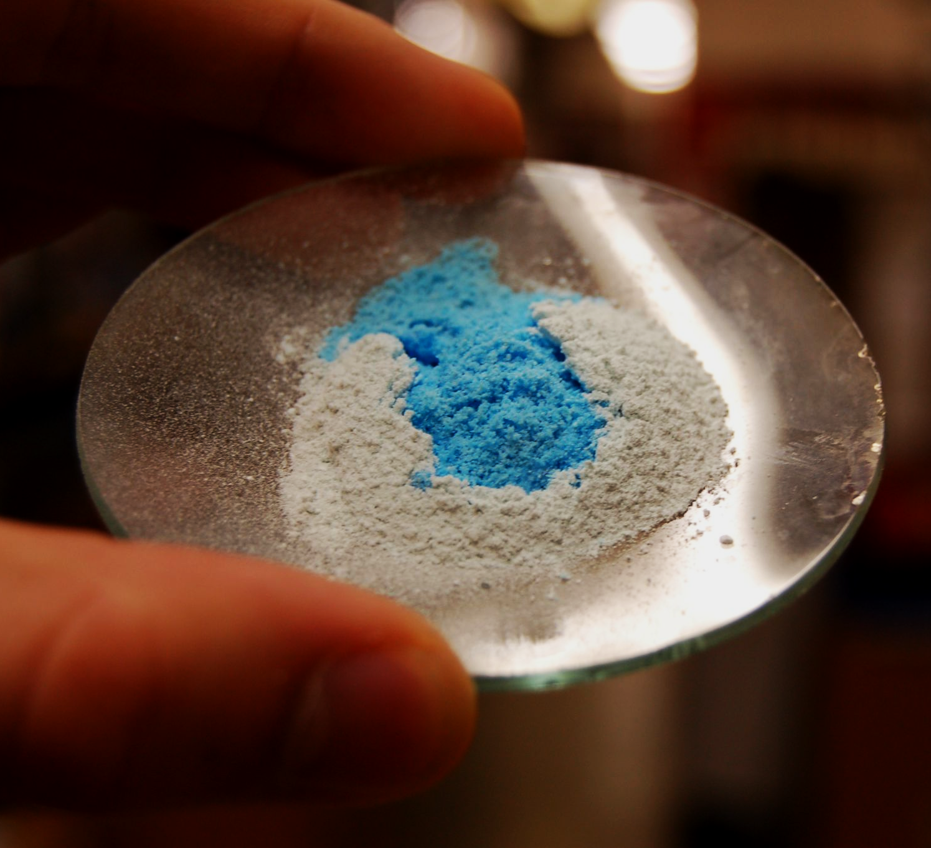
Solid copper sulphate crystals will form once all of the water has evaporated - preparation video.
For more help, please visit www.exampaperspractice.co.uk
© 2025 Exams Papers Practice. All Rights Reserved

