Slide 1
Edexcel IGCSE Chemistry
21 - Acids and Alkalis
pH, Indicators and Neutralisation Reactions
For more help, please visit www.exampaperspractice.co.uk
© 2025 Exams Papers Practice. All Rights Reserved

Slide 2
Indicators
Specification Point 2.28
Describe the use of litmus, phenolphthalein and methyl orange to distinguish between acidic and alkaline solutions.
An indicator is a dye that is used to distinguish between acids and alkalis.
Litmus paper is red in acidic solutions and blue in alkaline solutions.
Phenolphthalein is colourless in acidic solutions but turns bright pink in alkaline solutions.
Methyl orange is red in acidic solutions but turns yellow in alkaline solutions.
ACID
ALKALI
ACID
ALKALI
PHENOLPHTHALEIN
METHYL ORANGE
For more help, please visit www.exampaperspractice.co.uk
© 2025 Exams Papers Practice. All Rights Reserved

Slide 3
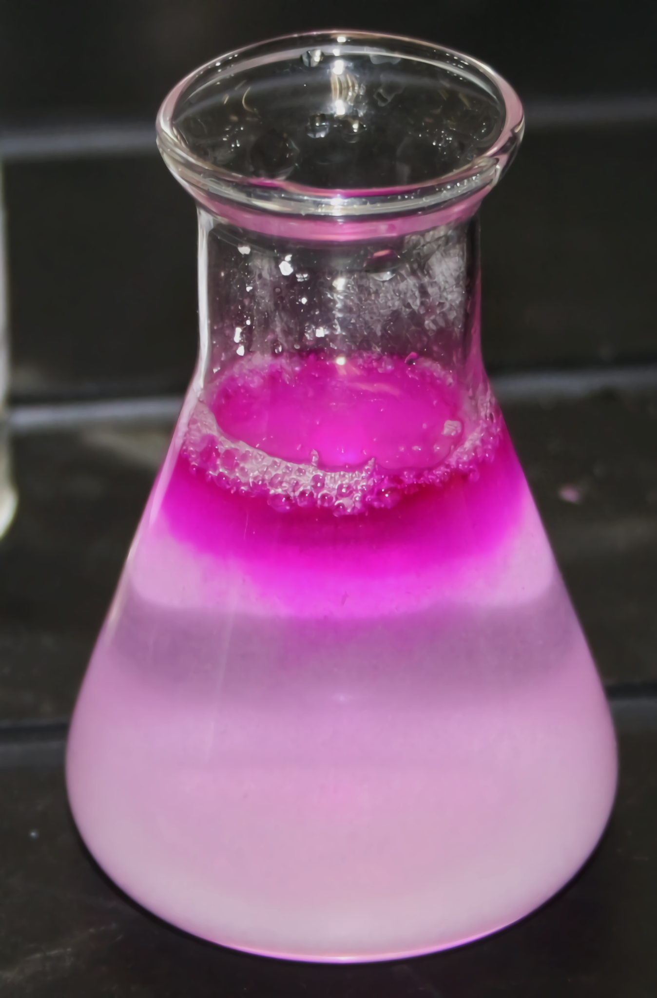
Phenolphthalein is a pH indicator that turns bright pink when exposed to an alkali.
For more help, please visit www.exampaperspractice.co.uk
© 2025 Exams Papers Practice. All Rights Reserved

Slide 4
Methyl orange is another indicator that shows a range of red/yellow tones depending on the pH.
STRONGLY ACIDIC
WEAKLY ACIDIC
WEAKLY ALKALINE
STRONGLY ALKALINE
For more help, please visit www.exampaperspractice.co.uk
© 2025 Exams Papers Practice. All Rights Reserved

Slide 5
The pH Scale
Specification Points 2.29 and 2.30
Understand how the pH scale can be used to classify solutions as strongly acidic, weakly acidic, neutral, weakly alkaline and strongly alkaline.
Describe the use of universal indicator to measure the approximate pH value of an aqueous solution.
Acidic and alkaline solutions can be classified using the pH scale.
The pH scale ranges from 0 to 14.
Acidic solutions have a pH of less than 7.
Strong acids have a pH between 0-3.
Weak acids have a pH between 4-6.
Alkaline solutions have a pH of more than 7.
Strong alkalis have a pH between 11-14.
Weak alkalis have a pH between 8-10.
Solutions that have a pH of 7 are considered to be neutral.
Water (H₂O) is an example of a neutral solution.
For more help, please visit www.exampaperspractice.co.uk
© 2025 Exams Papers Practice. All Rights Reserved

Slide 6
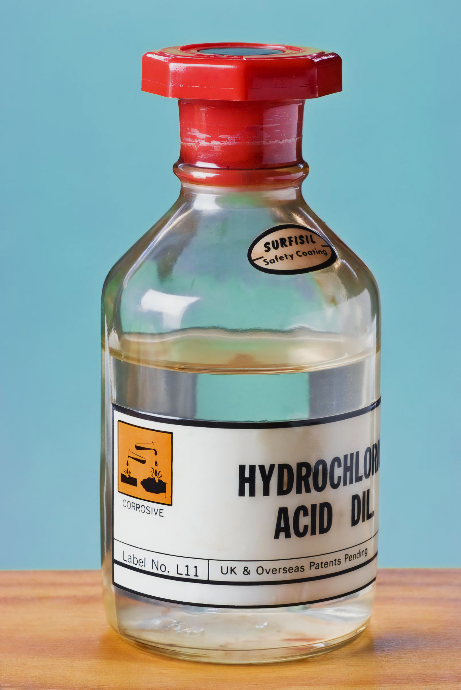
Hydrochloric acid (HCl) is an example of a strong acid with a pH between 1-3.
For more help, please visit www.exampaperspractice.co.uk
© 2025 Exams Papers Practice. All Rights Reserved

Slide 7
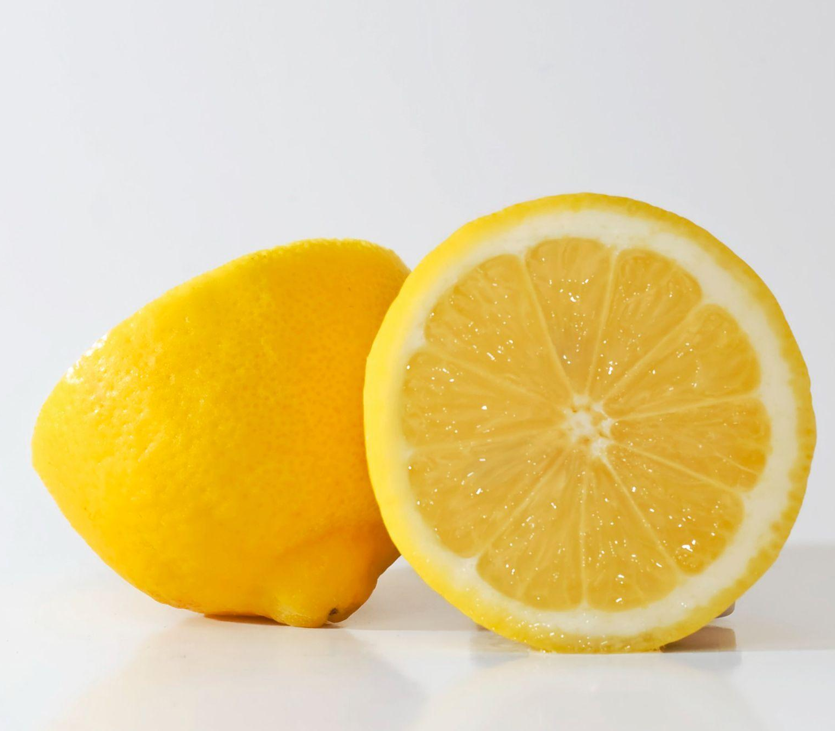
Citric acid is an example of a weak acid with a pH between 4-6.
Citric acid is found in citrus fruits such as lemons.
For more help, please visit www.exampaperspractice.co.uk
© 2025 Exams Papers Practice. All Rights Reserved

Slide 8
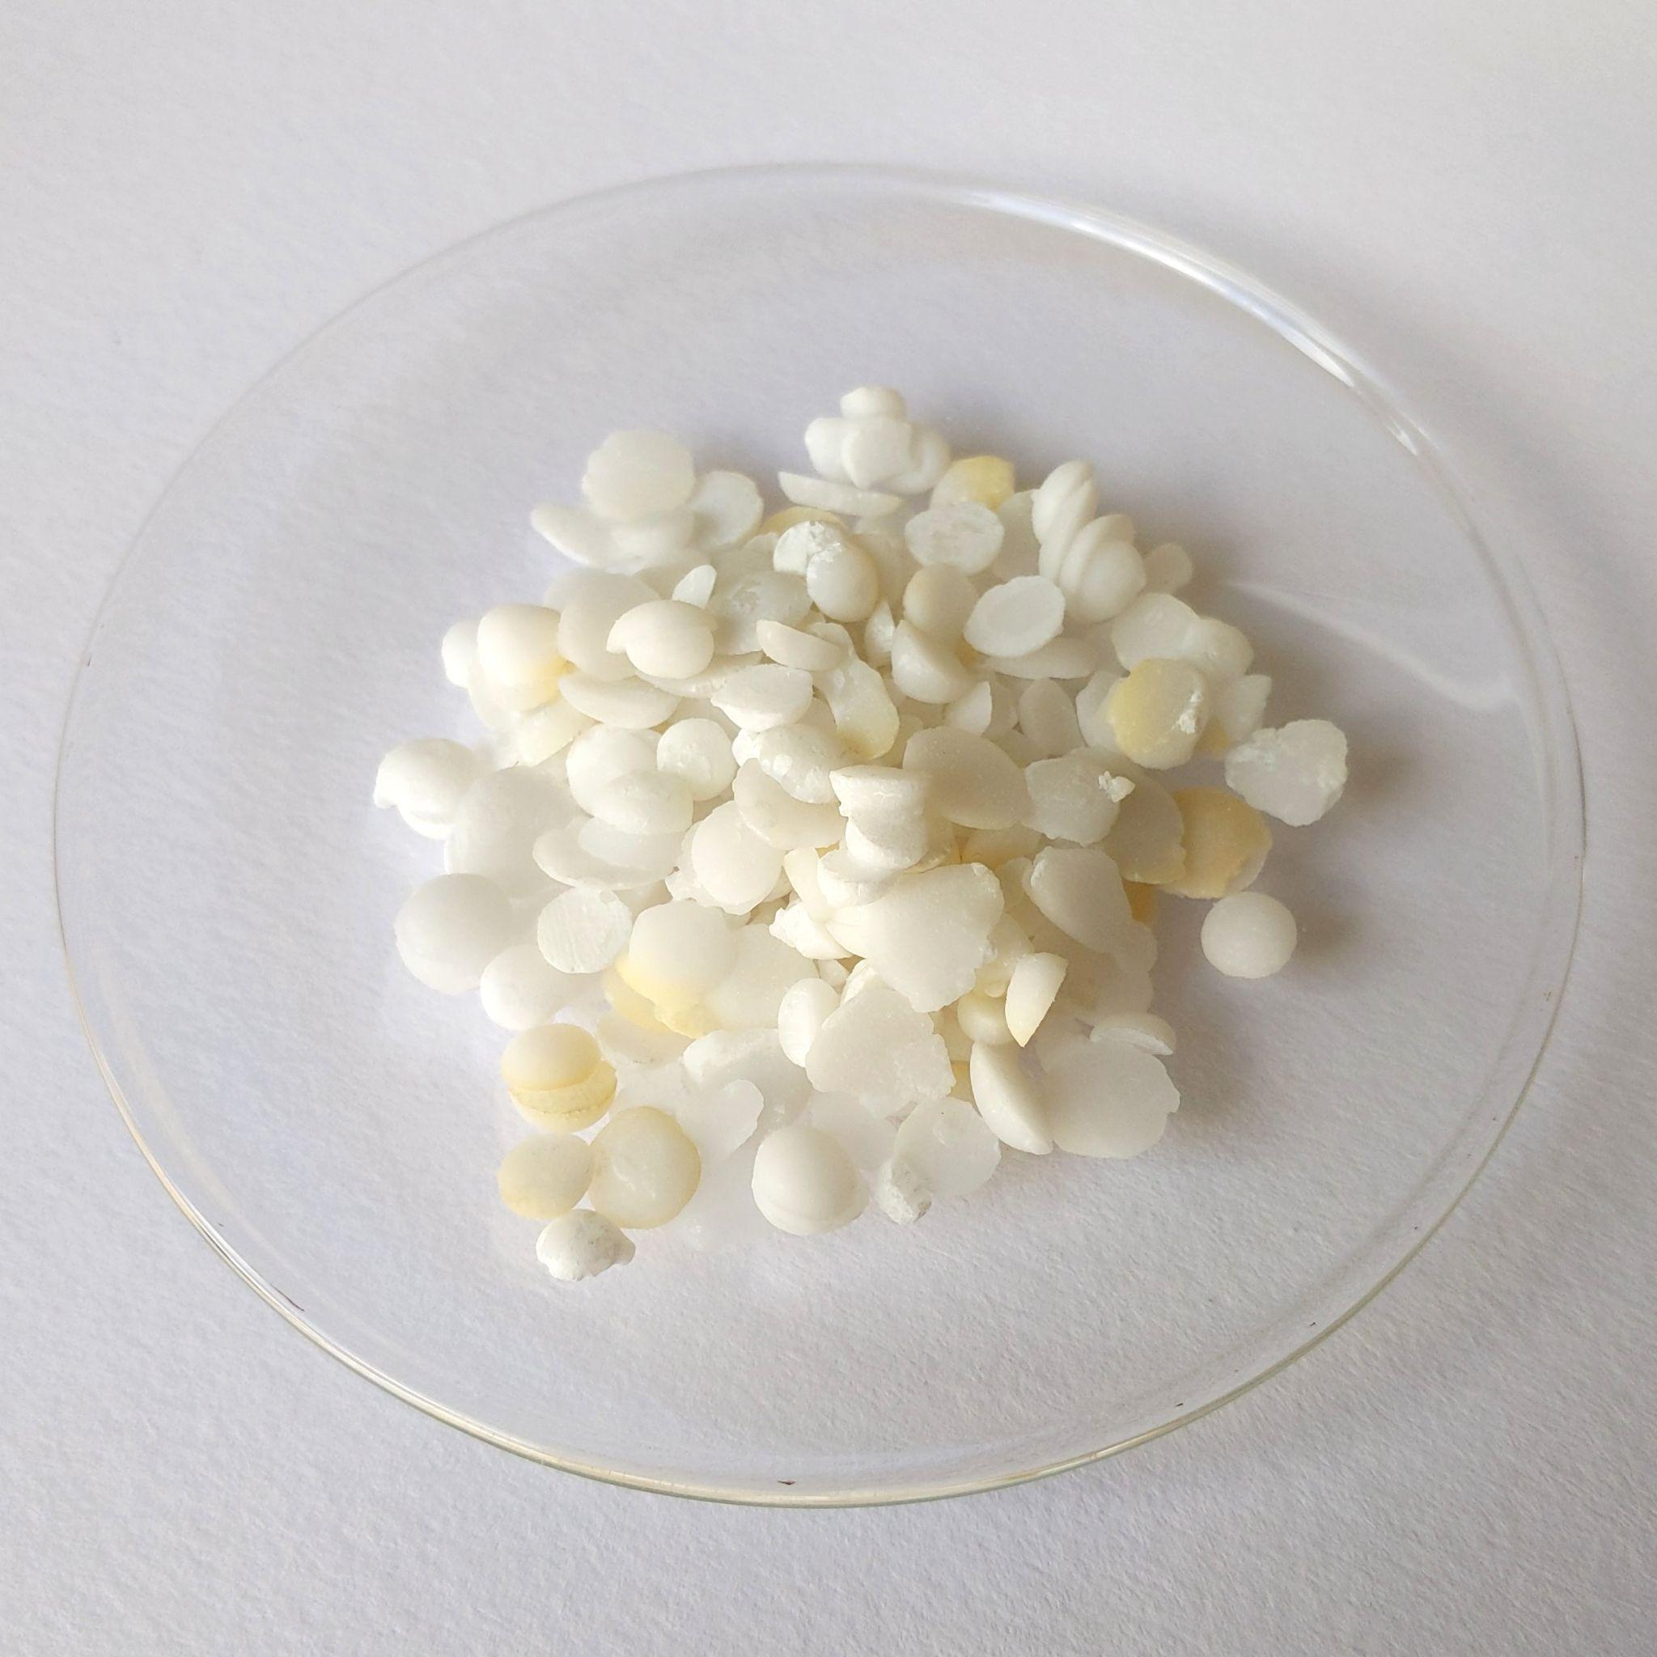
Sodium hydroxide (NaOH) is found as white crystals.
When dissolved, sodium hydroxide forms a strongly alkaline solution with a pH between 12-14.
For more help, please visit www.exampaperspractice.co.uk
© 2025 Exams Papers Practice. All Rights Reserved

Slide 9
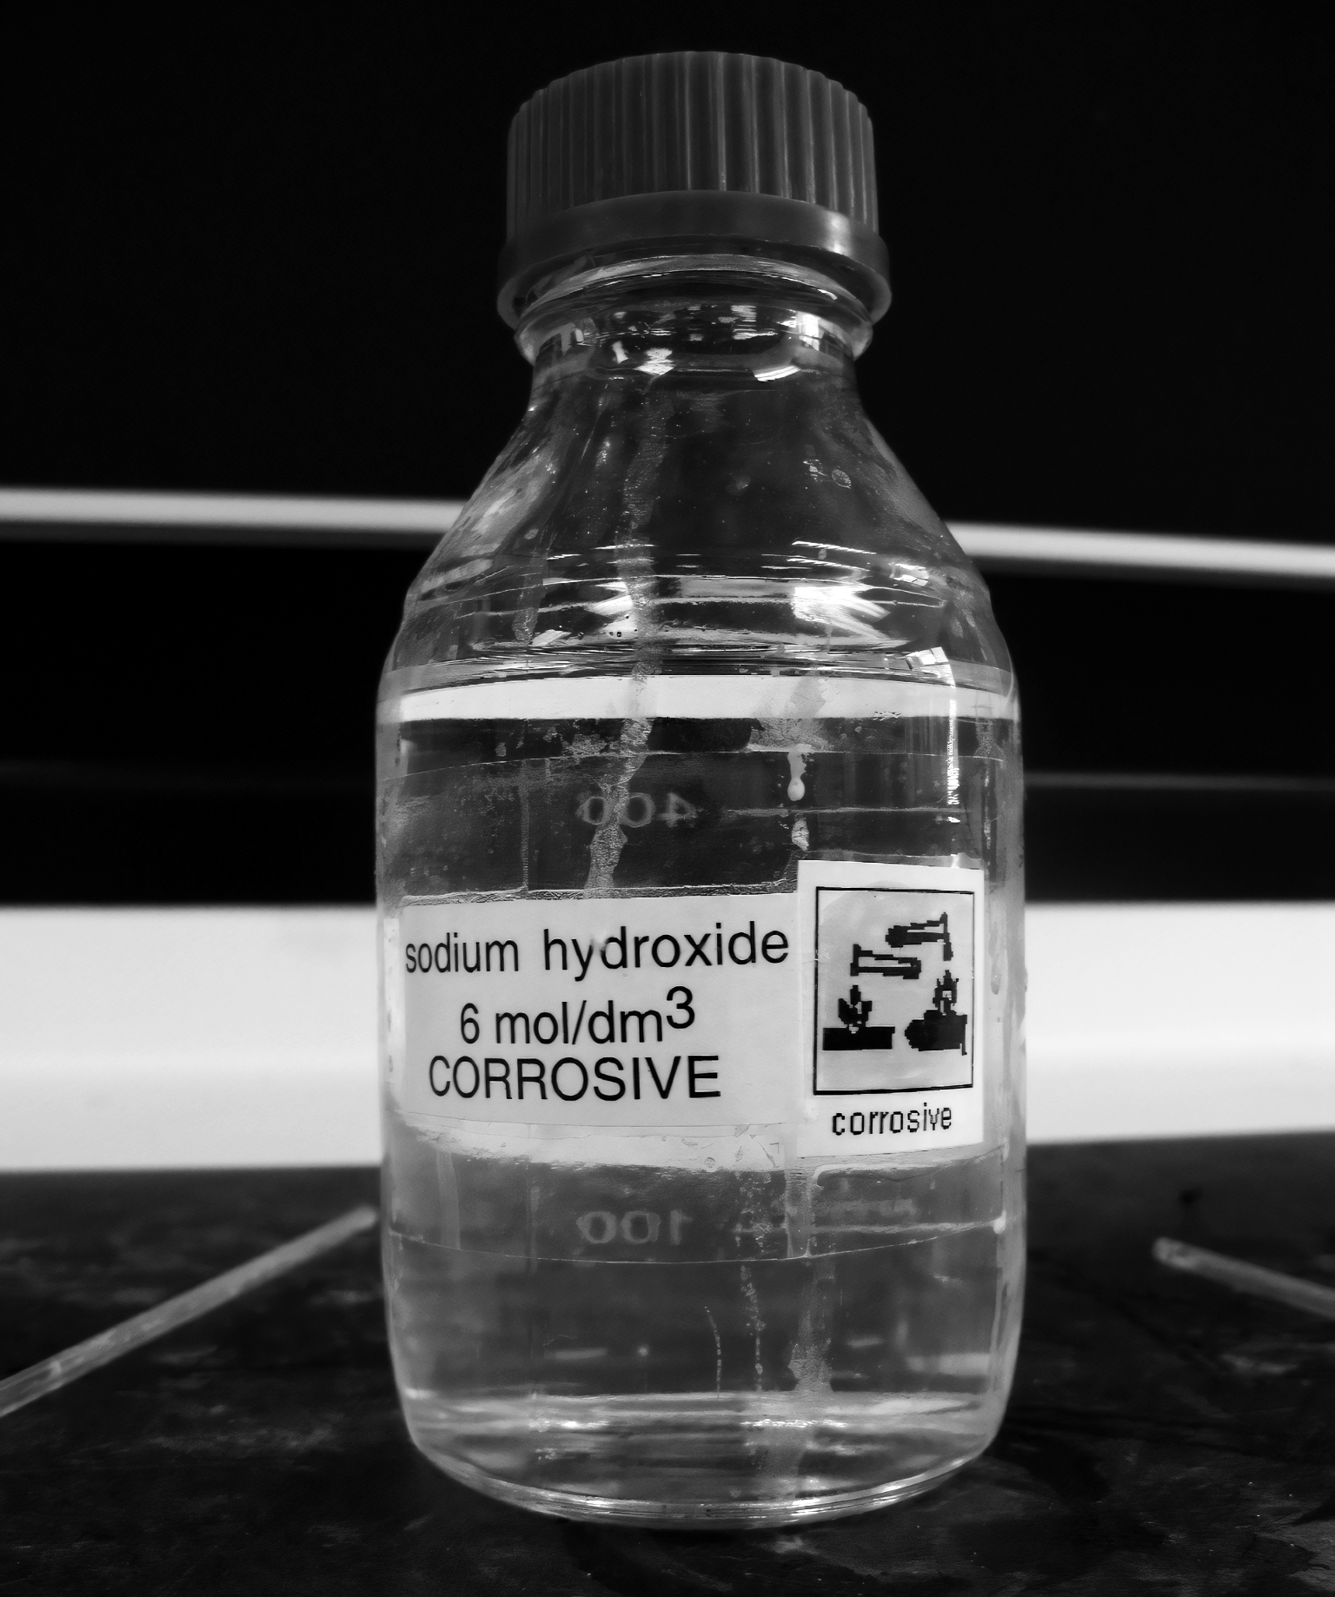
Sodium hydroxide (NaOH) is found as white crystals.
When dissolved, sodium hydroxide forms a strongly alkaline solution with a pH between 12-14.
For more help, please visit www.exampaperspractice.co.uk
© 2025 Exams Papers Practice. All Rights Reserved

Slide 10
The approximate pH value of a solution can be measured using universal indicator (UI). When UI is added to a solution, a colour change will occur. UI is a wide-range indicator and is not very accurate.
0
1
2
3
4
5
6
7
8
9
10
11
12
13
14
NEUTRAL
STRONGLY ACIDIC
WEAKLY ACIDIC
WEAKLY ALKALINE
STRONGLY ALKALINE
For more help, please visit www.exampaperspractice.co.uk
© 2025 Exams Papers Practice. All Rights Reserved

Slide 11
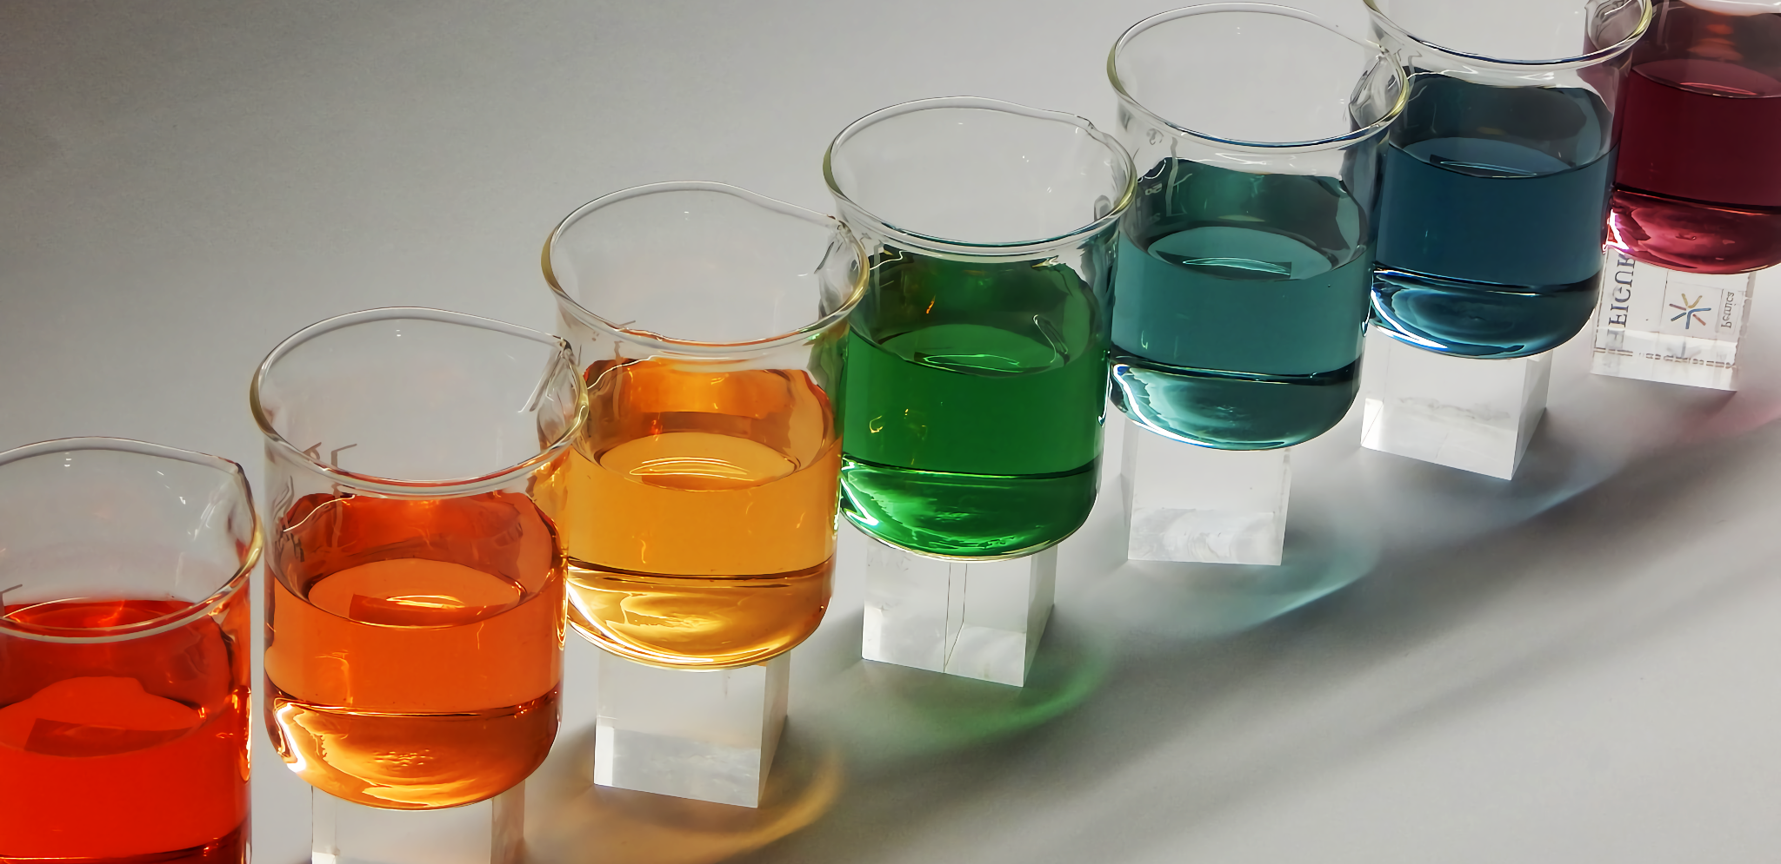
Universal indicators are used to estimate the pH of a variety of solutions.
For more help, please visit www.exampaperspractice.co.uk
© 2025 Exams Papers Practice. All Rights Reserved

Slide 12
Acids and Alkalis
Specification Points 2.31 and 2.32
Know that acids in aqueous solution are a source of hydrogen ions and alkalis in a aqueous solution are a source of hydroxide ions.
Know that alkalis can neutralise acids.
Acids are a source of hydrogen ions (H⁺).
The presence of H⁺ ions is what makes a solution acidic.
Hydrochloric acid (HCl), sulphuric acid (H₂SO₄) and nitric acid (HNO₃) are examples of acids.
Alkalis are a source of hydroxide ions (OH⁻).
The presence of OH⁻ ions is what makes a solution alkaline.
Sodium hydroxide (NaOH) is an example of an alkali.
When an acid reacts with an alkali, a neutralisation reaction occurs.
During neutralisation reactions, H⁺ ions combine with OH⁻ ions.
Neutralisation reactions form water as a product.
H⁺_{(aq)} + OH⁻_{(aq)} → H₂O_{(l)}
For more help, please visit www.exampaperspractice.co.uk
© 2025 Exams Papers Practice. All Rights Reserved

