Slide 1
Edexcel IGCSE Chemistry
1 - States of Matter
Solids, Liquids and Gases
For more help, please visit www.exampaperspractice.co.uk
© 2025 Exams Papers Practice. All Rights Reserved

Slide 2
States of Matter
Specification Point 1.1
Understand the three states of matter in terms of the arrangement, movement & energy of the particles.
Materials appear in three states:
Materials appear as solids.
Materials appear as liquids.
Materials appear as gases.
The state depends on the forces of attraction between particles in the material.
There are strong forces of attraction in solids.
There are weak forces of attraction in liquids.
There are very weak forces of attraction in gases.
For more help, please visit www.exampaperspractice.co.uk
© 2025 Exams Papers Practice. All Rights Reserved

Slide 3
Solids
In solids, particles are held in fixed positions.
This is because of the strong forces of attraction between particles in solids.
Solids have a defined shape and volume.
Particles vibrate around their positions.
The more the the solid is heated, the more particles in the solid will vibrate.
There are strong forces of attraction in solids.
For more help, please visit www.exampaperspractice.co.uk
© 2025 Exams Papers Practice. All Rights Reserved

Slide 4
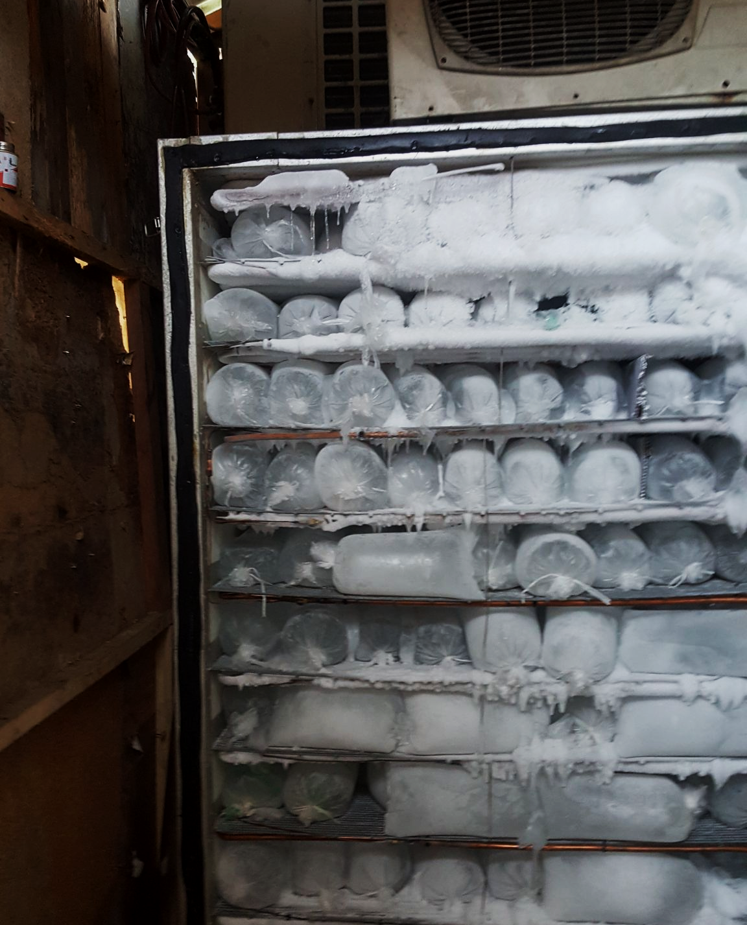
Ice is the solid form of water.
There are strong forces of attraction in solids such as ice.
For more help, please visit www.exampaperspractice.co.uk
© 2025 Exams Papers Practice. All Rights Reserved

Slide 5
Liquids
In liquids, particles are randomly arranged and free to move past each other.
This is because of the weak forces of attraction between particles in liquids.
Liquids have a defined volume but no fixed shape
Particles are constantly moving.
The more the the liquid is heated, the faster the particles will move.
There are weak forces of attraction in liquids.
For more help, please visit www.exampaperspractice.co.uk
© 2025 Exams Papers Practice. All Rights Reserved

Slide 6
Water is most often found as a liquid.
For more help, please visit www.exampaperspractice.co.uk
© 2025 Exams Papers Practice. All Rights Reserved

Slide 7
Gases
In gases, particles are and free to move and far away from each other.
This is because of the very weak forces of attraction between particles in gases.
Liquids have no defined volume or shape.
Particles are constantly moving.
The more the the gas is heated, the faster the particles will move.
There are very weak forces of attraction in gases.
For more help, please visit www.exampaperspractice.co.uk
© 2025 Exams Papers Practice. All Rights Reserved

Slide 8
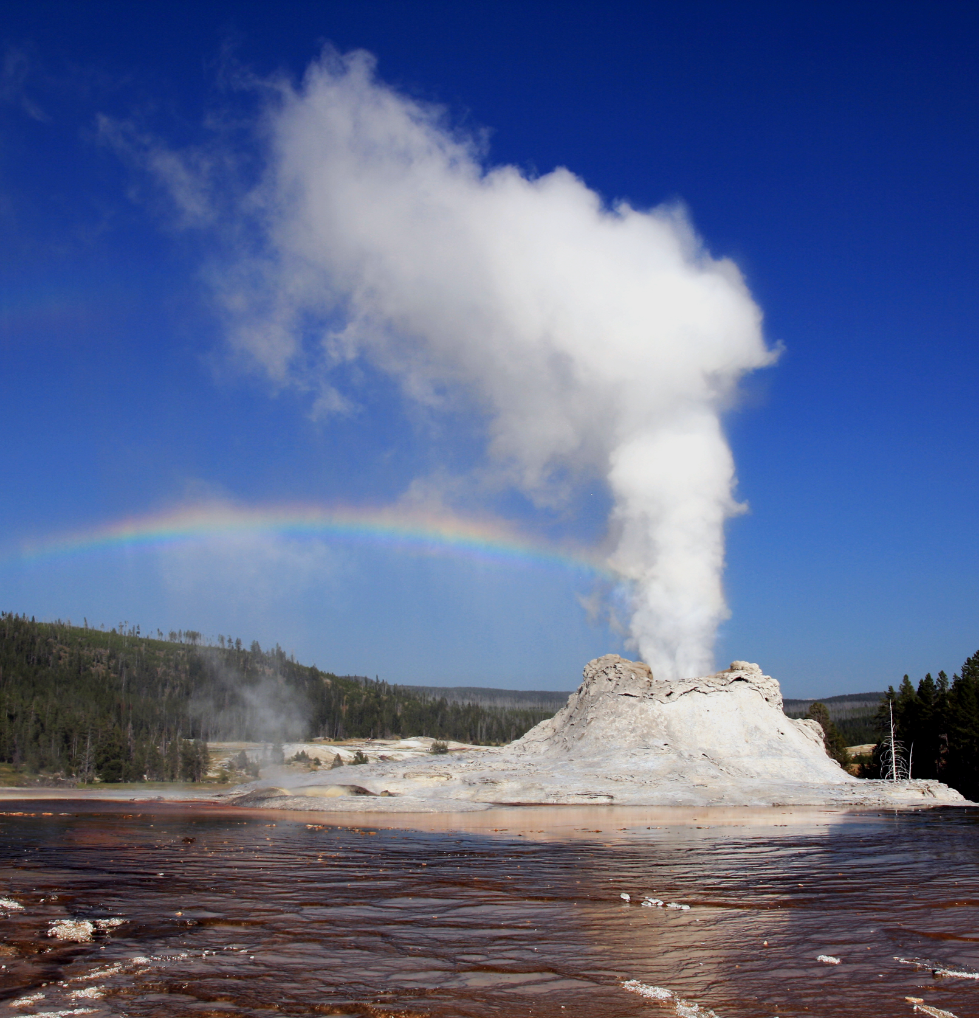
Steam is the gaseous form of water.
For more help, please visit www.exampaperspractice.co.uk
© 2025 Exams Papers Practice. All Rights Reserved

Slide 9
Changes of State
Specification Point 1.2
Understand the interconversions between the three states of matter in terms of:
The names of the interconversions.
How they are achieved.
The changes in arrangement, movement & energy of the particles.
Substances can change from one state to another.
Substances change state because an increase in temperature increases kinetic energy.
When there is enough kinetic energy, bonds can be broken.
For more help, please visit www.exampaperspractice.co.uk
© 2025 Exams Papers Practice. All Rights Reserved

Slide 10
Changes of State
Solids turn to liquids when they melt.
The increase in kinetic energy causes particles to vibrate more.
At a certain temperature, particles break free from their positions.
Liquids turn back into solids during freezing.
Liquids turn to gases when they evaporate.
Further increases in kinetic energy cause particles to move faster.
At a certain temperature, particles break their bonds.
Gases turn back into liquids during condensation.
Solids can turn directly into gases during sublimation.
If enough kinetic energy is supplied, substances can bypass the liquid phase.
For more help, please visit www.exampaperspractice.co.uk
© 2025 Exams Papers Practice. All Rights Reserved

Slide 11
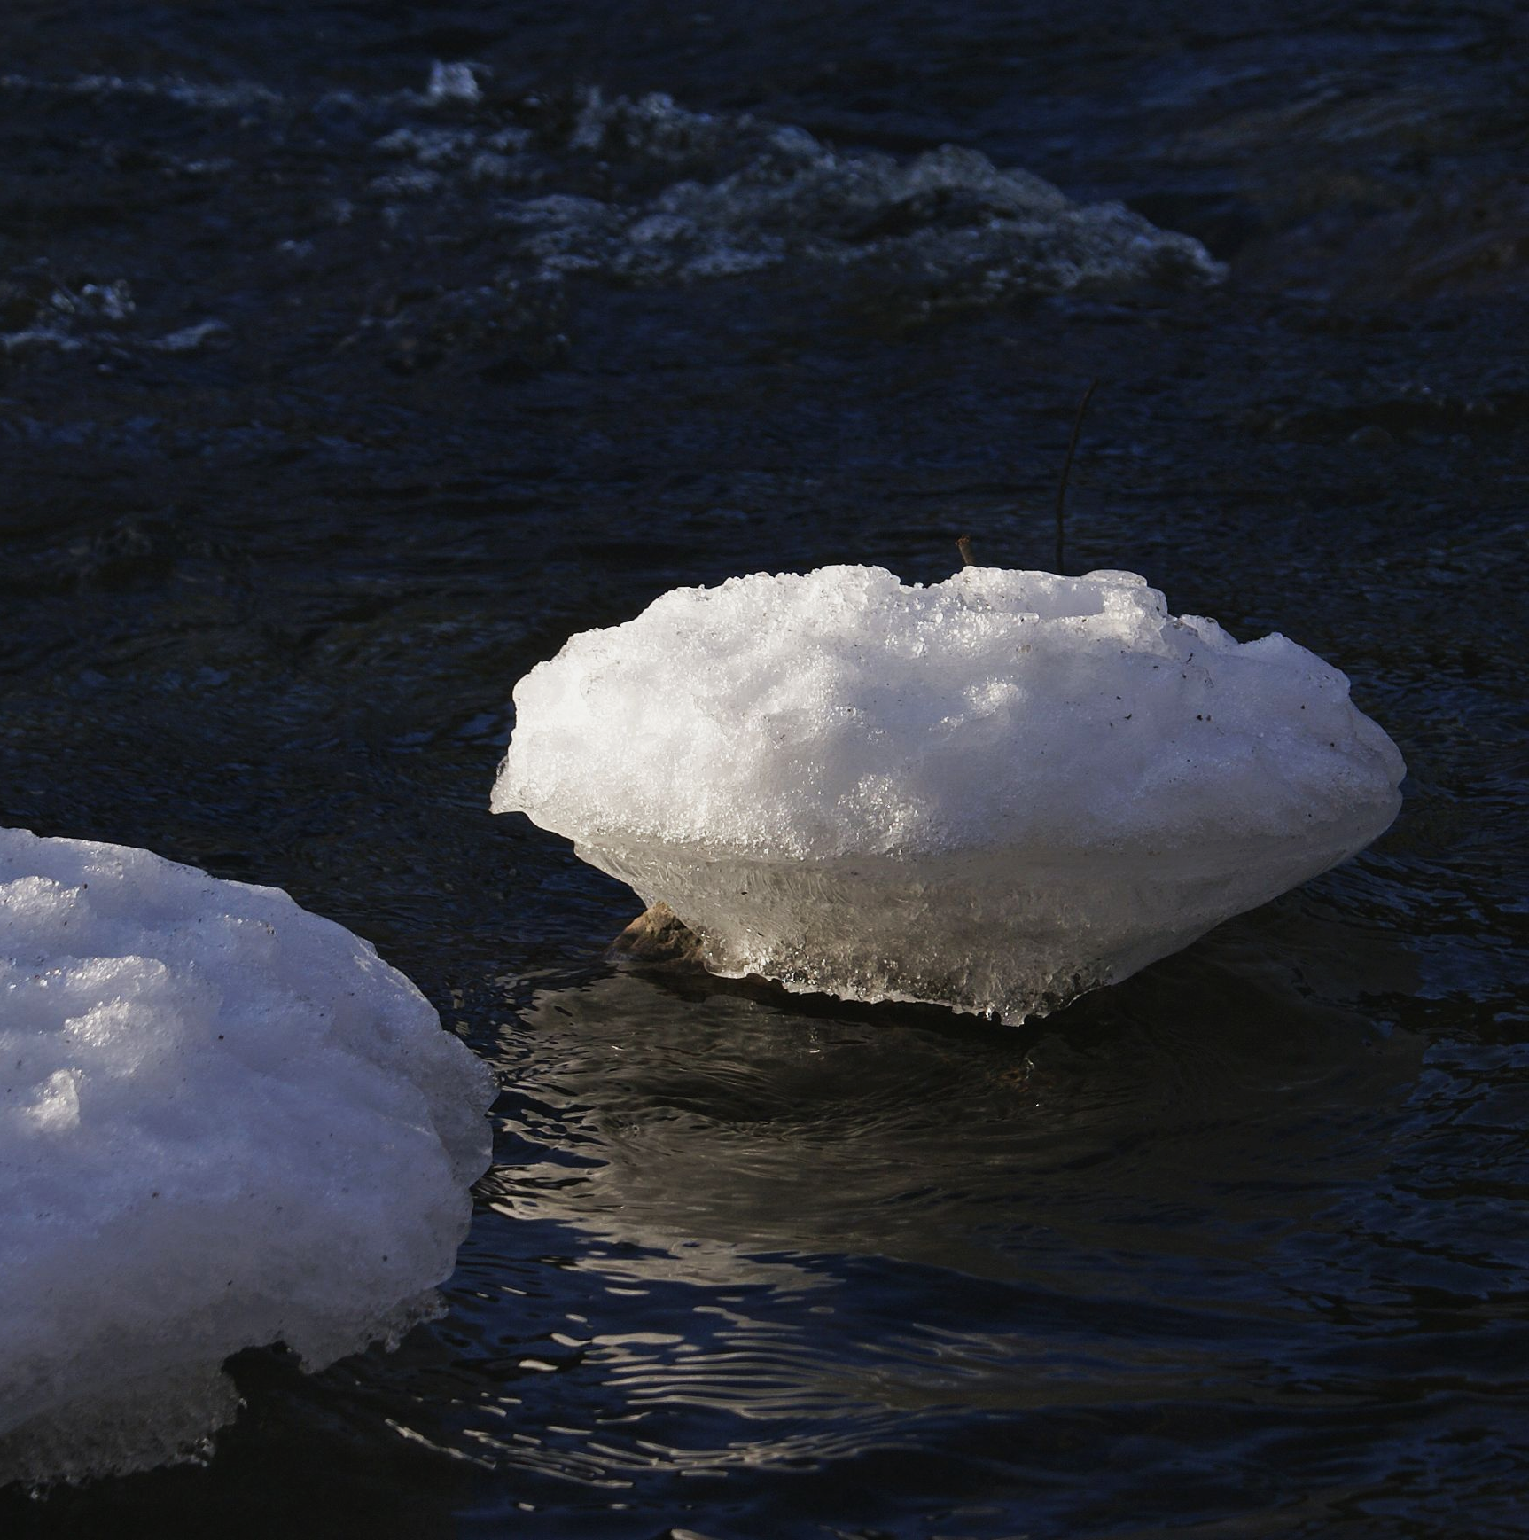
Solids melt when enough heat is supplied.
Heat provides kinetic energy allowing particles to break free from their fixed positions.
For more help, please visit www.exampaperspractice.co.uk
© 2025 Exams Papers Practice. All Rights Reserved

Slide 12
Liquids evaporate into gases. Many gases readily condense back into liquids.
For more help, please visit www.exampaperspractice.co.uk
© 2025 Exams Papers Practice. All Rights Reserved

Slide 13
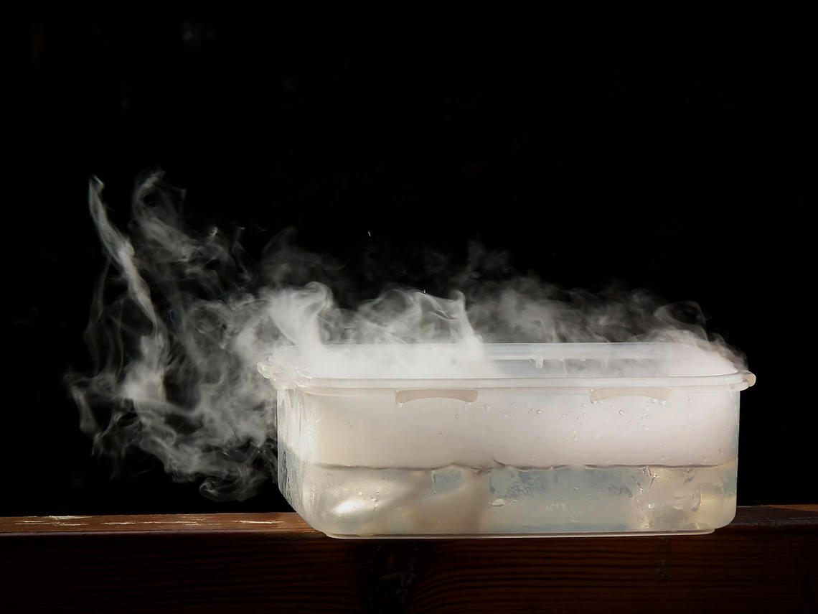
Compounds like dry ice can sublime, skipping the liquid phase entirely.
For more help, please visit www.exampaperspractice.co.uk
© 2025 Exams Papers Practice. All Rights Reserved

